Slide 1
What is Docker?

Slide 2
Docker is an open-source engine that allows Easy creation of lightweight, portable, self-sufficient CONTAINERS for any application that will run virtually anywhere.

Slide 3
Released under Apache 2.0 license
https://www.docker.com

Slide 4
Why all the excitement about containers?

Slide 5
Containers are light weight virtual machines

Slide 6
What is Virtualization and Virtual Machine?

Slide 7
Virtualization is a technology to run multiple same or different operating systems which is completely isolated from each other. Ex: Run both windows and Linux on the same machine

Slide 8
What is Hypervisor ? Hypervisor is a software layer that sits between Hardware and Oses which will interact with hardware and resources and provide an interface to share the available resources to virtual containers

Slide 9
Bare Metal
VM1
VM2
Hypervisor
Hardware
Vmware ESX, Microsoft Hyper-V, Citrix XenServer

Slide 10
Hosted
VM1
VM2
Hypervisor
OS
Hardware
Vmware Workstation, Microsot Virtual PC, Sun VirtualBox, QUMU, KVM

Slide 11
Docker
Container1
Container 2
Container 2
Container 2
Docker Engine
Linux OS (Kernel 3.8.1)
Virtual Machine/Metal

Slide 12
Process Virtual Machines
JVM Process 1
JVM Process2
JVM Process3
JVM Process4
Java Virtual Machine
Kernel
System Call Interface
Process Management
File Systems (VFS)
Memory Management
Network Stack
Hardware Abstraction Layer (Device Drivers)
Virtual Machine/Metal

Slide 13

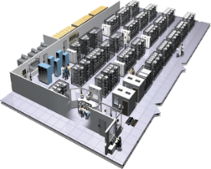
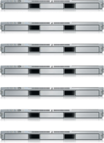
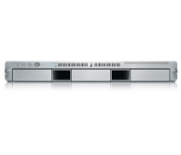
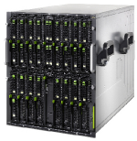

The Challenge
Multiplicity of Stacks
User DB
Static website
postgresql + pgv8 + v8
Queue
Analytics DB
nginx 1.5 + modsecurity + openssl + bootstrap 2
Do services and apps interact appropriately?
Redis + redis-sentinel
hadoop + hive + thrift + OpenJDK
Background workers
Web frontend
Python 3.0 + celery + pyredis + libcurl + ffmpeg + libopencv + nodejs + phantomjs
Ruby + Rails + sass + Unicorn
API endpoint
Python 2.7 + Flask + pyredis + celery + psycopg + postgresql-client
Production Cluster
Development VM
Public Cloud
Multiplicity of hardware environments
QA server
Can I migrate smoothly and quickly?
Disaster recovery
Customer Data Center
Contributor’s laptop
Production Servers

Slide 14
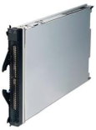
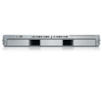
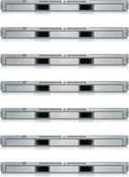
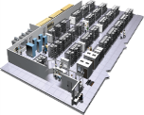
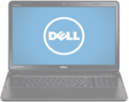
The Matrix From Hell
? | ? | ? | ? | ? | ? | ?
? | ? | ? | ? | ? | ? | ?
? | ? | ? | ? | ? | ? | ?
? | ? | ? | ? | ? | ? | ?
? | ? | ? | ? | ? | ? | ?
? | ? | ? | ? | ? | ? | ?
Static website
Web frontend
Background workers
User DB
Analytics DB
Queue
 | Development VM | QA Server | Single Prod Server | Onsite Cluster | Public Cloud | Contributor’s laptop | Customer Servers

Slide 15
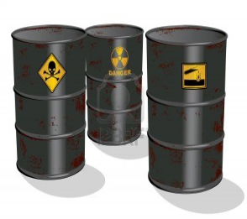
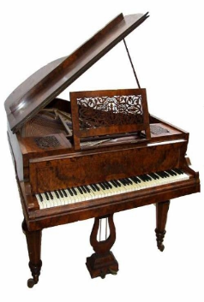
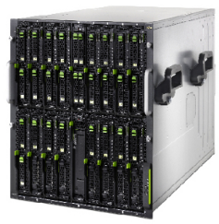
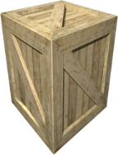
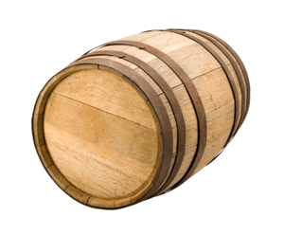
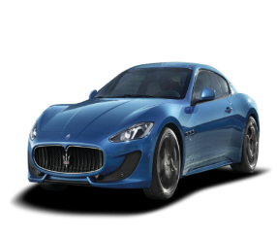
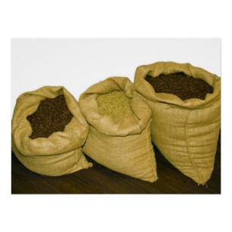

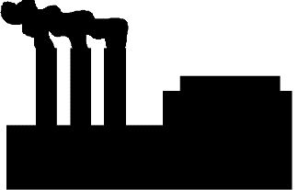

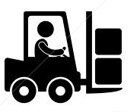
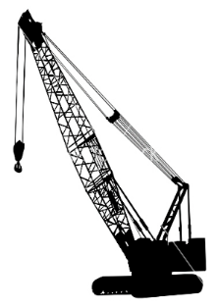
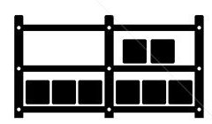

Cargo Transport Pre-1960: Another Matrix from Hell
Do I worry about how goods interact (e.g. coffee beans next to spices)
Multiplicity of Goods
Multipilicity of methods for transporting/storing
Can I transport quickly and smoothly
(e.g. from boat to train to truck)

Slide 16



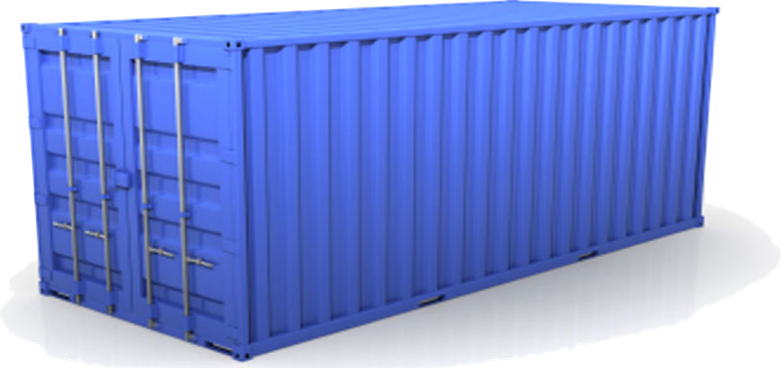
Solution: Intermodal Shipping Container
Do I worry about how goods interact (e.g. coffee beans next to spices)
Multiplicity of Goods
A standard container that is loaded with virtually any goods, and stays sealed until it reaches final delivery.
…in between, can be loaded and unloaded, stacked, transported efficiently over long distances, and transferred from one mode of transport to another
Multiplicity of methods for transporting/storing
Can I transport quickly and smoothly
(e.g. from boat to train to truck)

Slide 17
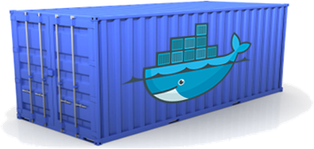
Docker is a shipping container system for code
Static website
User DB
Web frontend
Queue
Analytics DB
Do services and apps interact appropriately?
Multiplicity of Stacks
An engine that enables any payload to be encapsulated as a lightweight, portable, self-sufficient container…
…that can be manipulated using standard operations and run consistently on virtually any hardware platform
Multiplicity of hardware environments
Can I migrate smoothly and quickly
Development VM
QA server
Customer Data Center
Public Cloud
Production Cluster
Contributor’s laptop

Slide 18

Docker eliminates the matrix from Hell
Static website
Web frontend
Background workers
User DB
Analytics DB
Queue
 | Development VM | QA Server | Single Prod Server | Onsite Cluster | Public Cloud | Contributor’s laptop | Customer Servers

Slide 19
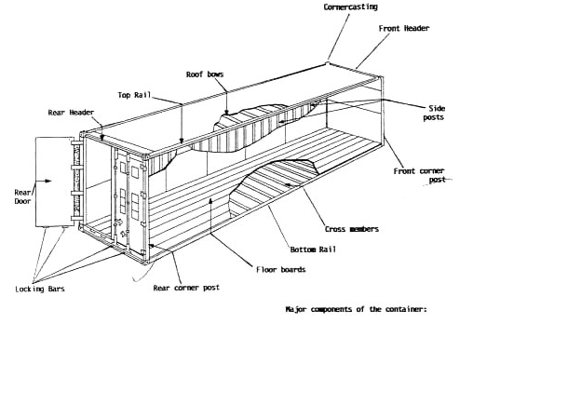
Why it works—separation of concerns
Dan the Developer
Worries about what’s “inside” the container
His code
His Libraries
His Package Manager
His Apps
His Data
All Linux servers look the same
Oscar the Ops Guy
Worries about what’s “outside” the container
Logging
Remote access
Monitoring
Network config
All containers start, stop, copy, attach, migrate, etc. the same way

Slide 20
Features

Slide 21
Docker is incredibly simple. It can run on a minimal host with compatible Linux kernal and Docker binary.

Slide 22
Docker adds an application deployment engine on top of virtualized container execution environment.

Slide 23
Docker provides a lightweight and fast execution environment to run application code.

Slide 24
It also Provides an efficient workflow to get that code from laptop to test environment and then to production.

Slide 25
The Mission

Slide 26
Provide easy and lightweight way to model reality
Most Docker containers have sub-second startups
No overhead of hypervisors means containers are highly performant and we can pack more of them into the host making best possible use of resources

Slide 27
Logical segregation of duties
Developers worry about what’s inside the container
Operations worry about how to manage and monitor them

Slide 28
Fast and efficient development life cycle
Docker aims to reduce the cycle time between code being written, tested, deployed and used

Slide 29
Encourages Service Oriented and Micro Services based Architecture.
Docker recommends that each container run single application or process.
This promotes distributed application model where each application or service is represented by multiple inter-connected containers

Slide 30
Components of Docker
The Docker Engine
Docker Images
Registries
Docker Containers

Slide 31
Docker Engine(Client/Server)
Docker Client1
Docker Client2
Docker Host
Docker Daemon
Container1
Container2
Container3

Slide 32
Docker Images
Images are building blocks in docker eco system
Docker containers are launched from images
They are “the build” part of docker eco system
They are layered format that are build step by step using a series of instructions like copy a file, run a command or open a port
They can be considered as source of containers
They are highly portable can be shared, stored and updated

Slide 33
Registries
Registries are storage place of docker images similar to git for source code, maven’s nexus for binaries
Docker Inc., maintains a public registry called docker hub which can be used to store and share the images
But typically organization maintains their own private registries to keep their own registries.
Docker hub contains more 10,000 images in it laready including base os images like ubuntu, redhat…etc

Slide 34
Docker Containers
The container is the central piece of docker eco system
The container is an image format, a set of standard operations and execution environment
They are used to build and package software applications
They are launched from images and can contain one or more running processes
These are like shipping containers that contains software images as cargo and allows a set of operations on them like those can be created, started, stoped, restarted and deployed.
Once built they can be stored and ported anyware

Slide 35
Application Build/Deploy Workflow with Docker
Container A
Docker Public Index
(or
Private
Registry)
Index
Push
Search
Pull
Source Code Repository
Run
Build
Docker file
For
A
Container A
Container B
Container C
Docker Engine
Docker
Host 1 OS (Linux)
Host 2 OS (Linux)

Slide 36
Changes and Updates
Docker
Container
Image Registry
App
A
Push
App Δ
Bins/
Libs
Bins/
Base
Container
Image
Container Mod A’
Container Mod A’’
App Δ
Update
App
A’’
App
A
Bins/
Bins/
Libs
Bins/
Libs
Bins/
Docker Engine
Docker Engine
Host is now running A’’
Host running A wants to upgrade to A’’. Requests update. Gets only diffs

Slide 37
What docker brings to the table
Rapid application deployment – containers include the minimal runtime requirements of the application, reducing their size and allowing them to be deployed quickly.
Portability across machines – an application and all its dependencies can be bundled into a single container that is independent from the host version of Linux kernel, platform distribution, or deployment model. This container can be transfered to another machine that runs Docker, and executed there without compatibility issues.
Version control and component reuse – you can track successive versions of a container, inspect differences, or roll-back to previous versions. Containers reuse components from the preceding layers, which makes them noticeably lightweight.

Slide 38
Contd…
Sharing – you can use a remote repository to share your container with others. Red Hat provides a registry for this purpose, and it is also possible to configure your own private repository.
Lightweight footprint and minimal overhead – Docker images are typically very small, which facilitates rapid delivery and reduces the time to deploy new application containers.
Simplified maintenance – Docker reduces effort and risk of problems with application dependencies.

Slide 39
Thank You!

Slide 40
References
https://www.docker.com/
https://hub.docker.com/account/signup/
https://docs.docker.com/reference/commandline/cli/
http://docs.docker.com/reference/builder/#workdir
https://github.com/rkapa2006
This is my git hub which has some sample apps and docker files to playwith

