Slide 1
PROCESS REVIEW · BPI CHALLENGE 2019 EVENT LOG
Purchase-to-pay: where invoices wait, and what to fix first
Most invoices that take longer than 60 days to pay are probably not a process failure: 68% of them sit in one spend area (Packaging), which pays at a median of 69 days — the signature of longer agreed terms. The delays the company does control are upstream: invoices wait a median 9.6 days to be booked, and goods receipts are posted late enough to hold payments up.
251,734 PO lines · 1,595,923 logged steps · 1,975 vendors · €996.8M ordered
R. Karan

Slide 2
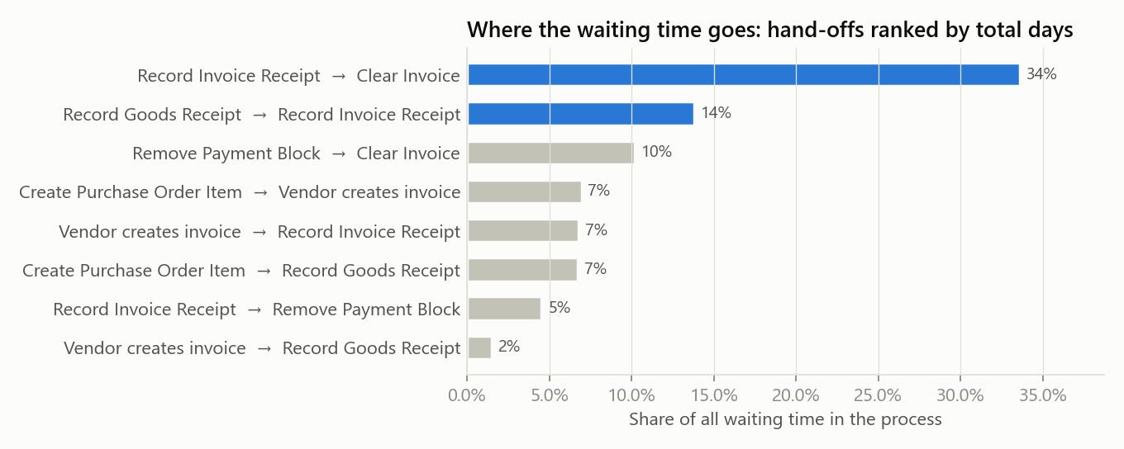
HOW THE PROCESS RUNS
7,438 different paths, but the waiting is in two hand-offs
The textbook path covers 20% of lines; 38 paths cover 80%.
Invoice booked → paid is 34% of all waiting time; goods receipt → invoice booked is the next 14%.
Median time from invoice booked to paid: 42 days.

Slide 3
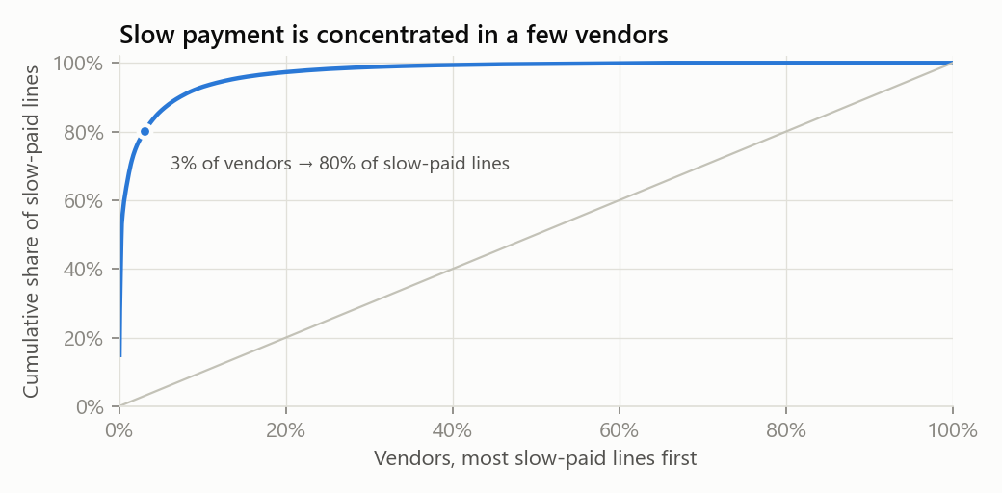
FINDING 1
42% are paid after 60 days — mostly a terms question, not a process one
42% of PO lines are paid after 60 days, but 57 vendors (3% of them) account for 80% of those lines, and Packaging alone accounts for 68%.
Action: Pull the contract terms for the 57 vendors. Where terms are 60 days or less, this is real late payment; where they are longer, re-baseline the KPI so it stops flagging agreed behaviour.

Slide 4
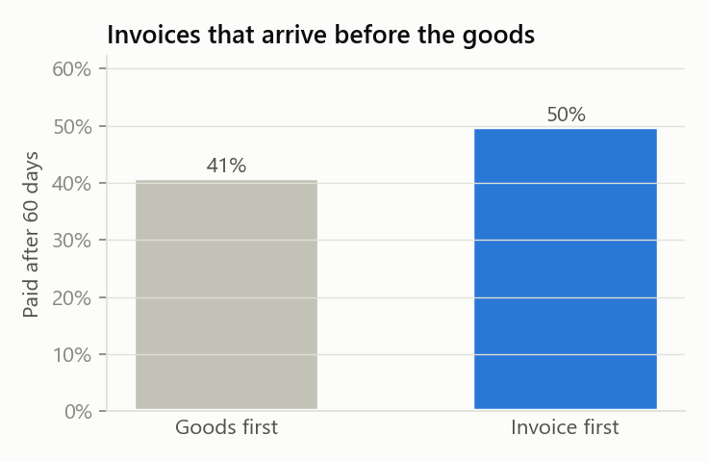
FINDINGS 2 AND 3
The delays the company controls are upstream of payment
Median 9.6 days from the vendor's invoice date to booking; 42% wait over two weeks. Booking is 96% manual, done by 29 people (219,288 bookings), although batch jobs already book 9,472.
Action: Pilot e-invoicing / OCR capture with the highest-volume vendors and track invoice-date-to-booking weekly, with a target median of 3 days.
When the invoice arrives before the goods receipt is posted, the line is paid after 60 days 7.7 percentage points more often — comparing within the same vendor (589 vendors). Blocked invoices spend 33% of their wait before the block is lifted (median 6.0 days).
Action: Set a 2-working-day posting target for goods receipts and report it by site. GR posting is 73% manual across 246 people; batch already posts 85,034, so extend automatic receipt to the vendors that support it.

Slide 5
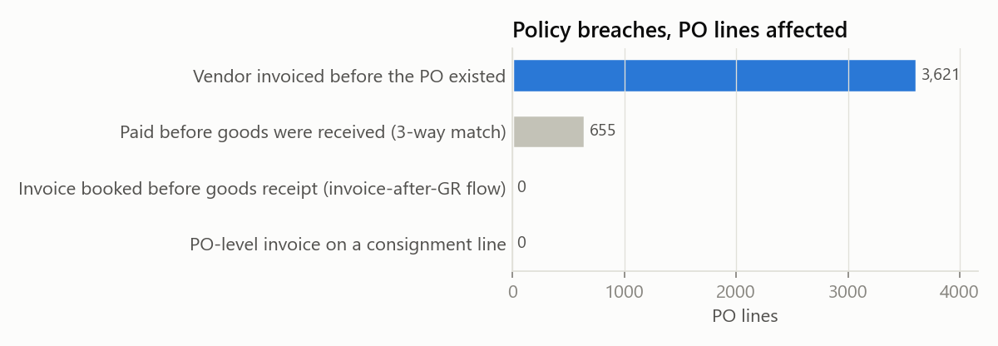
FINDING 4
3,621 purchases were approved after the vendor had invoiced
3,621 lines (1.4%, €49.4M) were ordered after the vendor had already invoiced — a median 12 days later. Trading & End Products produces 40% of them; in Real Estate, 52% of lines are retroactive.
Action: Enforce “no PO, no pay” in Trading & End Products and Real Estate first, and brief the buyers behind the 83 vendors that make up 80% of cases.

Slide 6
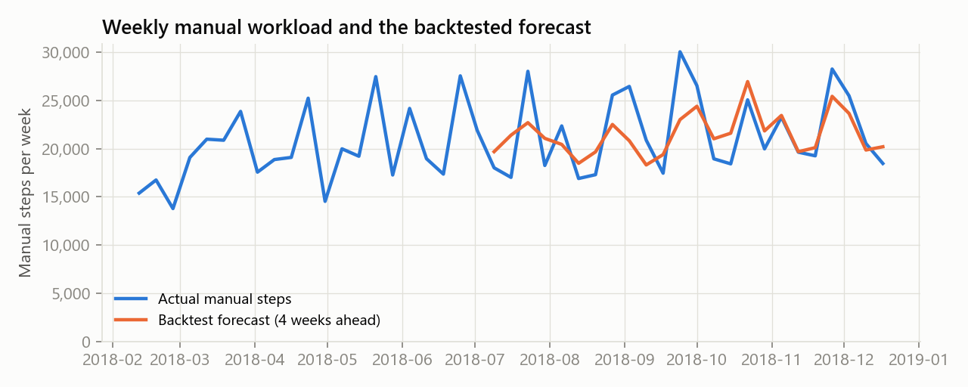
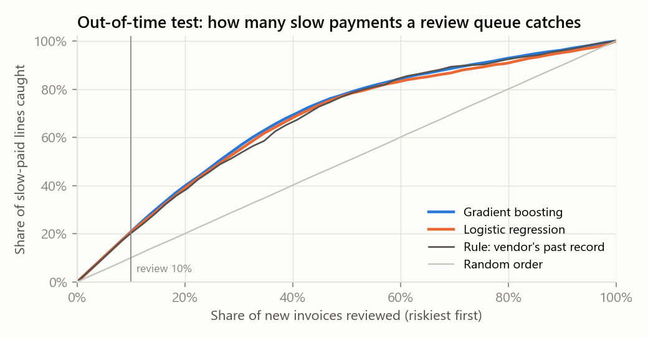
FINDING 5 AND WHAT WAS RULED OUT
A simple rule and a week-of-month forecast are enough to run the team
Manual work in the fourth week of the month (days 22-28) runs 25% above the other weeks. A forecast that knows this misses by 11% four weeks ahead, against 17% for a flat 4-week average (6 backtest folds). The obvious suspect, month-end close, does not explain it: weeks holding a month end are only 6% busier.
Rework does not slow payment. Lines with changes or cancellations are paid after 60 days 41.7% of the time, against 41.6% without — no difference worth acting on.
A machine-learning model adds little to a simple rule. Ranking new invoices by the vendor's past record scores AUC 0.825; gradient boosting scores 0.842. Among the riskiest 10% of invoices, the model is right 100% of the time and the rule 97% — use the rule.

Slide 7
RECOMMENDATIONS
What to do, in order
1. Check the terms before chasing “late” payments — Pull the contract terms for the 57 vendors. Where terms are 60 days or less, this is real late payment; where they are longer, re-baseline the KPI so it stops flagging agreed behaviour.
2. Invoices wait to be booked — Pilot e-invoicing / OCR capture with the highest-volume vendors and track invoice-date-to-booking weekly, with a target median of 3 days.
3. Late goods receipts hold payments — Set a 2-working-day posting target for goods receipts and report it by site. GR posting is 73% manual across 246 people; batch already posts 85,034, so extend automatic receipt to the vendors that support it.
4. POs raised after the invoice — Enforce “no PO, no pay” in Trading & End Products and Real Estate first, and brief the buyers behind the 83 vendors that make up 80% of cases.
5. Staff for week 4 of the month, not the average week — Plan the accounts-payable and receiving rota from the week-of-month forecast. Find out what lands in week 4 (a payment-run or reporting cut-off is the likely candidate) before moving work out of it.
Limits: no payment terms in the log; first invoice per line; line values, not invoice amounts; one company, one year.

