Slide 1
SELECTION-BIAS AUDIT
Is your scorecard's Gini real?
Your model is validated only on applicants you approved.
This audit measures how much that flatters it, and tests whether the
standard corrections can be trusted to fix it.
LendingClub 2007-2018 | 2,260,668 approved loans, 27,648,741 declines | seed 20260901
Every number reproducible: make data && make run

Slide 2
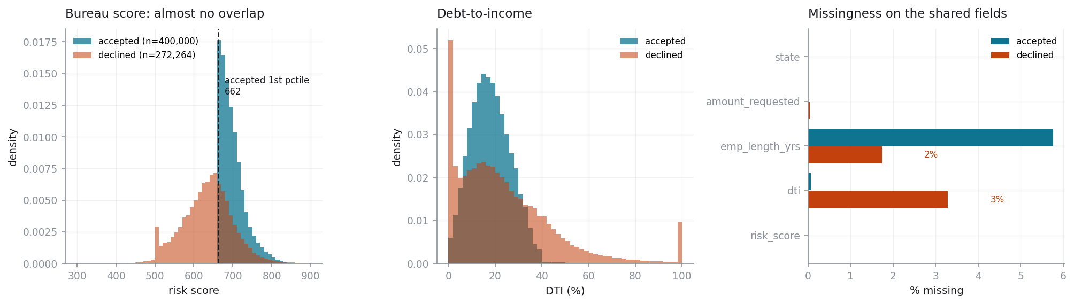
THE PROBLEM
You only ever see the applicants you approved
LendingClub approved 7.6% of applications. Only 33.2% of scored declines reach the 1st percentile of the approved book, and 67% of declines carry no bureau score at all.
The two populations barely overlap. That is the whole problem, and also the limit on how well anyone can solve it.

Slide 3
PART 1
Here is your measured Gini
GINI (held-out, approved loans)
KS
OBSERVED BAD RATE
0.2803
0.2018
19.9%
the number you report today
same population, same caveat
on settled approved loans
A conventional WOE + logistic application scorecard on the four fields both populations share.
It is a perfectly good model. The problem is not the model - it is that this number was measured on a population your cutoff already filtered. It answers 'how well do I rank the people I said yes to?', not 'how well do I rank everyone who walks in the door?'

Slide 4
PART 2
Here is your corrected Gini - four ways, and they disagree
Method | Est. through-the-door bad rate | Claimed Gini
parcelling | 42.53% | 0.4249
fuzzy | 43.59% | 0.4602
ipw | 20.71% | 0.2767
heckman | 23.65% | 0.2861
no correction (observed) | 19.88% | 0.2803
Four defensible methods. Percentage points apart on the same data.
The spread between them IS the uncertainty - and no amount of argument about which is theoretically nicer resolves it.
So the next slide stops arguing and runs an experiment.

Slide 5
PART 3
Can you trust the correction? Manufacture the truth
STEP 1
STEP 2
STEP 3
STEP 4
Take only approved loans
Impose an artificial cutoff
Run all four methods
Compare against the truth
every outcome is known
discard outcomes below it
on a synthetic decline population
that we deliberately hid
Reject inference is normally unfalsifiable - you cannot check an inferred bad rate against outcomes that do not exist.
This makes it falsifiable. Swept across rejection rates of 10%, 30%, 50%, 70%, with 5 replicates each, under three cutoff shapes: a hard risk threshold, a threshold with override noise, and - critically - a random cutoff where the correct answer is known to be 'do nothing'.

Slide 6
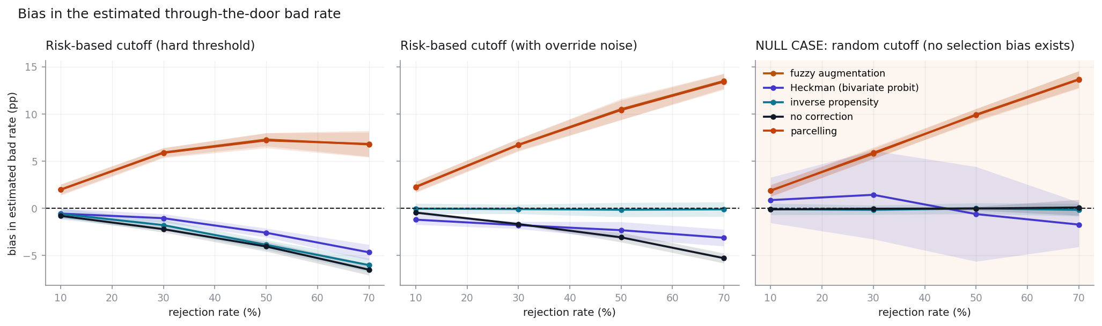
PART 3
How each method degrades as you decline more
Least biased on risk-based cutoffs: ipw (1.77 pp mean absolute error). Shaded bands are across-replicate variation.
heckman and ipw held within 2 pp up to a 30% rejection rate, beyond which every method exceeds it. Applying no correction at all held equally far (30%), so on this evidence none of the four earned its place.

Slide 7
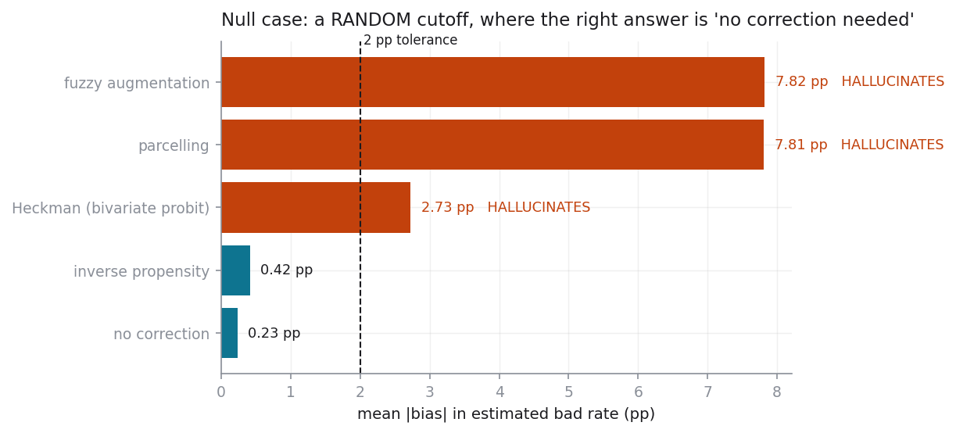
PART 3 - THE NULL CASE
Which methods invent a bias that isn't there?
Replace the risk cutoff with a RANDOM one.
Now there is no selection bias. The correct answer from every method is zero correction.
fuzzy: +7.6 pp
parcelling: +7.6 pp
heckman: +2.5 pp
The top two assume declines are worse by a fixed multiple, so they fire whether or not selection was informative.
Heckman's is smaller and has a different cause: under a random cutoff rho is unidentified. Its significance test stays honest; the point estimate drifts.
Passes the null: ipw

Slide 8
PART 2 - THE ECONOMETRIC READ
How much selection bias is actually in this portfolio?
SELECTION CORRELATION (rho)
LIKELIHOOD-RATIO p
VERDICT
0.018
0.319
SMALL
bivariate probit, full ML
H0: rho = 0
on the shared fields
rho is the correlation between the unobserved drivers of approval and of default. It is not distinguishable from zero here.
The honest reading: on the fields these two populations share, approval carried little information about default beyond what the scorecard already uses. Selection bias in this portfolio is small.
Manufacturing a larger correction would be the actual failure - and note that 3 of the four methods do exactly that.

Slide 9
PART 4
What is your cutoff costing you?
BREAK-EVEN BAD RATE
SWAP-IN BAD RATE (RANGE)
PROFIT EFFECT
14.7%
12.5%-19.2%
-$662m to -$280m
36-month loan, measured yields
across the four methods
the spread IS the finding
Volume-neutral swap: the corrected model approves exactly as many applicants as you do today, so this measures ranking quality, not appetite.
Yields, losses and LGD are measured from LendingClub's realised cash flows. Cost of funds, servicing and loan life are stated assumptions, and the answer is genuinely sensitive to them - the methodology PDF carries the full sensitivity grid.
Read the range, not the point estimate.

Slide 10
RECOMMENDATION
What I would actually do
Do not adopt a correction you cannot falsify.
3 of the four report a correction on data with provably zero selection bias, the worst by 8 pp. Run the null case before trusting any of them.
Treat the rho result as the headline, not the profit number.
Measured selection bias on the shared fields is small. That is a cheaper finding to act on than a contested dollar figure.
Fix the data before fixing the model.
67% of declines carry no bureau score. Retaining the decision-time bureau pull on declines would do more for this problem than any estimator.
Run a randomised-approval holdout.
A small random approval band above the cutoff generates the unbiased sample that makes all of this measurable rather than inferred. It is the only clean fix.
Use the ZIP flags to scope a fair-lending review.
59 ZIPs sit beyond 3 standard deviations of what risk predicts, against 1 expected. That is a place to look, not a conclusion.

