Slide 1

ALWD Citation Manual
The Second Edition

Slide 2

Philosophy
Not change for the sake of change
Clarifications
Additions
Responding to user questions and comments

Slide 3

Returning Features
Fast formats
Sidebars
Diagramed examples
More examples
Detailed index
Local court rules
Two-color design
Web site for updates

Slide 4
Notable Changes
So. 2d – Southern Reporter
“Accord” and “see also” new signals
Specific rules on capitalization and numbers added
New rules on citing jury instructions and ethics opinions
Conform to new conventions for citing Internet sources
New appendix on tax materials
Updated examples
Expanded index

Slide 5

Rule 1: Typeface
Underlining spaces
Comma after histories not italicized
Possessive endings
Italics within italics
Emphasis
Foreign words

Slide 6
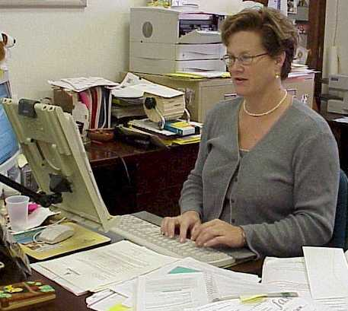
Rule 2: Abbreviations
Can now abbreviate &, Assn., Bros., Co., Corp., Inc., Ltd., and No. in text.

Slide 7
Rule 3: Capitalization
Hyphenated terms
Titles
Organization names
Proper nouns
Adjectives formed from proper nouns
Events and holidays
Numerical designations
Midword capitalization
Defined terms
Specific words (NOTE: Court)

Slide 8
Rule 4: Numbers
Numbers in text (0-99, plus round numbers)
Beginning a sentence
Series and proximity
Decimals, ratio, and time
Numbers and symbols
Fractions
Commas
Ordinals

Slide 9
Rules 5 and 6
Rule 5: Passim
Rule 6: Et seq.
No major changes to Rules 7 through 10.

Slide 10
Rule 11: Short Citations
11.2(b)(2): Use a short citation when (a) the reader will not be confused about which source is being referenced and (b) the reader will not have trouble locating the full citation quickly. Thus, in a short legal document, you may need only one full citation for a particular source and then may use short citations in each instance thereafter. In longer legal documents, you may need a full citation each time you start a new section.

Slide 11

Rule 12 – Cases
New information on foreign party names
Anonymous/initials
Abbreviating common words
Shortening names
List of business designations expanded
“The” in party name
Information on new Federal Appendix reporter

Slide 12

Rule 14: Statutes
New rule on electronic statutes
U.S.C. date – 2000
LEXIS L. Publg. now LEXIS
New rule on historical notes
Short citation options expanded

Slide 13
Short Citations for Statutes
Full citation (United States Code): 42 U.S.C. § 12101 (2000).
Short citation options: 42 U.S.C. § 12101.
§ 12101.
Id. at § 12102.
Full citation (named statute): Administrative Procedure Act § 5(d), 5 U.S.C. § 554(e) (2000).
Short citation options: Administrative Procedure Act § 5(d).
§ 5(d).
5 U.S.C. § 554(e).
Id. at § 5(a).

Slide 14
Rule 17: Rules
No date needed for current versions of rules: Fed. R. Civ. P. 11.
Ethics opinions rule added
Jury instructions rule added

Slide 15
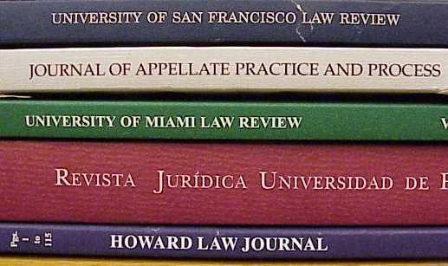
Rules 22 and 23: Books and Periodicals
Expanded language on subtitles and spacing after a colon

Slide 16
Rule 27: Restatements, Model Rules, etc.
ABA model rules now located here
Sentencing Guidelines rule added

Slide 17
Rule 40: World Wide Web
No angle brackets
  Citizens for a Better Envt., Environmental Update ¶ 3, http://www.environ.better.org/update/ 1999/html (last updated Mar. 15, 1999).
May designate subsections
May use page numbers in .pdf documents

Slide 18
Rule 40: URLs
Keystroke identifiers can be used
  Lib. Cong., THOMAS, Broadsides from the Continental Congress and the Constitutional Convention, http://thomas.loc.gov/; select Historical Documents (last updated Feb. 1, 2001).
Break points: after slash; before period
Dates: rule has hierarchy; may include a specific time
Sidebar on reliability
Short citation formats expanded

Slide 19
Rule 43
Old Rule 43 on neutral formats has been deleted.
So, everything that followed is now renumbered.

Slide 20
Rule 44: Signals
Accord: Use to show that two or more authorities state or support the proposition but the text quotes or refers to only one; the others are then preceded by “accord.” Also use to show that the law of one jurisdiction is in accord with that of another jurisdiction.
See also: Use to cite additional material that support the proposition. Support under this signal is not as strong or direct as when no signal or “see” is used. “See also” may be used when the cited authority supports the point made, but is in some respect distinguishable from previously cited cases.

Slide 21
Rule 46: Parentheticals
Example on using parentheticals to reflect synthesis added
Related authority rule added
  quoting
  quoted in
  cited in
  reviewing

Slide 22
Appendices
1: Updated; exact format given for intermediate appellate courts; more federal courts added
2: Updated
3: Many more words added
4: Very few changes
5: Some new journals added
6: Very few changes
7: (New) Tax materials
8: (Web only): administrative materials (was numbered 7 in first edition)

Slide 23

Result?
Very few differences from the Bluebook in terms of rules.
But, ALWD is more user friendly.
The last edition of the Bluebook actually used some ALWD features and shifted to some ALWD rules.
Major difference continues to be one citation system versus two in the Bluebook.

Slide 24
Significant Adoptions
University of Texas
University of Michigan
Northwestern University
Emory
Boston University
University of California – Hastings
United States District Court for the District of Montana
Bryan Garner’s Redbook on legal style

Slide 25

Final Issues and Thoughts
There will be a separate international/foreign edition
Speed Cite has been updated
The CALI lesson on ALWD has been updated

Slide 26
Questions/Discussion

