Slide 1
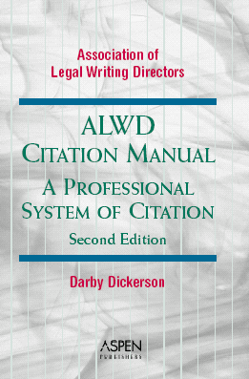
Footnoting Law Review Competition Papers

Slide 2

Preliminary Points
Look it up -- even if you THINK you know the answer. Guessing can be dangerous.
  Use the detailed index.
  Start with very specific terms.
  Move to more general terms and synonyms.

Slide 3

Additional Tip
You might have to analogize (just like reading a statute).
ALWD Intro: “Citing Sources Not Covered in This Book.”
  Be consistent.

Slide 4

Formatting
Make sure you know how to format your paper and how the formatting will affect citations.
ALWD, Intro. Part D.

Slide 5

Final Tips
Make your paper look as professional and appealing to read as possible.
Save often under different names.
Consult Fajans & Falk, Scholarly Writing for Law Students.
Read and faithfully follow all instructions.

Slide 6
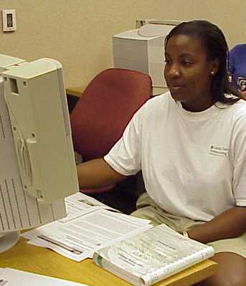
All About Endnotes

Slide 7

Footnotes v. Endnotes
Footnotes appear at the bottom of the page on which the corresponding portion of the main text appears.
Endnotes appear at the end of the entire paper, after the “conclusion.” Other than where they appear, endnotes are prepared in the same way footnotes are prepared.

Slide 8

Why Use Footnotes?
In scholarly legal writing, footnotes serve three primary functions:
  Authority.
  Attribution.
  Continue the discussion.

Slide 9
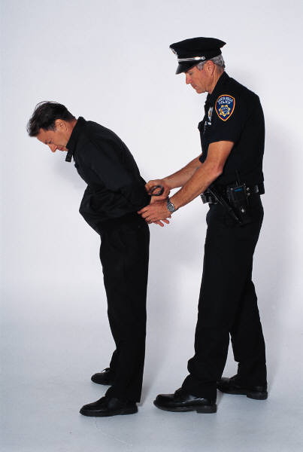
Preliminary Example
Police must inform suspects in custody of their constitutional rights before questioning them.
  This is a generally-known legal proposition.
  But the conventions of legal scholarship require writers to document this proposition with an AUTHORITY footnote.
Thus, you might cite Miranda v. Ariz., 384 U.S. 436 (1966).

Slide 10
Example
To take advantage of this rule, the movant must certify that it has "in good faith conferred or attempted to confer with other affected parties in an effort to resolve the dispute without court action" and must show "good cause" why protection is warranted.¹²⁶
__________________________________
¹²⁶Fed. R. Civ. P. 29 (stating in pertinent part that,
"[u]nless otherwise directed by the court, the parties may by written stipulation (1) provide that depositions may be taken ... at any time").

Slide 11
Preliminary Example
Lower courts have taken different approaches to Miranda in the prison context.
  Another legal assertion.
  Need to cite authority on this point as well.
You might cite several cases that illustrate this split.
  Compare . . . with.
  Textual sentences.

Slide 12
Example
____________________________________________________
⁶⁹Compare Mims v. Central Mfrs. Mut. Ins. Co., 178 F.2d 56 (5th Cir. 1949) (characterizing as unreasonable three days' notice, when depositions were to be held in scattered cities) Hart v. U.S., 772 F.2d 285 (6th Cir. 1985) (deeming three hours' oral notice of deposition unreasonable, when deposition was to be held about forty miles away, even though the deposition had been discussed during a court proceeding and even though the testimony was needed for an impending trial) with Pearl v. Keystone Consol. Indus., Inc., 884 F.2d 1047, 1052 (7th Cir. 1989) (allowing admission of deposition taken on six days' notice when plaintiff did not move to delay the deposition); Jones v. U.S., 720 F. Supp. 355, 366 (S.D.N.Y. 1989) (finding eight days' notice reasonable).

Slide 13
Preliminary Example
The best solution to this problem is to require warnings only for inmates upon whom official suspicion has focused.
  Assume you adopted this solution from another writer.
  You paraphrased his solution.
You need to give ATTRIBUTION to that other author by citing his work in a footnote.

Slide 14
Example
As two authors explained, producing a top official for deposition can reap certain benefits:
Personal knowledge of witness skills may enable the executive to deliver the case themes persuasively at an early stage of the litigation when the opposing counsel is not fully prepared to ask tough questions. If the company's message is effectively communicated, the other side may be discouraged and pursue the suit with less vigor. There may also be situations in which you need to depose your adversary's executives, an option that could be more difficult if you resist.²⁷
__________________________________
²⁷Pruess & Collins, supra n. 194, at 213.

Slide 15
Preliminary Example
Now, let’s assume you wish to further comment on the other author’s solution, but that the comment is incidental or marginal to the subject under discussion in the text.
  You might discuss whether the author’s proposal was so vague as to invite abuse from over-zealous prison authorities.
  You might put your comments in a TEXTUAL footnote.

Slide 16
Example
Despite their usefulness and popularity, depositions have provided the scene for episodes of extremely unprofessional and unethical⁶ attorney misconduct.⁷
________________________________________
⁶Professionalism and ethics are related, but distinct, concepts. Harold Clarke, former Justice of the Supreme Court of Georgia, explained the difference, stating that "legal ethics is the standard of conduct required of all lawyers, while professionalism is a higher standard expected of all lawyers." D.C. Offut, Jr., Professionalism, W. Va. Law. *4 (Oct. 1997) (available in WL, TP-ALL Database, 11-OCT W. Va. Law. 4).
⁷For articles that recount many instances of attorney misconduct during depositions, see Jean M Cary, Rambo Depositions: Controlling on Ethical Cancer in Civil Litigation, 25 Hofstra L. Rev. 561 (1966), and A. Darby Dickerson, The Law and Ethics of Civil Depositions, 57 Md. L. Rev. 2734 (1998).

Slide 17
Authority Footnotes
Legal scholarship is characterized by extensive documentation.
You must include an authority footnote to support virtually every proposition of law or fact in the text.
Exceptions: Sentences of pure, original argument and conclusions.

Slide 18
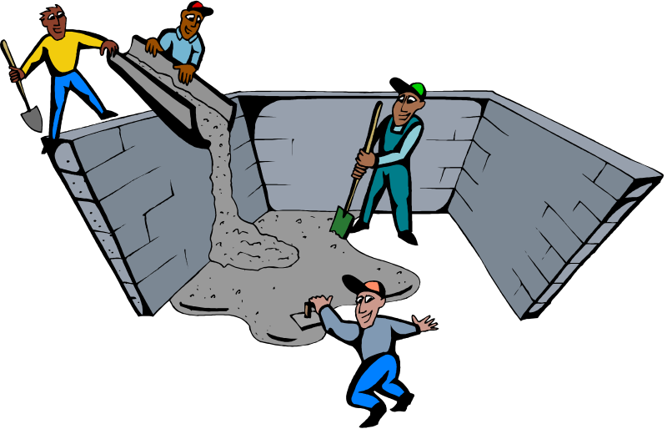
Attribution Footnotes
Like new law, which is constantly being fashioned out of existing rules, scholarly papers often build upon and advance ongoing legal debates.
Thus, reliance on others’ ideas is common and indeed expected.

Slide 19

Giving Credit
Therefore, “parade,” don’t “bury” this reliance.
Giving credit to others establishes the quality of your research and provides useful references to the reader.

Slide 20
Proper Attribution
Provide a footnote for ANY borrowed language or ideas, whether quoted or paraphrased.
When you borrow five or more consecutive words, use quotation marks.
  Where the wording is distinctive, use quotation marks for phrases of less than five words.
  Put borrowed text of less than 50 words OR less than 4 lines of type in quotation marks.
  Put borrowed text of 50 words or more OR 4 or more lines of type in a block quote.
    ALWD Rule 47.

Slide 21
Textual Footnotes
Textual footnotes contain textual sentences that supplement what you’ve said in the text.
  Provide an example or illustration of a point made in the text.
  Define a term used in the text.
  Clarify or qualify an assertion made in the text.
  Raise a potential complication.
  Musing; share an anecdote.
  Quote language paraphrased in the text.
  Give additional, interesting information that is tangential to the main text.
    Main plot v. sub-plot.

Slide 22
Hybrid: The Parenthetical
You might combine an authority or attribution function with a “textual” function by using parentheticals.
  Do this by citing the authority, and then briefly describing the authority.
Example: Smith v. Jones, 100 U.S. 97, 100 (1933) (examining the historical roots of the First Amendment’s free press clause).

Slide 23

Attribution
Much of the substantive material in this part of the presentation was derived from:
  Elizabeth Fajans & Mary R. Falk, Scholarly Legal Writing for Law Students (2d ed., West 2000).
  Available in the library and the bookstore.

Slide 24

ALWD Format

Slide 25
Manual’s Organization
Part One: Introductory Material
Part Two: Citation Basics
Part Three: Specific Print Sources
  Primary, then secondary
Part Four: Electronic Sources
Part Five: Incorporating Citations
Part Six: Quotations

Slide 26

Part Seven: Appendices
1: Primary sources
2: Local citation rules
3: General abbreviations
4: Court abbreviations
5: Periodical abbreviations
6: Sample memorandum
7: Tax materials
  More on Web site, www.alwd.org

Slide 27

Tip
Read the rule.
Then look at the examples.

Slide 28
Typeface: ALWD 1
Regular or italics (underlining).
Italicize:
  Signals
  Case names (always)
  History (e.g., aff’d)
  Titles of most documents
  Id.
  Punctuation within, but not after, italicized material

Slide 29

Abbreviations: ALWD 2
Use the Appendices.
Green circles do not equal green spaces; green triangles equal spaces.
Auto correct functions.

Slide 30
General Spacing Rules
In general, close up consecutive capital letters. Example: N.W.2d
DO NOT close up capital letters combined with longer abbreviations. Example: D.#Mass.
Ordinals are treated as capital letters. Example: F.2d
In law review abbreviations, separate L. Rev. from geographic designations. Example: N.Y.U.#L.#Rev.

Slide 31
Capitalization: ALWD 3
Conform titles to this rule.
Use spelling in original.
Capitalize first letter of:
  First word in title
  First word in subtitle
  First word after colon or dash
  All other words except articles, prepositions, “to” as an infinitive, coordinating conjunctions.
Check list of specific words and when to cap.

Slide 32

Right or Wrong?
No One is Above the Law
A Handbook on the Model Rules Of Professional Conduct
Behind
Him
Under
A
Across

Slide 33
Numbers: Rule 4
Typically spell out zero through ninety-nine.
Typically use numerals for 100+.
Numbers in a series and numbers in proximity.

Slide 34

Ordinal Numbers: ALWD 4.3
1st
2d
3d
4th
5th
33d
100th
FLYING ORDINALS

Slide 35

Page Numbers: ALWD 5
Use a pinpoint whenever possible.
Page spans. Retain all digits: 100-111

Slide 36
Multiple Sections and Paragraphs: ALWD 6
Do not use et seq.
Put a space between the section symbol and the number.
Use TWO section symbols when citing multiple sections. (§§ 237-299)
Use ONE section symbol when citing multiple SUBSECTIONS within a statute. (§ 237(a)-(g).)

Slide 37
Internal Cross-References: ALWD 10
Internal cross-references refer to other parts of the paper.
You can refer to parts of main text, to endnotes, or to both (read pages 43-45 for examples).
Supra = material that appears BEFORE the current citation.
Infra = material that appears AFTER the current citation.

Slide 38



Intro Short Citations: ALWD 11
11.3: Id. rule
11.4: Supra (as a short citation) rule.

Slide 39
Id.
Id. may be used as a short cite for any kind of authority, except internal cross-references (and appellate record cites).
In endnotes, use id. when:
  Referring to the immediately preceding authority in the SAME endnote, OR
  Referring to the preceding endnote when the preceding endnote cites only ONE authority.

Slide 40
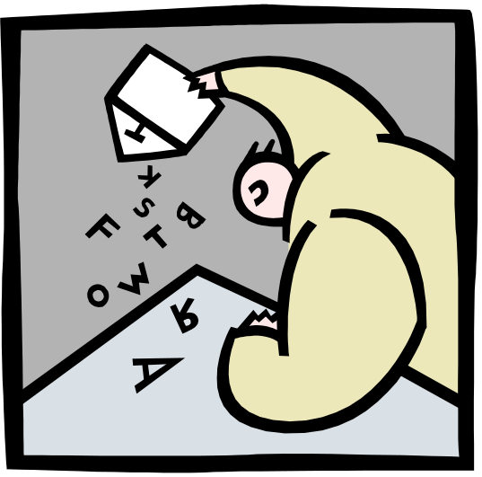
Id.
If id. is appropriate, use id. instead of another short form.
The period in id. is underlined/italicized.
Id. used after a signal is not capitalized.
  See id.

Slide 41
Id.
Indicate any particular variation from the preceding citation.
⁵Jones, 19 F.3d at 19.
⁶Id. at 21.
⁷Id.

Slide 42
Id.
Sources identified in explanatory parentheticals are IGNORED for purposes of the id. rule.
⁸Id. at 2 (citing Jones v. Smith, 555 F. Supp. 927 (N.D. Cal. 1977)).
⁹Id. at 4.

Slide 43
Supra as a Short Form
Use supra as a form of short cite for certain types of previously-cited sources. Most commonly used for books and law review articles.
⁵Oliver Wendall Holmes, The Law 77 (Macmillan 1928).
¹⁰⁰Holmes, supra n. 5, at 93.

Slide 44
Supra and Hereinafter
Use hereinafter to shorten a long title, when you have more than one piece (of the same type) by the same author within the same footnote, or if the short cite reference would be very long.
Make sure you’re going to use the new reference.
⁸War in Bosnia Ends Only after Lengthy Negotiations Force Sides into Reality, 78 Wall St. J. 3 (Oct. 2, 1996) [hereinafter War in Bosnia].

Slide 45
Hereinafter
Use supra to refer to the prior hereinafter reference.
³³War in Bosnia, supra n. 8, at 3.

Slide 46

Note Placement: ALWD 43.1(e)
Endnote numbers should be appended to the portions of text to which they refer.
  Superscript (above regular text).
You need a separate endnote for each separate idea.
Endnotes are placed after the punctuation.

Slide 47
Endnote Placement
If the sentence contains only one thought, you need only one endnote -- after the punctuation.
Incorrect :
The court held for the landlord¹.
Correct:
The court held for the landlord.¹

Slide 48
Endnote Placement
If the sentence contains several separate thoughts, you need an endnote for each thought -- after the pertinent punctuation.
Correct:
Structures include cars,¹ large crates,² recycling bins,³ and sheds.⁴

Slide 49
Endnote Placement
Typically insert an endnote number when citing a case for the first time in the text.
In Smith v. Jones,¹ the court held that the defendant bears the burden of self defense.²
¹45 F.3d 975 (2d Cir. 1996).
²Id. at 978.

Slide 50
Citations within Endnotes: ALWD 43.1
You may include textual sentences in your endnotes. Indeed, most authors do.
You must support textual material in the endnotes with citations.
Within endnotes, citations may appear as clauses or citation sentences.

Slide 51
Citation Sentence
If an authority supports or contradicts the ENTIRE sentence in the endnote, the citation should appear in its own sentence -- a citation sentence. ALWD 43.1(a).
⁷Jackson v. White, 452 U.S. 98, 105 (1977). In addition, murder is a crime. Smith v. Jones, 37 F.3d 745, 747 (11th Cir. 1994).

Slide 52
Citation Clause
When an authority supports or contradicts only part of a sentence in the endnote, then the citation should be included within the “endnote text” and should be set off with commas. ALWD 44.1(b).
⁷Jackson v. White, 452 U.S. 98, 105 (1977). Murder is a crime, Smith v. Jones, 37 F.3d 745, 747 (11th Cir. 1994), but insanity may be raised as a defense, Jefferson v. Clinton, 300 U.S. 555, 556 (1994).

Slide 53

How Many Sources?
Rule 43.4(b), (c).
In a law review, you typically have “string citations” that reflect the depth and breadth of your research.

Slide 54

Introductory Signals: ALWD 44
Signals indicate the purpose for which an authority is cited.
Signals indicate the degree of support or contradiction the authority cited in the endnote gives the proposition in the text.

Slide 55

Do Not Use a Signal If:
The cited authority directly supports the stated proposition.
The cited authority identifies the source of a quotation.
The cited authority merely identifies the authority referred to in the text.
You’ll have very few “see” signals in the paper.

Slide 56
Types of Signals
Support
Comparison
Contradiction
Background material
E.g. (for example)
Put signals in the order they appear in Rule 44.3.

Slide 57
Punctuation between Signals
³²Smith v. Jones, 438 F. Supp. 90, 96 (S.D. Fla. 1963); see French v. Williams, 457 F.2d 27, 32 (2d Cir. 1968) (agreeing with Jackson); but see . . . .
Separate signals with a semicolon.
ALWD 44.8(c).

Slide 58
Multiple Cases Within the Same Signal: ALWD 45.7
You may have more than one case that gives the same type and degree of support.
If so, do not repeat the signal.
Use Rule 45 to determine the order of cases within a signal.
⁹³See Jones v. Smith, 100 F.2d 97, 99 (5th Cir. 1952) (finding the defendant acted in self-defense); Gordon v. Ball, 76 P.2d 588, 599 (Mont. 1934) (finding that the plaintiff used the knife in self-defense).

Slide 59

Order of Authorities: ALWD 45
The authorities within the same signal must be in order.
Start ordering over when you switch signals.
45.3: General principles.
45.4: Specific sources.

Slide 60
Order of Federal Cases: Rule 45.3(f)
Higher courts come before lower courts.
Court of Appeals: 1st, 2d, 3d . . . D.C., Fed. Cir.
District Courts:
  Alphabetical by state, then
  Alphabetical by district.
From same court: Reverse chronological order (newest first).

Slide 61

Examples: Federal
1996 case from 11th Circuit comes after 1993 case from 2d Circuit.
1927 case from 3d Circuit comes before 1997 case from M.D. Fla.
1996 case from D. Wyo. comes after 1985 from N.D. Ala.

Slide 62
Order of State Cases: Rule 45.3(e)
Alphabetically by state name.
Then, within each state:
  Higher courts before lower courts.
  Then, within each court:
    Reverse chronological order (newest first).
    If same volume number, put the higher page number first.

Slide 63

Examples: State Cases
Cases from Alabama come before cases from Idaho.
Regarding Alabama cases, Alabama Supreme Court cases come before cases from the Alabama Court of Appeals.
A 1996 Alabama Supreme Court case would come before a 1976 Alabama Supreme Court case.

Slide 64
Another Rule 45 Tip
Subsequent and prior histories are IRRELEVANT for purposes of Rule 45.
  Go with the court and date of the case you are citing.
  The history “tags along.”
⁵⁵Smith v. Jones, 43 F.3d 97, 98 (2d Cir. 1999); Watson v. Johnson, 40 F.3d 399, 405 (6th Cir. 1999), cert. denied, 500 U.S. 16 (2000).

Slide 65
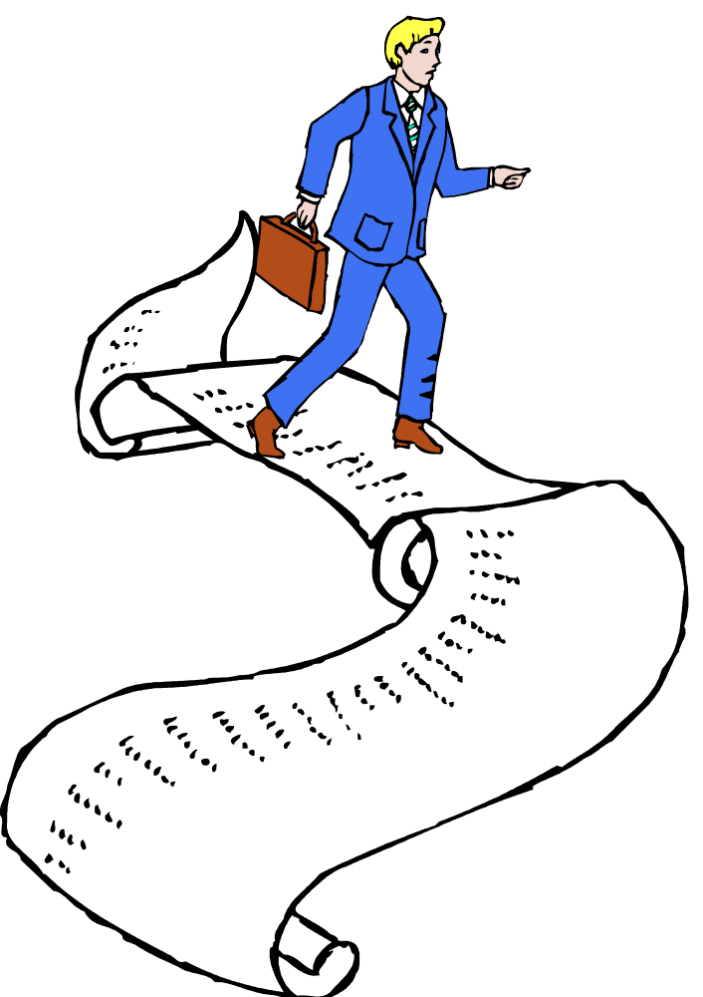
One More Rule 45 Tip
Use the lists. Put your authorities in the order listed.

Slide 66
Parentheticals: Rule 46
Use parentheticals to explain the importance of cases or to give other relevant information, such as the holding of a case not discussed in the text.
Use to show changes in a direct quote (emphasis added).
Usually needed when using a signal. ALWD 44.4).

Slide 67
Review’s Preferred Form of Parentheticals
Put space before open paren.
Start with an “ing” word.
Ignore exceptions.
Don’t always use the same word.
Don’t use a cap.
Typically no punctuation inside paren.
No “block quotes.”
²Smith v. Jones, 498 S.W.2d 470, 472-474 (Tex. App. 1982)#(hold-
ing that the landlord’s eviction notice was invalid).

Slide 68
Parentheticals and Subsequent History
If the case has a subsequent history, the subsequent history FOLLOWS the parenthetical.
⁶⁵Smith v. Jones, 498 S.W.2d 458, 472-473 (Tex. App. 1982) (concluding that the landlord’s notice was defective), aff’d, 502 S.W.2d 982 (Tex. 1984).

Slide 69

Indirect References
Use the parenthetical format.
Example:
  Smith v. Jones, 2 F. Supp. 2d 47, 52 (M.D. Fla. 1998) (quoting Forest v. Ackerman, 119 U.S. 1301, 1303 (1942)).

Slide 70
Quotations: ALWD 47
It is best not to use a lot of quotations in the main text (EXCEPTION: Quoting statutory language).
If you use a block quote, do NOT also use double quotation marks at the beginning and end.
Put brackets around material you change. ALWD Rule 48.

Slide 71

Quotations and Punctuation: ALWD 47.4(d)
Commas and periods go INSIDE the quotation mark, regardless of whether they were part of the original quotation.
Other symbols go OUTSIDE, unless they were part of the original quotation.
The controlling statute defines specific intent as “a state of mind which is thought culpable,” such as premeditation for first degree murder.

Slide 72

Quotations and Omissions: ALWD 49
Read the rule concerning how to use an ellipsis very CAREFULLY.
  How are you using the quotation?
Where is the omission?
  Final punctuation.
    Last word included (relief. . . .)
    Last word omitted (relief^. . . .)
  Spacing issues.

Slide 73
Cases: ALWD 12
May abbreviate first word of a party’s name (if an org.).
Case name always in italics.
Reporter abbreviations the same as the BB, except:.
Usually no “Ct.” in court abbreviations.
In case names, United States is U.S.

Slide 74

Common Mistakes with Case Cites
Do not use et al. in a case name.
Rarely abbreviate parts of a case name in the text. (see exceptions in Rule 2.3)
Make sure you include a pinpoint citation.
Don’t copy the West abbreviations.

Slide 75
Subsequent History: 12.8
Include appropriate subsequent history WHENEVER you use the FULL case cite -- not just the first time you cite a case.
Do not skip levels.
Read 12.8(a), (b) carefully.
Do not use cert. denied unless:
  It concerns the casenote case.
  The case you are citing is two years old or less. Sidebar 12.6.

Slide 76
Dissents and Concurrences: ALWD 12.11
Indicate dissents and concurrences that you refer to in a parenthetical.
  Even in short citations.
  (Scalia, J., dissenting).
  (Kennedy & Souter, JJ., concurring).
Include an abbreviation of the judge’s or justice’s title. Chart 12.2.
Never use the word “held” when describing a dissenting or concurring opinion.

Slide 77
Short Cites: 12.21
Do not use supra for cases or statutes.
Use id. if possible.
First party’s name, volume, reporter, at, pinpoint.
    Jones, 467 F. Supp. at 27.
If the first party is a government, use the second party’s name.

Slide 78

Constitutions: ALWD 13
Remember: NO large and small caps.
Separate parts with commas.
  U.S. Const. amend. XIV, § 2.
Check App. 3 for subdivision abbreviations.
No date on current version of a constitution.

Slide 79
Statutes: ALWD 14
Main volume or supplement? [Rule 8]
  28 U.S.C. § 1541 (2000).
  28 U.S.C. § 1541 (Supp. 2002).
  28 U.S.C. § 1541 (2000 & Supp. 2002).
Short cites:
  Use id. when possible.
  Otherwise, just drop the date.
Sidebar 14.2: Referring to statutes in text.

Slide 80
Periodicals: ALWD 23
No real distinction between consecutively and nonconsecutively paginated journals.
All student pieces = Student Author (not Note, Comment, etc.).
Appendix 5 has abbreviations (Web).

Slide 81
Periodical Examples
Cass R. Sunstein, Affirmative Action, Caste, and Cultural Comparisons, 97 Mich. L. Rev. 1311, 1315 (1999).
Gita F. Rothschild, Forum Shopping, 24 Litig. 40 (Spring 1998).
Tara Burns Koch, Student Author, Betting on Brownfields--Does Florida's Brownfields Redevelopment Act Transform Liability into Opportunity?, 28 Stetson L. Rev. 171, 175 (1998).

Slide 82

Internet: ALWD 40
Author or owner, Title, URL (access information Exact date).
James Wyman, Florida Law Online, http:www.gate.net/~ wyman/flo.html (accessed Aug. 1, 2002).
Be careful about breaking the URL across lines.
Be careful about the date.

Slide 83

Appendix 1
Goes by jurisdiction (states, then federal).
Reporters/Court Abbreviations.
How to cite statutes.
How to cite administrative regulations.

Slide 84
A Few Final Tips
There is usually more than one way to incorporate a citation into an endnote.
Don’t use all ids.
You must show some complexity and creativity.
Be consistent.
Put in the endnotes as you go.
Analysis is worth more than citation, but citation mistakes are easily spotted.

Slide 85

The End. Good Luck!

