Slide 1
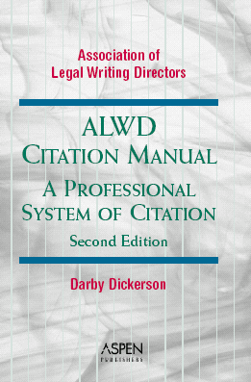
Introduction to Legal Citation

Slide 2
What Is Citation?
“Code” to help readers find the sources you refer to in your paper.
  Names, abbreviations, numbers.
  Author, title, volume, source abbreviation, page numbers, dates.
Each source you cite will have a slightly different format.

Slide 3
Purposes of Citations
Allow reader to find and verify sources.
Show weight and persuasiveness.
Show type and degree of support.
Show paper is well-researched.
Give attribution.

Slide 4
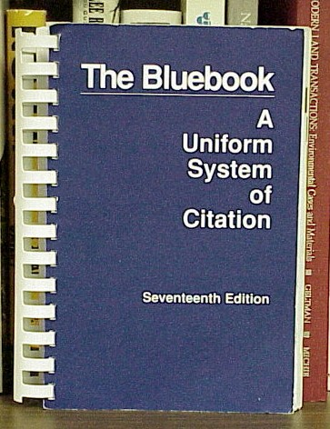
Background - Bluebook
For 75 years, the standard has been the Bluebook.
  Prepared by students at Harvard, Yale, Columbia, and Pennsylvania.
  Revised every 5 years.
  Much dissatisfaction with changes and format.
    Practitioners’ Notes v. Law Review.

Slide 5
ALWD Citation Manual
Prepared by the Association of Legal Writing Directors.
Pronounced ALL-wid.
Designed as a “restatement” of citation and to replace the Bluebook.
Now in its second edition (2003).

Slide 6
ALWD Citation Manual
Already been adopted by professors at about 90 law schools.
If you can use the ALWD Manual, you can use the Bluebook.
Many citation forms look the same -- so most attorneys and judges will not know which you used.
Also: Local court citation rules.

Slide 7

Major Change from Bluebook
Only one citation system for all types of documents (no more Practitioners’ Notes).

Slide 8

Features
Fast formats
Sidebars
Diagramed examples
More examples
Detailed index
Local court rules
Two-color design
Web site for updates

Slide 9
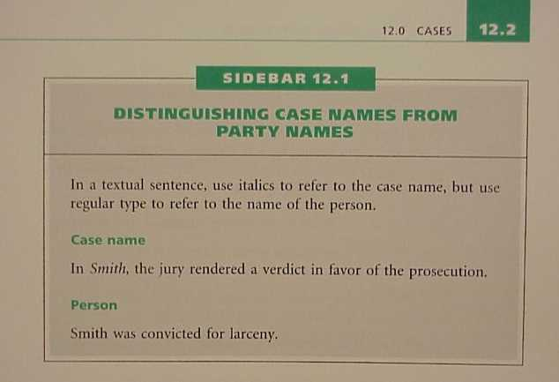

Slide 10
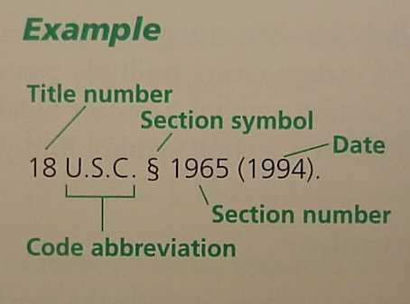

Slide 11


Slide 12
Organization
Part One: Introductory Material
Part Two: Citation Basics
Part Three: Specific Print Sources
  Primary, then secondary
Part Four: Electronic Sources
Part Five: Incorporating Citations
Part Six: Quotations

Slide 13
Part Seven: Appendices
1: Primary sources, by jxn
2: Local citation rules
3: General abbreviations
4: Court abbreviations
5: Periodical abbreviations
6: Sample memorandum
7: Tax materials
8: Fed. admin. sources (Web only)

Slide 14

Appendices on Web
Many have expanded coverage.
www.alwd.org
Web also has updates, clarifications, and errata.

Slide 15

How to Find Information
Start with the index.
  Look up the most specific term possible.
  If not there, think of a broader term or synonym.
Detailed table of contents.

Slide 16
Example of Citation
To establish that a contract exists, the plaintiff must establish three elements: offer, acceptance, and consideration. Jones v. Smith, 538 S.2d 64, 67 (Fla. 1987). If these essential elements are not proven, then the plaintiff’s case will fail. Id. at 69. In some cases, the parties’ intent can be used to establish each element. Gardner v. Cooper, 876 S.2d 999, 1002-1004 (Fla. 2d Dist. App. 1994).

Slide 17
Rule 1: Typeface
Ordinary or italics (underlining).
  If you underline, underline spaces.
  Appendix 6 uses underlining.
Each rule will tell you which parts of a citation should be in ordinary type and which should be in italics.
Italicize punctuation within italicized material, but not following it (look at examples).

Slide 18

Rule 2: Abbreviations
Use the Appendices (have flexibility about whether to abbreviate).
Spacing rules (let’s look at some).

Slide 19
Rule 3: Capitalization
Conform titles to this rule.
Use spelling in original.
Capitalize first letter of:
  First word in title
  First word in subtitle
  First word after colon or dash
  All other words except articles, prepositions, “to” as an infinitive, and coordinating conjunctions

Slide 20

Rule 4: Numbers
Generally spell out zero through ninety-nine.
Ordinals: 1st, 2d, 3d, 4th, 5th, etc.

Slide 21

Rule 5: Page Numbers
Use a pinpoint whenever possible.
Page spans. Either:
  Retain all digits: 100-111
  Drop repetitive digits, but retain two on right-hand side: 100-11

Slide 22
Rule 8: Supplements
Material only in main volume.
  (2002)
Material only in supplement.
  (Supp. 2002)
Material in both.
  (2002 & Supp. 2003)

Slide 23

Rule 11: Intro to Full and Short Citations
Use a full citation the first time you cite a source.
May use a short citation thereafter.
Id.

Slide 24
Primary Sources
Rule 12: Cases
Rule 13: Constitutions
Rule 14: Statutes
Rule 15: Other federal legislative materials
Rule 16: Other state legislative materials
Rule 17: Rules (e.g., civ. pro.)
Rule 18: Local ordinances

Slide 25
Other Primary Sources
Rule 19: Federal administrative and executive material
Rule 20: State administrative and executive material
Rule 21: Treaties and conventions

Slide 26
Rule 22: Treatises
Author, Title subdivisions (edition, publisher date).
R. Joseph Smith & Patrice J. Goodwin, Foreign Relations in the Post-Modern World vol. 2, § 42, 310 (3d ed., West 1999).
Editor instead of author?

Slide 27
Rule 23: Periodicals
Author, Title volume, periodical abbreviation initial page, pinpoint page (Date).
  Consecutive v. Nonconsecutive.
  Student pieces = Student Author (not Note, Comment, etc.).
Appendices 3 and 5 have abbreviations.

Slide 28
Periodical Examples
Cass R. Sunstein, Affirmative Action, Caste, and Cultural Comparisons, 97 Mich. L. Rev. 1311, 1315 (1999).
Gita F. Rothschild, Forum Shopping, 24 Litig. 40 (Spring 1998).
Tara Burns Koch, Student Author, Betting on Brownfields--Does Florida's Brownfields Redevelopment Act Transform Liability into Opportunity?, 28 Stetson L. Rev. 171, 175 (1998).

Slide 29
Frequency of Citation
Support each thought that is not your own.
“Within a single paragraph . . . if you refer to material from the same part of the same source, you may place one citation at the end of the material. Do not use this convention if the page, section, or other subdivision of the cited material changes.”

Slide 30
Quotations (Rules 48)
Block quote: 50 or more words OR four or more lines of typed text.
Punctuation:
  Periods and commas inside quotation marks.
  Everything else outside, unless they are part of the quoted material.

Slide 31
The End.

