Slide 1





DesignQA
AI for Engineering Rule Understanding & Compliance
Team Name: Team_MTU
By:
Reiki Tanaya Karuka
Nazanin Mahjourianmoghadam
Dr. Vinh Nguyen
Notes:
[Dani]

Slide 2
About Us:
Reiki Tanaya
Mechanical engineering PhD student
Michigan Tech university - Under supervision of Dr. Vinh Nguyen
Research area : Robotics & Digital Twins
Nazanin Mahjourianmoghadam
Mechanical engineering PhD student
Michigan Tech university - Under supervision of Dr. Vinh Nguyen
Research area : Computer vision in Robotics and Manufacturing

Slide 3
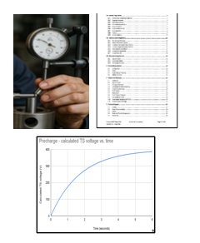

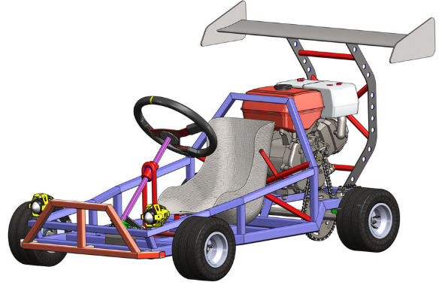


Problem Statement:
Idea+ Design+ Model
Precision+ Verification
Product
Every engineering process has rules, limitations, and checks .Searching through them manually is slow; LLMs can provide instant, reliable assistance.
Notes:
[Dani]

Slide 4
Proposed Approaches
Rule Extraction
Rule Compliance
Rule Comprehension
Model : GPT-4-RAG
Notes:
[Dani]

Slide 5
Proposed Approaches
Rule Extraction
Rule Compliance
Rule Comprehension
Notes:
[Dani]

Slide 6
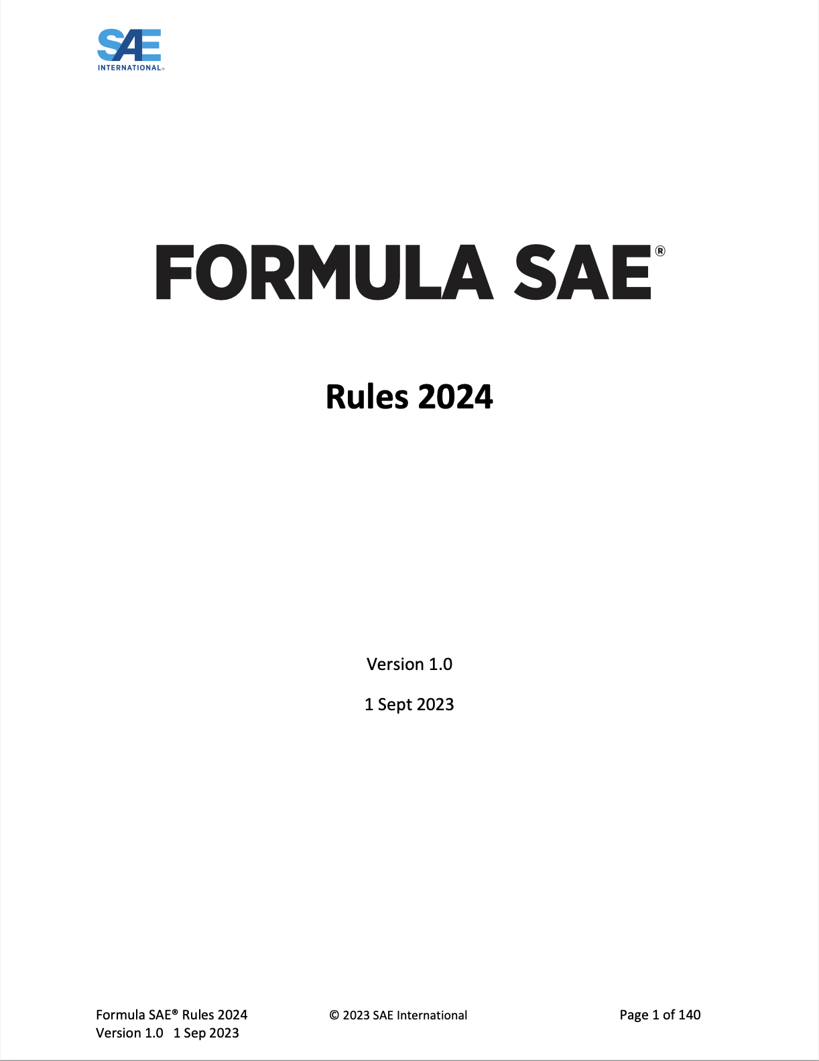
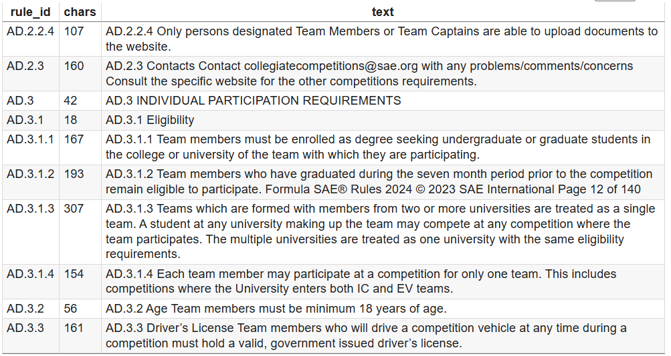
Rule Extraction: Retrieval
Headers
Table of Contents
Section Banners
Split into structured rules with IDs
Cleaning the document
Notes:
[Dani]

Slide 7
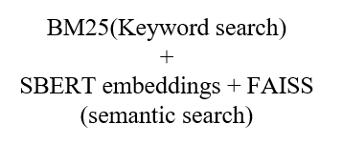

Rule Extraction: Retrieval
Question
Answer
Splits into structured rules with IDs
Hybrid Retrieval
LLM+RAG+Prompt
F1 Score: 0.924753
Notes:
[Dani]

Slide 8
Rule Extraction: Compilation
Question
Section-based filtering
Output
Splits into structured rules with IDs
Hybrid Retrieval
LLM
Parent–child expansion
(include sub-rules)
F1 Score: 0.443195
Notes:
[Dani]

Slide 9
Proposed Approaches
Rule Extraction
Rule Compliance
Rule Comprehension
Notes:
[Dani]

Slide 10
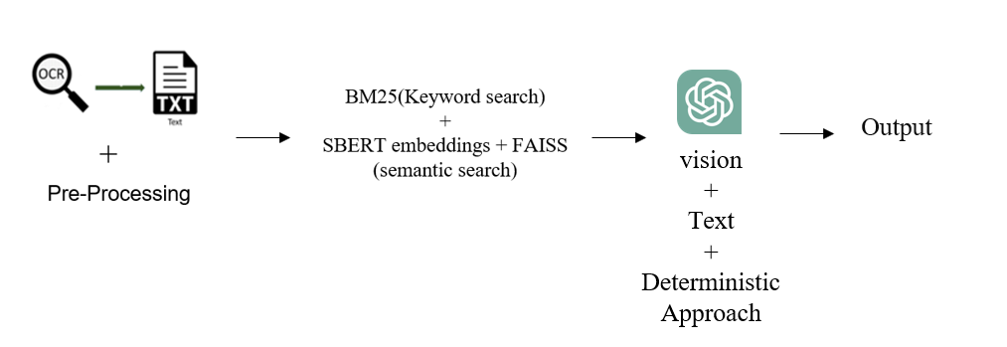
RuleCompliance: Dimension
Preprocessing: Clean rule text (remove noise, chunk rules) + Enhance images (grayscale, sharpen, scale-bar crop).
ACC: 0.266667
Notes:
[Dani]

Slide 11
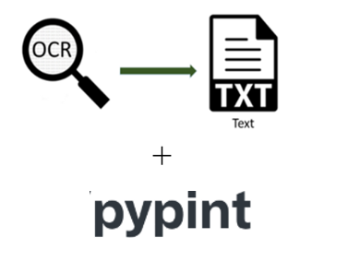


RuleCompliance: Functional Performance
Yes / No / Insufficient Evidence
Extract measurements
And
normalize units
compares OCR values vs rule thresholds
Output
Retrieve relevant rules
ACC :0.812500
Notes:
[Dani]

Slide 12
Proposed Approaches
Rule Extraction
Rule Compliance
Rule Comprehension
Notes:
[Dani]

Slide 13
RuleComprehension: Definition-Approach 1
Parse PDF Clean Text Segment Glossary & rule sections
Strength: Deterministic ,avoids hallucination
Limitations :Misses implicit definitions
Notes:
[Dani]

Slide 14
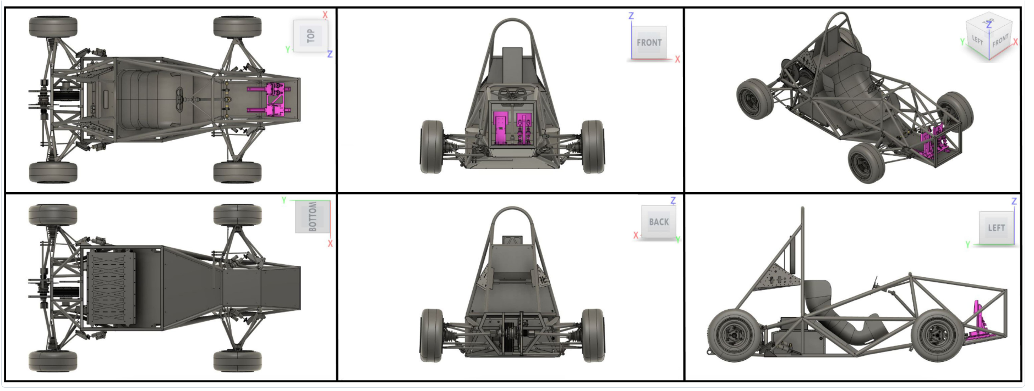
RuleComprehension: Definition-Approach 2
Multi-View Decision Approach:
Color Segmentation
Per Panel Features-Aspect,
Shape, Pair detection.
Class Specific Views
Super Imposition with ATLAS
ACC :0.812500
Notes:
[Dani]

Slide 15
RuleComprehension:Presence
Images are resized → compressed → base64 encoded for fast API calls.
Image + Rulebook+ question send to multimodal LLM
Prompt forces the model to answer only Yes / No / Insufficient Rule Evidence.
ACC : 0.548387
Notes:
[Dani]

Slide 16
Results:
Subset | Score
Retrieval | 0.924753
Compilation | 0.443195
Dimension | 0.266667
Functional Performance | 0.812500
Definition | 0.084485
Presence | 0.548387
Notes:
[Dani]

Slide 17
Challenges & Limitations:
API Token Constraints
Vocabulary Extractions
Engineering terms are domain-specific → model hallucinates
vision + text
Knowledge Limitations
Notes:
[Dani]

Slide 18
Future Work & Conclusion
Notes:
[Dani]

Slide 19


Thank you!
Questions?
Notes:
[Dani]

