Slide 1
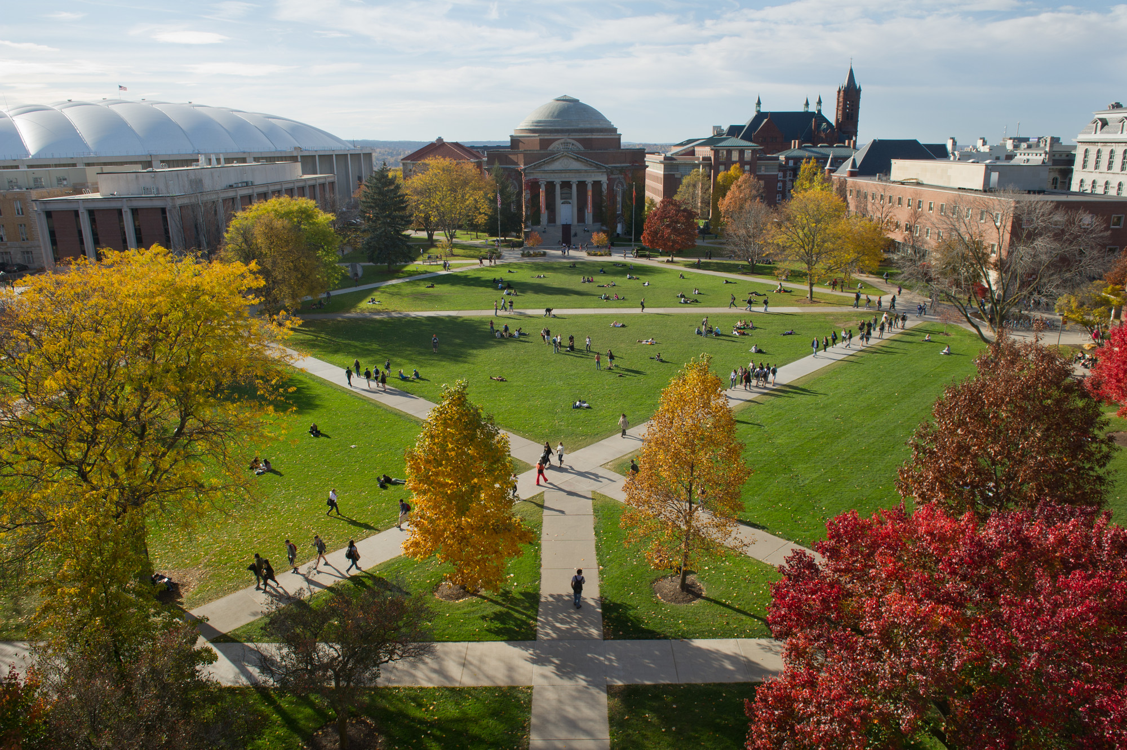
Master of Science Applied Data Science Portfolio Milestone : Rebecca Karunakaran

Slide 2
Introduction
The Master of Science in Applied Data Science program at Syracuse University is interdisciplinary curriculum that focuses on delivering organizational insight and driving business strategy by using data capture, management, mining and analysis skills.
The main goal of the program is to provide a mixture of technical and theoretical skills for today’s professionals.
The program focuses on data science but also includes an understanding of how to procure, analyze and manage data in order to make informed decisions.

Slide 3
7 Key Learning Goals of the Program
Describe
Describe a broad overview of the major practice areas of data science.
Collect and organize
Collect and organize data.
Identify
Identify patterns in data via visualization, statistical analysis, and data mining.
Develop
Develop alternative strategies based on the data.
Develop
Develop a plan of action to implement the business decisions derived from the analyses.
Demonstrate
Demonstrate communication skills regarding data and its analysis for managers, IT professionals, programmers, statisticians, and other relevant professionals in their organization.
Synthesize
Synthesize the ethical dimensions of data science practice.

Slide 4
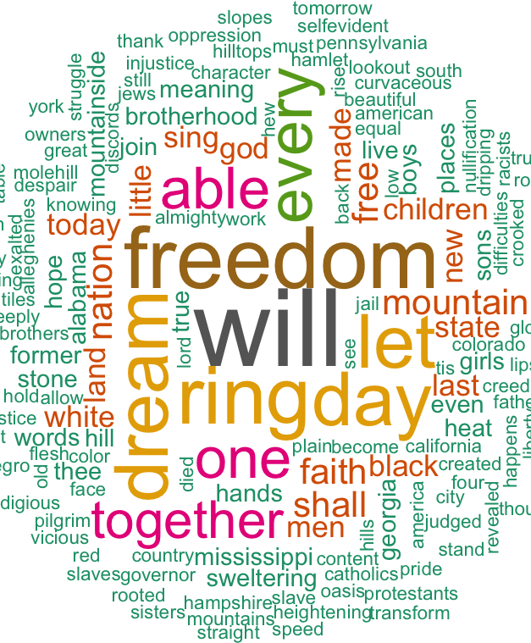
IST 736 Text Mining

Slide 5
IST 736 Text Mining
PROJECT MOTIVATION
William Shakespeare may be the most-recognized playwright in the world but very little of his life is known. This has led to many conspiracy theories that suggest that Shakespeare may have been more than one person.
PROJECT GOAL
Analyze Shakespeare’s plays using Text Mining to see if
1. there is evidence that it was written by more than one person
2. there is any linguistic difference between the Male and Female characters in his plays.
Python was used to for data analysis and modelling

Slide 6
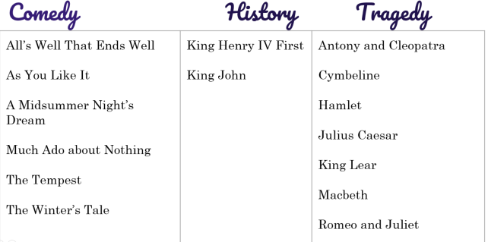
IST 736 Text Mining
Data Collection
Plays from each of the Categories - “Comedy”, History” and “Tragedy” were chosen to form a collection of 15 plays that were used for the analysis.
To analyze the conspiracy theory that Shakespeare’s works may have be written by other people, a selection of 52 Shakespeare poems were compared against poems by Christopher Marlowe and Edward de Vere.
Standard data Preprocessing options were applied.

Slide 7
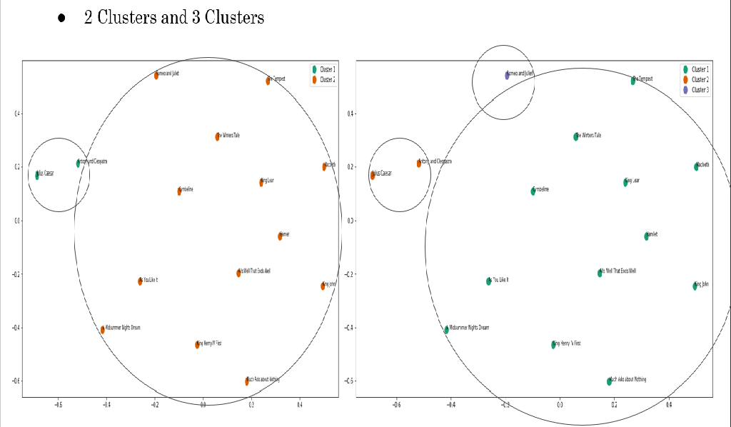
IST 736 Text Mining
Potential Authors - Visualization
Plotting the 15 plays with various clustering options (K-Means) indicate that it is most likely that two or three authors wrote these plays. Any more than that is improbable with the current analysis.

Slide 8
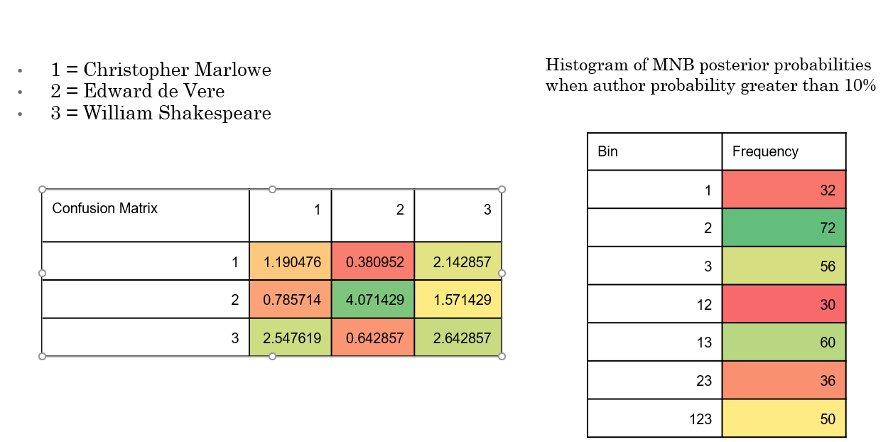
IST 736 Text Mining
Potential Authors - Algorithms
SVM and MNB classifiers were used to build multiple models using different parameters and seeds
The models were able to classifying Edward de Vere’s and Shakespeare’s works but not Marlowe’s. Marlowe’s works instead appeared to be confused with Shakespeare’s poems which suggested that he could potentially be alternate author for Shakespeare.

Slide 9
IST 736 Text Mining
Gender Analysis - Visualization
Corpus with 9000 speaking line was created and the Actor and Gender were identified
Corpus was evenly split into about 4500 Male and 4500 Female speaking line
Word Frequency Analysis to determine feasibility of differentiating male characters from female ones
IST 736 Text Mining

Slide 10
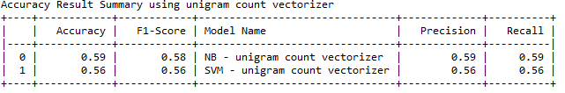
IST 736 Text Mining
Gender Analysis – Algorithms
SVM and MNB classifiers were used to predict the gender for the speaking lines
Three vectorization options were analyzed-
N-gram Count Vectorizer
N-gram Boolean Vectorizer
N-gram TfidfVectorizer
Using hold-out method using 70% of data from Training and 30% for Testing, MNB scored higher with 59% accuracy for Gender Classification

Slide 11
IST 736 Text Mining
Reflection
Text mining algorithms are as good as the data
Investing the time to collect the right data, understand the data and applying the correct pre-processing steps important
Choice of Algorithm depends on the Data being analyzed as well as the type of Classification
The key take away from this course was that the choice of the Algorithm and the Vectorization Options are very critical and depend entirely on both the Data and the Classification !!
Different Algorithms have different predictive capabilities

Slide 12
IST 736 Text Mining
Learning Goals
Applying standard preprocessing techniques to clean and organize the data
Learning to collect the necessary data
Visualizing and analyzing the data via Word Clouds and Word Frequency Distribution Plots
Applying multiple text mining algorithms such as SVM and Naïve Bayes
Interpreting the results to gain meaning insights from the results

Slide 13
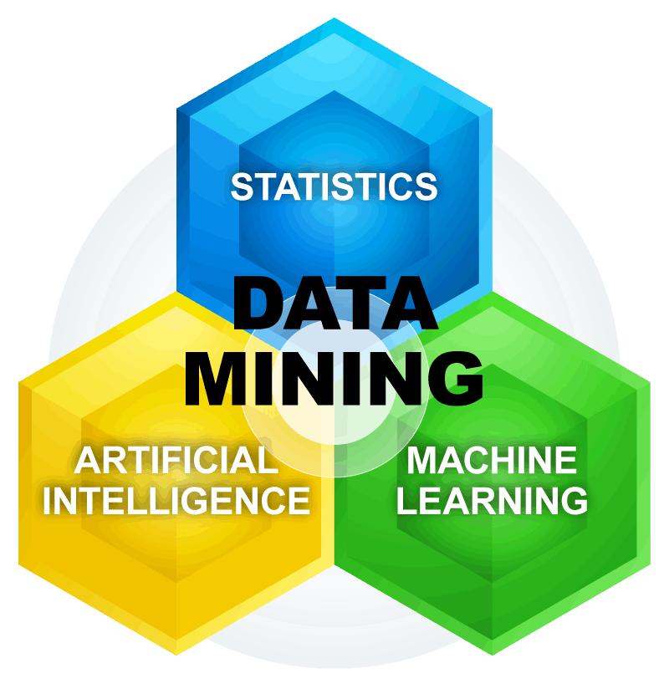
IST 565 Data Mining

Slide 14
IST 565 Data Mining
PROJECT MOTIVATION
Black Friday is the busiest shopping day of the year pulling in records sales for the Retail Industry. Stores are very motivated to determined who their customers and what do they shop for on Black Friday.
PROJECT GOAL
The goal of the project was to use data mining to analyze a sample dataset from a Retail store to find out who the best customers are, what pushes them to shop, how much do they spend? The use the information to train models to predict the Gender of the Customers for future Black Friday Sales.
R Studio was used to conduct the Analysis

Slide 15
IST 565 Data Mining
Data Collection
The Data for this analysis was chosen from a sample Black Friday Sales Dataset from Kaggle and has –
Variety of attributes both discrete and continuous
12 Variables and about 530k observations
Relatively clean dataset
Standard data Preprocessing options were applied.

Slide 16
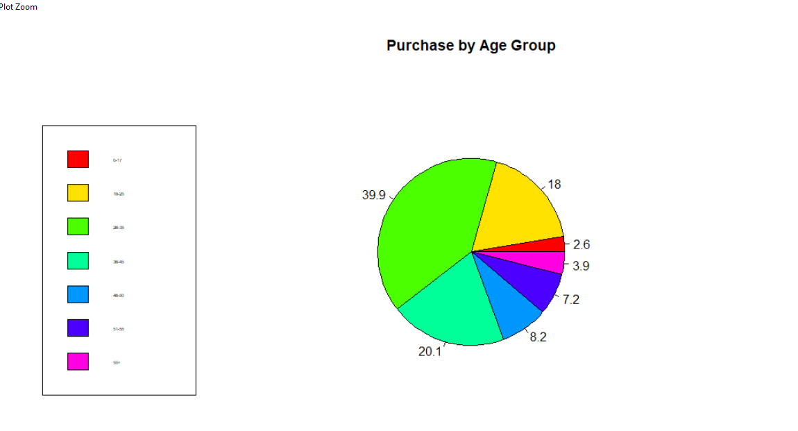
IST 565 Data Mining
Data Visualization
Purchase habits based on the Age Bracket
The majority of the buyers were in the Age Bracket 36-45 followed by buyers in the Age Bracket 26-35. This makes sense because people in this group typically are employed and have spending power

Slide 17
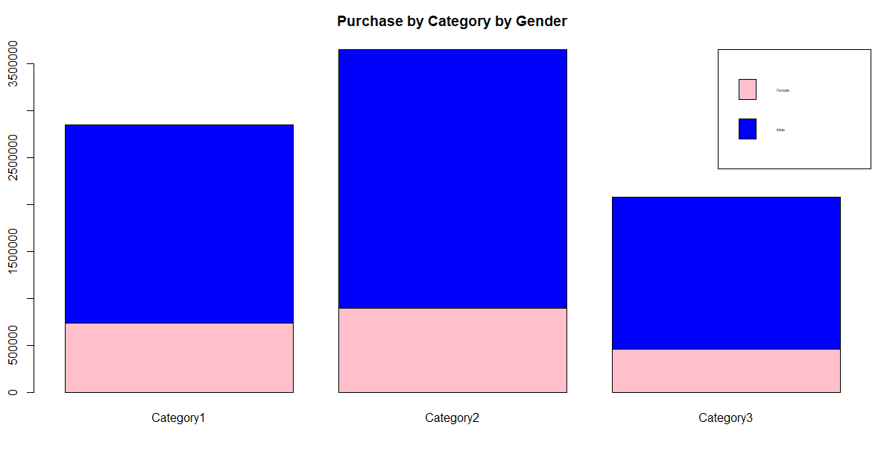
IST 565 Data Mining
Data Visualization
Purchase habits based on Gender
Surprisingly Male buyers were clearly the biggest spenders
Also, the Category 2 which is “Electronics” had the greatest number of buyers which is not a surprise since most buyers were Men.

Slide 18
IST 565 Data Mining
Algorithms - Association Rules Mining
Association Rule Mining using the Apriori Algorithm was used as Supervised Learning Method to find out which attributes contributes to a given Purchase Category.
Insights gained from these rules
Male shopper have a high probability of making Large Purchases ($25000 - $12000) while Female shoppers tend to make medium purchases ($5000 - $ 8000).
Buyers that live in City Category “C” tend to make Large Purchases indicating that it may be an affluent City.
Buyer in the Age Group of 26-35 and 36-45 are more likely to make Large purchases ($25000 - $12000) where as buyers in the Age Group 45-50 (Rule 15) are more likely to make Medium Purchases ($5000 - $ 8000).
.

Slide 19
IST 565 Data Mining
Algorithms - Classification
Four classification Algorithms - Random Forest, Naïve Bayes, Knn and Support Vector Machine were trained using various parameters predict the Gender of the buyer..
Insights
Random Forest had the highest Accuracy of 85% which is expected to see because Random Forest uses Ensemble technique which improves the predictive performance.
Random Forest also had the fastest execution speed while SVM had the slowest execution speed.
Model | Parameter | Accuracy
Random Forest | Mtry, Ntree | 85.39%
Naïve Bayes | Usekernel, Adjust, fL | 75.25%
knn | k | 84.55%
Linear SVM | C | 75.70%
Radial SVM | C, Sigma | 75.13%

Slide 20
IST 565 Data Mining
Reflection
Classification Algorithm were able to predict the Gender of the Customer with a relatively high accuracy of 85%.
Data Mining Algorithms provided to be extremely useful for any Retail Store, helping them analyze their buyers and their spending habits which will help improve future Black Friday Sales.
Association Rules Mining proved to be very value data mining tool since it could identify some important rules such as the population of buyer for each purchase category.

Slide 21
IST 565 Data Mining
Learning Goals
This project provided an opportunity to demonstrated several leaning goals such as –
collect the necessary data
applying standard preprocessing techniques to clean and organize the data
visualize the data using pie charts and bar charts
applying several data mining algorithms like Random Forest, knn, Naïve Bayes and SVM to analyze their predictive performance and accuracy against the Black Friday Sales Data.

Slide 22

IST 697 Data Administration

Slide 23
IST 697 DataAdministration
PROJECT MOTIVATION
A local Karate Studio wants a Martial Arts Software tool to automate and streamline administrative tasks
PROJECT GOAL
Develop a software tool to
Create and Maintain information about the Studios
Create and Maintain Class Schedules
Create and Maintain Employee Information
Create and Maintain Student Information
Schedule Events at the Studio Locations
MS SQL was used for the database implementation and MS Access was used to implement the User Interface

Slide 24
Normalized Logical Model
IST 697 DataAdministration

Slide 25
IST 697 DataAdministration
Implementation
MS SQL was used to implement the Database Tables and Views.
The Business Rules were implemented using Stored Procedure and Functions.
For example, a Stored Procedure “sp_AddModify_Employee_Info” was developed to maintain information about the employees like address, salary and employee schedule and allows for adding and updating employee information.

Slide 26
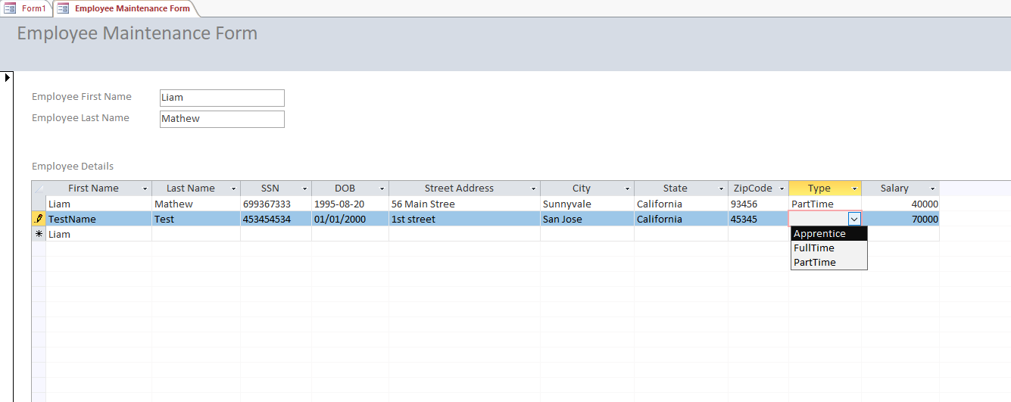
IST 697 DataAdministration
Implementation
MS Access was used to implement the Data Entry and Maintenance Screens in order to add/view employees information

Slide 27
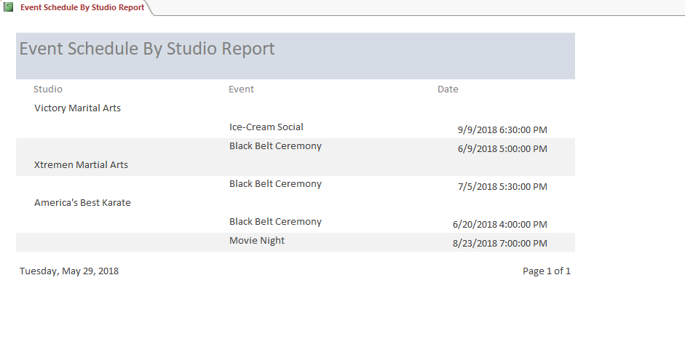
IST 697 DataAdministration
Implementation
MS Access was used to implement Reports.

Slide 28
Reflection
Data is the most important asset to any Data Scientist
Investing enough time to understand the data and designing the conceptual and normalized data model is the foundation to any database
The database design needs to be flexible enough to accommodate changes to the business rules easily
IST 697 DataAdministration

Slide 29
Image Sources
Text Mining - https://www.pngkey.com/detail/u2e6y3a9a9y3i1i1_word-cloud-and-text-mining-i-have-a/
Data Mining - https://www.kisspng.com/png-advanced-data-mining-java-data-mining-computer-sci-6297230/
Data Administration - https://pngriver.com/download-database-free-png-image-82326/

