Slide 1

Left Coast
Looking at gentrification through its relationship with levels of economic standing, housing price, and insurance coverage.

Slide 2
Specify: What’s the problem?
“Dramatic changes are playing out across parts of urban America, making many neighborhoods hardly recognizable from a relatively short time ago. A new class of more affluent residents is moving into once underinvested and predominantly-poor communities. Development has followed, typically accompanied by sharp increases in housing prices that can displace a neighborhood’s longtime residents. It’s a scenario known as gentrification, and one that presents a growing dilemma for policymakers.”
- Gentrification in America Report, Census Report by Mike Maciag, February 2015

Slide 3
Specify: How will we address the problem?
Can we understand the relationship between housing prices and homeownership/renter rates, poverty rates, insurance coverage, income, and population across different ethnic populations? If so, can we predict where gentrification will happen in the future and can we come up with policy recommendations to address the phenomenon?

Slide 4
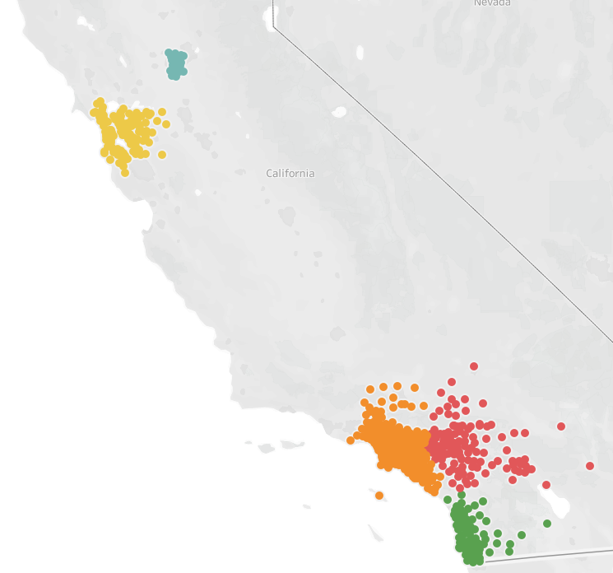
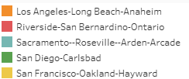
Specify: What’s the data?
Zillow Housing Data:
Average Housing price per year, for each zip code for CA metro between 2012-2017.
Census Data:
Population (All, Asian, Black, White, Other)
Insurance Coverage (White, Black)
Poverty (Black, White, Hispanic)
Income (All, Black, White, Hispanic)
Subsetting: Looking at the top metro areas in CA.
Home Ownership
Renter
Foreign Born
HealthCare

Slide 5
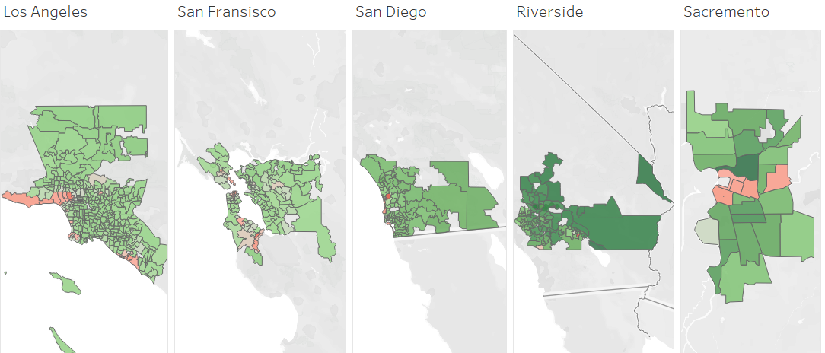
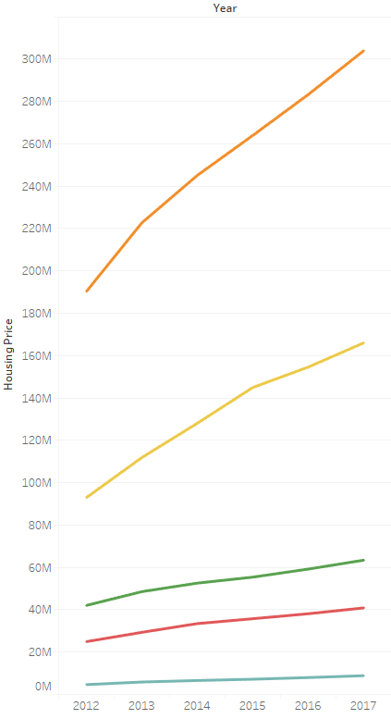
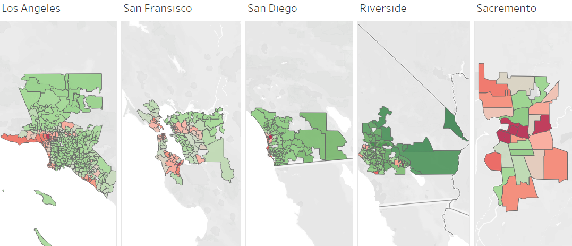
Observation: Housing Prices
2012
2017

Slide 6
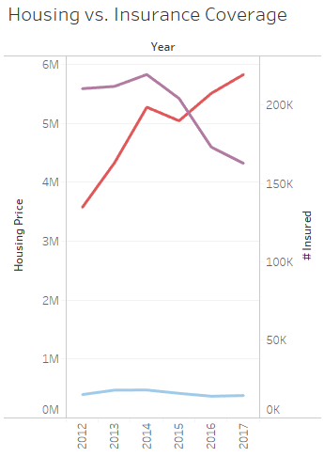
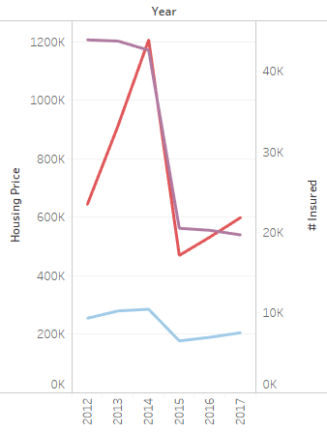
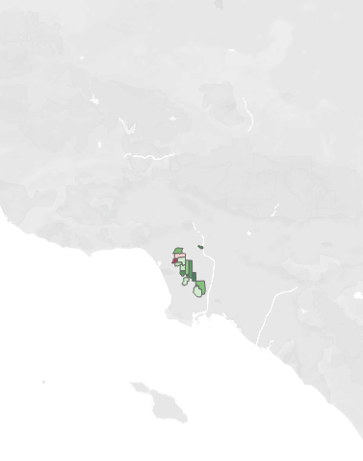
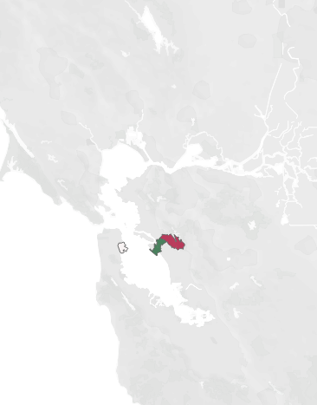

Observation: Insurance Rates in Different Demographics
Majority Black Zipcodes in LA
Majority Black Zipcodes in SF

Slide 7
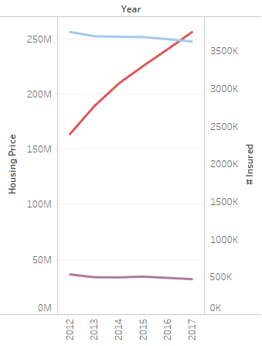
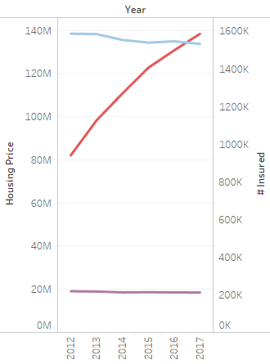
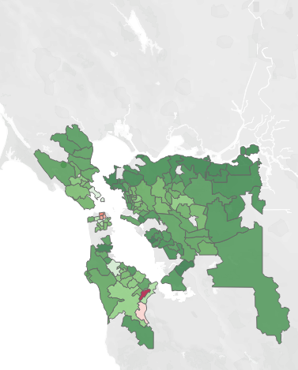
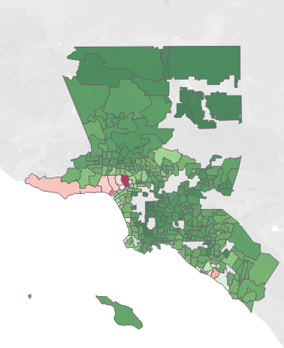
Observation: Insurance Rates in Different Demographics
Majority White Zipcodes in LA
Majority White Zipcodes in SF

Slide 8
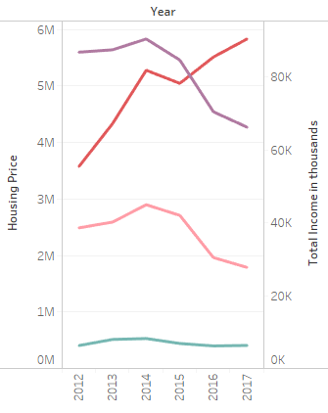
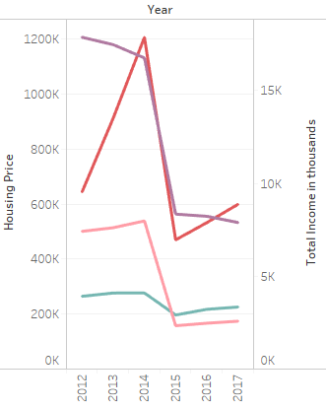
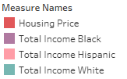
Observation: Income in Different Demographics
Majority Black Zipcodes in LA
Majority Black Zipcodes in SF

Slide 9
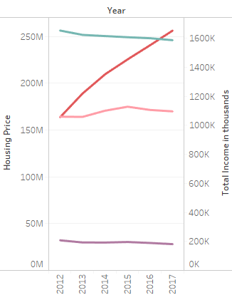
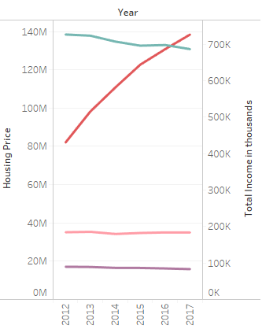
Observation: Income in Different Demographics
Majority White Zipcodes in LA
Majority White Zipcodes in SF

Slide 10
Observation: Population and
Rent vs. Own
~ Live demo of Tableau Dashboard ~

Slide 11
Analysis: Association Rule Mining
Association Rule Mining was used to find relationships among the data categories
Home Price | Below Median, Median, AboveMedian
Income Bracket | Low(< $10,000), Middle (< $20,000) Upper Middle (< $30,000) , Upper (>$30,000)
Geographic Area | Rural (Pop < 2500), Semi-Urban (Pop < 50000), Urban (Pop >50000) per Census Bureau
Population Type | Native , Foreign born
Ethnicity | White, Black, Asian, Others
Housing Type | Owners, Renters
Below Poverty | White, Black, Hispanic

Slide 12
Analysis: Association Rule Mining
Keeping Support at 0.1 , Lift > 1 and Confidence >=0.8, we get a bird’s eye view of the relationships and patterns among the data items.
I
if you own your home that is above the Median Price , live in a Semi- Urban Area , are “Native Born” , you are likely to be “White” as indicated with a high Confidence of 0.9 and Lift of 1

Slide 13
Analysis: Association Rule Mining
Lowering the Support to 0.01 , and keeping the Lift > 1 and Confidence >=0.8, we see evidence of gentrification as indicated by the rule below -
If you live in a Semi-Urban Area where the majority of people that live below the poverty line are “Black” and own a home that is above the Median Price and are “Native Born”, you are likely to be “Asian” as indicated with a high Confidence of 0.91 and Lift of 12.77

Slide 14
Analysis: Association Rule Mining
Lowering the Support further to 0.005 , and keeping the Lift > 1 and Confidence >=0.9, we see additional rules that supports gentrification -
If you are White and Own your property, “Native Born”, you fall in the Upper Middle Income Bracket , you are likely to live in an Urban and as indicated with a high Confidence of 1 and Lift of 5.24
Also, if you are “Asian” and “Native Born”, fall in the Upper Middle Income Bracket , own a home which is above the Median Price in an area where the majority of people under the poverty line are Black, you are likely to live in an Urban and as indicated with a high Confidence of 1 and Lift of 5.24

Slide 15
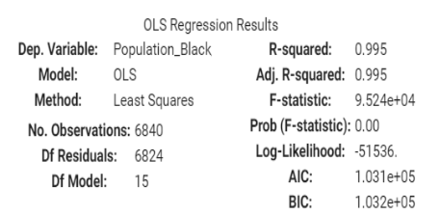
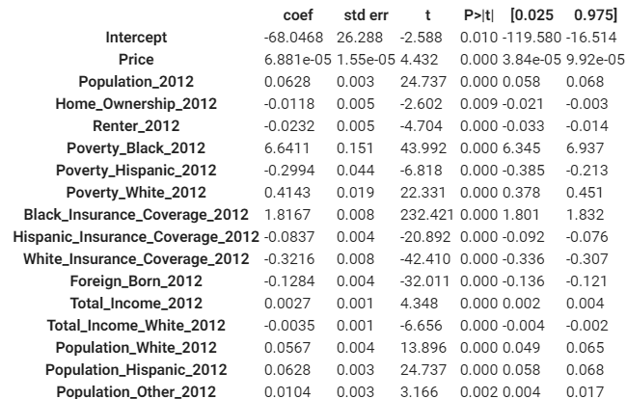
Analysis: OLS Regression; Race Specific
Interesting Observation:
Black Population is negatively correlated to White Population’s Income.

Slide 16
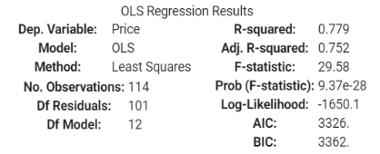
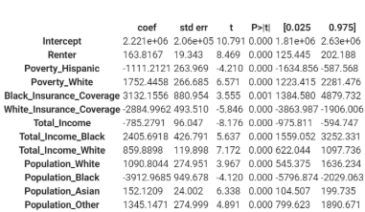
Analysis: OLS Regression; City Level
City: San Francisco
Interesting Observation:
Black Population is negatively correlated to Housing Price.

Slide 17
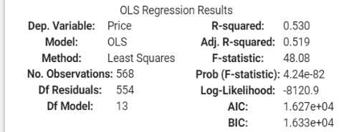
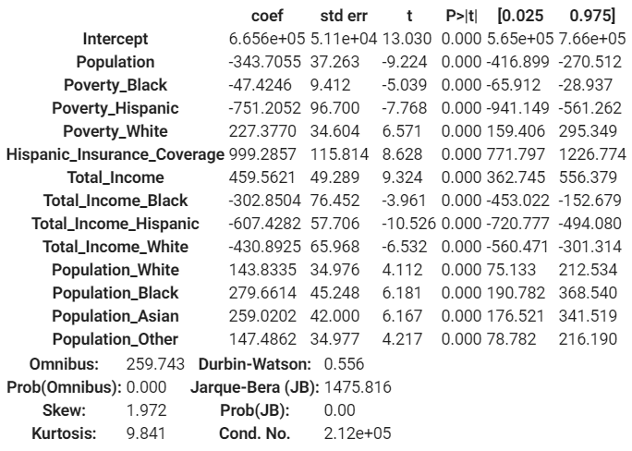
Analysis: OLS Regression; City Level Cont’
City: Los Angeles
OLS regression does not always explain a large variance among the data when looking at certain metro areas.

Slide 18
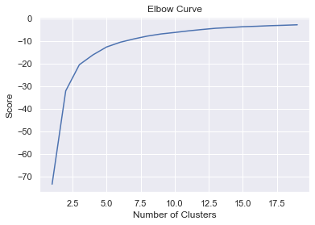
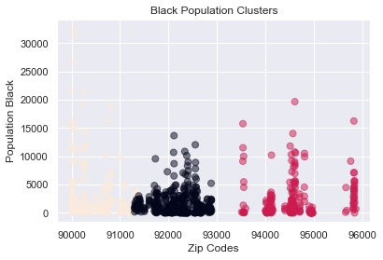
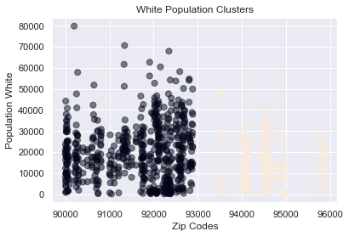
Analysis: K Means and Time Series
Optimum Number of Clusters using Elbow method for Zip code and income.
K_means clustering for Zip code and black population.
K_means clustering for Zip code and white population.

Slide 19
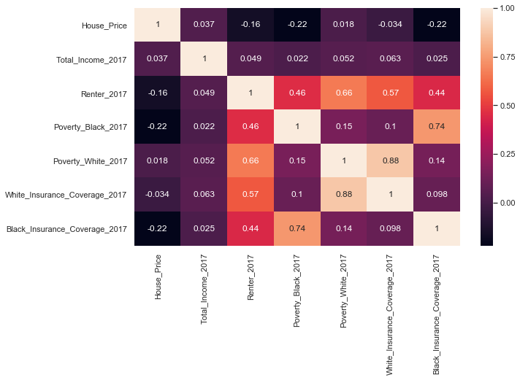
Correlation
•House Price and Black People Insurance are negatively correlated while Income and House Price are positively correlated.
•There is a positive correlation between renting and Black Insurancerate, however the correlation is much stronger in white population.
•Poverty rate is highly correlated with insurance coverage, which could be explained by Medicaid.
•There is positive correlation between Poverty and Renting.

Slide 20
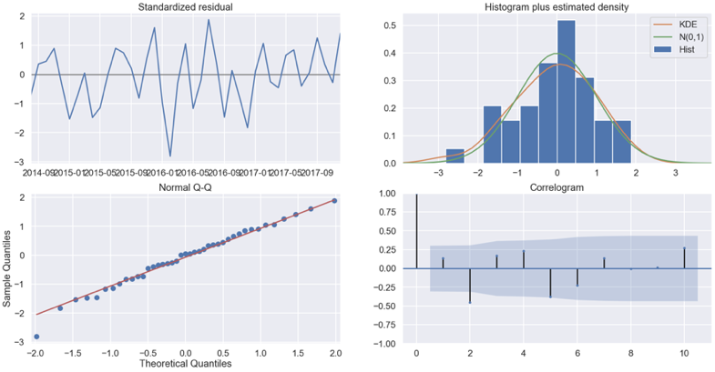
Model Performance

Slide 21
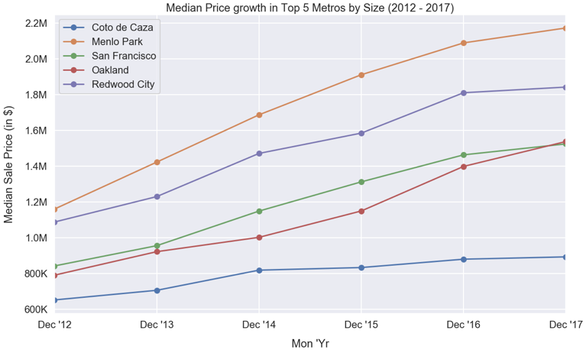
Housing in the major cities in the Bay area is getting expensive at a high rate

Slide 22
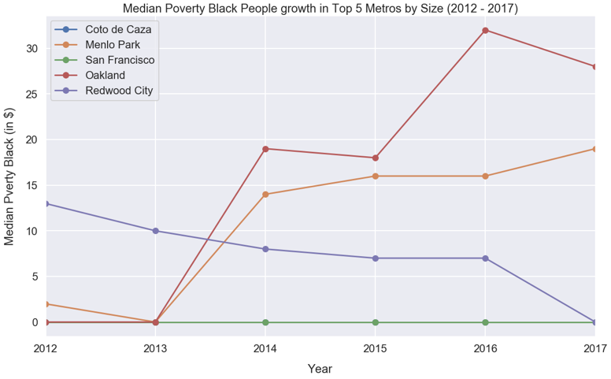
Poverty rate among black people is higher than average population

Slide 23
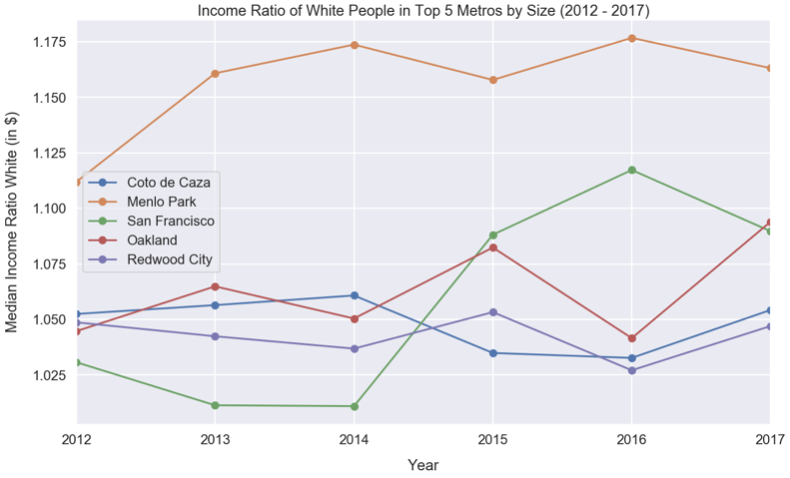
White income is higher than average income and growing in most cities

Slide 24
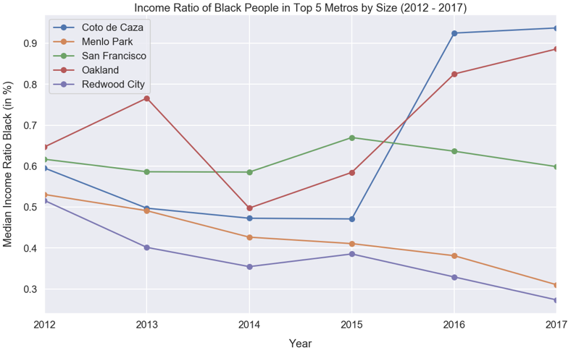
Income of black people is lower than average and not keeping up with growth of other groups

Slide 25
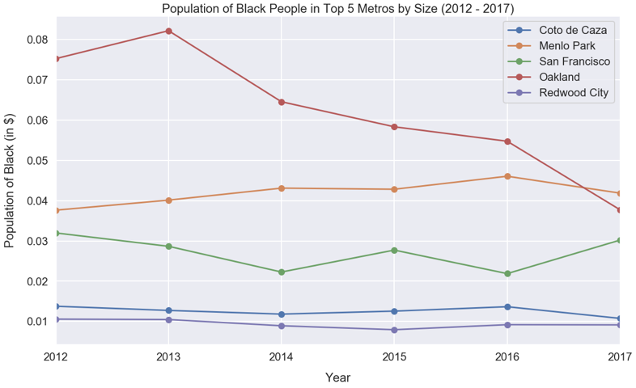
Black population is declining in most expensive cities in the Bay area, which is a clear sign of gentrification

Slide 26
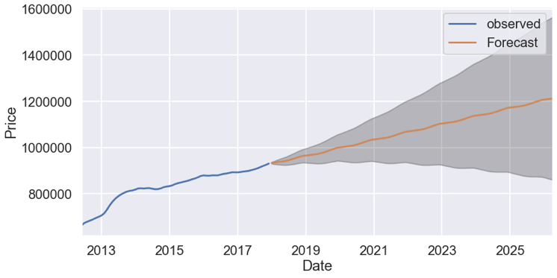
Model Performance, Forecast, price
Housing Price is predicted to continue to rise

Slide 27
Observation and recommendation:
Based on the available data and analysis the following trend has been observed:
Housing price in increasing in most metro areas in California, in particular in the Bay Area
Income is increasing for white people in most expensive parts of California, however the same is not true for Black population, they have much lower average income than median income in most expensive cities.
Black population is declining in most expensive cities in the bay area.
The widening gap between black population income and housing pricing is pushing black people out of the Bay area, this is a clear sign of gentrification.
Recommendation
To reduce the negative impact of widening gap between housing price and income of poor people (in particular the observed black population) it is recommended to increase inventory of affordable housing by encouraging investment in building new high density housing projects with mix income level.
Additionally to bridge the gap between income levels and in absence of a federal single payer insurance system it is recommended that California expands Medi-Cal to cover population in lower income bracket.

