Slide 1

Home selection in Chicago, IL

Slide 2
Introduction
People look at a variety of factors when deciding to rent/buy a home in a new town. Location is a major driver of this decision
A lot of manual effort goes into this process along with realtor fees. For e.g. people may want to rent in a neighborhood that has coffee shops and grocery stores and a train station
In this problem, I will be analyzing Chicago neighborhoods to provide recommendations on neighborhoods to rent/buy homes based availability of combination of certain venues per the user's preference
This analysis would be of interest to anyone who is looking to move into the city and rent/buy a home

Slide 3
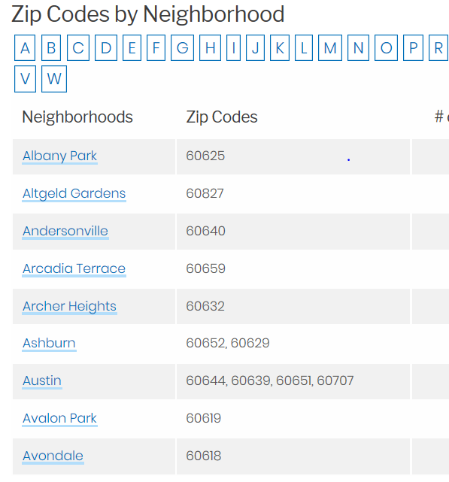
Data
Chicago has been selected to be the city whose neighborhoods will be analyzed
Three sets of data will be required for this problem:
Chicago neighborhoods and associated zip codes: will be scraped from https://www.dreamtown.com/maps/chicago-zipcode-map
The data will be converted to a dataframe and a longitude/latitude will be appended to the table using Python package: uszipcodes
For each neighborhood, the nearby venues and associated latitudes/longitudes and categories are obtained using the FOURSQUARE API

Slide 4
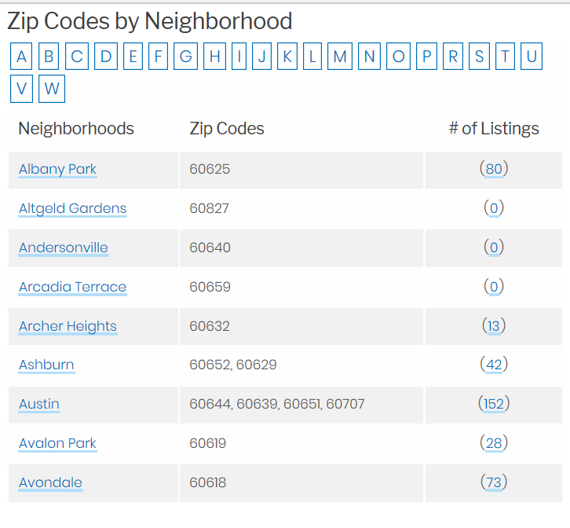
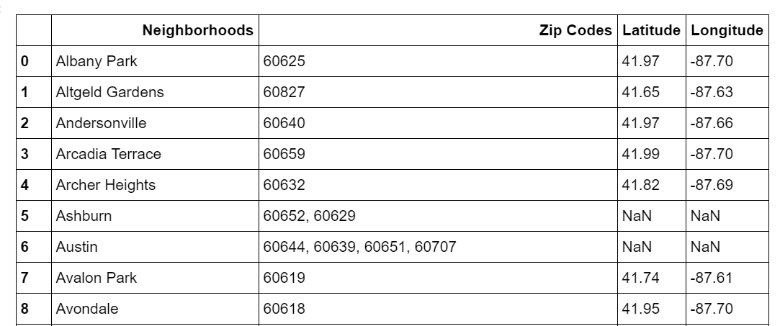
Methodology – Data Cleansing & Wrangling
The table is cleaned by combining the neighborhoods and zip codes into one table
The # of listings are removed
Using the “USZIPCODE” / SearchEngine package/module, we get the latitude and longitude of each of the zip codes
Neighborhoods that have more than one zip code are excluded from the analysis
Original Data
Updated Dataframe

Slide 5
Methodology – Clustering of Similar Neighborhoods
Need to cluster together similar neighborhoods – similarity is determined based on the number of a type of venue (e.g. grocery store, coffee shop)
Foursquare API provides the category/ number of venues in a neighborhood along with latitude and longitude coordinates
Estimate the total number of venue categories in each neighborhood
We follow the one-hot encoding process to create a table enumerating the category of the venues in each neighborhood
We estimate a normalized frequency of occurrence of a category within a neighborhood and create a new dataframe
In this analysis, we want to cluster neighborhoods based on the number of coffee shops, grocery stores and train stations they encompass
The clustering is based on k-means clustering algorithm – we start with 5 clusters
The idea is that neighborhoods that have most of the three venue categories (coffee shops, grocery stores, train stations) will be clustered together as opposed to neighborhoods that don’t have any of the three

Slide 6
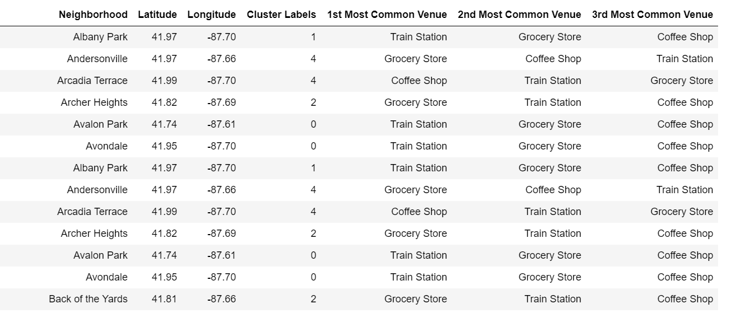
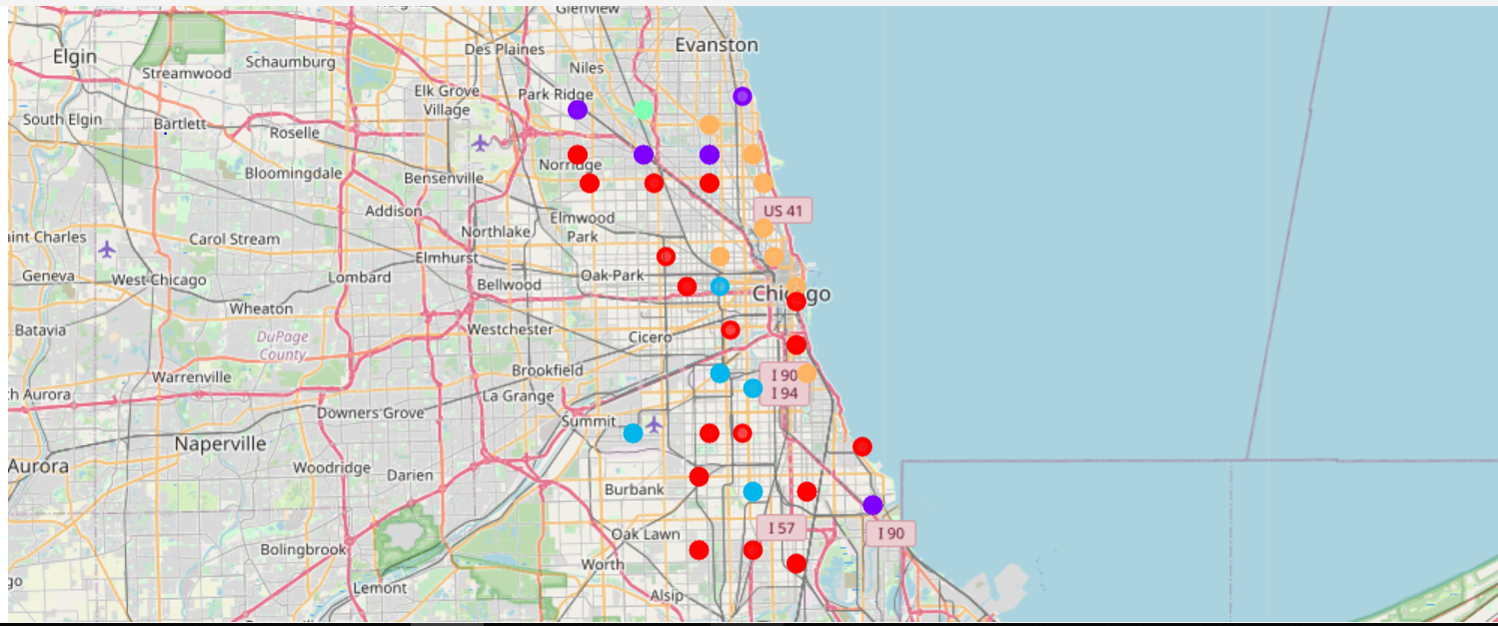
Results
Neighborhoods with cluster labels (0 to 4)
Map with neighborhood clusters (each neighborhoods is a color coded dot)

Slide 7
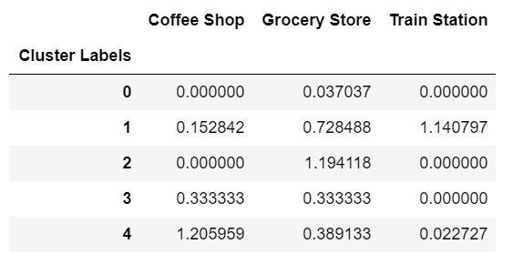
Discussion
Frequency of venue categories by cluster
We can see from the table above that the total normalized frequency of the venue categories in each cluster – cluster 0 does not have a train station nor coffee shop, so we can probably skip all neighborhoods in that cluster
Cluster 1 seems to be a blend with reasonable scores for each venue category – so that can be explored further; for example from the above right table, we see Albany Park may be a candidate for a neighborhood to rent/buy a home in

Slide 8
Conclusion
We can use k-means clustering technique to cluster neighborhoods in a city that include a certain combination of venue categories important to home renter/buyer
This saves manual effort and resources of looking into each and every neighborhood in a city
In this analysis we used Train station, coffee shop and grocery store as the 3 venue categories
In future analysis, we can increase or decrease the number of clusters to get a better sense of the neighborhood clustering
Furthermore, we can extend the analysis to provide an html interface where the user can select the type of venues they are interested in and the back-end Python ‘engine’ code can be run on the fly to identify neighborhoods they should be looking at first

