Slide 1

Product Category
Product Visibility
Product Weight
Product Fat Content
Product Price
Outlet Type
Outlet Size
Product Sales
Product Features
Outlet Features
Response Variable

Slide 2
Naïve Imputation
Optimal Impute
KNN Impute
Implemented KNN impute for missing data since it had lowest MAE
Created interaction terms and transformations of the variables.
Wanted to consider that bigger stores sell different type of products than the smaller stores.
Data Imputation
Feature Engineering

Slide 3
Implemented Stable Regression to get the toughest training set
Leads to better performance on out of sample data
Select best variable transformations.
Impose Sparsity.
Limit highly correlated variables
Impose selection of Visibility
Stable Regression
Holistic Regression
R^2 = 0.6538

Slide 4
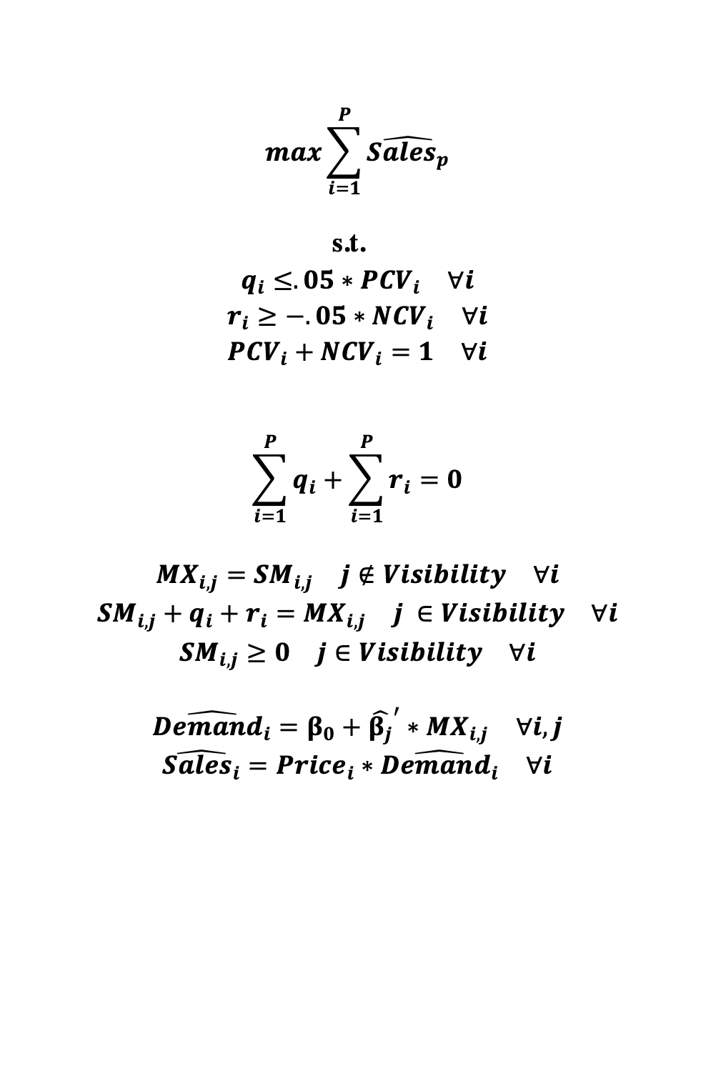
$$\max{\sum_{i=1}^{P}{\hat{Sales_{p}}}}$$
s.t.
$$q_{i}≤.05∗PCV_{i} ∀i$$
$$r_{i}≥−.05∗NCV_{i} ∀i$$
$$PCV_{i}+NCV_{i}=1 ∀i$$
$$\sum_{i=1}^{P}{q_{i}}+\sum_{i=1}^{P}{r_{i}}=0$$
$$MX_{i,j}=SM_{i,j} j∉Visibility ∀i$$
$$SM_{i,j}+q_{i}+r_{i}=MX_{i,j} j ∈Visibility ∀i$$
$$SM_{i,j}≥0 j∈Visibility ∀i$$
$$\hat{Demand_{i}}=β_{0}+{\hat{β_{j}}}^{′}∗MX_{i,j} ∀i,j$$
$$\hat{Sales_{i}}=Price_{i}∗\hat{Demand_{i}} ∀i$$
Objective: Maximize predicted revenue.
Constraints
Change visibility of products in store.
Total change of visibility must be zero.
Cannot change visibility more than 5%
Optimization

