Slide 1

Data Warehouse
By Robert Kaszubski

Slide 2
Company Background
Tesla is the world’s largest Electric Car Manufacturer and most valuable car manufacturer.
Specializes primarily in Electric Vehicles, but also Energy, and Software
Currently operating out of 2 Factories, in Fremont, California and Shanghai China
Produces and Sells 4 models (S, 3, X, Y), with several more on the way
Currently planning on opening two more factories
Experiencing heavy delay due to demand – up to a year wait

Slide 3
Goals
Transitioning the world toward a more sustainable future
Generate more revenue and profits
Expand their market share of electric vehicles
Meet skyrocketing demand and deliver cars promptly
Increase productive capability and efficiency
Improve production quality control and improve customer relations
Expand and grow rapidly, build new factories and hire more people

Slide 4
Gaps and Problems
Ability to keep up with demand – more efficient manufacturing
Address shortages of parts and equipment
Address the need for growth and expansion
Improve customer and employee satisfaction – fill vacancies urgently
Maintain a larger market share and track competitor progress
Possess access to key company information and KPIs and the ability to perform business intelligence analysis for better decision making
Track financial performance and risk management

Slide 5
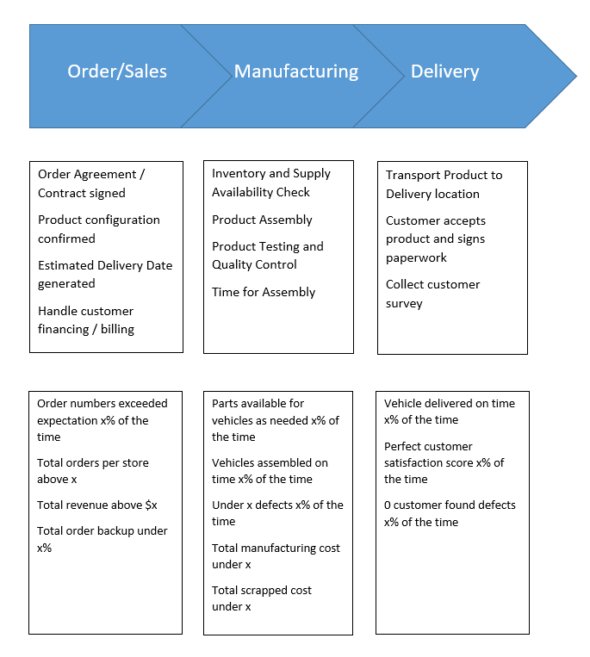
Process Maps

Slide 6
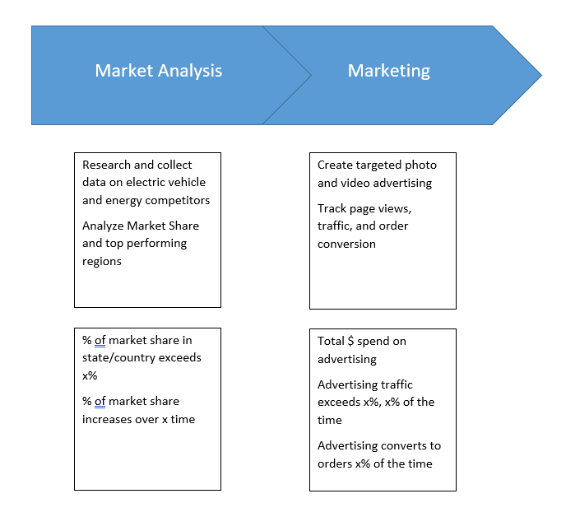

Slide 7
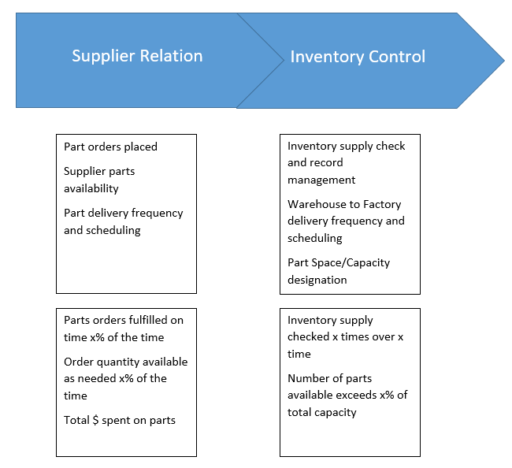

Slide 8
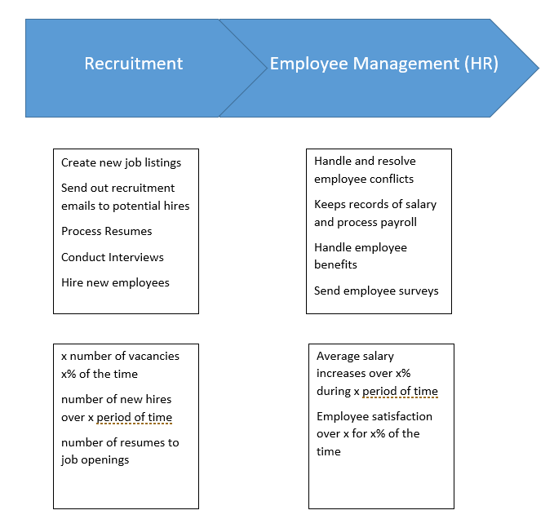

Slide 9
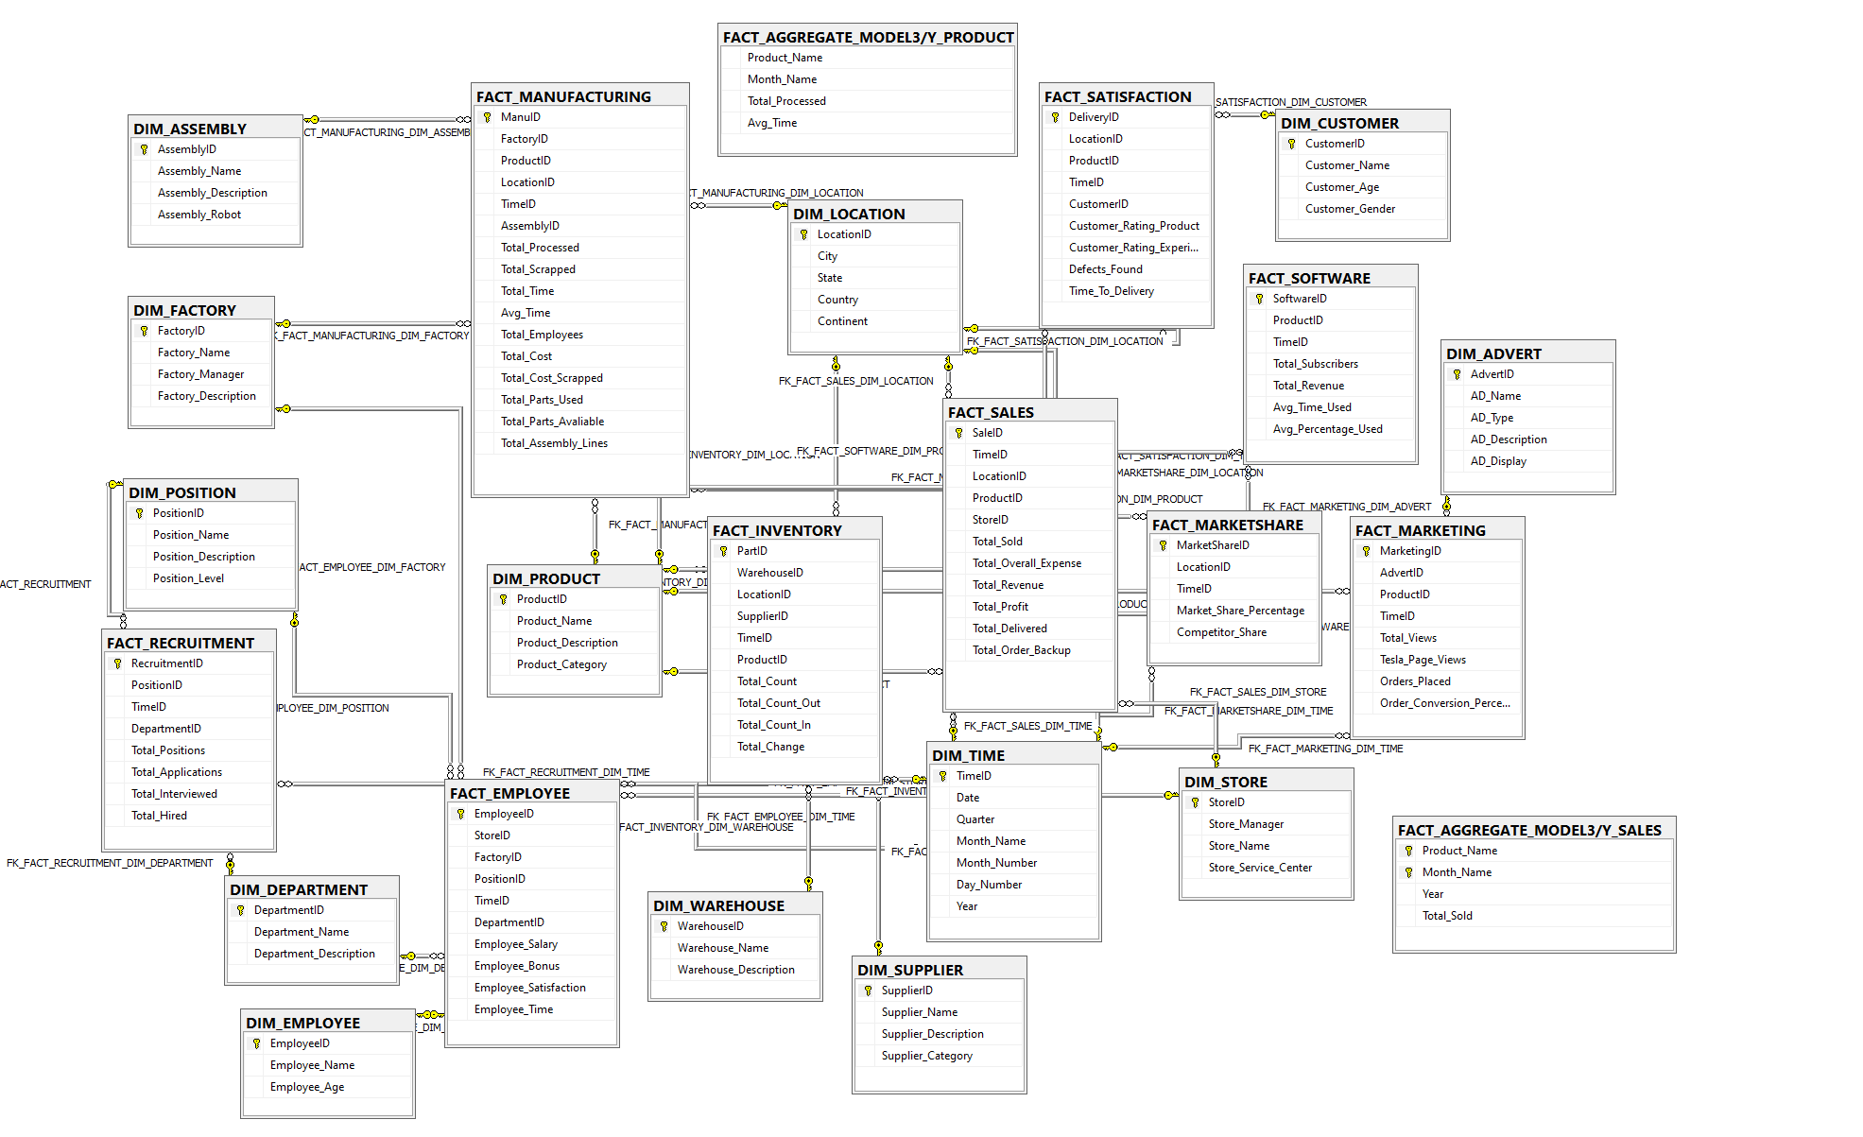
Dimensional Model

Slide 10
Data Quality
ETL with SSIS Packages made using SQL Server Import Export Wizard
Errors: Foreign Key Constraints, Truncation, Data Conversion, Column Mapping Mismatch, Incorrect Data Types
Standards: Primary/Foreign Keys, Time measures in Minutes, Monetary figures all in $, Percentages reported from 0-100, Names always First (space) Last

Slide 11
Architecture
See PDF for Diagrams
Source System -> ETL -> Presentation + BI -> Users
Source Systems: Factory Databases, Market Analysis Data, Competitor Analysis Data, HR Databases, Supplier Data, Customer Service Data, Orders, Sales, Billing data
BI Tools: Tableau, but easily expandable
Users: Business executives, Data Analysts, Data Scientists, Business Analysts, Department Managers, Factory Supervisors, Store Managers, any employee with authorization

Slide 12
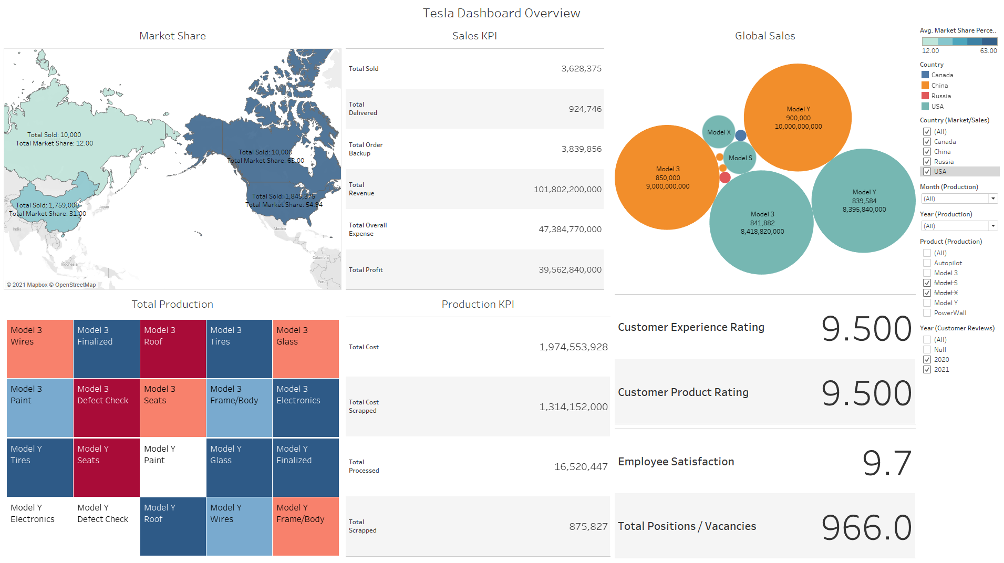

Slide 13
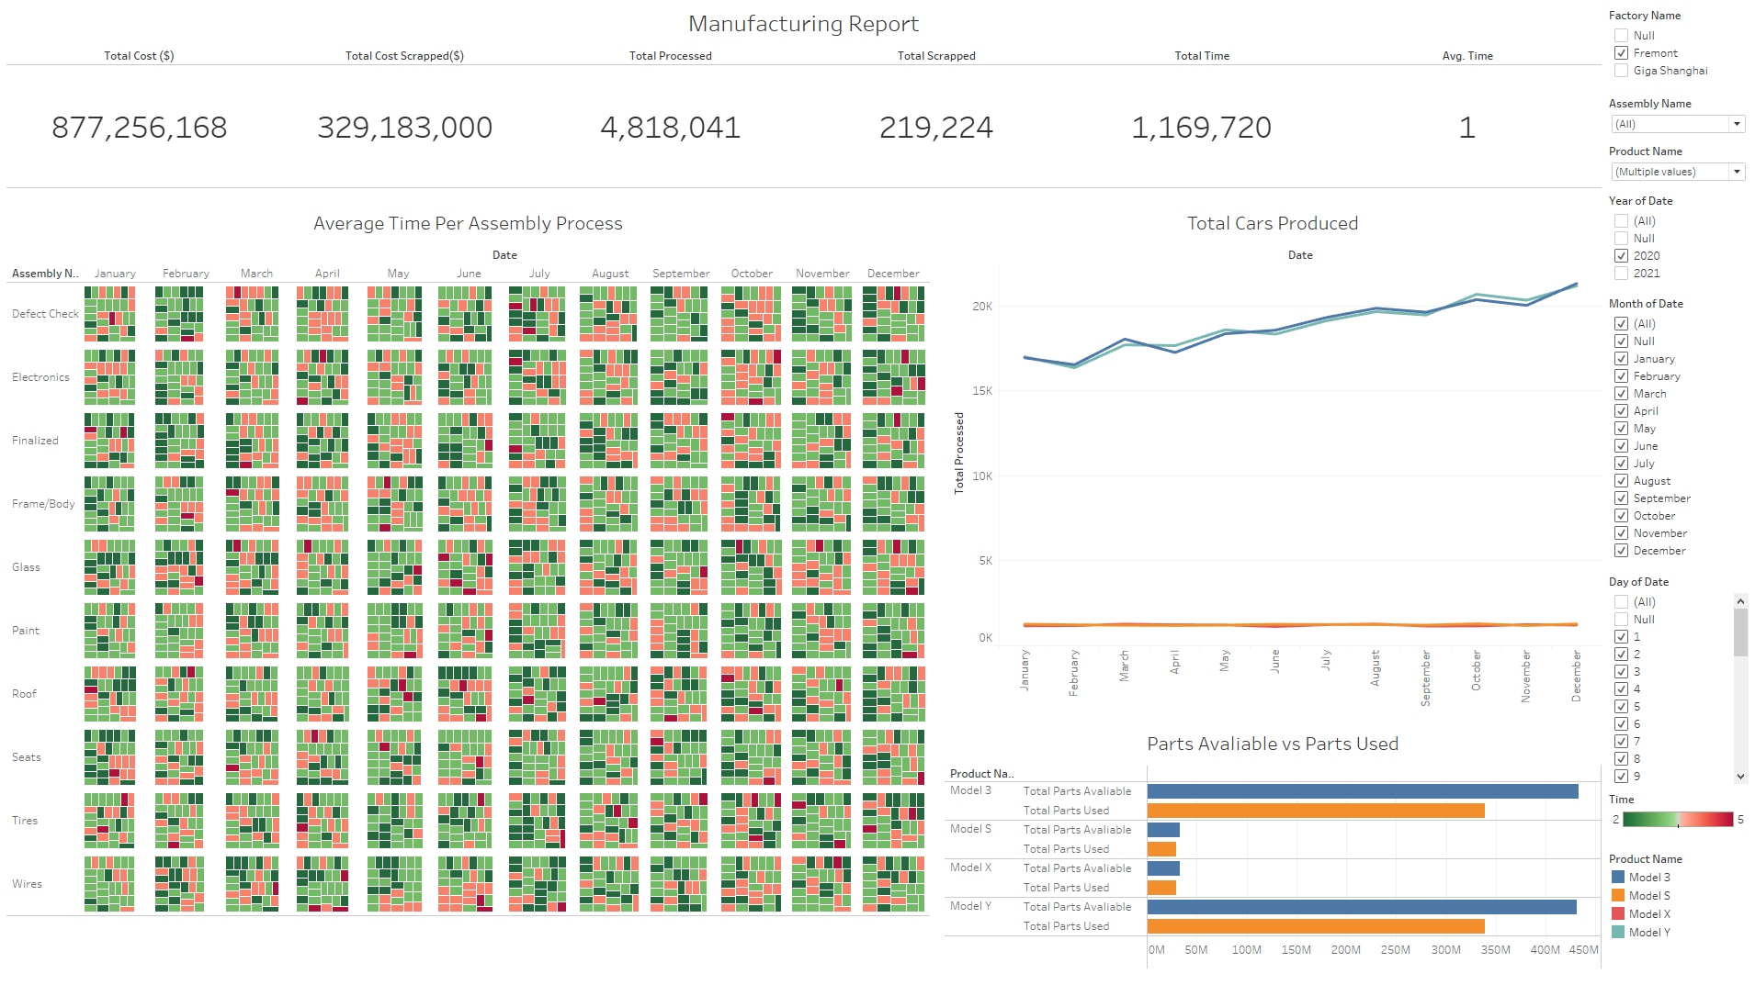

Slide 14
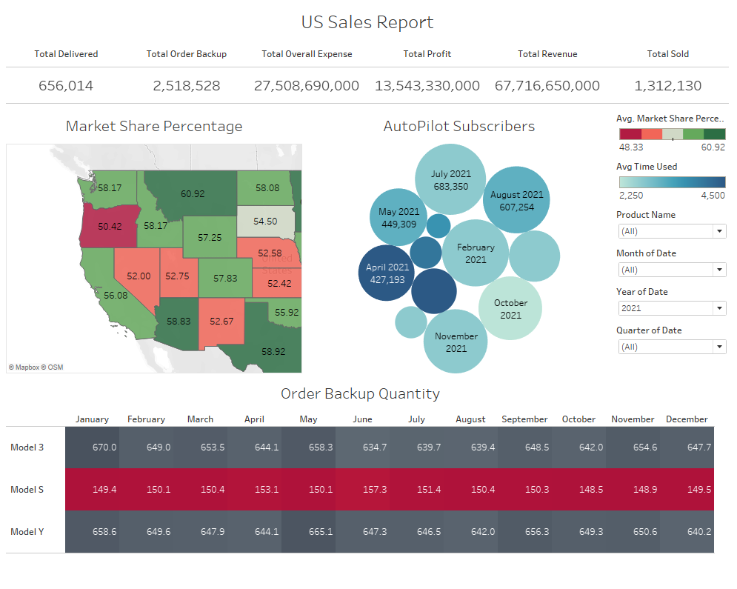

Slide 15
