Slide 1


SIFT (Scale Invariant Feature Transform)
학부과정 : 권혁민
지도교수 : 김성호 교수님
영남대 전자공학과
Advanced Visual Intelligence LAB

Slide 2
Index
scale space
DOG(Difference Of Gaussian)
Find keypoints
Keypoint localization
Assign Orientation
Output

Slide 3
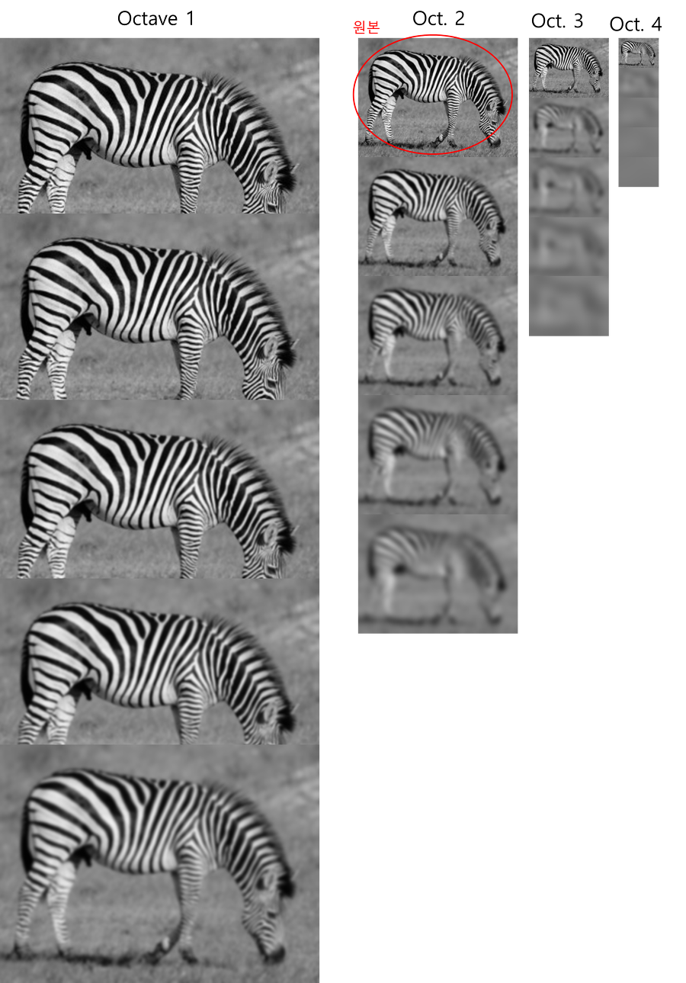


Scale Space
SIFT’s property 1 : scale invariant

Slide 4

L is blurred image
G is Gaussian filter
I is Input Image
is scale parameter
The bigger it is, the more blur it gets

Slide 5
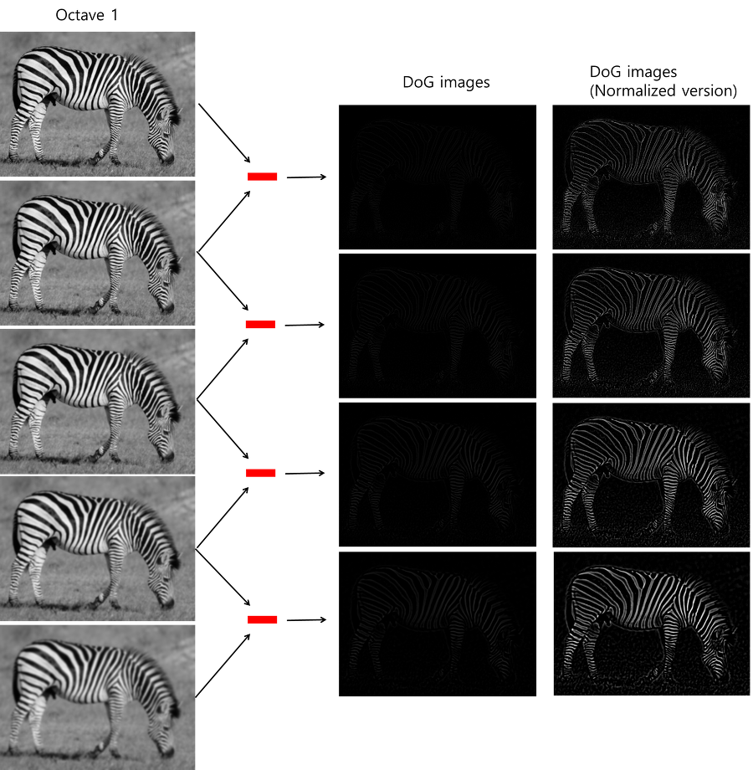
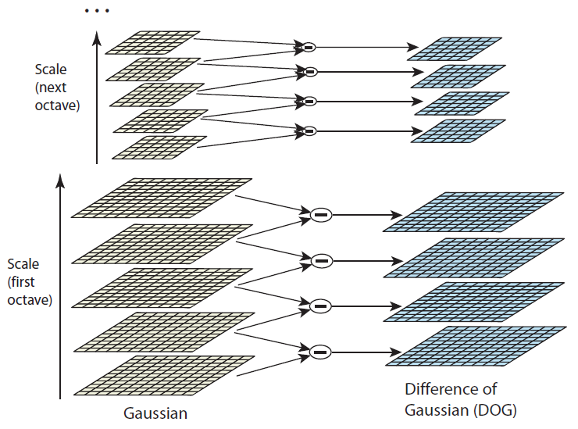

Slide 6
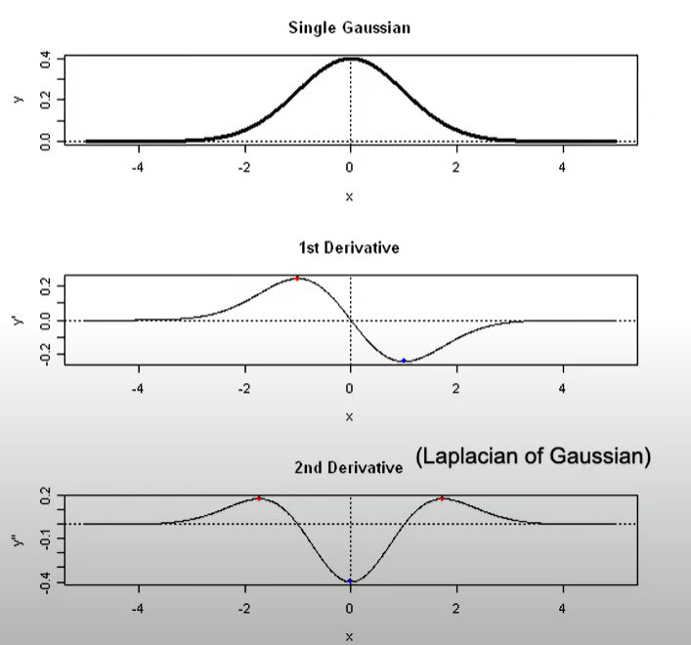
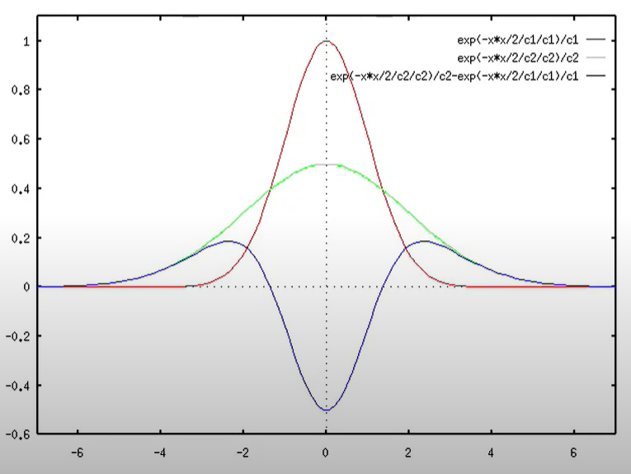

Slide 7
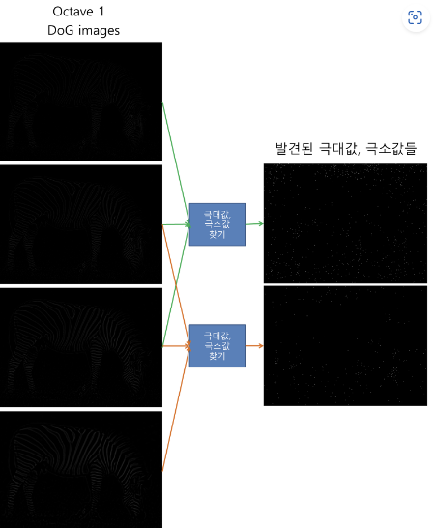
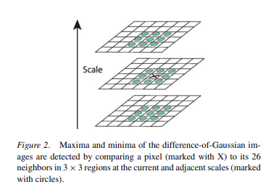


ds

Slide 8
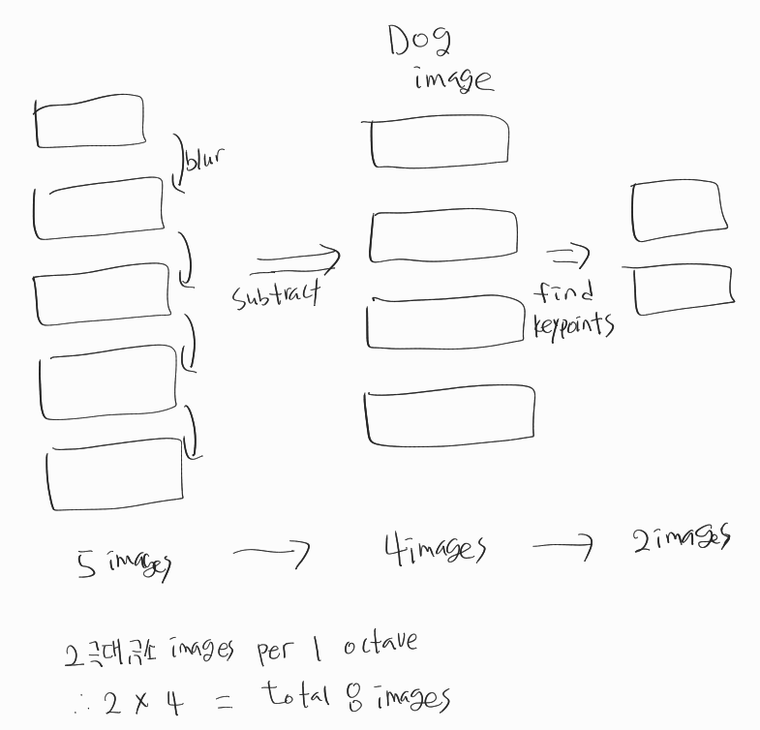

Slide 9
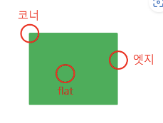
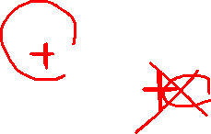
Keypoint localization (keypoint selection post- processing)
There are two methods to eliminate keypoints that are not valuable
Remove pixels whose brightness ratio is lower than the threshold
Remove extremum value on the edge,
recognize only on the corner as keypoints
- To prevent that DOG mistakenly recognize noise as an edge when DOG finds an edge
- If the change is small in the vertical direction and the change is large in the horizontal direction, it is the ‘edge’.
- If there is a big change in both vertical and horizontal directions, it is a ‘corner’
so after this work, we can get only corner keypoints , not edge.

Slide 10

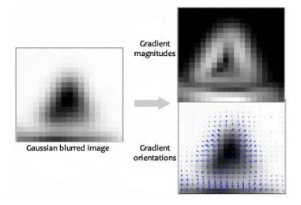
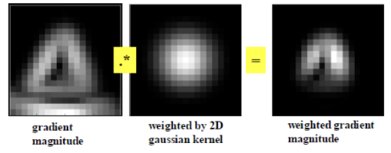
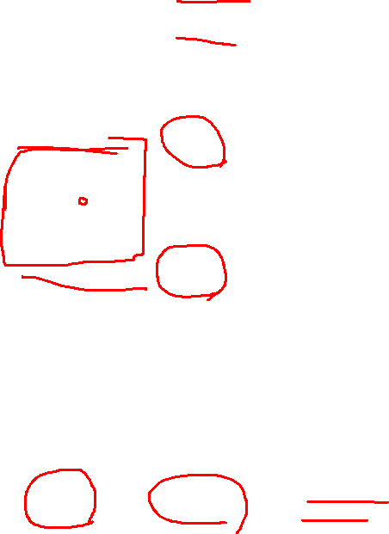
Assign Orientation
Hold 16*16 pixels window around the keypoint and do Gaussian blurring
And Find the magnitude and orientation of the gradient of all pixels using the above formulas
Convolution between gradient magnitude and weighted Gaussian kernel
And Find weighted gradient magnitude

Slide 11
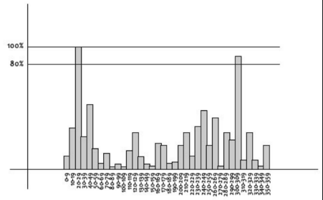
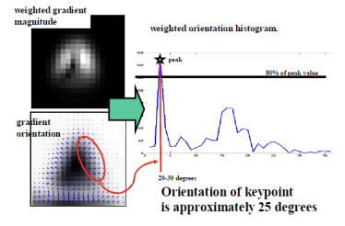
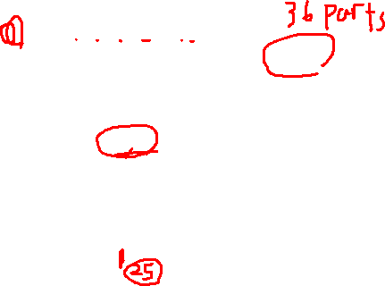
Assign Orientation
Divide the degree by 0 ~ 9,10 ~ 19, ..., 350 ~ 359
And find the histogram of the gradient magnitude for each degree
The orientation with the highest percentage is assigned to the orientation of the keypoint

Slide 12
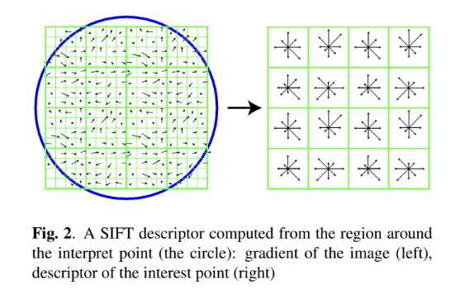
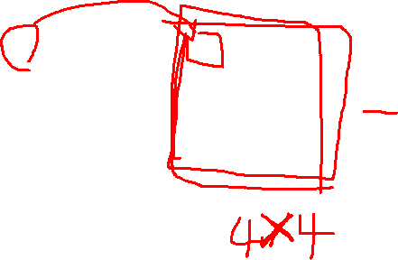
SIFT’s property 2 : rotate invariant
Keypoint Descriptor
Extraction
For being invariant to rotation
Make 16 windows and Divide the degree by 0 ~ 44,45 ~ 89, ..., 320 ~ 359 (make total 8 parts)
so we can get 8*16=128 - dim vector(this is SIFT descriptor)
And Subtract the orientation of the keypoint from each gradient orientation
Then, the orientation of the 16 windows are relative to the keypoint orientation
Finally, if we match two images, The matching position is where the difference between the descriptors of the two images is the smallest

Slide 13
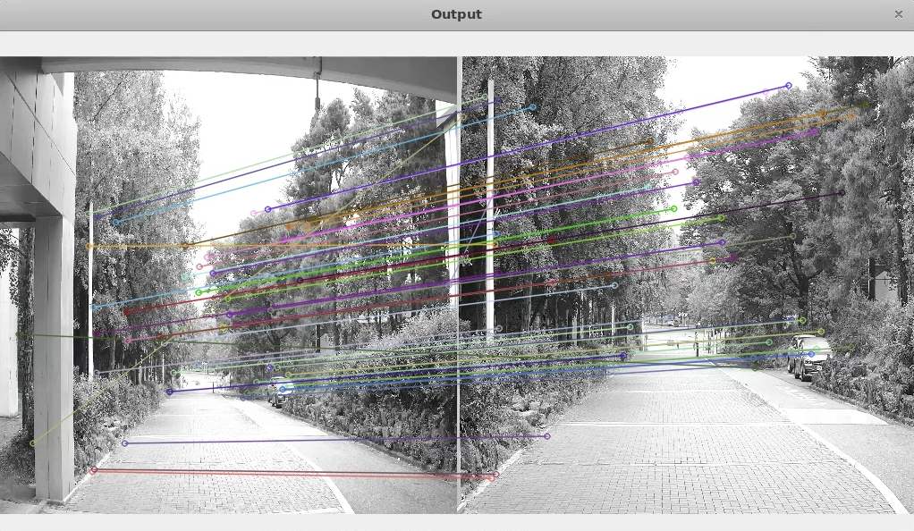
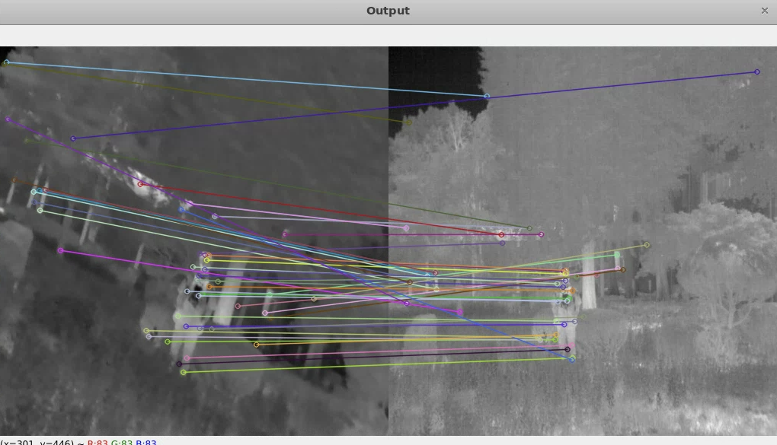
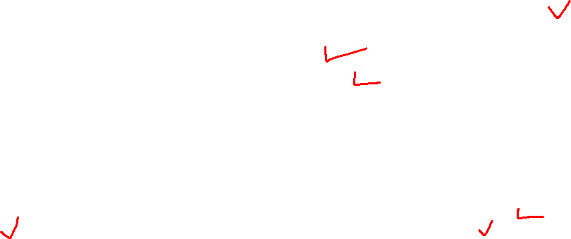

Slide 14

Thank you

