Slide 1
Presentation on Graphs Leetcode 207: Course Schedule
INFO 6205: Program Structures & Algorithms
Fall 2024
Presented by Rishabh Kaushick

Slide 2
Problem Statement
Leetcode 207: Course Schedule
Stats:
Difficulty: Medium
Accepted: 1.8M
Submissions: 3.8M
Acceptance Rate: 47.8%

Slide 3
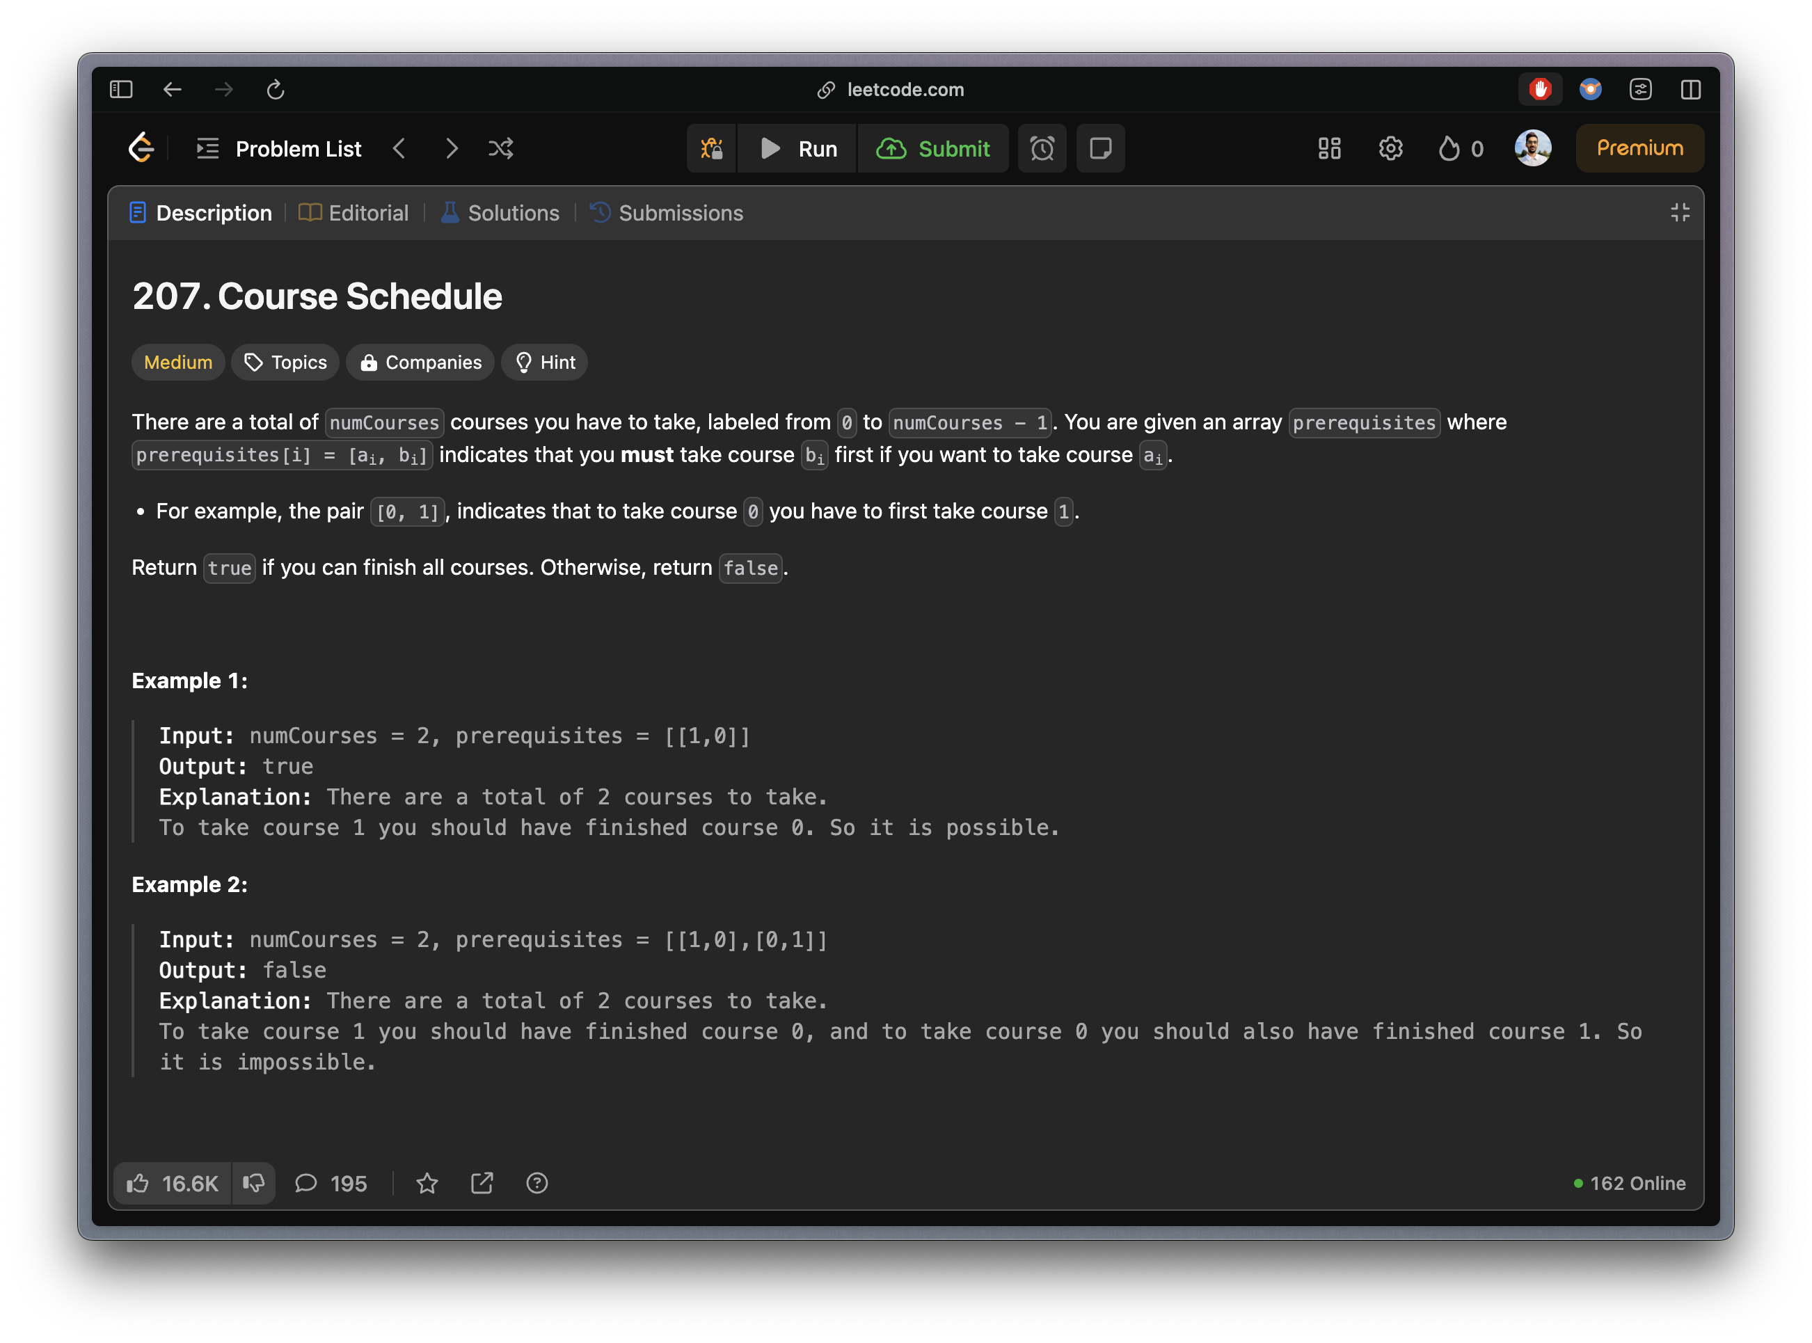
Problem Statement
Inputs:
numCourses: int
prerequisites: List[List]
Output:
Boolean: If the courses can be finished, return True. Otherwise return False.

Slide 4
Problem Statement
Constraints:
1 <= numCourses <= 2000
0 <= prerequisites.length <= 5000
prerequisites[i].length == 2
0 <= ai, bi < numCourses
All the pairs of prerequisites[i] are unique.

Slide 5
Problem Statement
Example #1 (Provided)
Input: numCourses = 2, prerequisites = [[1,0]]
Output: true
Explanation: There are a total of 2 courses to take. To take course 1 you should have finished course 0. So, it is possible.

Slide 6
Problem Statement
Example #2 (Provided)
Input: numCourses = 2, prerequisites = [[1,0],[0,1]]
Output: false
Explanation: There are a total of 2 courses to take. To take course 1 you should have finished course 0, and to take course 0 you should also have finished course 1. So, it is impossible.

Slide 7
Problem Statement
Example #3
Input: numCourses = 3, prerequisites = [[2,0], [2,1], [1,2]]
Output: false
Explanation: There are a total of 3 courses to take. To take course 2, we should have finished course 0 and course 1, and to finish course 1 we must have finished course 2. So, it is impossible.

Slide 8
Problem Statement
Example #4
Input: numCourses = 4, prerequisites = [[1,0], [2, 0], [3, 1], [3, 2]]
Output: true
Explanation: There are 4 courses to take. We must take course 0 before taking course 1 or 2; course 1 before taking course 3; and course 2 before taking course 3. So, it is possible.

Slide 9
Problem Statement
Example #5 (Edge Case)
Input: numCourses = 2, prerequisites = []
Output: true
Explanation: There are 2 courses to take and there are no prerequisites. So, it is possible.

Slide 10
Insights
When there is a cycle, it means it is impossible to complete all the courses.
1
0
1
2
0
2
3
Not Possible
Possible

Slide 11
Approach #1: DFS to Detect Cycle
Pseudo code:
Step 1: Create the graph – using Adjacency List
Step 2: Create a recursive DFS function:
Use a recursive stack (currently being visited) and visited set.
Set the exit conditions:
If a node which is in the recursive stack comes up again → Cycle:
return False
If a node is already visited: it is safe:
return True
Add the node to the recursive stack
For each neighbor of the node call the DFS function:
If any of them return False – then exit & return False
If none of them return False, then we can:
remove the node from the recursive stack
add the node to the visited set
return True
Time Complexity: O (V+E)
Space Complexity: O (V+E)

Slide 12
Approach #2: Topological Sort to Detect Cycle
Pseudo code:
Step 1: Create the graph – using Adjacency List
Step 2: Calculate the in-degree of each course
Step 3: Use queue to add the nodes which have in-degree 0
Step 4: Perform Topological Sort
While the queue is not empty
Remove the first item from the queue
Decrement the in-degree of its neighbors
If a neighbor’s in-degree becomes 0, add it to the queue
After processing all the courses, if the count is less than the number of courses, it means there is a cycle.
Time Complexity: O (V+E)
Space Complexity: O (V+E)

Slide 13
Let’s Code

