Slide 1
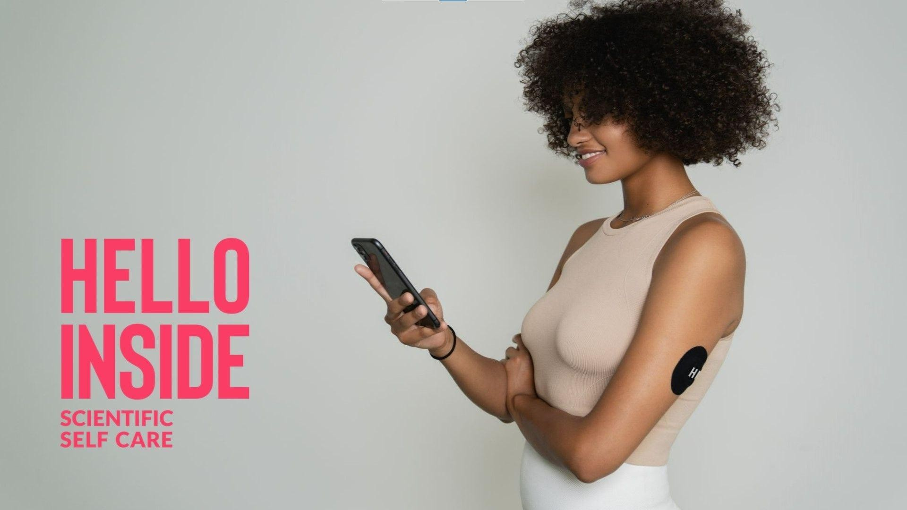

Slide 2
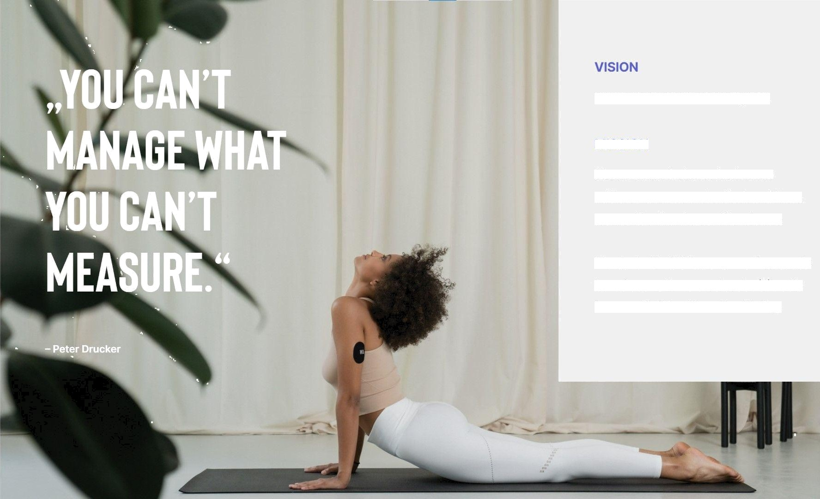
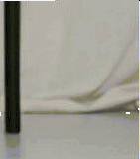
Scientific Self Care For Everyone.
MISSION
We are on a mission to lead a new
self care movement that is data-driven, personalisecl and rooted in science.
We start with CGMs, empowering people to make smarter every day decisions to increase their bealtb and wellbeing.

Slide 3





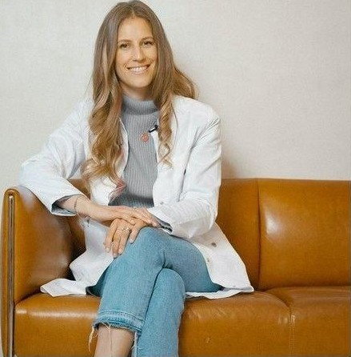
Dr. Med. ANNE LATZ, M.Sc.
Medical Nutrition
Formerly Chief Medical Officer alley.de& advisor for the German Ministry of Health
Experience in patient care, private and public healthcare sector
Medical Doctor, Nutritionist and Diplomate in Lifestyle Medicine M.Sc. Business, Doctorate in Neuroscience
Postgraduate Certificate Harvard Medical School
Author of several ai-ticles on Healthcare Innovation & Digital Doctors
Fodcast Host for HELLO INSIDE
Vordenker Award BCG & Handelsblatt 2021
"Working with my patients I realised: We lost touch with our body and its signals. Are overwhelmed and exhausted by too many choices, trends and 'getting it right’. Technology and personalised data are the key to bring us back the sense, literacy and intelligence for ourselves. Understanding ourselves is our human superpower.”
C ENT FDC SELF CARE

Slide 4











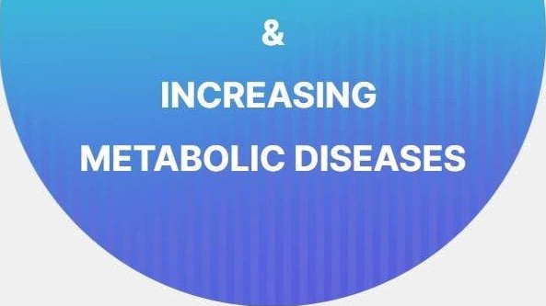
P R O B L E M
METABOLIC HEALTH CRISIS
In Europe, 1.1 million heaths were attributable to dietary risks due to unhealthy diets or low physical activity (in 2017). More than 50% of the population suffer from obesity or are overweight, with steadily increasing numbers.
”
ESCALATING HEALTHCARE
COSTS
75% of all healthcare costs (€700 billion) are currently spent on chronic cliseases within the EU.
C ENT FDC SELF CARE

Slide 5











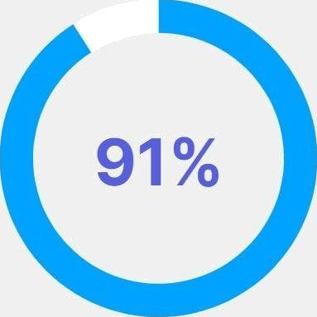
M E T A B O LI C
H E A L T H
(PRE-) DIABETIC / OVERWEIGHT
A recent study showed a staggering 91% of Covid-19 intensive care patients to be (pre)diabetic and/or overweight!
C ENT FDC SELF CARE
Source: httpmsm: www
h gap
c a icle PMC7
4 252

Slide 6







Several genetic variants have been identifiecl that are associated with an increased risk of metabolic diseases.
Intestinal bacteria can have an impact on weight gain, as well as important health markers like blood glucose, cholesterol, triglyceride levels, and even the brain.
DIET
The amount of macronutrients (sucb
as fibers, fat, carbohyclrates) as well as micronutrients alters our microbiota composition and immune system function.
LIFESTYLE
Our lifestyle (activity, exercise, stress, sleep, etc.) heavily influences our metabolic healtb by altering microbiome, epigenetics, etc.

Slide 7







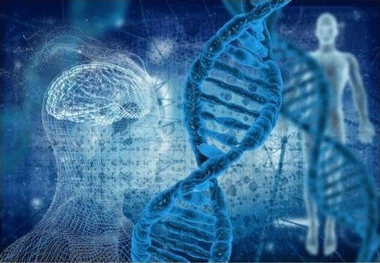



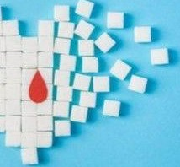
W H Y P E O P L E A R E S T R U G G L I H G
ONE SIZE DOESN'T FIT ALL
NO ENOAGEMENT
MISSINO PREVENTION
Nutrition is a crowded and complex space. We are all individuals.
Optimal nutrition is personal.
Long and passive feedback loops. Lack of actionable, personalized guidance.
Current market solutions are reactive systems. No preventative measures or products available.
C ENT FDC SELF CARE

Slide 8







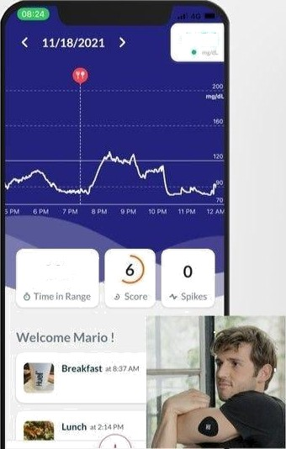
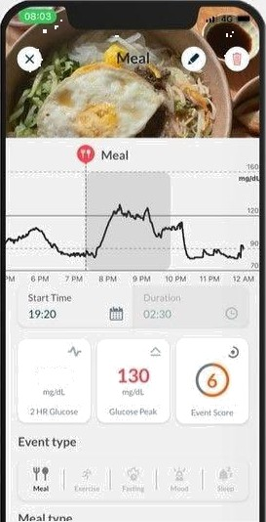
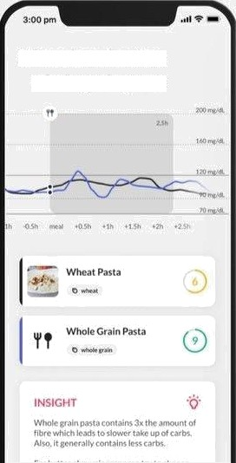
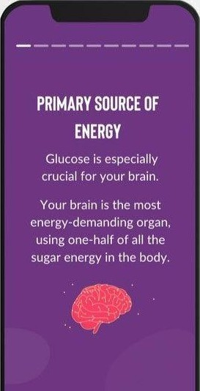

G O T O M A R K E T P R O D U C T
APP, SENSORS, PATCH
ANALYTICS
EXPERIMENTS
LESSONS
Hello Inside Mobile App with CGM (continuous glucose management) Sensors and Hello Inside security patch.
Hello Inside food and activity analytics, for personalized insights and actionable recommendations.
Collection of guided biobacking experiments to understand which foods and activities work best for your body.
Bite-sized knowledge hacks to help you interpret your data, understand your biological processes and increase health.
‹ Regular wheat vs. whole grain pasta
89
110

Slide 9




W H Y N O W
QUAN ED SELF MOVEMENT
real-time
Iziofeeclzack
cleclining se ssor costs & hai"iiei“s to technology aclo/ztion
next generation of wea abtes
FOOD REVOLUTİON
plant-based
healthy &
convenient
personalized
C ENT FDC SELF CARE

Slide 10




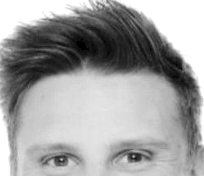
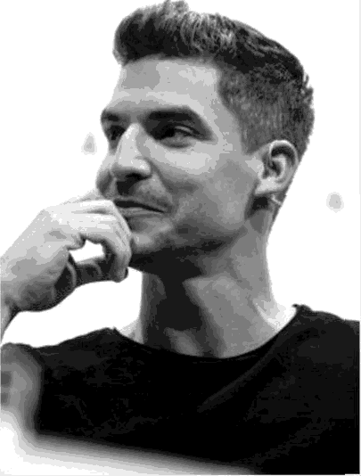
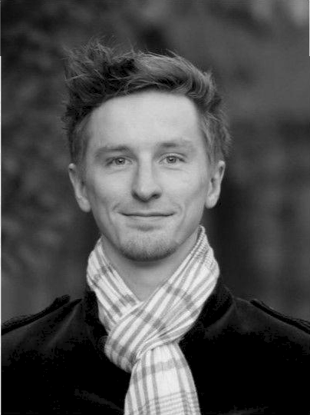

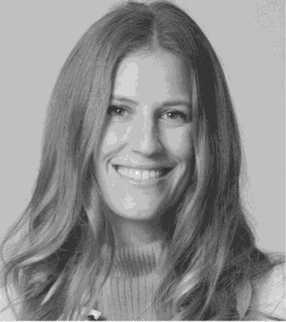
ANNE LATZ, M.D.
Medical & Nutrition
formerly Chief Medical Officer alley.de Nutritionist, Medical Doctor, M.Sc.
Business, Vordenker Award 2021
VINZENZ WEBER
Technology
formerly CTO Díagnosía.com
MARIO AICHLSEDER
Product, Growth, Strategy
JÜRGREN FURIAN
Brand, Comms, Operations
Co-Founder Pioneers.io
formerly VP of Growth & VP Strategy/ Innovation adidas Runtastic
C ENT FDC SELF CARE

Slide 11





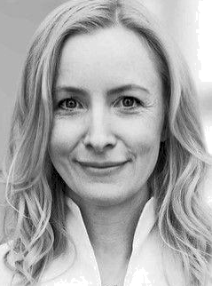
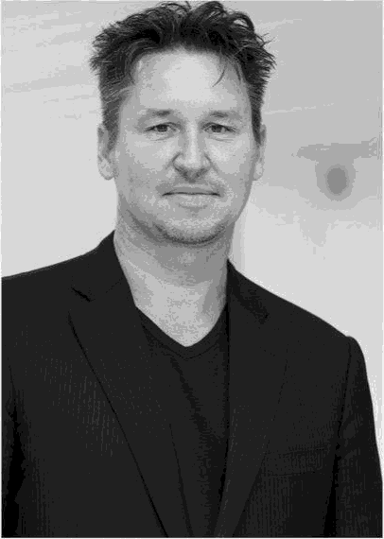
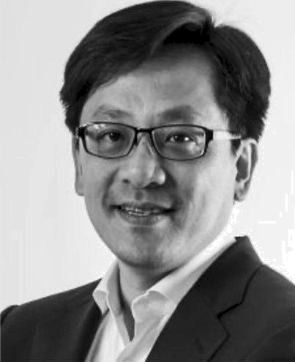
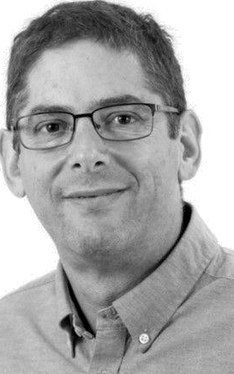
PROF. DR. ERAN ELINAV
Weizmann Institute, Israel Author: The Personalised Diet
BEN HWANG, PH.D.
CEO Profusa, USA
Next generation BioSensors
DR. MED. ANNE FLECK
Docfleck.com, Germany
TV Personality & Functional Medicine
PROF. STEPHAN HERZIG
Helmholtz Center Munich, Germany Director Institute for Diabetes and Cancer
C ENT FDC SELF CARE

Slide 12


