Slide 1
Digital Portfolio
Student Portfolio : Kaviyarasu. R
Reg NO: 24132061802521035
NMID : ID: 20624132061802521035
Department : BSC Computer Science
College : Thiru A Govindasamy Goverment Arts College, Annamalai University
Tindivanam.

Slide 2
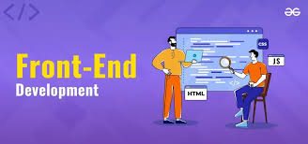
Project Portfolio
Creative Student Portfolio using FWD

Slide 3

AGENDA
Problem solving
Project Overview
End Users
Tools and Technolgics
Portfolio design and Layout
Features and Functionality
Results and Screenshots
Conclusion
Github link

Slide 4

Problem Statement
"As a student, I wanted to showcase my projects and skills to potential employers and academic institutions. However, I faced challenges in creating a professional online presence that effectively communicated my experiences and accomplishments. I needed a platform that would allow me to easily showcase my projects, skills, and achievements in a clear and concise manner."Solution:"I designed and developed a student portfolio website that highlights my projects, skills, and experiences. The website provides a clean and intuitive interface for visitors to explore my work and learn more about my capabilities."Feel free to customize it to fit your specific needs and goals!

Slide 5
Project Overview
This project allowed me to develop and showcase my skills in HTML , CSS, JAVASCRIPT. Through this project, I gained valuable experience in Frontend web development, Learn My Knowlede in web Development .

Slide 6

Tools and Techniques
Tools
HTML – Pages , Sections .
CSS – Layout , Colors , Fonts.
JAVA SCRIPT – Interactive Navigation, Forms.
VISUAL CODE - Implementation code editor , Github .

Slide 7
PORTFOLIO DESING AND LAYOUT
Section:
This section lists the main components of a portfolio design and layout.
Home , Projects , Skills , Contact
Mobile/Desktop/Tablet:
This section likely refers to the different devices or platforms on which the portfolio will be viewed.
Detailed explanation: This section is empty, suggesting that it is intended for additional information or notes about the portfolio design and layout.

Slide 8
FEATURES AND FUNCTIONALITY
Project Showcase:
A section where you can showcase your projects, including images, descriptions, and links to live projects or code repositories.
Skills and Expertise:
A section where you can list your skills and areas of expertise, including programming languages, tools, and technologies
About Me:
A section where you can provide a brief bio, including your background, interests, and career goals.
Contact Information:
A section where you can provide your contact information, including email address, phone number, and social media links.

Slide 9
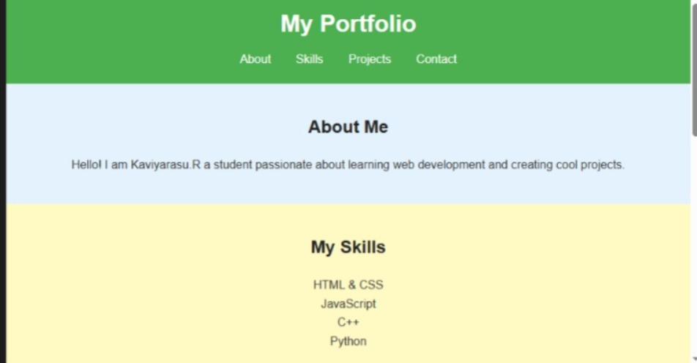
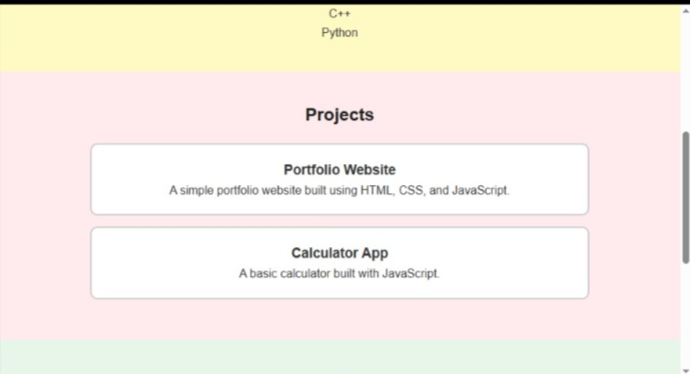
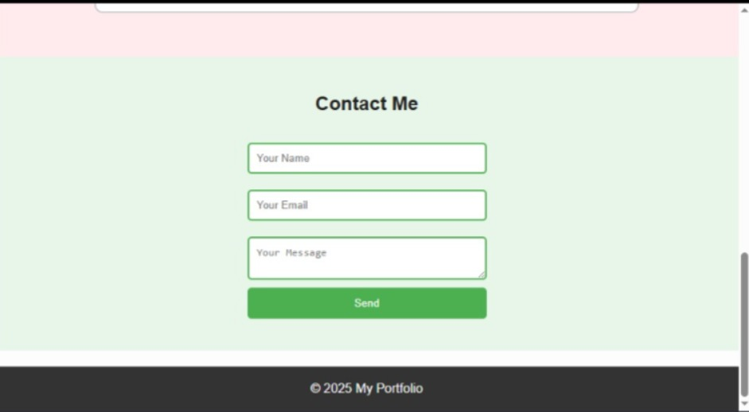
RESULTS AND SCREENSHOTS

Slide 10
CONCLUSION
Easy to share with recruiters.
It makes online presence.
"Thank you for visiting my portfolio! I'm excited to showcase my projects, skills, and experiences as a student. I'm constantly learning and growing, and I'm looking forward to exploring new opportunities and challenges. Feel free to reach out to me if you'd like to collaborate, provide feedback, or learn more about my work. Let's connect and create something amazing together!

Slide 11
Github Link
https://github.com/rkaviyarasu112007-droid/kaviyarasu.git

