Slide 1


GENESIS
IDEATHON
TEAM & DOMAIN
  Team Name – INNOV4
  Team Members – Danushree K S - CB.SC.U4CSE26313
  Nibashini V G - CB.SC.U4CSE26363
Kavyashree Rupesh - CB.SC.U4CSE26325
Shamritha - CB.SC.U4CSE26354
  Selected Domain – 4. Climate action, water and environmental resilience
  Problem Statement – Climate-related disasters repeatedly damage homes, roads, public facilities and livelihoods, yet reconstruction often focuses on restoring what existed before rather than adapting communities to the risks they are increasingly likely to face. How can post-disaster reconstruction become more resilient to future climate conditions rather than simply replacing what was lost?

Slide 2

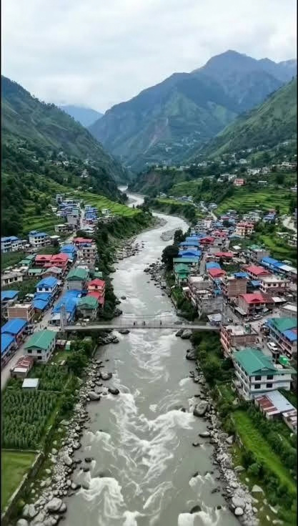
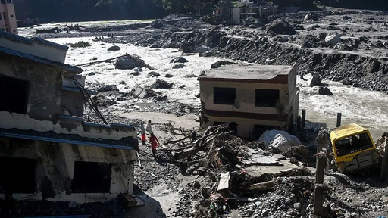
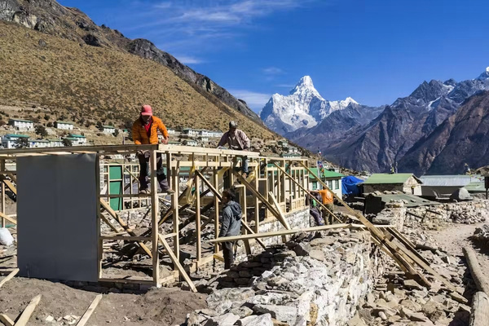

WHY DO WE REBUILD THE SAME WAY AFTER A DISASTER?
TEAM
INNOV4
A family. A home. A road. A community.
Floods. Landslides. Extreme weather.
The community starts again.
“They shouldn't have to rebuild the same home after every disaster.”
WHAT EXACTLY NEEDS TO BE SOLVED?
WHY IS IT IMPORTANT RIGHT NOW?
  After a disaster, communities often focus on restoring damaged homes and infrastructure as quickly as possible.
  The challenge is to make reconstruction consider the risks of future disasters — not just repair the damage from the last one.
  Communities are facing increasingly difficult climate-related risks, while rebuilding resources are limited.
  If we rebuild without adapting, the same people and infrastructure can remain vulnerable to the next disaster.
-DON'T JUST BUILD BACK. BUILD BETTER-
image source : generated by Gemini
Genesis Ideathon – Pre-Ideathon
2

Slide 3
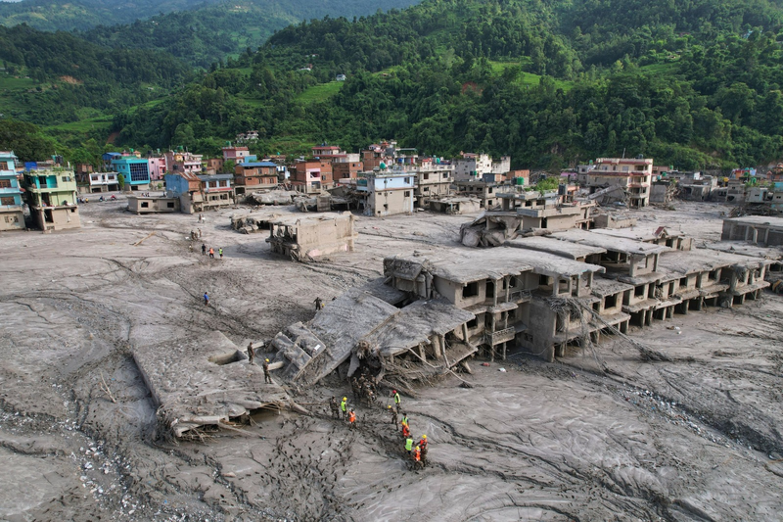
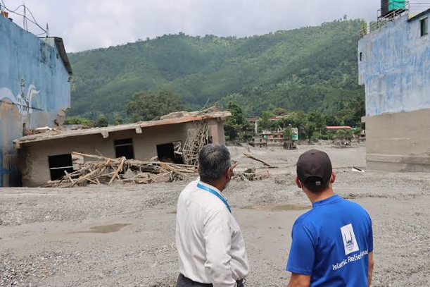
WHO IS AFFECTED?
TEAM
INNOV4
‘’Effective disaster recovery requires a balance between immediate restoration and long-term resilience.’’
  Government and local authorities: They are responsible for planning reconstruction, managing budgets and ensuring essential services are restored.
  Engineers and construction teams: They help repair damaged infrastructure and find ways to make roads and bridges safer against future disasters.
STAKEHOLDERS
TARGET USERS
  People living in disaster-prone areas: Families living in flood- and landslide-prone regions are directly affected when roads, bridges and other infrastructure are damaged.
  Daily commuters and local residents: People who depend on roads to reach schools, hospitals, workplaces and markets face difficulties when transport routes are disrupted.
Source:- https://islamic-relief.org/news/nepal-floods-your-questions-answered/
BENEFICIARIES
  Local communities: They benefit from safer infrastructure, fewer disruptions and better access to essential services.
  Farmers and small businesses: Reliable roads and bridges help them transport goods, reach markets and recover more easily after disasters.
Source:- https://islamic-relief.org/news/nepal-floods-your-questions-answered/
Genesis Ideathon – Pre-Ideathon Template
3

Slide 4
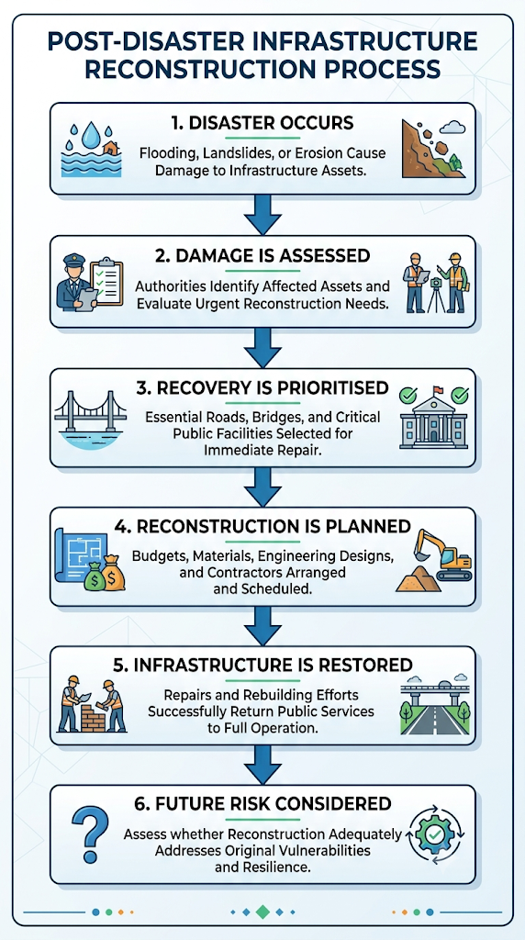
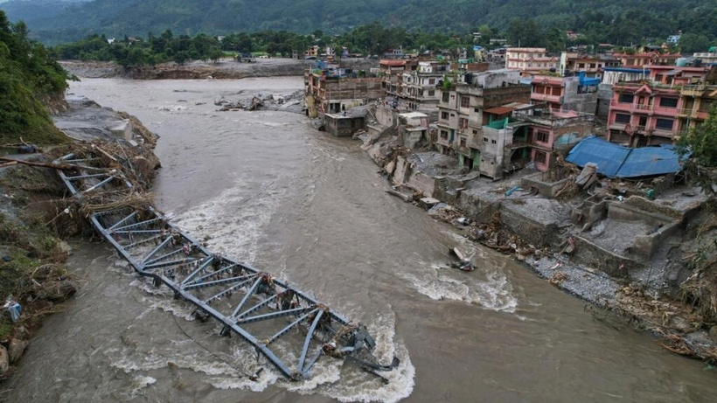
CURRENT SITUATION & CONTEXT
TEAM
INNOV4
EXISTING SCENARIO AND BACKGROUND
After a disaster, authorities and communities assess damage, restore essential access and arrange repairs or reconstruction. Under pressure to restore services quickly, immediate recovery needs may compete with longer-term resilience considerations.
source : https://www.france24.com/en/asia-pacific/20260829-nepal-tibet-floods-live-death-toll-passes-600-nearly-2-500-people-still-missing
RELEVANT CONTEXT
EVIDENCE TO COLLECT
Nepal's mountainous terrain, monsoon rainfall, river systems and landslide exposure make infrastructure resilience an important context for examining disaster recovery.
  Examples of infrastructure repeatedly damaged by hazards.
  Repair and reconstruction timelines, where documented.
  Whether hazard assessments and resilient design measures were incorporated into reconstruction.
image generated by gemini
Genesis Ideathon – Pre-Ideathon Template
4

Slide 5
KEY CHALLENGES
TEAM
INNOV4
ROOT CAUSES BEHIND THEM
CONSEQUENCES OF LEAVING THEM UNSOLVED
MAIN DIFFIICULTIES AND BOTTLENECKS
  Restoring Instead of Improving Reconstruction often focuses on bringing damaged infrastructure back to its previous condition. The opportunity to redesign it for future hazards may be overlooked.
  Gaps in Coordination and Learning Different agencies and stakeholders may be involved in disaster recovery. Lessons from previous failures are not always effectively transferred into future reconstruction decisions.
  After a disaster, roads, bridges and essential facilities need to be restored quickly. This urgency can reduce the time available for detailed planning and risk assessment.
  Limited Resources and Expertise Budget constraoge of skilled professionals and limited technicaL resources can make resilient reconstruction difficult. Immediate repairs may become the priority over better long-term alternatives.
  Uncertain Future ClimateRisk,Floods, landslides, erosion and changing weather patterns make future conditions difficult to predict. Infrastructure designed only for past conditions may not remain safe.
  Repeated Damage and Vulnerability:When underlying risks are not addressed, the same roads, bridges and facilities can remain exposed to similar hazards, leading to repeated damage and disruption.
  Growing Social and Economic Losses:Repeated reconstruction consumes public resources and can disrupt transportation, education, healthcare, businesses and local livelihoods for communities.
Genesis Ideathon – Pre-Ideathon Template
5

Slide 6
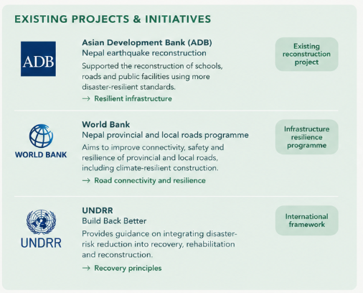
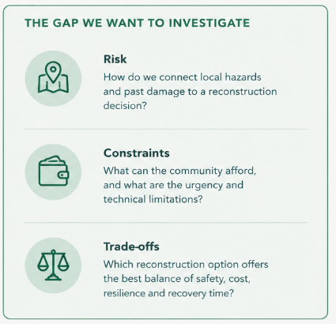
EXISTING SOLUTIONS AND RESEARCH GAPS
TEAM
INNOV4
From
principles to practical decisions
source:
ADB : https://www.adb.org/results/nepal-earthquake-rehabilitation-builds-back-better-infrastructure
world bank : https://www.worldbank.org/en/news/press-release/2024/11/21/nepal-government-world-bank-launch-us-128-million-project-to-improve-provincial-and-local-roads
UNDRR : https://www.undrr.org/publication/words-action-guidelines-build-back-better-recovery-rehabilitation-and-reconstruction
imaes generated by chatgpt
“Building on what already exists, we want to explore the next step - from resilience principles to practical, asset - level decisions”
Genesis Ideathon – Pre-Ideathon Template
6

Slide 7



PROBLEM INSIGHTS & OPPORTUNITY AREAS
TEAM
INNOV4
The right tools - the right technology - the right people - A stronger, safer tomorrow
HARDWARE REQUIREMENTS
Hardware
Requirements
Software
Requirements
SOFTWARE REQUIREMENTS
Development laptop / PC:
  A computer with adequate storage for coding, testing, mapping and data analysis.
Storage and backup:
  SSD storage and cloud backup to manage source code, maps, project files and disaster-related datasets.
Field data collection:
  A smartphone with GPS and a camera for recording locations and collecting observations, if field visits are undertaken.
  Python: Data processing and risk analysis
  SQL: Store infrastructure and damage data
  Streamlit: Build an interactive web app
  Colab / VS Code: Write and run code
  GitHub: Save and collaborate on code
  QGIS: Map hazards and vulnerable areas
  Streamlit Cloud: Host the demo app
DISASTER - RESILIENT
RECONSTRUCTION
Other Resources
OTHER RESOURCES
1. Software Development Team
  2–4 student members (coding, database, UI/UX, and research).
  Faculty mentor / software developer (guidance and testing).
2. Domain Experts (for real implementation)
  Civil / Structural Engineer – 1–2: Bridge structure, materials, and safety.
  Geotechnical Engineer – 1: Soil, foundations, and slope stability.
  Hydrologist / Hydraulic Engineer – 1: Water flow, flood levels, and drainage.
  Surveying & Construction Specialists – 1–2: Site surveys, planning, and execution.
  Environmental / Disaster-Risk Specialist – 1: Risk assessment and mitigation.
Genesis Ideathon – Pre-Ideathon Template
7

Slide 8
INITIAL DIRECTION & EXPECTED OUTCOME
TEAM
INNOV4
“Rebuild with the next disaster in the mind”
OUR PLAN
“Not just what we lost, but what could be safer”
EXPECTED OUTCOME
  INVESTIGATE
  2.COMPARE
  3.IDENTIFY AN
OPPORTUNITY
Examine existing reconstruction practics and compare them with approaches that account for future risks, costs and local constraints
  A clearer understanding of why infrastructure is damaged and how reconstruction decisions are made.
  Identification of gaps between immediate recovery and long-term resilience.
  A practical, evidence-informed proposal for considering resilience in future reconstruction decisions.
  Criteria to evaluate the proposal, such as safety, cost, durability, feasibility and community needs.
Study a real disaster case, identify what was damaged, and understand the factors influencing reconstruction
Develop a reasoned proposal for improving reconstruction decisions, supported by evidence from the selected case study
OUR BIG PICTURE
The goal is not merely to rebuild faster
It is to make every reconstruction decision an opportunity to reduce future vulnerability
Genesis Ideathon – Pre-Ideathon Template
8

