Slide 1

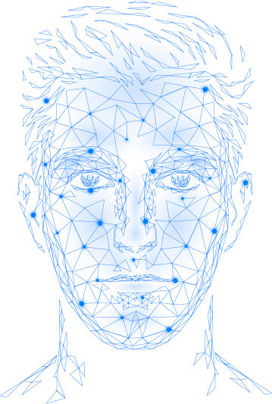
Welcome
To My
Presentation.

Slide 2

An Efficient Approach to Real-Time Face Recognition From Digital Images.
Presented by
.
Researcher
Md. Raihanul Kabir
Id- 1608347
Supervised By-
Co-supervised By-
A. S. M. Abu Saeed
Assistant Professor
Department of statistics
Rajib Dey, PhD
Associate Professor
Department of statistics
Hajee Mohammad Danesh Science & Technology University, Dinajpur-5200

Slide 3
Project Outline
Introduction
Literature Review
Preliminary Concept
Research Methodology
Analysis The Result
Conclusions
Future Context

Slide 4
Introduction
What is Face Recognition?
Stroke is a Neurological disease that occurs when the blood supply to brain is interrupted or reduce, depriving brain tissue of oxygen and nurturance.
State of Stroke in world and Bangladesh
Brain Stroke is the second leading cause of death in worldwide and third in Bangladesh.
What is Machine learning?
Machine learning is a branch of artificial intelligence and computer science which focuses on the use of data and algorithms to imitate the way that humans learn, gradually improving its accuracy.
Implementation of Machine Learning for classifying stroke
Machine learning has been implementing in health care in a wide range. Stroke is a critical health condition, so if we use advance machine learning algorithm then it will reduce the hardship of hundreds of thousands of stroke patient.

Slide 5
Objective
To develop a face recognition system.
To ensure the accuracy and reliability of the system.
To identify individuals based on their facial features.
Why this Project?
Stroke is one of the major health crisis of this present era. Stroke is very expensive to deal with. So, if we are able to develop such a environment which will help the health care officials to improve the quality of treatment.
We know that data is the fuel of 4th industrial revolution and we want to make the data useful for the betterment of our healthcare sector.

Slide 6




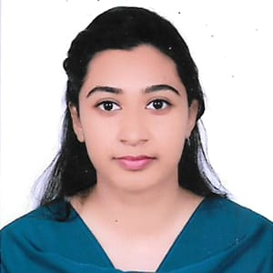


Data:
I have created a database of 400 face images of 40 students and Honourable Teachers in my department. Each of them has 10 images and all images are taken from their social media account.
Total Images : 40 x 10 = 400
Individuals : 40
Color Mode : RGB
Resolution : unknown

Slide 7
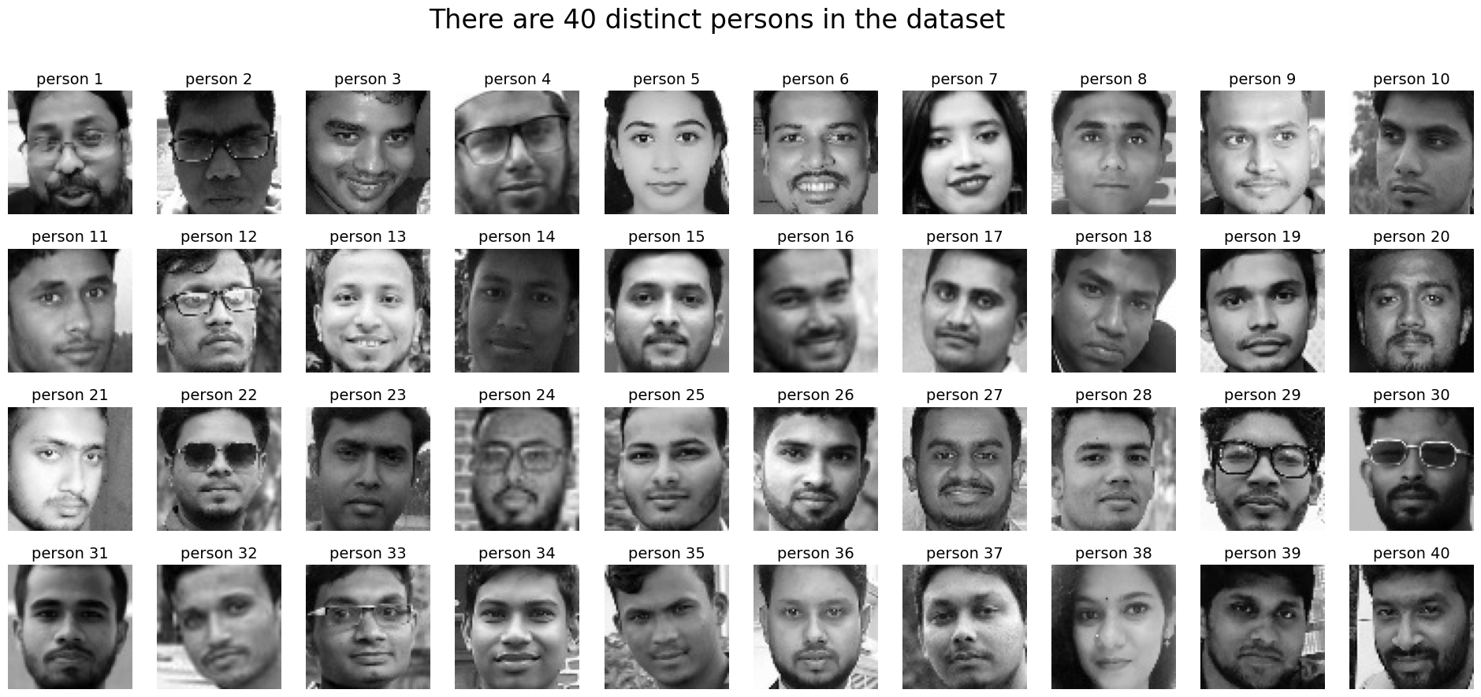
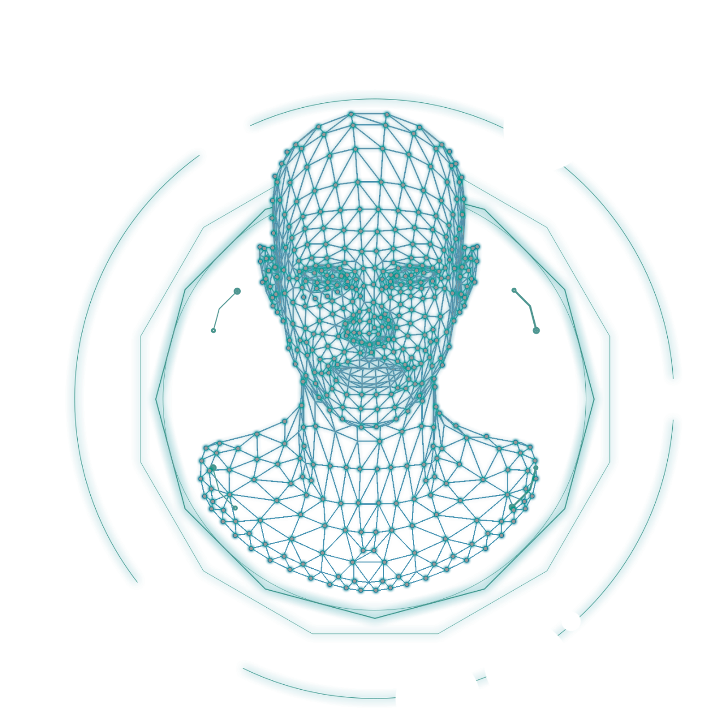
Data Processing and Dataset:
Here we converted and resized our data. The color mode is grayscale now and the size of each image are (64 x 64 ) px.

Slide 8
How Machine Learning Works:
Feature
Vectors
Machine
Learning
Algorithm
Training Data
Labels
Training Phase
Testing Phase
Feature
Vectors
New Data
Classification
Model
Classified
Labels

Slide 9
How the PCA works
Input Images
Convert the image into face vector
Flatteing the vector
Split of the vector into train and test test and standardise both set
Input the test unlabel image & set classifiers (SVM, KNN and more) and predict the outcome and compare the classifier.
Train on the train set vector acording to label.
Extract PCA component
Apply PCA on Both Train and Test

Slide 10
Model Building & Used Algorithm
Algorithms:
Logistic Regression
Support vector
Machine
Random Forest
K Nearest Neighbour
Naive Bayes
Here we used Anacoda3 For programming environment.
And some packages are: sklearn panda, numpy etcthe .
Splitting the data:
We split the data into training and test data.
Train the model:
Based on the train Data we train our model.
Here the Train data is 70% of the total data.
Test the model with the test data and classification:
We will test our model's validity with rest 30% test data and make our classification.

Slide 11
ACCURACY TABLE
Now let take a look on the table given below which will give as the accuracy at a glance .
We utilize different algorithm to get highest accuracy to exactness from our dataset.
 | METHOD | ACCURACY (%)
0 | Random Forest | 77.50
1 | KNN | 77.50
2 | SVM | 78.33
3 | Naive_Bayes | 78.33
4 | Logistic Regression | 80.83

Slide 12
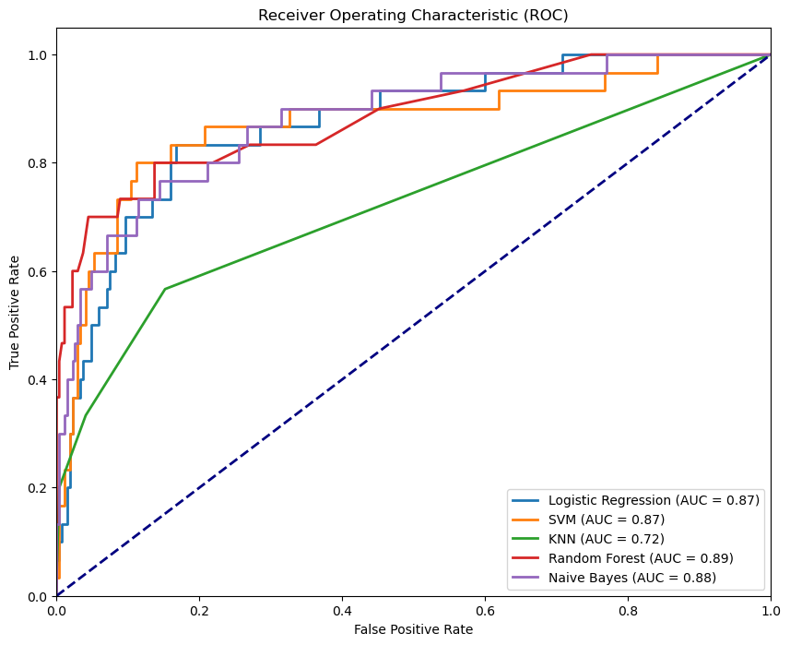
Receiver Operating Characteristic
The AUC is a popular metric used to evaluate the performance of binary classification models. It measures the degree of separability between the positive and negative classes.
The AUC value ranges from 0 to 1, with higher values indicating better performance.
So we can make a decision from that algorithm that, Random Forest has the highest discriminatory power among the models with AUC values of 0.89 .

Slide 13
CONCLUSION
The AUC (Area Under the Curve) values for the different models suggest that Random Forest and Naive Bayes have the highest discriminatory power among the models with AUC values of 0.89 and 0.88, respectively. Logistic regression and SVM also have high AUC values of 0.87, indicating that they may also be effective models. However, KNN has a lower AUC value of 0.72, which suggests that it may not be as effective as the other models in discriminating between classes.
FUTURE GOALS
For the purpose of this project we face a lots of odd and hazardous situation and learn a lot . Here we use secondary data for our project and our future target is to work with real world primary data that will be beneficial for our community and the family those have belonging with stroke .
Afterwards all of the odds our long term goal of this project to build an interactive IOT and Machine Learning based environment which will help to classify such acute health crisis like stroke in a short time . We know better data is the most significant tool for the purpose of any kind of classification in the edge of 4th industrial revolution. So we want to use machine learning algorithms for making more suitable and advance technique for classifying disease like stroke with the available data as accurately as possible .

Slide 14
Thank you.

