Slide 1
PYTHON CAPSTONE PROJECT
REGRESSION & CLASSIFICATION MODELS
By- Rashpinder Kaur chahal

Slide 2
DATASET DESCRIPTION
CLASSIFICATION

Slide 3
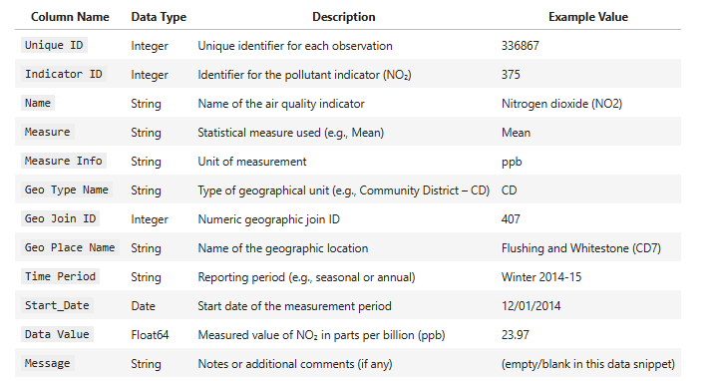

Slide 4
UNIVARIATE ANALYSIS
VISUALIZATION and descriptive statistics

Slide 5
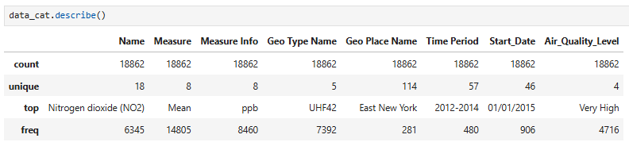

Slide 6
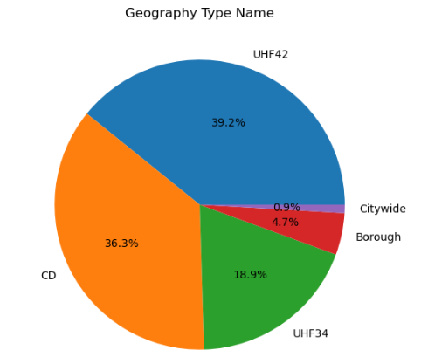

Slide 7
BIVARIATE ANALYSIS
Correlation – continuous vs continuous

Slide 8
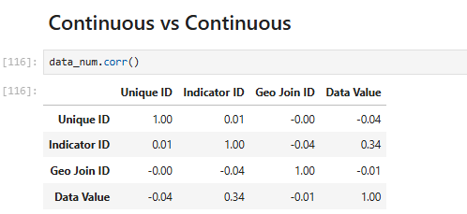

Slide 9
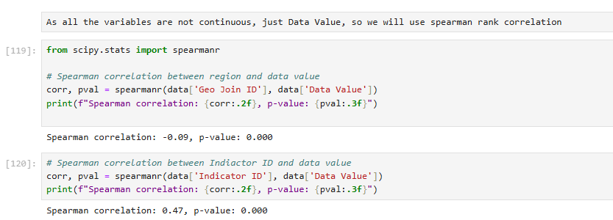

Slide 10
Model Comparison
visualization and model metrics

Slide 11
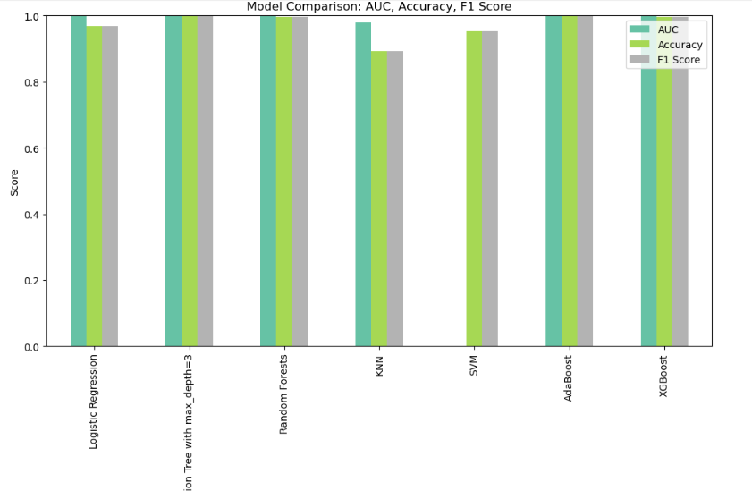

Slide 12
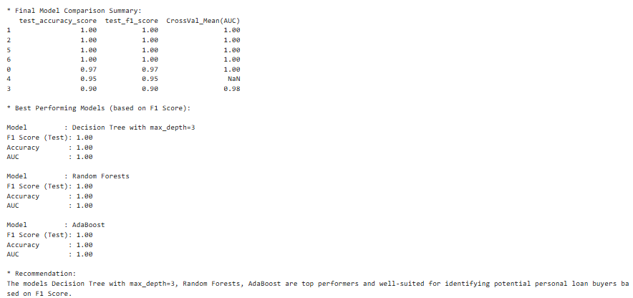

Slide 13
DATASET DESCRIPTION
REGRESSION MODEL

Slide 14
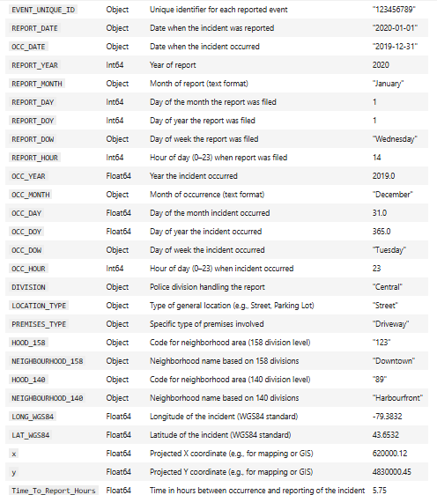

Slide 15
UNIVARIATE ANALYSIS
NUMERICAL VARIABLES

Slide 16
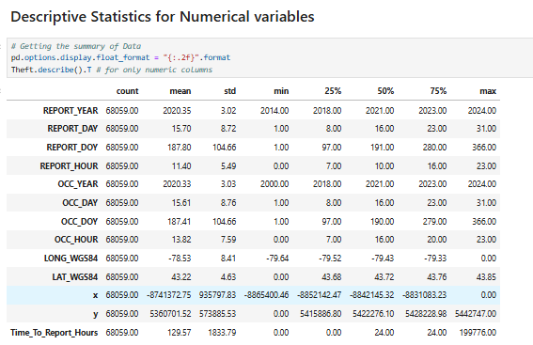

Slide 17
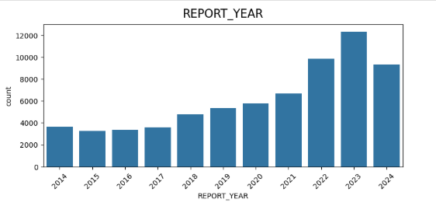

Slide 18
CHI-SQUARE
CONTINGENCY AND VISUALIZATION

Slide 19
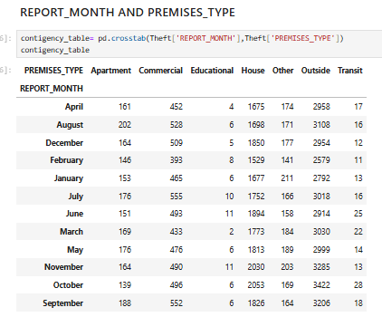

Slide 20
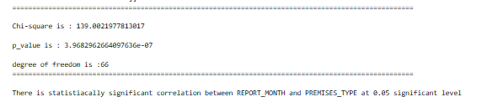

Slide 21
MODEL COMPARISON
VISUALIZATION AND MODEL METRICS

Slide 22
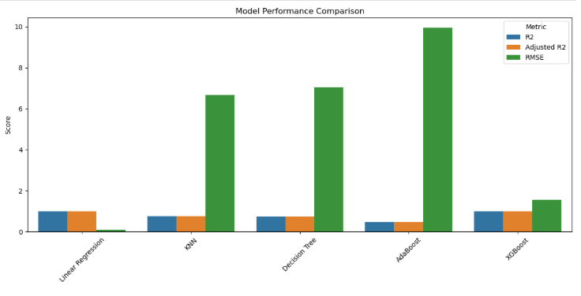

Slide 23
