Slide 1

Project By :
Rashpinder
Kaur

Slide 2
Objective
Customer Distribution and Deactivation Analyses
The data is CRM data of a wireless company for 2 years.
The wireless company would like to investigate the customer distribution and business behaviors, and then gain insightful understanding about the customers, to forecast the deactivation trends for the next 6 months.

Slide 3
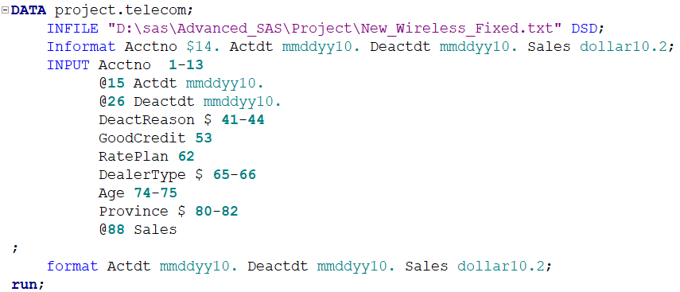
STEPS TAKEN TO LOAD DATA
Step A- Load Data Into SAS
Step B – Format the Dates
Step C – Using correct data types

Slide 4
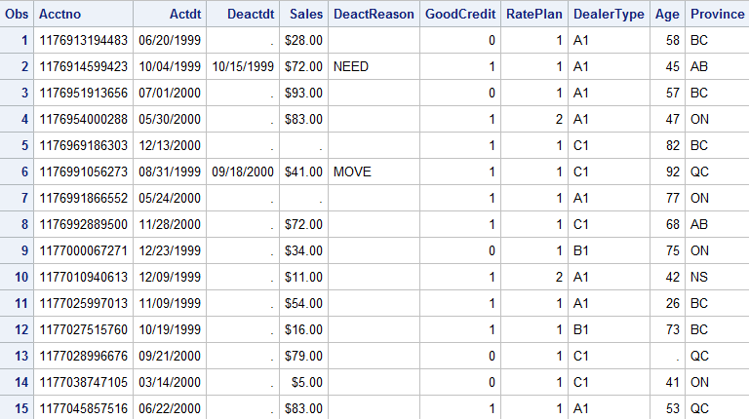
PRINTING DATASET

Slide 5
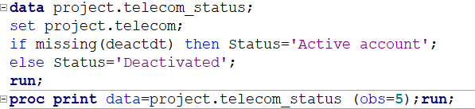
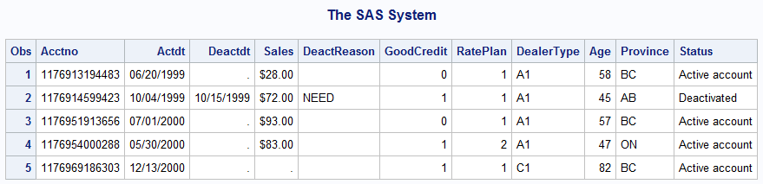
CHECKING ACTIVATION STATUS

Slide 6
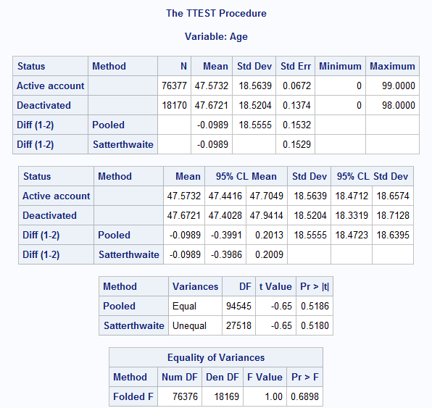
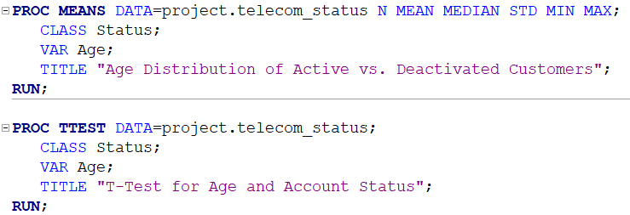
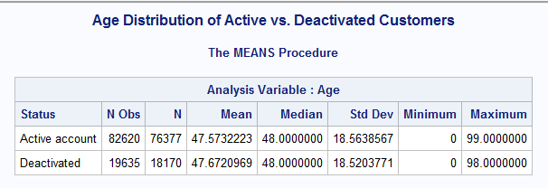
ASSOCIATION BETWEEN AGE & STATUS

Slide 7
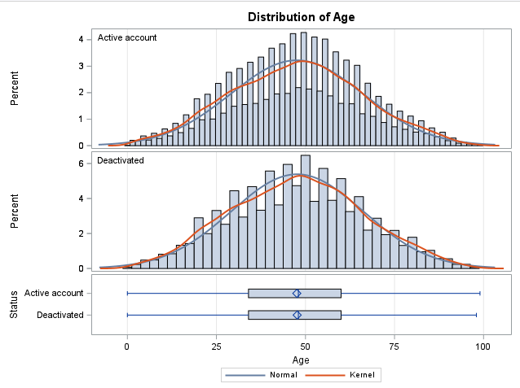
ASSOCIATION BETWEEN AGE & STATUS
There is no significant difference in the age distribution between active and deactivated customers.
The variances of age are similar for both groups.
Age does not seem to be a strong factor in account deactivation.
Since p > 0.05, the difference in age is not statistically significant.
Age does not appear to be significantly different between active and deactivated customers.

Slide 8

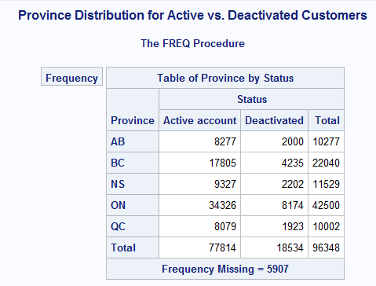
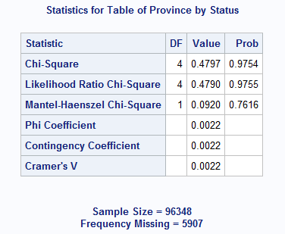
ASSOCIATION BETWEEN PROVINCE & STATUS
Since p > 0.05 in all tests,
Province and Account Status are NOT significantly associated.
This means the province a customer is from does not impact whether their account is
active or deactivated.

Slide 9
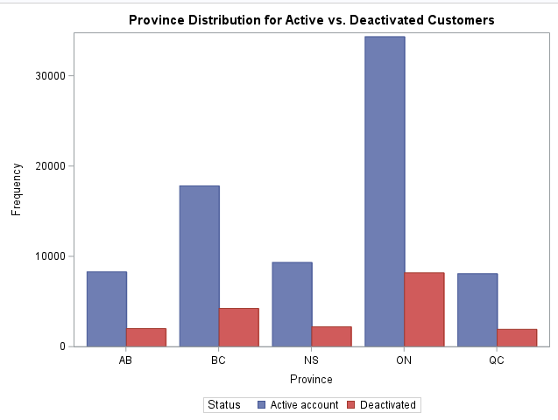
ASSOCIATION BETWEEN PROVINCE & STATUS
According to the given data, ONTARIO have maximum Active accounts.

Slide 10
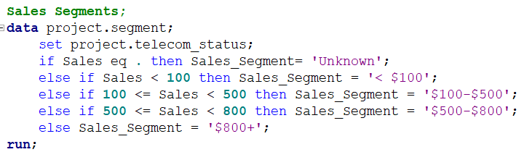
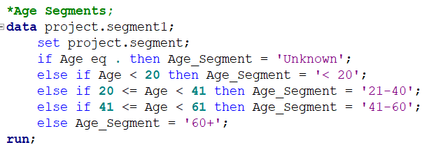
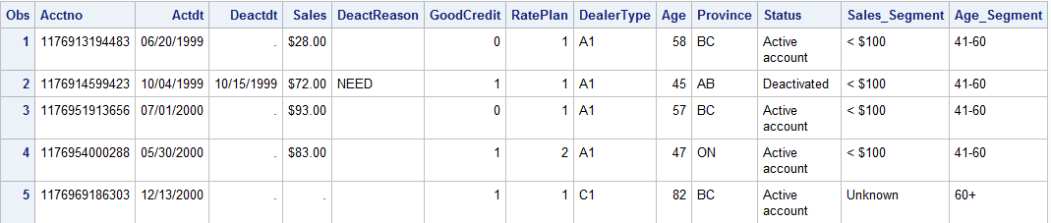
Segmentations

Slide 11
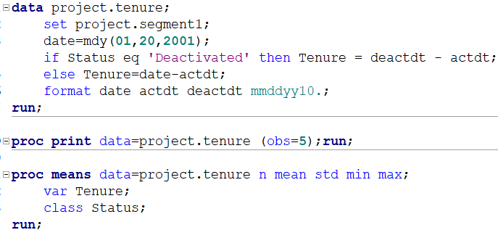
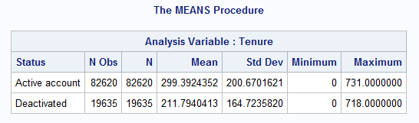
Q: Calculate the tenure in days for each account and give its simple statistics.
Date used here is
20 January 2001 because the earliest activation is
January 20, 1999 and the analysis dataset is for two years so the maximum limit of the date will range up to two
years from the earliest activated date.

Slide 12
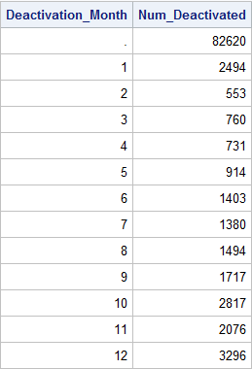
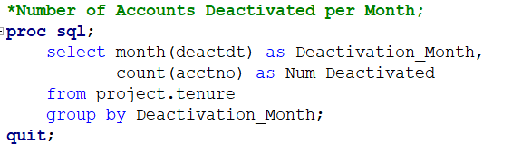
Q Calculate the number of accounts deactivated for each month.

Slide 13
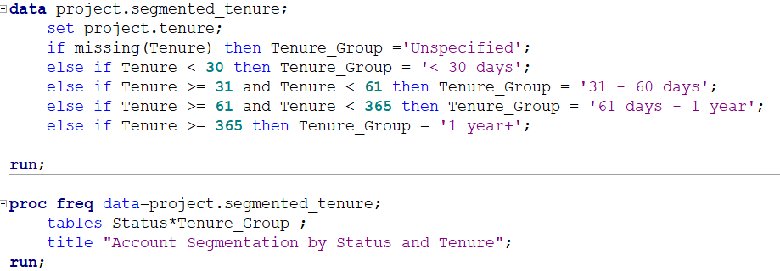
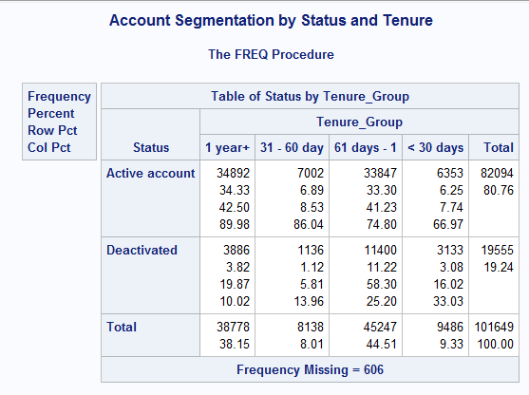
Q: Segment the account, first by account status “Active” and “Deactivated”, then by Tenure, Report the number of accounts of percent of all for each segment.

Slide 14
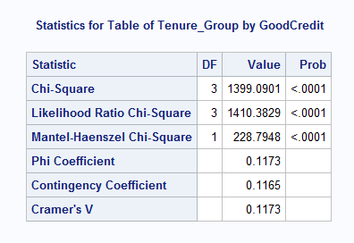
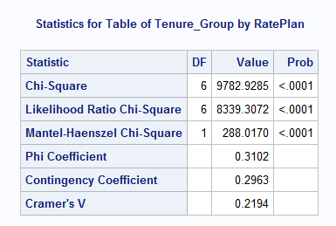
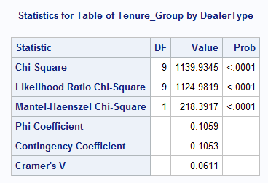
Q: Test the general association between the tenure segments and “Good Credit” , “Rate Plan ” and “Dealer Type.”
Reject the Null Hypothesis (H₀) – There is a significant association between the categorical variables in all of the above cases, p-values less than 0.005, so we reject null hypothesis and accept that there is significant association between:
Tenure_Group and GoodCredit
Tenure_Group and RatePlan
Tenure_Group and DealerType

Slide 15
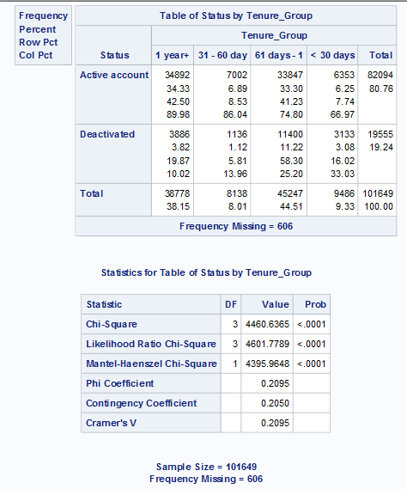

Q: ASSOCIATION BETWEEN STATUS AND TENURE
Conclusion:
Chi-Square Value (χ²) = 4460.6365
This is a very high chi-square value, suggesting a strong association between account status and tenure group.
p-value < 0.0001
Since p < 0.05, the null hypothesis (H₀) is rejected.
This means account status is significantly associated with tenure group.
There is a significant and moderate relationship between tenure and account status.

Slide 16
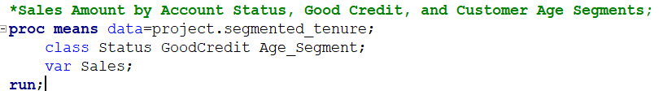
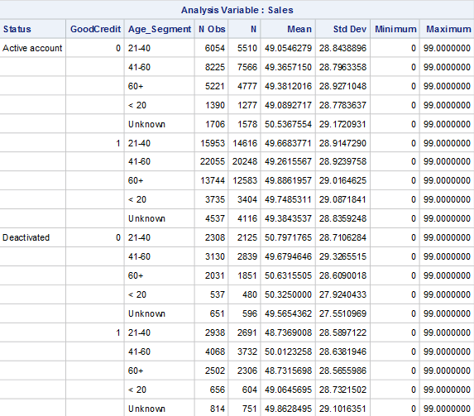
Q: Does the Sales amount differ among different account status, GoodCredit, and customer age segments?

Slide 17
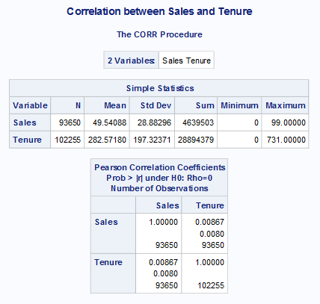
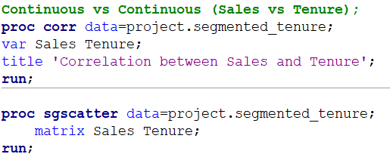
CORRELATION
The correlation coefficient (0.00867) is very close to zero.
The p-value (0.0080) is below 0.05, meaning the result is statistically significant, reject null hypothesis, there is relationship between Sales and Tenure.

Slide 18
Conclusion
Key Factors Affecting Activation & Deactivation
• Age & Province: There is no significant difference in activation/deactivation trends based on age or province. This suggests that external demographic factors do not play a major role in customer retention.
• Tenure: There is a strong association between tenure and account status. Customers with longer tenure are more likely to stay active, while newer accounts have a higher risk of deactivation.

