Slide 1
Data Processing and Analysis
Energy, GDP, and ScimEn Data
Author: Rashpinder Kaur Chahal

Slide 2
Overview of the TaskS
The task involves processing three distinct datasets:
Energy Indicators (Energy data from the United Nations)
World Bank GDP Data (GDP of countries from 1960 to 2015)
Sciamgo Journal Rankings (Ranking of countries in Energy Engineering and Power Technology)
Then, clean, merge, and analyze these datasets to derive insights regarding energy supply, GDP, and scientific contributions.

Slide 3
Task Breakdown: Reading and Cleaning Data
Load Energy Data.
Drop unnecessary columns.
Rename columns.
Convert Energy Supply to gigajoules.

Slide 4
Handle missing data.
(pd.to_numeric)
is a function from the pandas (pd) library that attempts to convert
data to a numeric type (like int or float). It can be applied to a pandas Series,a single column in a DataFrame.
The errors parameter controls what happens if the conversion encounters an issue. In this case, setting errors='coerce' means that if a value in the 'Energy Supply' column cannot be converted to a numeric type (e.g., it contains non-numeric characters), it will be replaced with NaN (Not a Number), which is used to represent missing or undefined values in pandas.

Slide 5
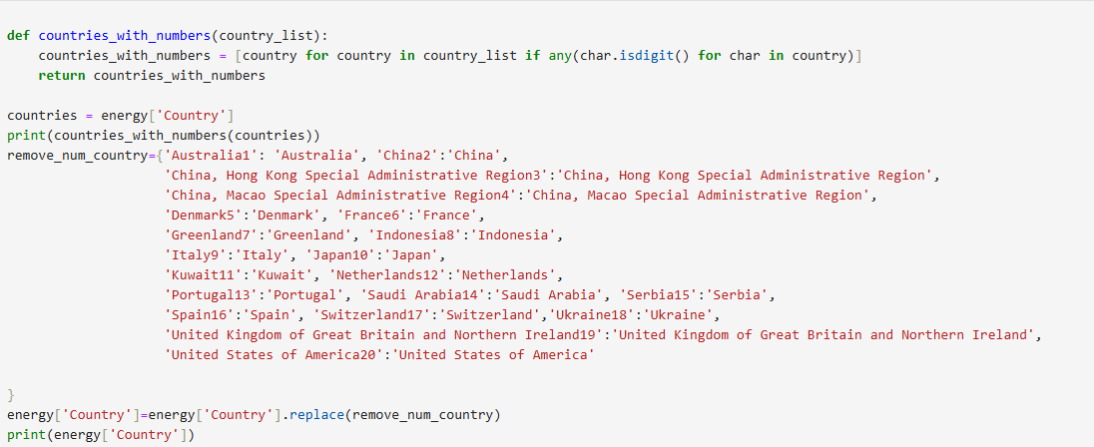
Cleaning the names of countries according to data merging requirement :
Removing the trailing numbers at the end of the countries
Renaming certain countries
Removing the parenthesis in name of countries

Slide 6
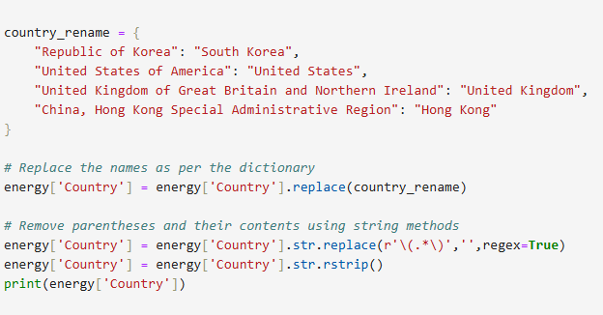

Slide 7
Task Breakdown: Reading and Cleaning Data
Load GDP Data:
Replacing some country names.
Load Sciamgo Journal Rankings:

Slide 8
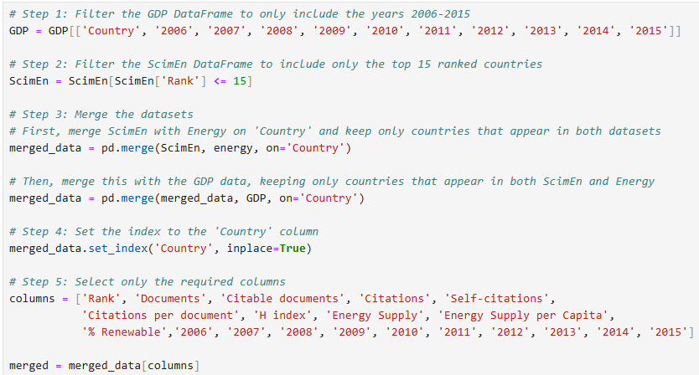
Task Breakdown: Merging Data
Merge Energy, GDP, and Sciamgo data: (using Country)

Slide 9
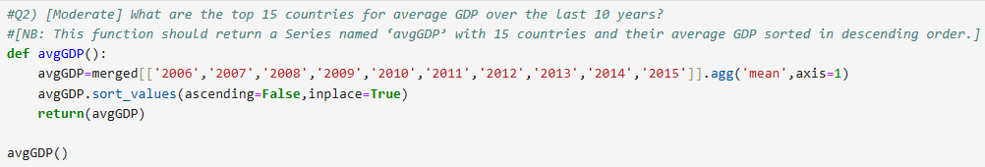
Key Tasks and Functions
Q2) Calculate Average GDP (2006-2015).

Slide 10
Calculating and sorting countries by their average GDP from 2006-2015 provides valuable insights into global economic performance, trends, and stability. This approach allows for:
Clear identification of economic leaders and emerging powers.
A better understanding of global inequality and economic health.
By sorting countries based on average GDP, you gain a holistic view of how countries have performed economically over a sustained period, enabling better decision-making for businesses, policymakers, and analysts.

Slide 11
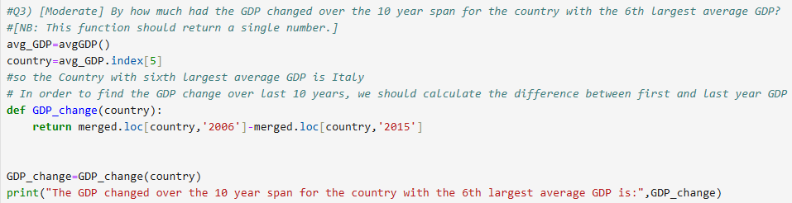
Key Tasks and Functions
GDP Change for 6th Largest Average GDP: Find the GDP change for the country with the 6th largest average GDP.

Slide 12
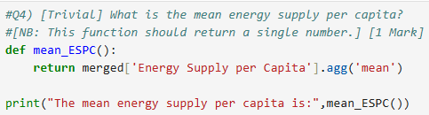
Key Tasks and Functions
Mean Energy Supply per Capita: Calculate the mean of the Energy Supply per Capita.

Slide 13
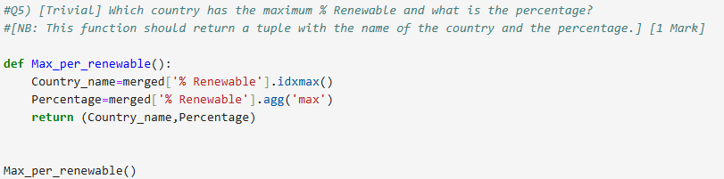
Key Tasks and Functions
Country with Maximum % Renewable: Find the country with the maximum renewable percentage and return the country name and percentage.

Slide 14
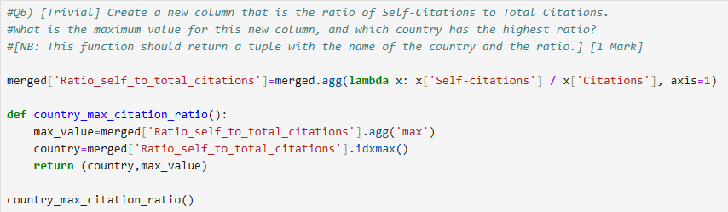
Key Tasks and Functions
Maximum Self-Citation Ratio: Create a ratio of Self-Citations to Total Citations and find the country with the maximum ratio.

Slide 15
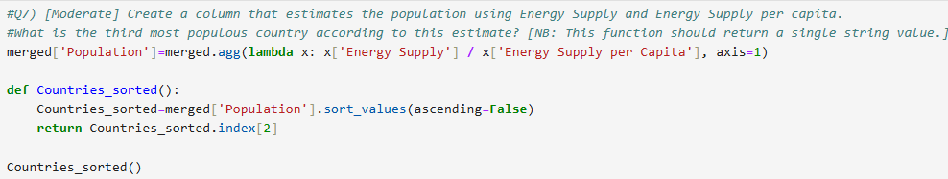
Key Tasks and Functions
Third Most Populous Country: Estimate population and find the third most populous country.

Slide 16
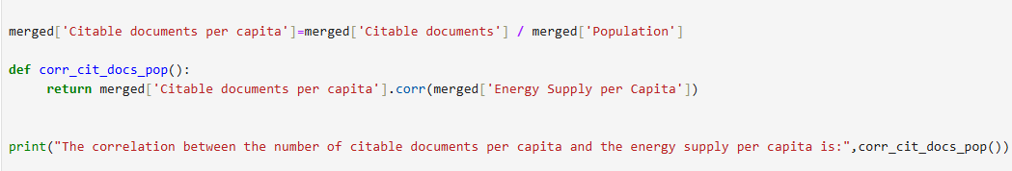
Key Tasks and Functions
Create a column for citable documents per person.
Calculate the correlation between citable documents per capita and energy supply per capita.

Slide 17
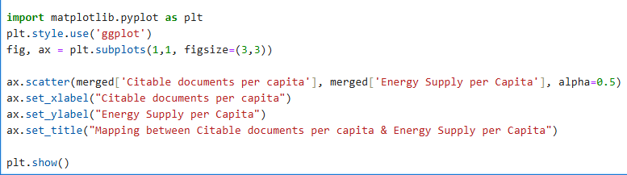
Key Tasks and Functions
Plot to visualize the relationship between Energy Supply per Capita vs. Citable docs per Capita.

Slide 18
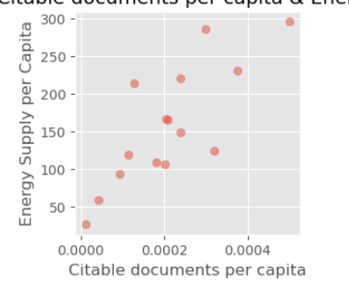
Correlation between Citable documents per capita
& Energy Supply per Capita
This graph shows that there is a positive linear correlation between Energy Supply Per Capita and Citable documents per capita as we can see, when one increase other variable increases too.
Around 0.0002 citable documents per capita there is more values in and about that value.
Also, we can see that all the scattered points are dispersed and not crowded so the correlation is not very high.

Slide 19
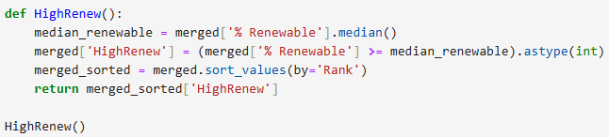
Key Tasks and Functions
% Renewable vs Median Classification: Classify countries based on whether their % Renewable is above or below the median.

Slide 20
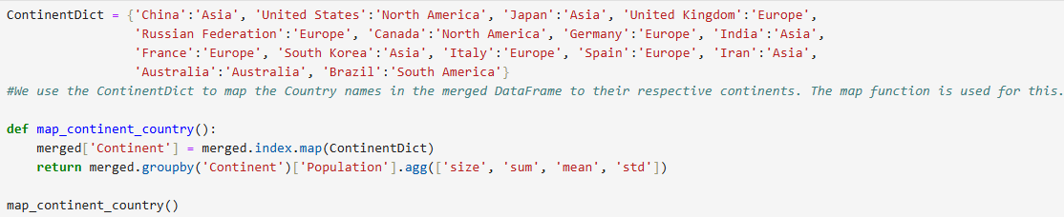
Key Tasks and Functions
Continent Grouping: Group countries by continent and calculate statistics for population estimates.

Slide 21
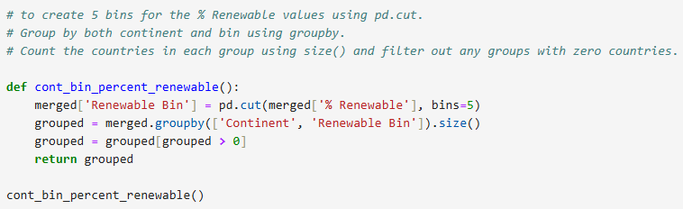
Key Tasks and Functions
% Renewable Binned by Continent: Create bins for % Renewable and group countries by continent and renewable bins.

Slide 22
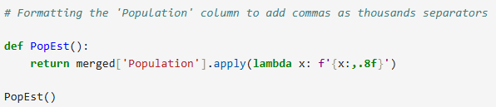
Key Tasks and Functions
Population Estimate as String: Convert population estimates to string with thousands separator.

Slide 23
Conclusion
This presentation has walked through the steps of loading, cleaning, merging, and analyzing energy, GDP, and ScimEn datasets. The tasks range from simple column operations to advanced analyses like continent grouping and renewable energy binning.
Comprehensive steps for data processing and analysis.
Insights from energy, GDP, and scientific data.
Foundation for further exploration and decision-making.

