Slide 1

Data Mining:
Project Presentation By:
Rashpinder Kaur Chahal

Slide 2
INTRODUCTION
Dataset description: Superstore
The dataset contains sales details of different stores of a supermarket chain that has multiple stores in different parts of the US.

Slide 3
STEPS TAKEN TO IMPORT AND CLEAN DATA
Import the dataset: Load the data into your analysis environment.
Display records: Show the first 5 and last 5 records of the dataset.
Identify data types: Check and note the data types for each variable.
Missing entries: Determine the number of missing entries per variable.
Duplicate records: Identify and count any duplicate records.

Slide 4
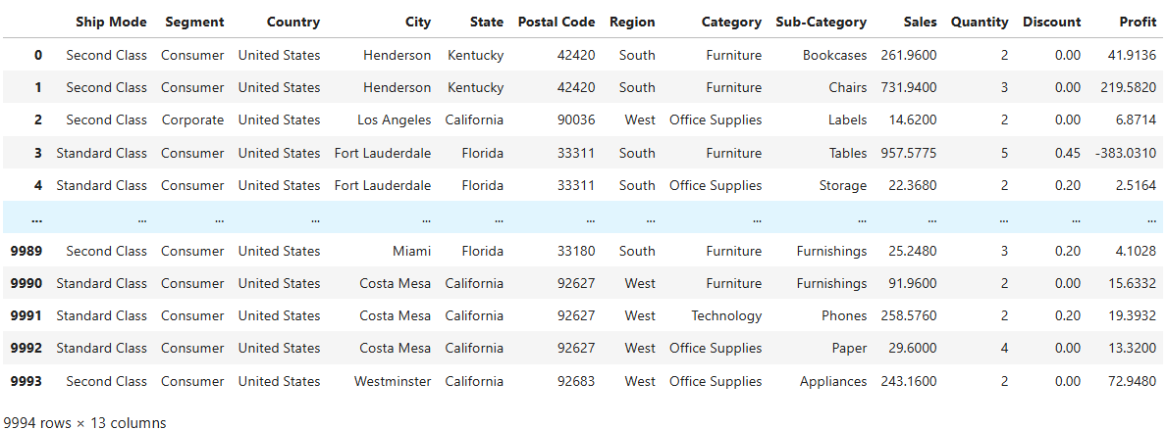
Retail Dataset
Head and Tail view

Slide 5
UNIVARIATE ANALYSIS
Numerical variables:
Sales
Quantity
Discount
Profit
Categorical variables:
Ship Mode
Segment
Region
Category
Sub-Category

Slide 6
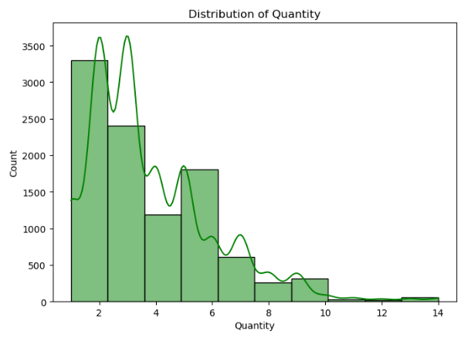
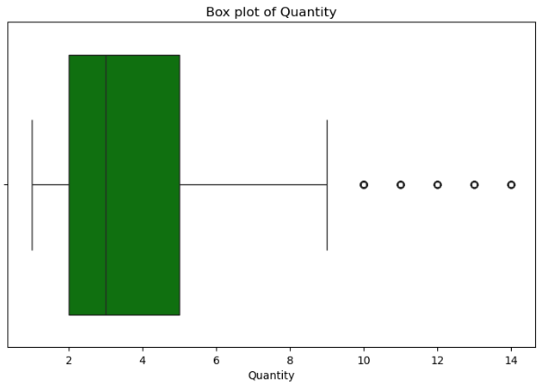
Numerical Univariate Analysis
Skewness is positive which indicates that the outliers exist in the right side of the data (can be seen by whiskers in box plot as well as tail in density curve).
Mean and median values are not approximately similar (we can see that in box plot) which indicates that the value of mean is affected by the outliers and that the data distribution is not normal.

Slide 7
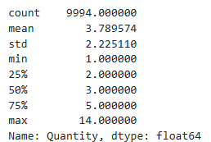
Numerical Univariate Analysis
Total observation are 9994 with
average quantity is 3.7895 for all the observations.
The value of Q1=2
(75% data have quantity value more than 2 and 25% data have less than 2)
Similarly, Q3=5
(25% data for quantity is more than 5 and 75% data for quantity is less than 5)

Slide 8
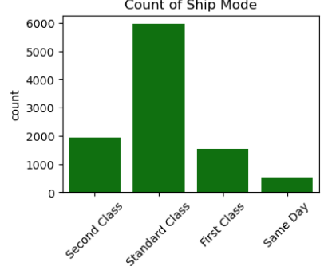
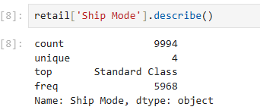
Univariate Analysis Categorical
The Shipment mode, have four levels: First Class, Second Class, Standard Class, Same Day.
Standard Class is top mode of shipment with frequency of 5968 out of 9994 total observations.

Slide 9
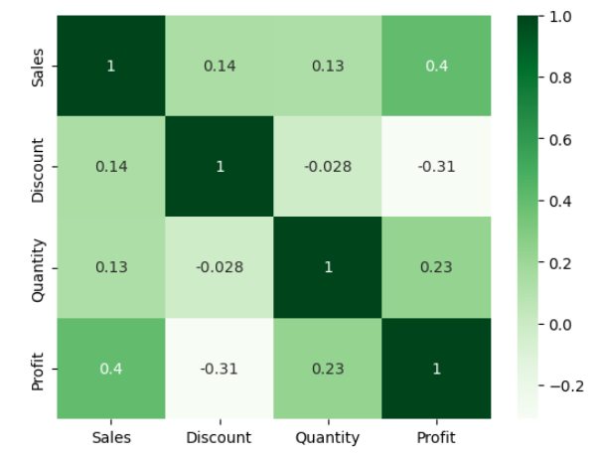
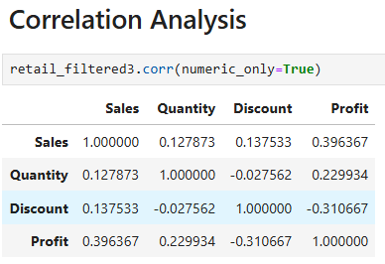
Bivariate: Correlation Analysis
Key Takeaways
Increasing sales generally leads to higher profit.
Discounts have a negative impact on profit, meaning excessive discounting reduces profitability.
The number of items sold (Quantity) has a weak effect on both Sales and Profit, suggesting that selling more items doesn't necessarily guarantee significantly higher revenue or profit.
Discounts and quantity have almost no relationship, implying that increasing discounts doesn't necessarily increase the number of items sold.

Slide 10
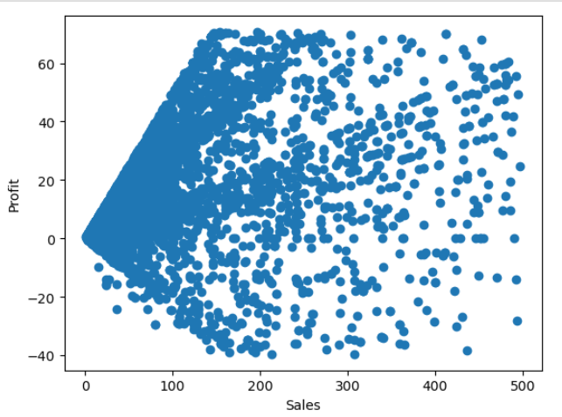
Sales and Profit (Correlation) Null Hypothesis (H₀): There is no relationship between Sales and Profit (correlation = 0). Alternative Hypothesis (H₁): There is a relationship between Sales and Profit (correlation ≠ 0).
A 0.5793 correlation suggests a moderately strong relationship
The statistical significance (p-value = 0.0) confirms that this result is reliable.
So, it confirms that higher sales generally lead to higher profits.

Slide 11
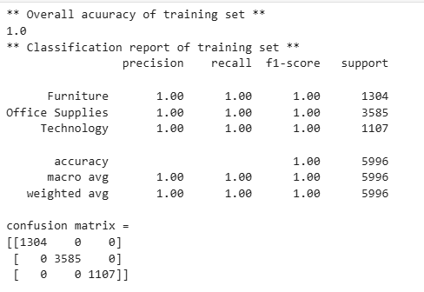
Logistic Regression (target=Category)
Training Set Performance:
Overall Accuracy: 1.0 (100%)The model perfectly classified all training samples with no errors.
Confusion Matrix: Each diagonal element (e.g., 1304, 3585, 1107) represents correct classifications.
Possible Concern: Overfitting 100% accuracy on the training set suggests that the model may be memorizing the training data rather than learning general patterns.

Slide 12
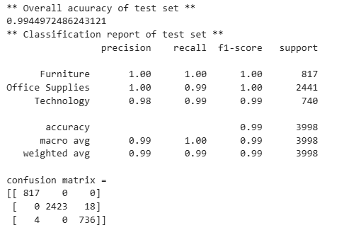
Logistic Regression (target=Category)
2. Test Set Performance:
Overall Accuracy: 99.45%The model performs extremely well on unseen data, meaning it's generalizing well.
Class-wise Performance:
Furniture: Perfect classification (100% precision and recall).
Office Supplies: Small drop in recall (99%) due to 18 misclassified samples.
Technology: Precision (98%) and recall (99%) indicate a few misclassifications.
Confusion Matrix Observations: Furniture (817 correctly classified, 0 misclassified).Office Supplies (18 samples misclassified out of 2441).Technology (4 misclassified as other categories).Very few misclassifications overall.

Slide 13
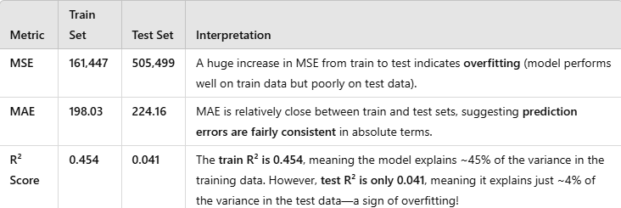
Linear Regression (target=Sales)

Slide 14
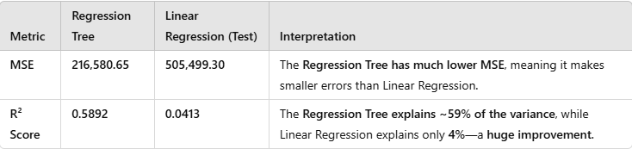
Linear Regression (target=Sales)

Slide 15
Conclusion
Sales & Profit Relationship
A moderately strong correlation confirms that higher sales generally lead to higher profits.
Impact of Discounts
Excessive discounts negatively affect profitability, meaning a careful discounting strategy is crucial.
Quantity Sold
Selling more items does not significantly boost revenue or profit, suggesting that pricing and product mix are more important than sheer volume.
Predictive Modelling
Linear Regression: Sales predictions showed inconsistent performance, suggesting non-linear relationships.
Logistic Regression: The model performed exceptionally well in classifying product categories

