Slide 1
Spark “join” deep dive Part1 (DRAFT)
SortMergeJoinExec
Nikolay
Join us in telegram t.me/apache_spark
August 2020

Slide 2
val rdd = spark.sparkContext.parallelize(Seq(1,2,3,4,7,8,1,1,9,8,3,1,2,9,0,1,10),3)
val ds1 = spark.sqlContext.createDataset(rdd).select($"value".as("l_value"))
val ds2 = spark.sqlContext.createDataset(rdd)
ds1.join( ds2, $"l_value" === $"value").explain()

Slide 3
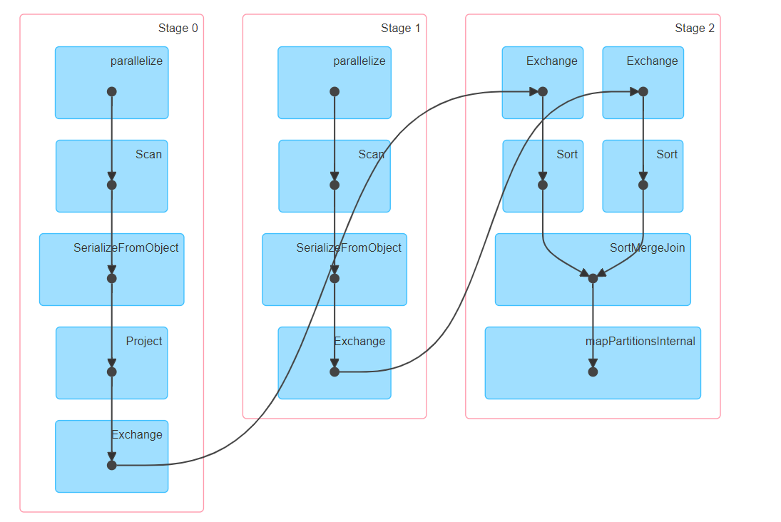
DAG

Slide 4
== Optimized Logical Plan ==
Join Inner, (l_value#5 = value#9)
:- Project [value#2 AS l_value#5]
: +- SerializeFromObject [input[0, int, false] AS value]
: +- ExternalRDD [obj#1]
+- SerializeFromObject [input[0, int, false] AS value#9]
+- ExternalRDD [obj#8]
== Physical Plan ==
SortMergeJoin [l_value#5], [value#9], Inner
:- Sort [l_value#5 ASC NULLS FIRST], false, 0
: +- Exchange hashpartitioning(l_value#5, 200), true, [id=#24]
: +- Project [value#2 AS l_value#5]
: +- SerializeFromObject [input[0, int, false] AS value#2]
: +- Scan[obj#1]
+- Sort [value#9 ASC NULLS FIRST], false, 0
+- Exchange hashpartitioning(value#9, 200), true, [id=#25]
+- SerializeFromObject [input[0, int, false] AS value#9]
+- Scan[obj#8]

Slide 5
case class Join(
left: LogicalPlan,
right: LogicalPlan,
joinType: JoinType,
condition: Option[Expression],
hint: JoinHint)
case class SortMergeJoinExec(
leftKeys: Seq[Expression],
rightKeys: Seq[Expression],
joinType: JoinType,
condition: Option[Expression],
left: SparkPlan,
right: SparkPlan,
isSkewJoin: Boolean = false)
Spark Planner

Slide 6
method doExecute of SortMergeJoinExec
left.execute().zipPartitions(right.execute()) { (leftIter, rightIter) =>
// An ordering that can be used to compare keys from both sides. val keyOrdering = newNaturalAscendingOrdering(leftKeys.map(_.dataType))
joinType match {
case _: InnerLike =>
case LeftOuter =>
case RightOuter =>
case FullOuter =>
case LeftSemi =>
case LeftAnti =>
case j: ExistenceJoin =>

Slide 7
The idea
Left Iterator
1
1
3
5
Right Iterator
1
1
2
3
bufferedMatches
1
1
val bufferedMatches = new ExternalAppendOnlyUnsafeRowArray(inMemoryThreshold, spillThreshold)

Slide 8
doExecute
case _: InnerLike => new RowIterator { private[this] var currentLeftRow: InternalRow = _ private[this] var currentRightMatches: ExternalAppendOnlyUnsafeRowArray = _ private[this] var rightMatchesIterator: Iterator[UnsafeRow] = null private[this] val smjScanner = new SortMergeJoinScanner( createLeftKeyGenerator(), createRightKeyGenerator(), keyOrdering, RowIterator.fromScala(leftIter), RowIterator.fromScala(rightIter), inMemoryThreshold, spillThreshold, cleanupResources )

Slide 9
doExecute(2)
private[this] val joinRow = new JoinedRow if (smjScanner.findNextInnerJoinRows()) { currentRightMatches = smjScanner.getBufferedMatches currentLeftRow = smjScanner.getStreamedRow rightMatchesIterator = currentRightMatches.generateIterator() }

Slide 10
doExecute(3)
override def advanceNext(): Boolean = { while (rightMatchesIterator != null) { if (!rightMatchesIterator.hasNext) { if (smjScanner.findNextInnerJoinRows()) { currentRightMatches = smjScanner.getBufferedMatches currentLeftRow = smjScanner.getStreamedRow rightMatchesIterator = currentRightMatches.generateIterator() } else { currentRightMatches = null currentLeftRow = null rightMatchesIterator = null return false } } joinRow(currentLeftRow, rightMatchesIterator.next()) if (boundCondition(joinRow)) { return true } } false } override def getRow: InternalRow = resultProj(joinRow)

Slide 11
val rdd = spark.sparkContext.parallelize(Seq(1,1,2,3,4,7,8,1,1,9,8,3,1,2,9,0,1,10),3)
val ds1 = spark.sqlContext
.createDataset(rdd).select(($"value" %2).as("key1"), $"value".as("v1"))
val ds2 = spark.sqlContext
.createDataset(rdd).select(($"value"%2).as("key2"),$"value".as("v2"))
ds1.join(ds2, $"key1" === $"key2" && $"v1" > $"v2" ).collect()
keyOrdering
boundCondition

Slide 12
SortMergeJoinScanner
Helper class that is used to implement SortMergeJoinExec.
To perform an inner (outer) join, users of this class call findNextInnerJoinRows()
which returns `true` if a result has been produced and `false` otherwise. If a result has been
produced, then the caller may call getStreamedRow to return the matching row from the streamed
input and may call getBufferedMatches to return the sequence of matching rows from the
buffered input (in the case of an outer join, this will return an empty sequence if there are no
matches from the buffered input). For efficiency, both of these methods return mutable objects
which are re-used across calls to the findNext and JoinRows() methods.

Slide 13
method findNextInnerJoinRows()
Advances both input iterators, stopping when we have found rows with matching join keys. If
no join rows found, try to do the eager resources cleanup.
Returns true if matching rows have been found and false otherwise. If this returns true, then
getStreamedRow and getBufferedMatches can be called to construct the join results.

Slide 14
def findNextInnerJoinRows(): Boolean = {
while (advancedStreamed() && streamedRowKey.anyNull) {
// Advance the streamed side of the join until we find the next row whose join key contains
// no nulls or we hit the end of the streamed iterator.
}
val found = if (streamedRow == null) {
// We have consumed the entire streamed iterator, so there can be no more matches.
matchJoinKey = null
bufferedMatches.clear()
false
} else if (matchJoinKey != null && keyOrdering.compare(streamedRowKey, matchJoinKey) == 0) {
// The new streamed row has the same join key as the previous row, so return the same matches.
true
} else if (bufferedRow == null) {
// The streamed row's join key does not match the current batch of buffered rows and there are
// no more rows to read from the buffered iterator, so there can be no more matches.
matchJoinKey = null
bufferedMatches.clear()
false
}

Slide 15
} else {
//Advance both the streamed and buffered iterators to find the next pair of matching rows.
var comp = keyOrdering.compare(streamedRowKey, bufferedRowKey)
do {
if (streamedRowKey.anyNull) {
advancedStreamed()
} else {
assert(!bufferedRowKey.anyNull)
comp = keyOrdering.compare(streamedRowKey, bufferedRowKey)
if (comp > 0) advancedBufferedToRowWithNullFreeJoinKey()
else if (comp < 0) advancedStreamed()
}
} while (streamedRow != null && bufferedRow != null && comp != 0)

Slide 16
if (streamedRow == null || bufferedRow == null) {
// We have either hit the end of one of the iterators, so there can be no more matches.
matchJoinKey = null
bufferedMatches.clear()
false
} else {
//The streamed row's join key matches the current buffered row's join, so walk through the
//buffered iterator to buffer the rest of the matching rows.
assert(comp == 0)
bufferMatchingRows()
true
}
}
if (!found) eagerCleanupResources()
found
}

Slide 17
/**
* Called when the streamed and buffered join keys match in order to buffer the matching rows.
*/
private def bufferMatchingRows(): Unit = {
assert(streamedRowKey != null)
assert(!streamedRowKey.anyNull)
assert(bufferedRowKey != null)
assert(!bufferedRowKey.anyNull)
assert(keyOrdering.compare(streamedRowKey, bufferedRowKey) == 0)
// This join key may have been produced by a mutable projection, so we need to make a copy:
matchJoinKey = streamedRowKey.copy()
bufferedMatches.clear()
do {
bufferedMatches.add(bufferedRow.asInstanceOf[UnsafeRow])
advancedBufferedToRowWithNullFreeJoinKey()
} while (bufferedRow != null && keyOrdering.compare(streamedRowKey, bufferedRowKey) == 0)
}

Slide 18
/** Buffered rows from the buffered side of the join. This is empty if there are no matches. */
private[this] val bufferedMatches =
new ExternalAppendOnlyUnsafeRowArray(inMemoryThreshold, spillThreshold)

Slide 19
Class ExternalAppendOnlyUnsafeRowArray
private val inMemoryBuffer = if (initialSizeOfInMemoryBuffer > 0) { new ArrayBuffer[UnsafeRow](initialSizeOfInMemoryBuffer) } else { null }
/**
* An append-only array for [[UnsafeRow]]s that strictly keeps content in an in-memory array
* until [[numRowsInMemoryBufferThreshold]] is reached post which it will switch to a mode which
* would flush to disk after [[numRowsSpillThreshold]] is met (or before if there is
* excessive memory consumption). Setting these threshold involves following trade-offs:
*
* - If [[numRowsInMemoryBufferThreshold]] is too high, the in-memory array may occupy more memory
* than is available, resulting in OOM.
* - If [[numRowsSpillThreshold]] is too low, data will be spilled frequently and lead to
* excessive disk writes. This may lead to a performance regression compared to the normal case
* of using an [[ArrayBuffer]] or [[Array]].
*/

Slide 20
Class ExternalAppendOnlyUnsafeRowArray
def add(unsafeRow: UnsafeRow): Unit = {
if (numRows < numRowsInMemoryBufferThreshold) {
inMemoryBuffer += unsafeRow.copy()
} else {
if (spillableArray == null) {
logInfo(s"Reached spill threshold of $numRowsInMemoryBufferThreshold rows, switching to " +
s"${classOf[UnsafeExternalSorter].getName}")
// We will not sort the rows, so prefixComparator and recordComparator are null
spillableArray = UnsafeExternalSorter.create(
taskMemoryManager,
blockManager,
serializerManager,
taskContext,
null,
null,
initialSize,
pageSizeBytes,
numRowsSpillThreshold,
false)
…

Slide 21
Summary
SortMergeJoinExec
SortMergeJoinScanner
findNextInnerJoinRows()
ExternalAppendOnlyUnsafeRowArray

