Slide 1
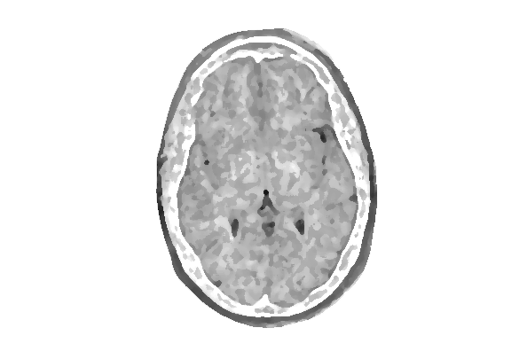
Brain Tumors Detection using Deep learning
Rosa Kim Cho * CPSC 589 * Fall 2022

Slide 2
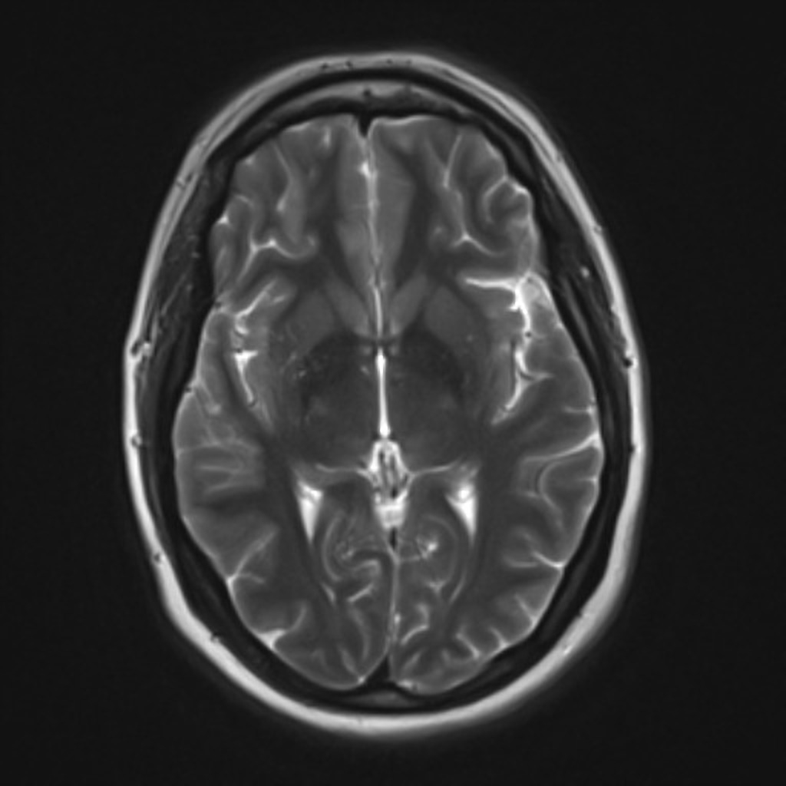
Introduction
Using an extensive dataset consisting of 5000 MRI scans of brains with tumors, a neural network is used to determine whether a scan contains a tumor or not
Different tumor classifications are limited to simply two types: solid or amorphous
To determine the accuracy, the CNN will be compared to a K-Nearest Neighbor (KNN) model or ML model

Slide 3
Tentative Schedule
2023 | January | February | March | April | May | Summary
Tasks |  |  |  |  |  | Hours | Percent
Requirements | 20 |  |  |  |  | 20 | 10.6%
Design | 12 | 4 | 12 |  |  | 28 | 14.9%
Code & Testing | 10 | 20 | 22 | 10 |  | 62 | 33.0%
Testing and Refining |  | 2 | 12 | 20 |  | 34 | 18.1%
Documentation |  |  | 4 | 12 |  | 16 | 8.5%
Final Report |  |  |  | 12 | 12 | 24 | 12.8%
Demonstration |  |  |  |  | 4 | 4 | 2.1%
Hours | 42 | 26 | 50 | 44 | 16 | 188 | 100%

Slide 4

Areas of Focus
Planning
Design
Performance Metrics
ML Model
Deployment
Determining which library is best for image classification
CNN will be divided into 4 segments:
Input Pre-processing
Segmentation Detection/Classification
Create a training dataset composed of brains without tumors
Build the K-Nearest Neighbor model to gauge accuracy of the neural network
Deploy a NN with replicable results

Slide 5

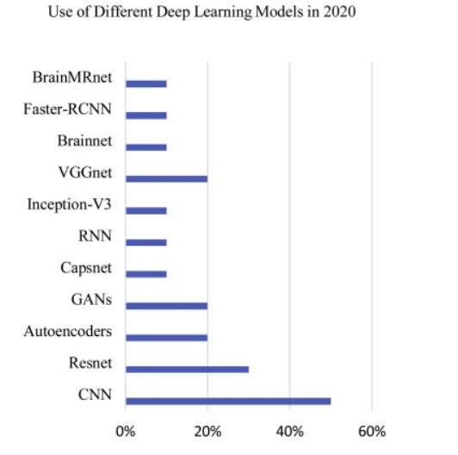
Research and Resources
Performance analysis of machine learning detection and classification of brain tumor using computer vision
Role of deep learning in brain tumor detection and classification
A proposed CNN architecture of 19 weighted layers (16 convolutional to 3 fully connected) is made
It was compared to another neural network called a Multilayer Perceptron which uses different units of measure called perceptrons along with multiple layers
They then were compared to five other Machine Learning models to determine accuracy
Tumor classification was limited to cancerous vs. non-cancerous

Slide 6



Discussion
Coding
While tensorflow and keras have both been considered, are there any other suggestions?
Would another ML model be preferable to compare the NN against?
Classification
Classifying brain tumors into different types of tumors ?
What if tumors are

Slide 7

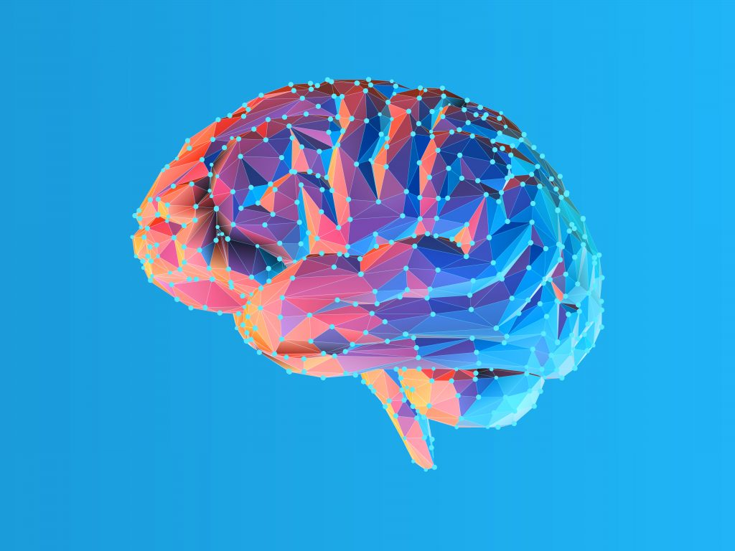
Thank you

