Slide 1
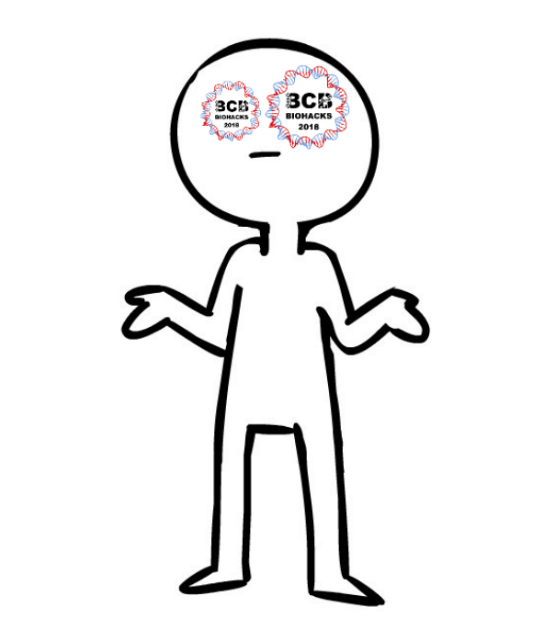
BioHacks 2018

Slide 2
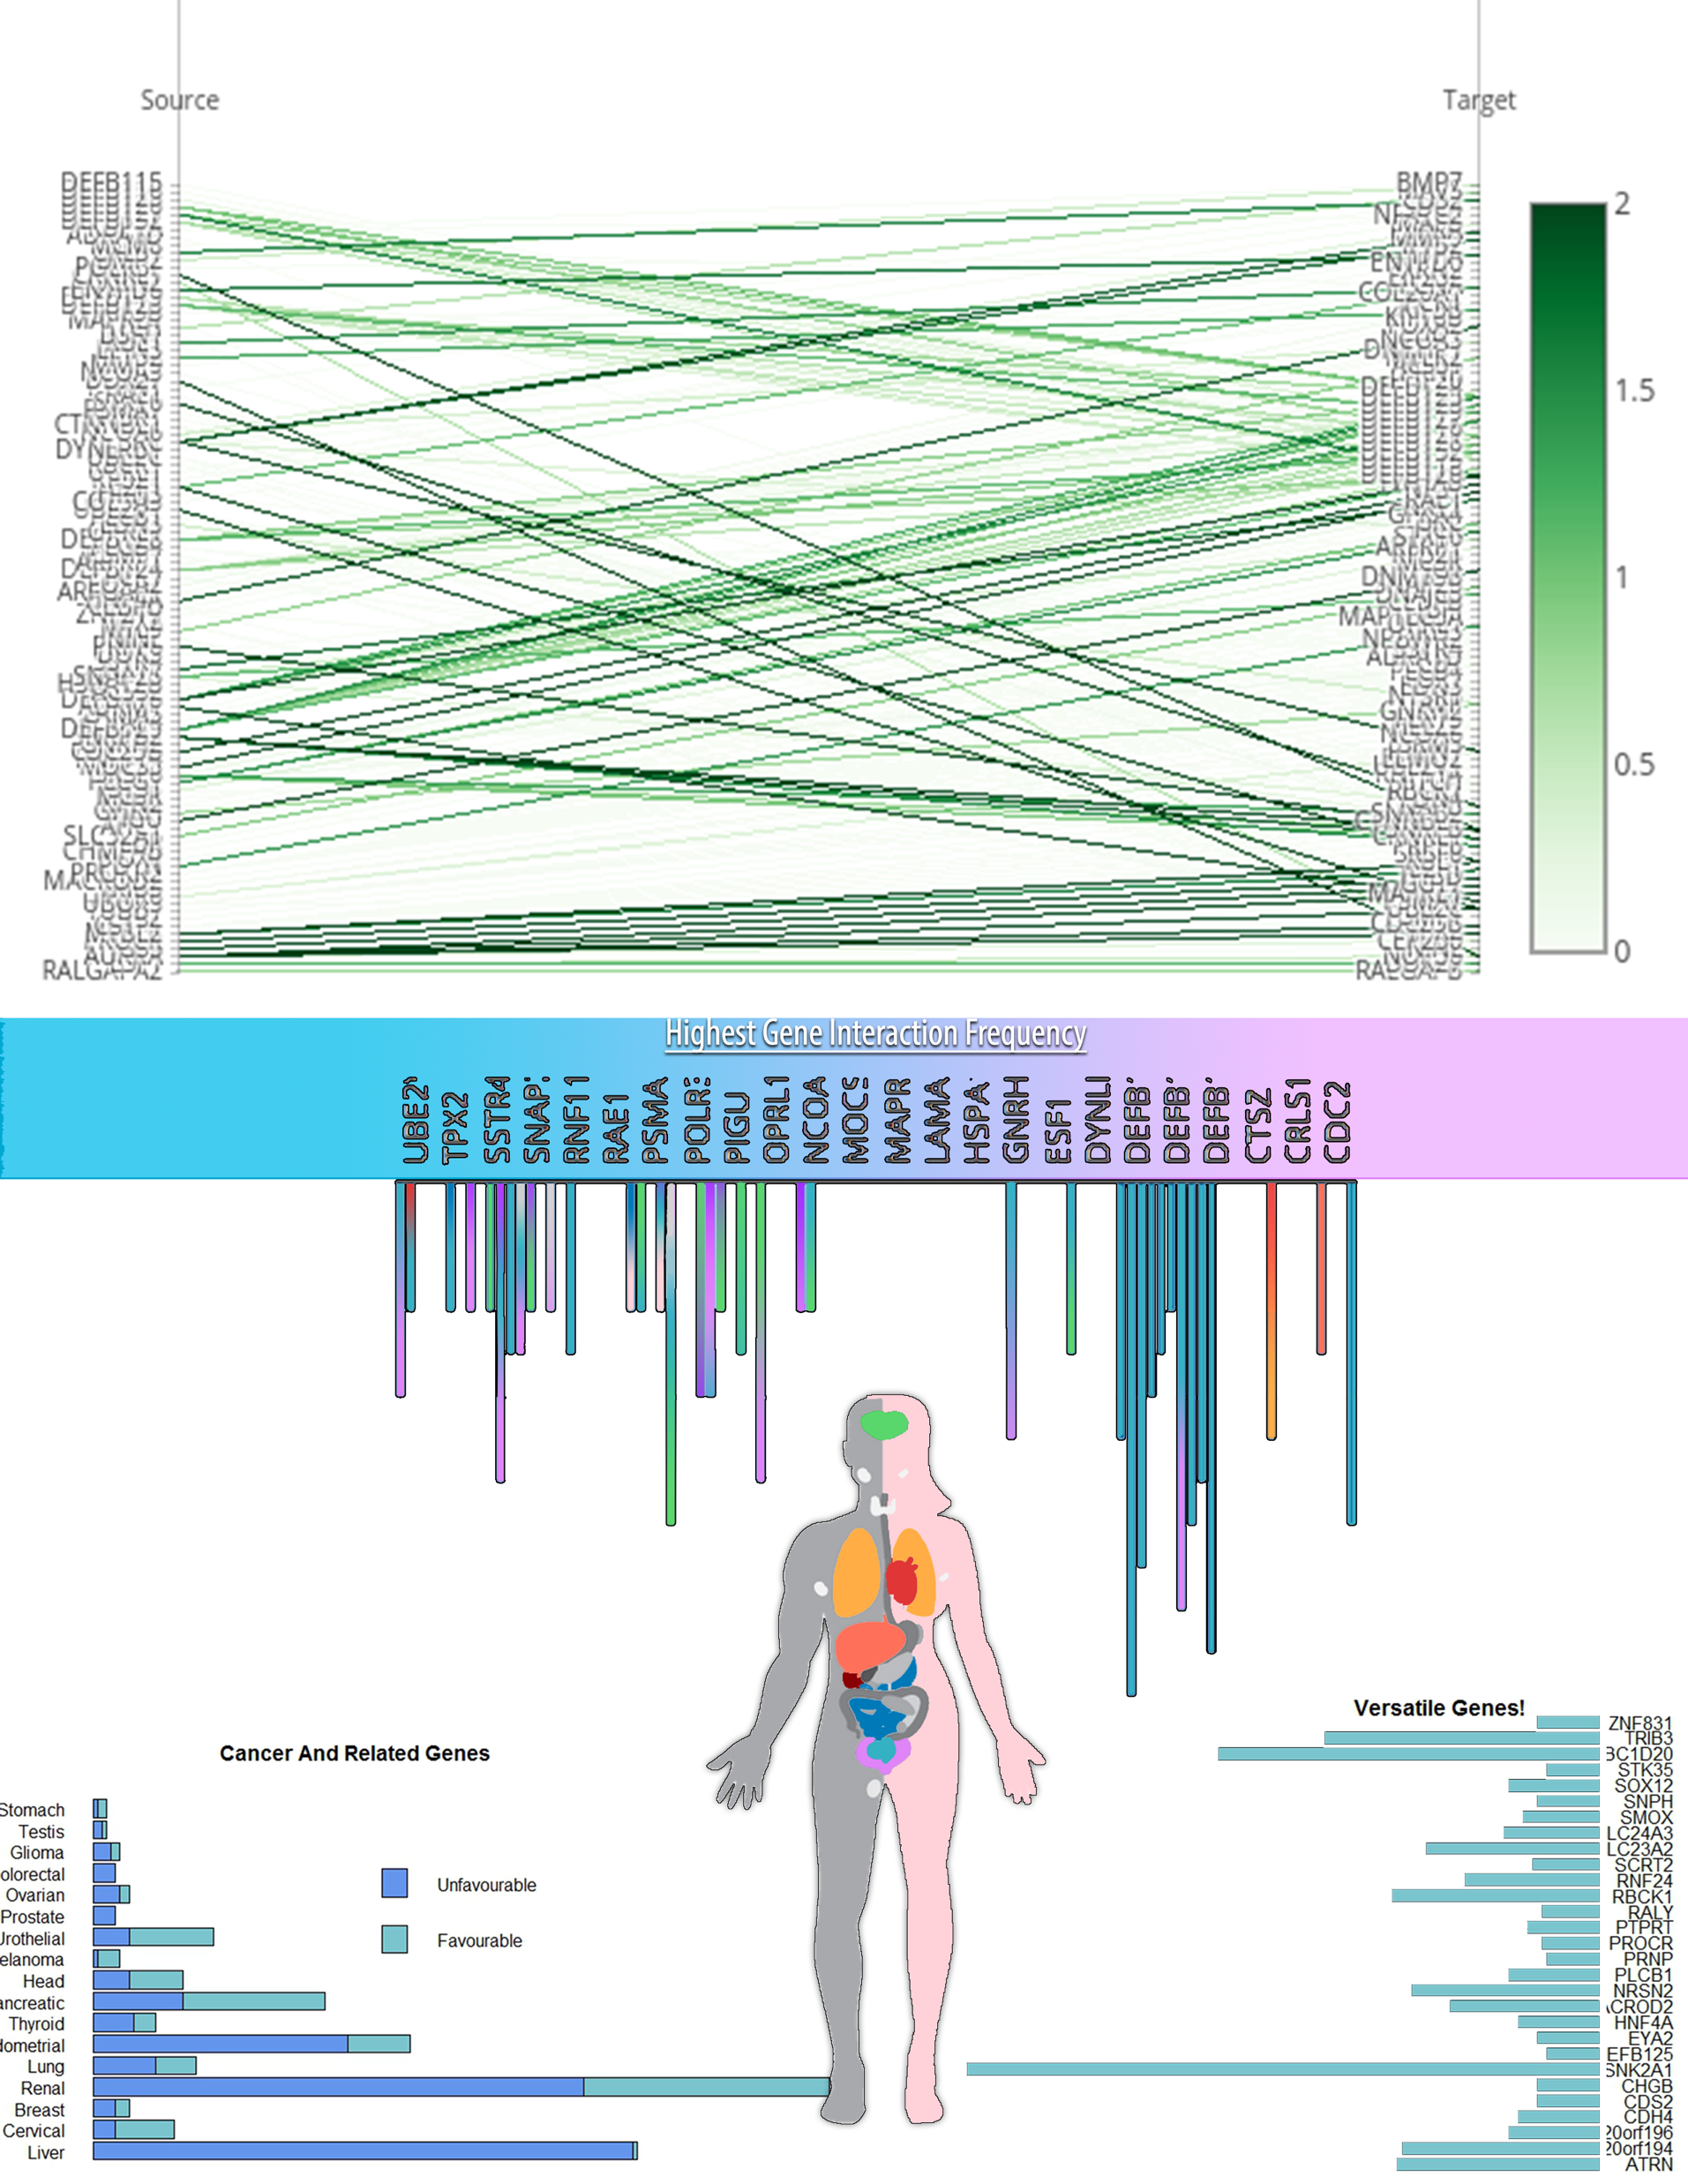

Slide 3
The Idea
What makes us human?
We wanted to show how the genome is a network of interactions- a community of elements working together.
We wanted to display gene-gene interactions, without ignoring the medical impact Chromosome 20 has on the body and its functions.
We definitely wrote a very efficient and professional code for getting all of the information that we used. Truuuussssst me.

Slide 4
Prototype
The gene-gene interactions are shown in the first portion of the image.
While we have no information regarding the likelihood of developing certain cancers as the result of a mutation in chromosome 20, we were given information relating to how the genes of chromosome 20 impact the prognosis for certain types of cancers. This information was featured in the second part of the image, with emphasis on the proportion of favourable to unfavourable prognoses.
Conceptual and abstract.

Slide 5
Next Steps – Genome Wide Application
We would like to look into making the image dynamic. This would allow for more information to be featured, and draw a tidier connection between gene-gene interactions and cancer prognoses.
To do this, we could integrate the Human Protein Atlas in such a way that clicking on the gene would connect you to the image of a body, so that you can see the regions of gene expression and protein targeting.
If given more time, we would find a way to order the genes in relation to what impact they have on the prognoses of different cancers. Ideally, those with similar impacts would be grouped together. Knowing this would allow for the image to address the possibility that genes with similar cancer prognosis impacts could have similar functions, or even be expressed in the same tissue.
For example, AURKA is a gene that was found to be quite interactive. When examined on the Human Protein Atlas, it is also expected to be involved in tumour development and progression. Finding a way to express this in the image would be a beneficial next step to take.

