Slide 1
Homework #4: Cache
November 6th, 2019
Jae W. Lee (jaewlee@snu.ac.kr)
Computer Science and Engineering
Seoul National University
TA: Yunho Jin, Jeonghun Gong

Slide 2
Goal of This Project
You will be asked to write a cache simulator
Understand cache structure
Implement cache policy

Slide 3
Setup
You need Linux environment
Install valgrind tool for extracting memory traces
Download PA4.tar from eTL
linux> sudo apt-get install valgrind
linux> tar -xvf PA4.tar
linux> cd PA4
linux> make clean; make

Slide 4
What You Need to Do
Your Task: Implement a cache simulator producing the same output as the reference simulator (=csim-ref)
Reference cache simulator can simulate a cache with
Arbitrary cache size
Arbitrary associativity
LRU replacement policy
File to modify (and submit): csim.c

Slide 5
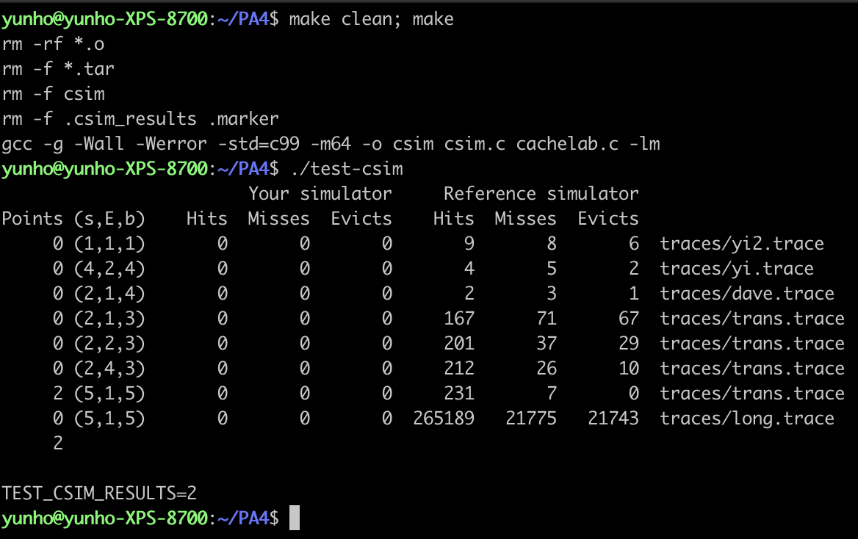
Test your code: An Example

Slide 6
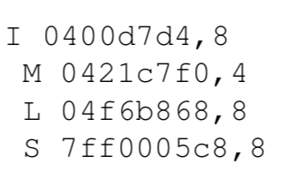
Helper Programs
valgrind : generate trace files
valgrind output
<[operation] address, size >
I: instruction load (no space before [operation])
L: data load
S: data store
M: data modify (store after load)
linux> valgrind --log-fd=1 --tool=lackey -v --trace-mem=yes ls -l > <filename.trace>

Slide 7
Helper Programs
csim-ref: reference cache simulator program
-h: optional help flag
-v: optional verbose flag
-s: # of set index bits(S = 2^{s} number of sets)
-E: number of lines per set (=associativity)
-b: block bits (B = 2^{b} bytes per block)
-t: trace file
linux> ./csim-ref [-hv] -s <s> -E <E> -b <b> -t <trace file>

Slide 8
General Cache Organization (S, E, B)
E = 2e lines per set
set
line
S = 2^{s} sets
Cache size:
C = S x E x B data bytes
v
tag
0
1
2
B-1
valid bit
B = 2^{b} bytes per cache block (the data)

Slide 9
Program rules
csim.c should run without failure
Should work for arbitrary s, E, b
Focus only on data cache
ignore “I” operations in traces
“I” operations start in the first column while others start in second (should help you parse trace files)
Call printSummary() in cachelab.c at the end of your main function
printSummary(hit_count, miss_count, eviction_count);
All memory accesses are aligned properly
Single memory access does not cross block boundary

Slide 10
Submission
Compress your source code and write-up into a single zip file.
Compress csim.c and your report.
Filename should be [student_id].zip (example: 2019-12345.zip).
Please submit it in ZIP format. Other formats are not accepted.
Submission deadline: By 2019. 11. 20 (Wed) 23:59 KST

Slide 11
Grades
Writeup: 10%
Late Submission:
Within next 24 hours: 10% deduction
Within next 48 hours: 30% deduction
Within next 72 hours: 50% deduction
After next 72 hours: Submission not accepted

