Slide 1
Version Control with Git and GitHub

Slide 2
Version Control with Git and GitHub
Overview
Why is version control important?
What are Git and GitHub?
Repos
Organizations
Features
How to integrate basic version controlling with your work
Development environments
Licensing
Notes:
So we will now move onto version control. We’ll cover what are git and github, some features of GitHub. Then we’ll take a dive into some IDEs, and developing software. Finally, we’ll take a dive into licensing.

Slide 3
Why is version control important?
VC can help you create ethical software
UNESCO guidelines:
Safety and Security
Accountability
Transparency and explainability
FAIR
Your software will be findable
People can use your software, or modify it or build on top of it
Personal benefits
You can undo catastrophic mistakes!
Another route for community engagement.
Required in industry

Slide 4

Git
About Git
Git helps us keep track of versions of files.
Git is very useful if you are working with many collaborators.
Relatively straight-forward to use, but can come with some headaches.
Through the course material, we will explore most of the git commands that you will need throughout your life.
Good rules:
Have a main branch and a dev branch
Commit often, and when you have working code
Amend commits if they are similar
Notes:
Git is a way that we can keep track of these files. It comes in really handy if you want to work with very many people.
We will quickly go through an intro to git here, and then we’ll cover other things that we need as they come up.
I’ve just included some general rules for git and github.
So the main structure of git is the branch. When you make a change you add the change to your pile of changes. Then when you’re finished, you commit these changes.
There are a few different approaches to using git. Main branch and dev branch is a decent way to go for open source software development.

Slide 5






An introduction to GitHub
A number of version control repositories exist:
Notes:
If you want to make your code publicly available, how do you do this? We essentially use cloud storage, but for code!
There are quite a few version control repositories out there. It allows you to make changes, track changes, upload and download files, publicly share your code, deploy websites, etc.
By far the most popular are github and gitlab, but there are others as well like bitbucket and sourceforge. Often code will be posted to very many of these.
So we’ll just walk through github and what it looks like (anybody with experience of git and github, please feel free to add anything at any time.)

Slide 6
Why GitHub?
GitHub has emerged as the front-runner in digital version control repositories.
Early advantage
User-friendly UI
Ecosystem and integrations
Strong community
Microsoft acquisition
These reasons make GitHub a relatively safe choice for software developers to store remote versions of their code.
Notes:
Why did GitHub emerge as the go-to VC repo?
Early emergence advantage: GitHub was one of the first and most prominent platforms to provide git-based online version control
User friendly: GitHub is very user friendly, and has a wide range of features for developers. Things like pull requests, issue tracking, and code review tools have become integral to modern software workflows
Lots of third party tool integrations that enhance the functionality and integrate with other development tools and services.
Many popular open source projects are on GitHub, and they have attracted a large community of developers
In 2018, Microsoft acquired GitHub, which further solidified its position, and provided additional resources, as well as integration with other Microsoft tools and services.
A great feature is also Codespaces, which we will use today
So all in all, GitHub is a great platform.

Slide 7

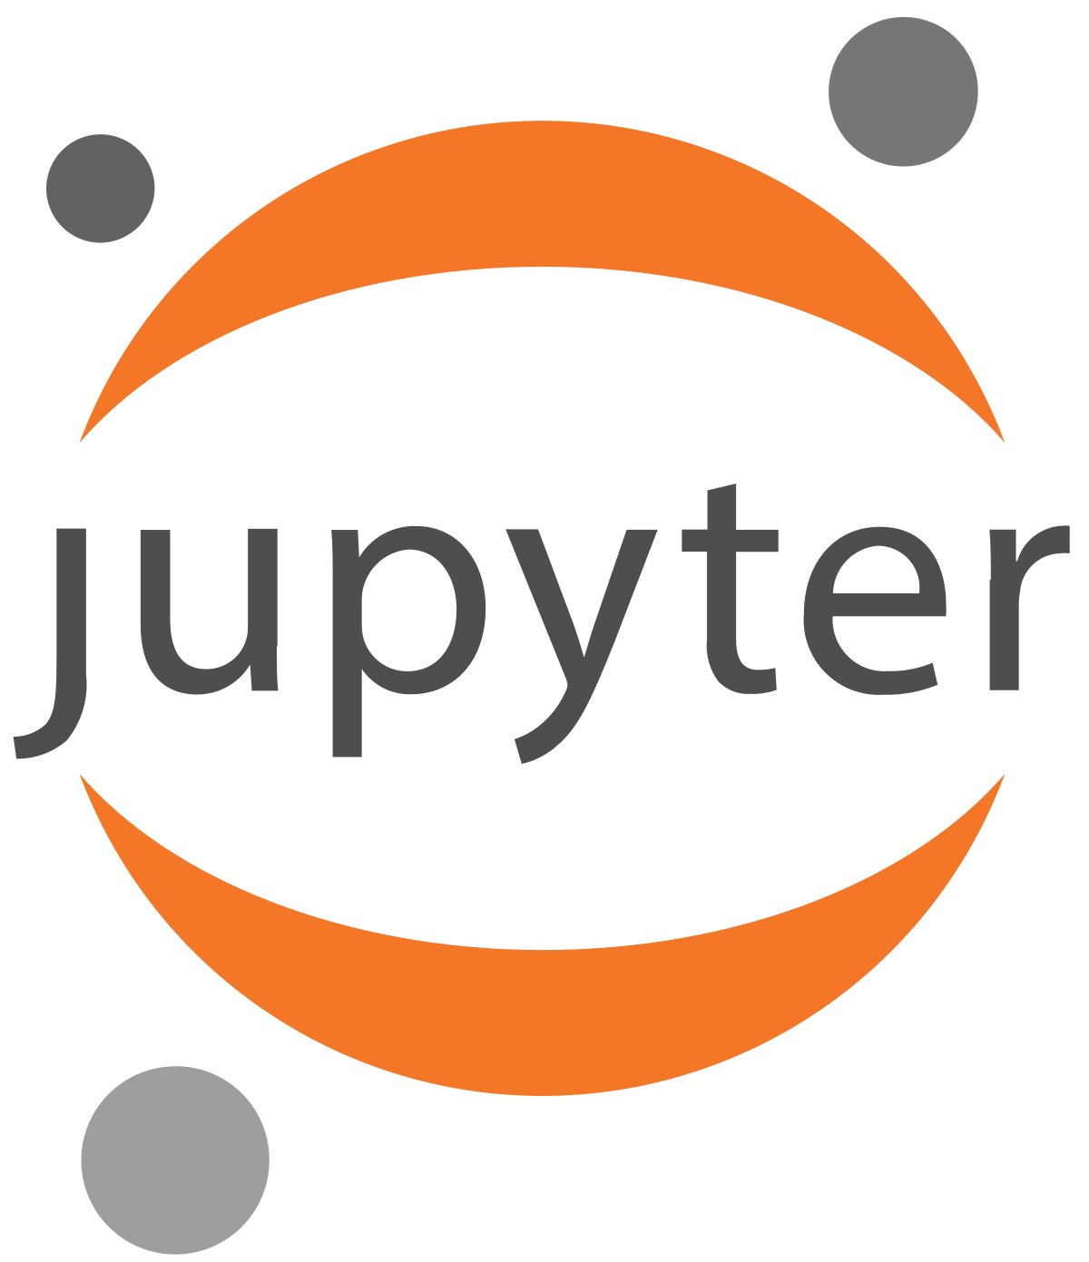





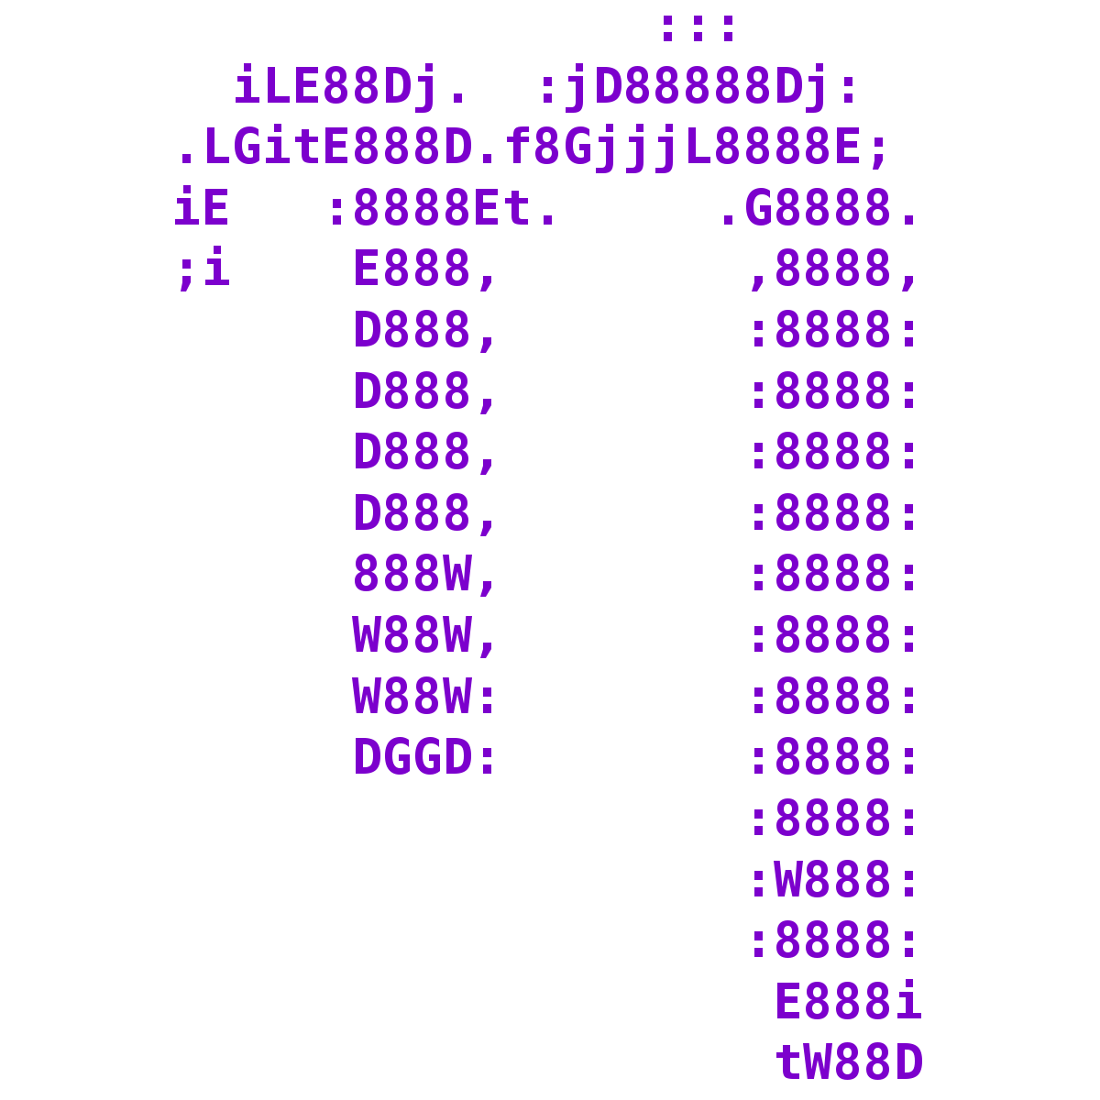
Developing code
There are many ways to develop Python code:
Notes:
There are so many ways to write python code. My story arc went something like this:
I first learnt to use python using Wing IDE. I then switched to using Anaconda, because at the time it was hot and billed as a great framework for scientific software, which it really was – it made things very convenient. So I used mainly Jupyter Notebooks, and Spyder. Spyder offers a great landing zone for people who are migrating from MATLAB, because the look and feel of it are very familiar. Then I did some work involving C/C++, so I used Atom for a while. Then I moved back to mostly working in Python, so I switched back and forth between PyCharm and Jupyter. I really liked the convenience of PyCharm. I also had a brief affair with Spyder again, after I discovered how much storage space my PyCharm projects were taking up. Also during this time, I used Nano because I was working on a remote server and needed to edit some scripts. Then I was working in C++ again, so I switched to Visual Studio, which is a very heavy all around beast of a development environment – it really is a very comprehensive tool, and when you’re developing C++ code, it takes a way a lot of the pain. And now I’ve permanently settled on VS Code. With Zed for Rust.
You still have a subset of people who insist on using Vim or Nano, but we just nod politely when they speak to us.

Slide 8
Developing code
We use Visual Studio Code
Lightweight, and faster than some other environments.
Not restricted to a single language.
Has a debugger and terminal.
Extensions:
Jupyter
Remote development and cloud integration
VC and GitHub integration
Copilot
Lots of nice themes!
Notes:
VS Code is a good all round development environment.
Some advantages:
VS Code is quite lightweight, which means it opens quickly, and executes code quickly
You don’t have to use it for Python, you can use it for basically any language you want, or even multiple languages
It comes with all of the features you expect it to: a debugger, a terminal, testing
Probably the most powerful part of VS Code are the extensions:
Jupyter – Jupyter is really good for exploratory analysis and quick prototyping, so if you want to use it, you can.
Version control and github integration. You don’t need to use the terminal for git, you can do most of the simple stuff from the UI
Remote development – you can setup vscode as a remote development environment. So if you’re doing any work on the HPC, you can set things up so that you can just do all of your work from code, as if you’re working locally, which is a fantastic feature
It has copilot, and copilot chat.

Slide 9

An aside about Copilot…
Should you use it…?
Advantages
Reduces the time to write relatively straight-forward bits of code
Substitute for spending time digging through stack overflow or the documentation
Write basic test cases
Find issues with code, and help optimize
Great for learning new things
Disadvantages
Sometimes produces nonsense – susceptible to hallucination, just like other LLMs
At the mercy of Microsoft updating or nerfing
Potential to waste time looking for faulty code
Remember…
Human-in-the-loop
It is not a substitute for understanding
Notes:
Does anybody here use Copilot?
There are some advantages and disadvantages about using Copliot
Reduces time to write fairly easy bits of code.
An example might be trying to parse a certain file type. You might say, write me a function that will read a .txt file and break it down by lines.
Or some numpy or pandas functionality that you can’t quite remember like, give me the column with this heading and the column with this heading, multiply them together, reverse it, and then take the 10th element of the result and put it into a dictionary. And numpy will have like a oneliner that will do it or something.
This means you spend less time on stack overflow and sifting through documentation
It can help you write basic test cases. And I do mean very basic.
It can help you find issues with code, or find the source of errors, or suboptimal code
It’s a great learning tool. I am what you might call a backend developer, so I know very little about building frontend Uis using things like JS/HTML/CSS. And there is a lot of information out there about these tools, which means copilot has probably had a lot of exposure to them in its training data.
Disadvantages
It sometimes produces total nonsense. At it’s heart, copilot is a large language model, and LLMs are highly susceptible to hallucination
This is a microsoft product and it is closed source. You have no idea what’s going on under the hood and are therefore susceptible to their terms of use, and any updates they make.
You might waste time looking for faulty bits of code.
There are many divisive opinions on using large language models for work. In my opinion, to turn away from it entirely is a mistake. It can be a real productivity booster if used correctly, but can lead to serious problems if abused. Some other models to use are GPT4, and Claude Opus. Both are highly capable.
Copilot is not a substitute for actually understanding your code. You need to verify that it’s correct!
So, do I use it? Yes!

Slide 10
Key GitHub files
There are some key files that appear in GitHub
README.md
Includes information about your project
Markdown format
Can also include HTML and CSS, and can get quite complicated
.gitignore
Everything that you don’t want to commit to your git history and your repo
Usually standard templates
You should include any files that contain private information such as API keys!
Copilot can produce this for you very easily.
LICENSE
Notes:
There are a number of files that are quite important to your project repository:
A README.md file. Includes some general information about your project. Written in a markdown language which is simple and quick to use, with a lot of functionality. There is also the ability to add html and css for more complicated pages.
A .gitignore file. Everything that you want to hide from the public. There is usually a standard template that you can follow. Git will not track the changes made in the files or folders listed in the gitignore file and it will not sync them to your repo. You would include your local environment here, and things like large data files, or .env files that include private information like API keys.
A LICENSE file. This is a very important file

Slide 11
Software licensing
Including a license in your software is critical
“When you make a creative work (which includes code), the work is under exclusive copyright by default. Unless you include a license that specifies otherwise, nobody else can copy, distribute, or modify your work without being at risk of take-downs, shake-downs, or litigation. Once the work has other contributors (each a copyright holder), ‘nobody’ starts including you.”
If you don’t include a license, other people can view and fork your code, but they can’t modify it or use it in any meaningful way.
Not allowing others to use your code is probably not what you intended by not including a license.
If you come across software that has no license, this means you have no permission to use, modify or share the code.
Ask the maintainers to include a license
Don’t use it
Negotiate a private license
Notes:
If you want others to use your code, you have to include a license. If you don’t, then other people cannot legally take your code and modify it in any way.
Similarly, if you come across code that has no license, you can’t use it!
This is probably not what you intend when you decide not to include a license. So you should include one!

Slide 12
Software licensing
What types of licenses are available
Community licensing
For when you are extending existing software, it is easiest to use the same license as the existing project.
Permissive licensing
Anybody can do anything they want with your software
Includes making closed source versions
Non-commercial licensing
Anybody can do almost anything with your software…
…except making closed source versions.
Permissive licenses:
Apache 2.0
MIT
Non-commercial:
GNU GPLv3
Mozilla Public
Notes:
What kind of licenses are available to you:
If you are contributing or extending a piece of software where your work is highly dependent on or is almost the same as the original software, then it is generally best to use the same license as the original project. Many licenses actually require you to use the same license.
Then there are essentially two types of licenses: commercially permissive and commercially non-permissive. The core difference is, can you use the code in order to produce closed source code. So for permissive licenses, people can take your code and use it for commercial closed source purposes. Some very common examples are the Apache and MIT licenses.
The second are highly restrictive: if people use your code, they have to essentially make their own code also open source. The most common version of this type of license is the GNU GPLv3, which also comes in the affero form – which also means any SaaS applications being run on servers must also be open source.
So why wouldn’t you just GPL everything? Everything open source right? Well the GPL license is very restrictive – imagine trying to develop machine learning applications in industry if PyTorch was under a GPL license…?
You can also negotiate with individual users a separate license to allow commercial use.

