Slide 1
Developing with Poetry
Notes:
1:10

Slide 2
Why Poetry?
Tool | Maintainer | # supported features | # partially supported features | # unsupported features
setuptools | PyPA | 4 | 2 | 3
pip | PyPA | 2 | 1 | 6
venv | PyPA | 1 | 0 | 8
wheel | PyPA | 0 | 1 | 8
Twine | PyPA | 1 | 0 | 8
pip-tools | Jazzband | 2 | 0 | 7
pipx | PyPA | 2 | 1 | 6
conda | Anaconda | 3 | 4 | 2
pipenv | PyPA | 3 | 1 | 5
Poetry | Sebastien Eustace et al. | 7 | 2 | 0
Hatch | PyPA | 7 | 0 | 2
Manage environments
Install packages
Package apps
Package libraries
Package C extensions
Install in editable mode
Lock dependencies
pyproject.toml
PyPI
Notes:
So here are some of the tools we were talking about earlier. What would you want from a good tool? What features would you want it to support. So here are 9 things you might want out of a tool in python.
Of these features conda does not support pyproject.toml or PyPI (although, some evidence from the conda github page suggests they may be working on this)…
To build packages with conda requires an additional tool conda-build.

Slide 3
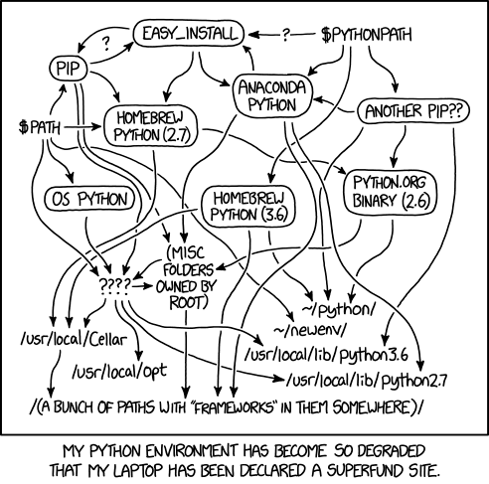
What about Anaconda/Conda
We want to make life easy!
Anaconda is very “heavy” piece of software.
Most of the time, people don’t use it correctly.
If you do have to use conda, use miniconda.
For this workshop, we will use:
Poetry
venv (standard with python)
Pip (standard with python)
Notes:
Anaconda used to be the go-to for scientific software, and it’s still quite popular today.
Anaconda itself is very bloated and comes with something like 2GiB of installs. There is an alternative: miniconda, which is lightweight. However it still comes with the downsides mentioned in the previous slide.

Slide 4
How to use Poetry
Way #1 – start off your project the right way
:~$ poetry new my-project
my-project
├── pyproject.toml
├── README.md
├── my_project
│ └── __init__.py
└── tests
└── __init__.py
Initializing a new project is easy
Standard files and directory structure is created for you
Adding packages is easy:
:~$ poetry add numpy
Poetry will automatically update your toml file
Poetry will also manage your virtual environment if you have already created one

Slide 5
How to use Poetry
Way #2 – Initializing a pre-existing project
This way is a little more involved, and it is covered in the course material
Poetry init
You will then follow some instructions to create your toml file
I recommend always starting off your projects in the right way – assuming that you will always be writing significant pieces of software!
By default, Poetry will create a virtual environment.
“Poetry will detect and respect an existing virtual environment that has been externally activated.
To take advantage of this, simply activate a virtual environment using your preferred method or tooling, before running any Poetry commands.”

Slide 6
The toml file
The toml file is the control center for your project
Metadata
Name, version, description, authors, licensing, included packages
Dependency management
The libraries you need for the project
Development libraries
Build system configuration
What tools are used to build the project
Script configuration
CLI entry points
Notes:
So we talked about important files for github and git, well this is the important file for poetry. The toml file is the control center for your python project.

Slide 7
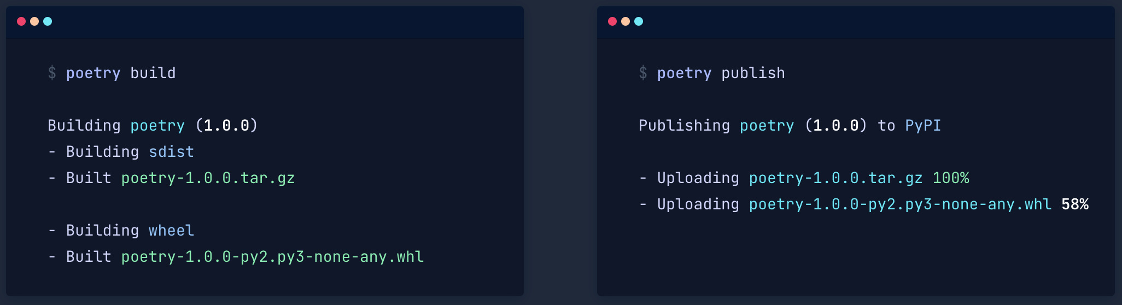
Building and publishing
Once your PyPI tokens are configured, life is good…

