Slide 1
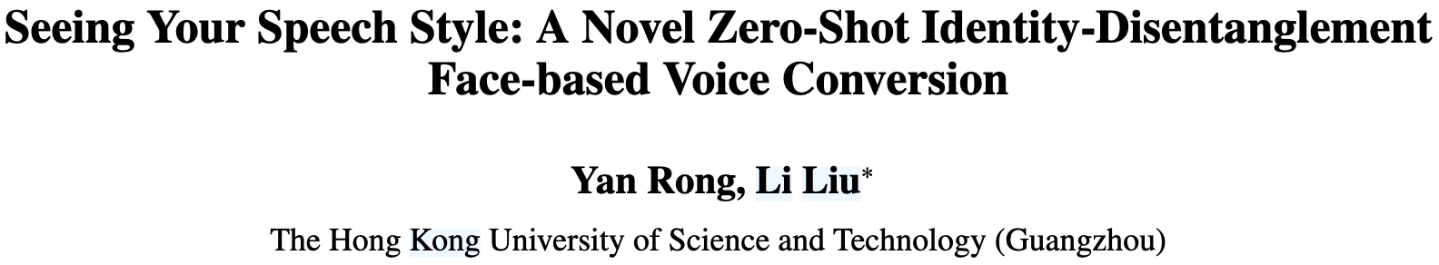

Slide 2
Table of Contents
Introduction
Method
ID-Aware Query-based Contrastive Learning
Mutual Information-based Dual Decoupling
Alternative Text-Input with Style Control
Training Loss
Experiment and Result
Conclusion

Slide 3
Table of Contents
Introduction
Method
ID-Aware Query-based Contrastive Learning
Mutual Information-based Dual Decoupling
Alternative Text-Input with Style Control
Training Loss
Experiment and Result
Conclusion

Slide 4
Face-based Voice Conversion
Voice Conversion (VC) aims to change the speaker identity in speech from a source speaker to that of a target speaker, while preserving the linguistic content.
Zero-Shot Face-based Voice Conversion is explored.
Application
Automated film dubbing
Personalized virtual assistants(e.g., siri, bixby)

Slide 5
Challenge
The fundamental challenge is to accurately map identity information between faces and voices.
Acquisition of facial embeddings that are well-aligned with the speaker’s voice identity
Now, focus on general facial features rather than speaker-specific features(FVMVC, FaceVC)
the models become highly dependent on the training data and lack the ability to locate unique voice characteristics among different speakers
Decoupling of content and speaker identity information from the audio input
FVMVC use mixed supervision strategy
However, in practical scenarios, it is often difficult to acquire adequate and balanced supervision
Lead to suboptimal decoupling performance

Slide 6
To Address Challenge 1
We design an Identity-Aware Query-based Contrastive Learning (IAQ-CL) module
Instead of adopting static encoding methods
Precisely extract the most identity-relevant facial features.
Identity-Aware Query-based Contrastive Learning (IAQ-CL) Module
Self-Adaptive Face-Prompted QFormer (SAFPQ)
Employs learnable self-adaptive face prompts.
Queries identity-relevant features from a frozen CLIP visual encoder (Radford et al., 2021).
Contrastive Learning with identity features extracted from audio

Slide 7
To Address Challenge 2
We propose a novel Mutual Information-based Dual Decoupling (MIDD) module
Enhance feature purification by addressing overlapping information in speech features.
Mutual Information-based Dual Decoupling (MIDD)
Speech Feature Decoupling
Decomposes speech into subspaces representing different attributes.
Minimizes overlap between the speaker identity and content features by Mutual Information (MI).
Fine-Grained Speaker Supervision
Emphasizes subtle speaker distinctions.
Prevents model collapse by leveraging speaker identity.

Slide 8
Text-Based Speech Generation with Style Control
Additional Problem with Previous Approaches
Voice Input-Based Models
Reference audio is not always available in practical scenarios.
e.g., digital humans, historical figures
Text Input-Based Models
Lack the flexibility to manipulate speech style
Often produce speech in a “machine” manner
Contribution
Incorporate text as an alternative modality during the inference stage.
Propose a style-controllable strategy to control over emotion and speed of speech.
Enables the generation of natural, rhythmical, and controllable speech from text.

Slide 9
Table of Contents
Introduction
Method
ID-Aware Query-based Contrastive Learning
Mutual Information-based Dual Decoupling
Alternative Text-Input with Style Control
Training Loss
Experiment and Result
Conclusion

Slide 10
Method
ID-FaceVC employs an end-to-end training approach.
Main Components
ID-Aware Query-based Contrastive Learning Module
Aligns facial features with voice identity.
Mutual Information-based Dual Decoupling Module
Separates content and speaker identity in audio input.
Alternative Text-Input with Style Control Module
Allows text-based input with emotion and speed control.

Slide 11
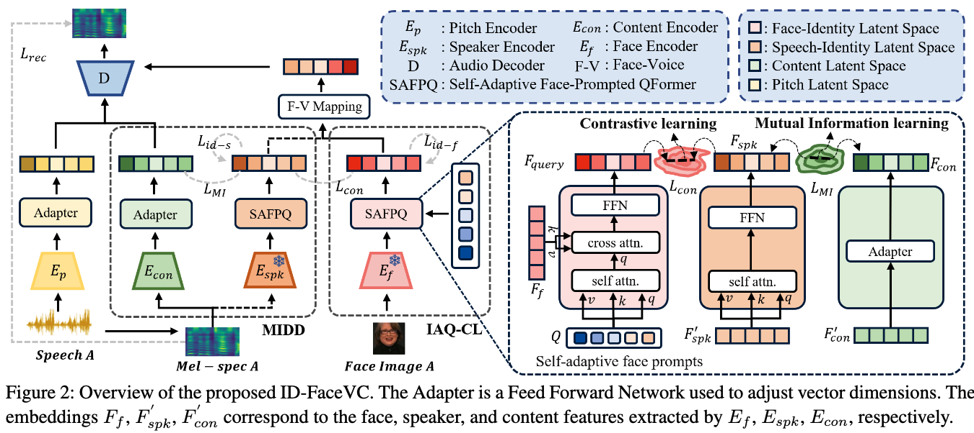
Architecture of the proposed ID-FaceVC

Slide 12
ID-Aware Query-based Contrastive Learning
Purpose
Extract facial features aligned with the speaker’s voice identity.
Key Components
Self-Adaptive Face-Prompted QFormer
Adapts facial features dynamically for better voice identity alignment.
Face-Related Speaker Identity Supervision
Ensures accurate mapping between facial features and speaker identity.
Outcome
Enhanced feature alignment for natural and accurate voice conversion.

Slide 13
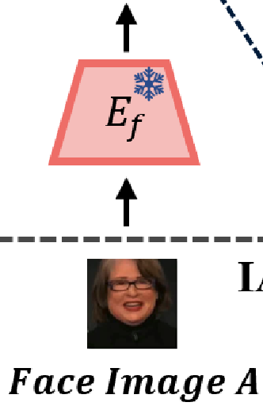

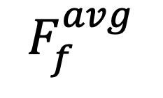
Using CLIP as Face Encoder
CNN-based Limitations: Struggles with the diversity of facial features.
Approach
Frozen CLIP Visual Encoder
Uses a pretrained CLIP (Radford et al. 2021) model to extract robust facial features.
Frame-wise Visual Embedding Averaging
Computes the arithmetic mean of embeddings across frames.
Avoids sampling bias by eliminating dependence on a single frame.
$$F_{f }^{avg}$$
$$CLIP$$
Notes:
Frame-wise의 의미가 뭘 의미하는지는 코드까봐야 알거 같은데
(1) w/o IAQ-CL: Randomly selects a facial frame from a video ablation study에서 이렇게 표현한거 보면 학습할때 한 utter당 모든 이미지 들어가서 평균 내는거 같음

Slide 14
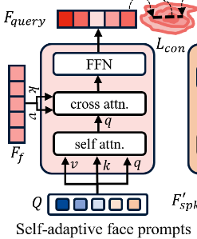


Self-Adaptive Face-Prompted QFormer
CLIP Visual Features
High-dimensional and redundant.
Include unnecessary information. (e.g., facial expressions, head poses, backgrounds)
Small portion related to speaker style.
Self-Adaptive Face-Prompted QFormer (SAFPQ)
Filters speech-relevant features from facial embeddings.
Acts as an information bottleneck, eliminating redundancy.
Enhances identity integration across face and voice domains.
*information bottleneck: process of selectively passing on the important information and reducing the unnecessary.
$$CLIP$$
Notes:
Redundant: 중복

Slide 15
Self-Adaptive Face-Prompted QFormer
Key Features
Enhanced Feature Filtering
Extracts only identity-relevant features from facial embeddings.
Identity Cohesion
Combines identity information from face and voice domains.
Inference Stage
Self-Adaptive Face Prompts (SAFP)
Dynamically retrieve identity-relevant features.
Facilitate prediction of speaker’s style from unseen facial images.
$$CLIP$$
Notes:
Retrieves: 검색하다

Slide 16
SAFPQ Workflow
Workflow Overview
Initialize SAFP: Learnable prompts are established and updated through self-attention.
Self-Attention: The most informative prompts are highlighted from global perspective.
Cross-Attention: SAFP retrieves identity-relevant features by interacting with facial embeddings.
Fully Connected Layers: FFN fuses the retrieved features for final representation.
Notes:
FFN: feed forward network

Slide 17
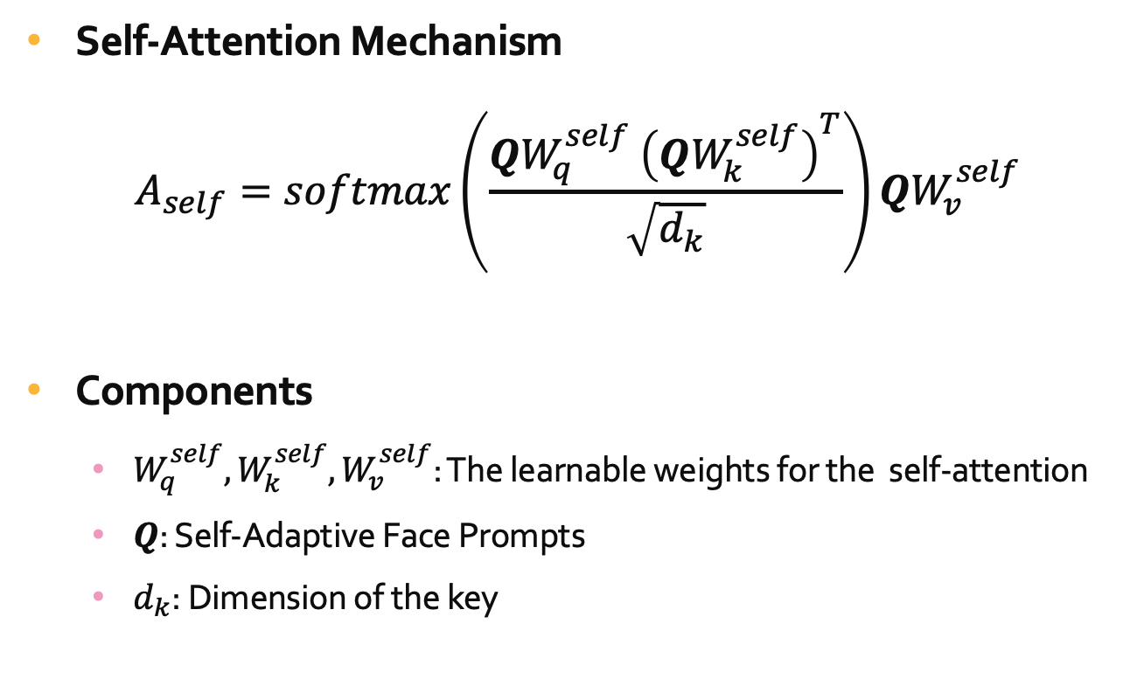
Mathematical Process of SAFPQ
Self-Attention Mechanism
$$A_{self}=softmax\left(\frac{QW_{q}^{self} {\left(QW_{k}^{self}\right)}^{T}}{\sqrt{d_{k}}}\right)QW_{v}^{self}$$
Components
$W_{q}^{self},W_{k}^{self},W_{v}^{self}$: The learnable weights for the self-attention
$Q$: Self-Adaptive Face Prompts
$d_{k}$: Dimension of the key

Slide 18
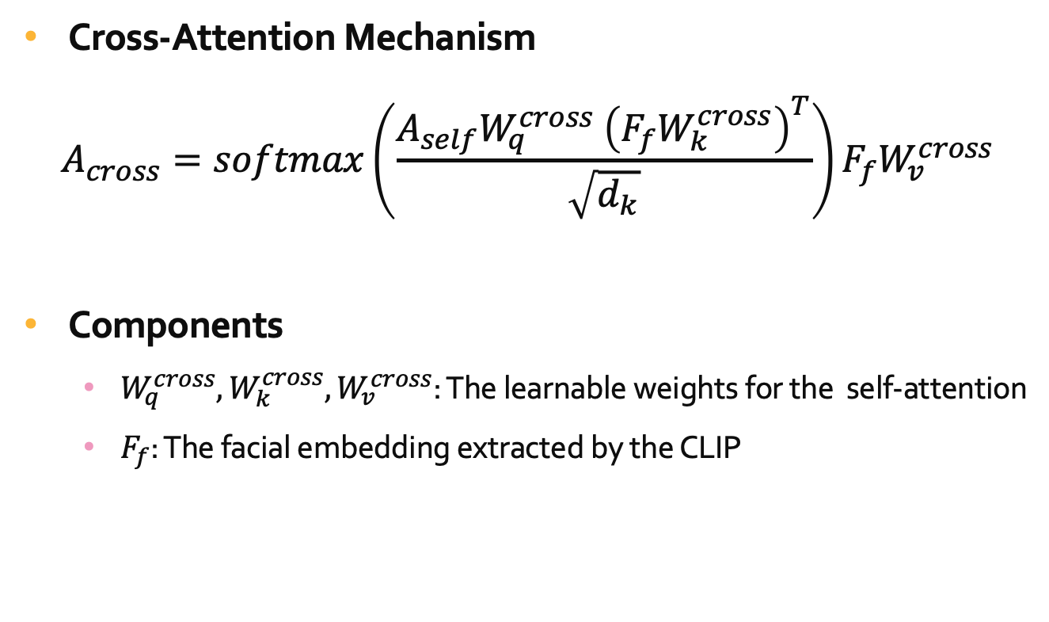
Mathematical Process of SAFPQ
Cross-Attention Mechanism
$$A_{cross}=softmax\left(\frac{A_{self}W_{q}^{cross} {\left(F_{f}W_{k}^{cross}\right)}^{T}}{\sqrt{d_{k}}}\right)F_{f}W_{v}^{cross}$$
Components
$W_{q}^{cross},W_{k}^{cross},W_{v}^{cross}$: The learnable weights for the self-attention
$F_{f}$: The facial embedding extracted by the CLIP

Slide 19
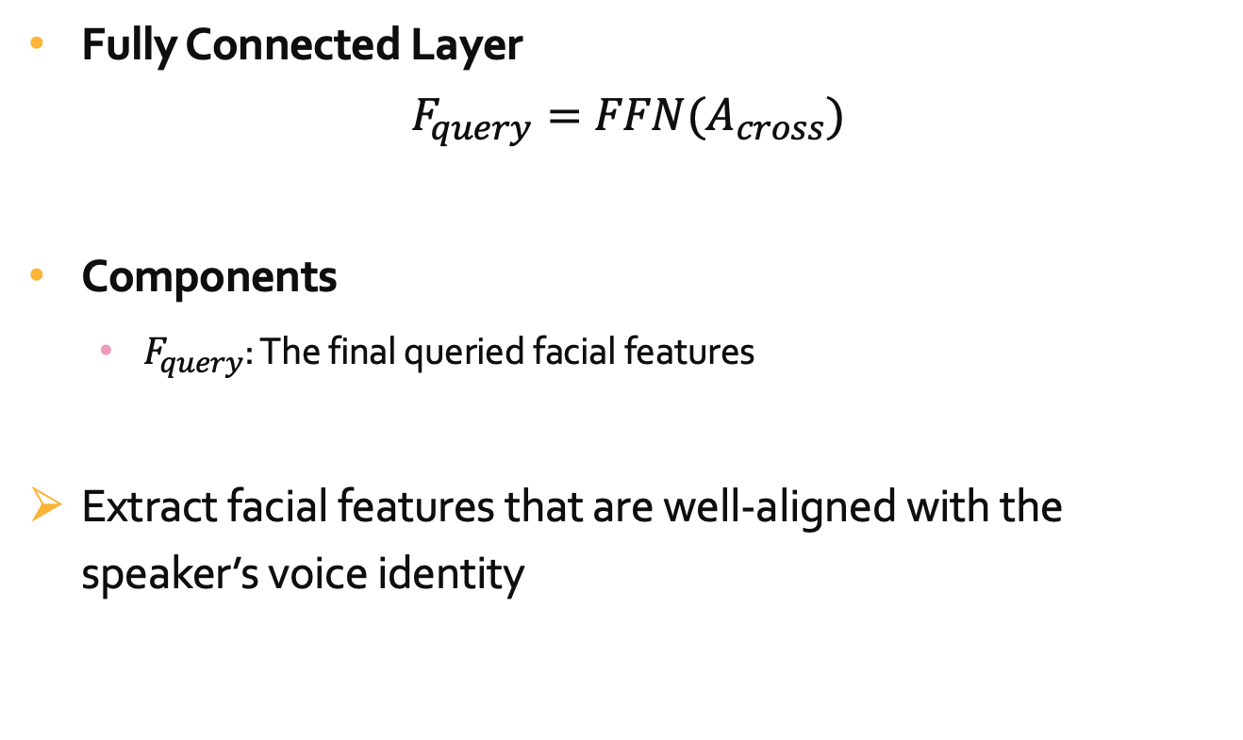
Mathematical Process of SAFPQ
Fully Connected Layer
$$F_{query}=FFN(A_{cross})$$
Components
$F_{query}$: The final queried facial features
Extract facial features that are well-aligned with the speaker’s voice identity

Slide 20
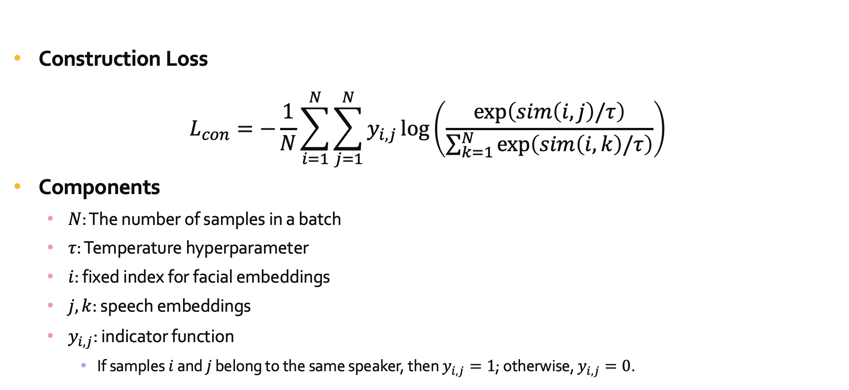
Loss of SAFPQ
Construction Loss
$$L_{con}=−\frac{1}{N}\sum_{i=1}^{N}{\sum_{j=1}^{N}{y_{i,j}\log\left(\frac{\exp\left(sim\left(i,j\right)/τ\right)}{\sum_{k=1}^{N}{\exp\left(sim\left(i,k\right)/τ\right)}}\right)}}$$
Components
$N$: The number of samples in a batch
$τ$: Temperature hyperparameter
$i$: fixed index for facial embeddings
$j, k$: speech embeddings
$y_{i,j}$: indicator function
If samples $i$ and $j$ belong to the same speaker, then $y_{i,j}=1$; otherwise, $y_{i,j}=0$.
Notes:
Sim은 cos sim일듯, y_i,j=1이 pos, =0이 neg인 contrastive learning 식

Slide 21
Face-related Speaker-identity Supervision
Objective Enhance the model’s ability to differentiate facial features between speakers.
Mechanism
Consistency: Ensures facial features remain stable for the same speaker.
Diversity: Promotes clear differentiation for different speakers.
Goal
Consistency: Generate similar speech styles for different images of the same speaker.
Diversity: Create distinct speech styles for different speakers.

Slide 22
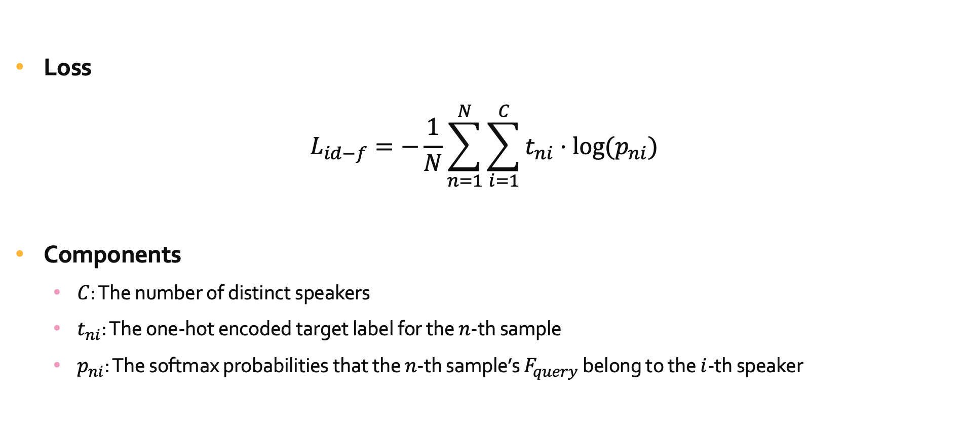
Face-related Speaker-identity Supervision
Loss
$$L_{id−f}=−\frac{1}{N}\sum_{n=1}^{N}{\sum_{i=1}^{C}{t_{ni}⋅log⁡(p_{ni})}}$$
Components
$C$: The number of distinct speakers
$t_{ni}$: The one-hot encoded target label for the $n$-th sample
$p_{ni}$: The softmax probabilities that the $n$-th sample’s $F_{query}$ belong to the $i$-th speaker
Notes:
아마 저 p_ni는 이전 식에 exp()~~랑 같은듯 CE사용해서 정답 클래스 집중 • L_{\text{id-f}} 는 **정답 클래스의 softmax 확률 p_{ni} **를 최대화하기 위해 사용되는 Cross-Entropy 기반 손실 함수입니다.
• 목표: 모델이 정확한 분류를 하도록 학습.

Slide 23
Table of Contents
Introduction
Method
ID-Aware Query-based Contrastive Learning
Mutual Information-based Dual Decoupling
Alternative Text-Input with Style Control
Training Loss
Experiment and Result
Conclusion

Slide 24
Mutual Information-based Dual Decoupling (MIDD)
Purpose
Precisely represent disentangled latent spaces.
Purify speech content information.
Key Components
Disentangled Latent Space
Mutual Information-based Decoupling

Slide 25
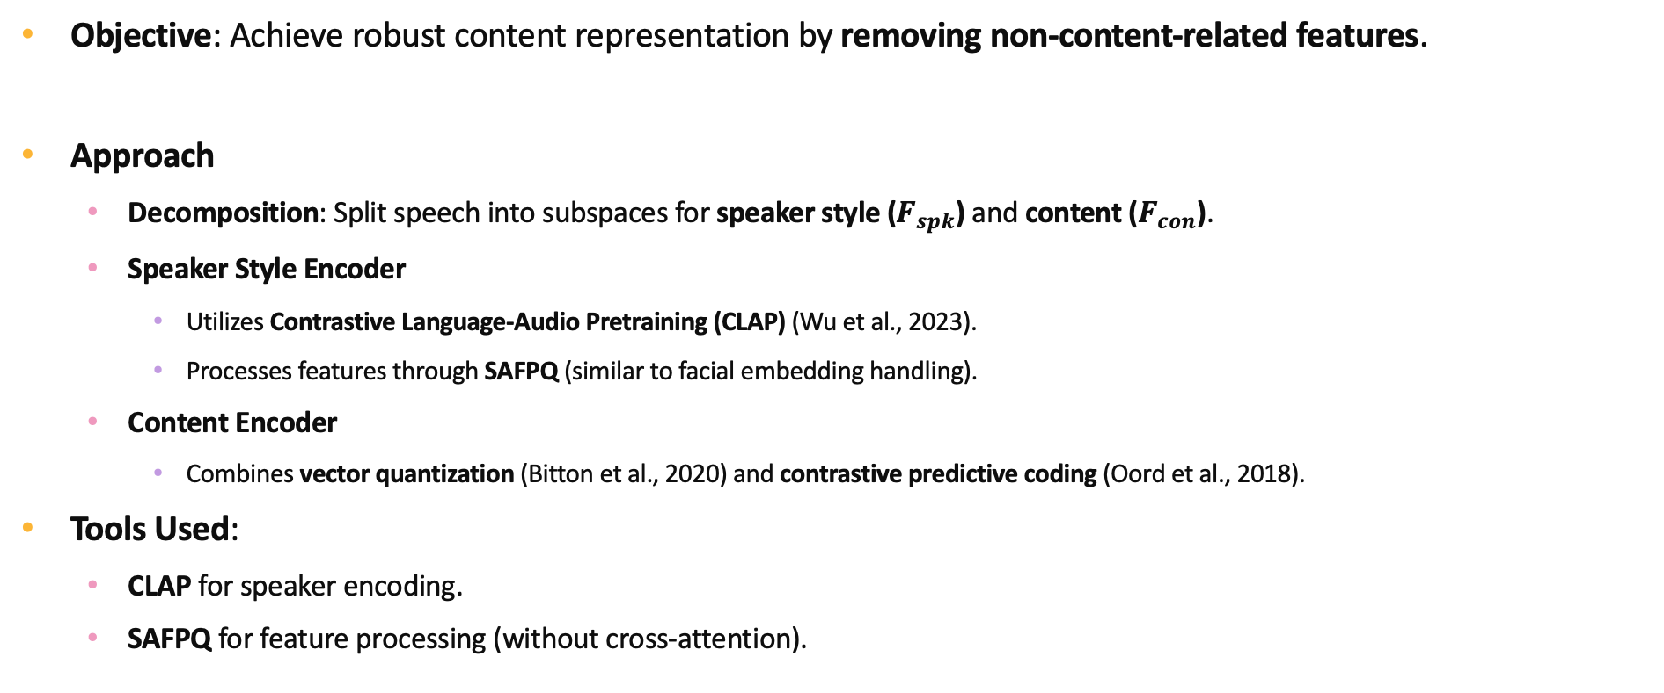
Disentangled Latent Space
Objective: Achieve robust content representation by removing non-content-related features.
Approach
Decomposition: Split speech into subspaces for speaker style ($F_{spk}$) and content ($F_{con}$).
Speaker Style Encoder
Utilizes Contrastive Language-Audio Pretraining (CLAP) (Wu et al., 2023).
Processes features through SAFPQ (similar to facial embedding handling).
Content Encoder
Combines vector quantization (Bitton et al., 2020) and contrastive predictive coding (Oord et al., 2018).
Tools Used:
CLAP for speaker encoding.
SAFPQ for feature processing (without cross-attention).
Notes:
CPC
예측 학습 (Predictive Learning)
Contrastive Loss (대조 손실)
Latent Representation
음성 데이터의 경우, 이전 5초의 신호로 다음 1초를 예측하는 과정을 반복하면서 음성 신호의 구조적 패턴을 학습.

Slide 26
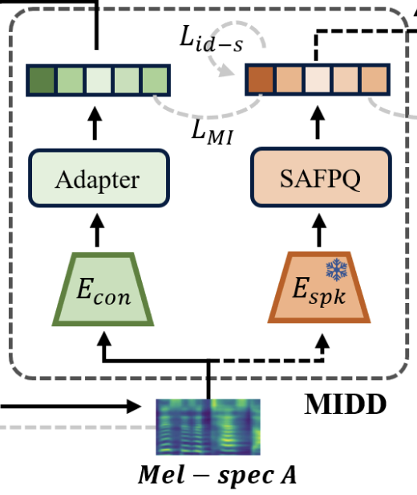
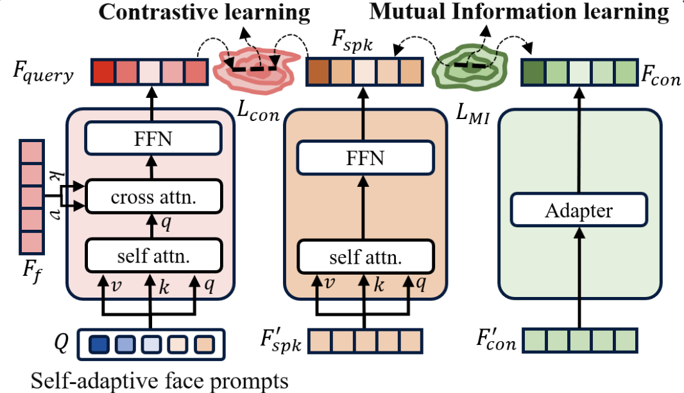
Disentangled Latent Space
Tools Used
CLAP for speaker encoding.
SAFPQ for feature processing (without cross-attention).

Slide 27
Mutual Information-based Decoupling
Challenge
Simply separating latent spaces for speaker and content embeddings does not guarantee sufficient feature decoupling.
Previous methods (e.g., inter-speaker supervision) suffer from overlapping features.
Solution
Mutual Information (MI): Measures dependency between variables, capturing linear and non-linear relationships.
Estimation Approach
Challenge: Direct MI calculation is impractical due to high dimensionality and unknown distributions.
Technique
Use a variational upper bound (Cheng et al., 2020) to approximate MI.
Introduce parameterized conditional distributions for efficient estimation and minimization.

Slide 28
Mutual Information-based Decoupling
Challenge
Simply separating latent spaces for speaker and content embeddings does not guarantee sufficient feature decoupling.
Previous methods (e.g., inter-speaker supervision) suffer from overlapping features.
Solution
Mutual Information (MI): Measures dependency between variables, capturing linear and non-linear relationships.
Notes:
Mutual: 상호

Slide 29
Estimation Approach
Challenge: Direct MI calculation is impractical due to high dimensionality and unknown distributions.
Solution
Use a variational upper bound (Cheng et al., 2020) to approximate MI.
Introduce parameterized conditional distributions for efficient estimation and minimization.
Minimizing the overlap information between the extracted style features and content features
Successfully establish a speaker style space related to identity and a content space associated with semantics.

Slide 30
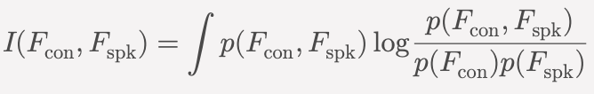
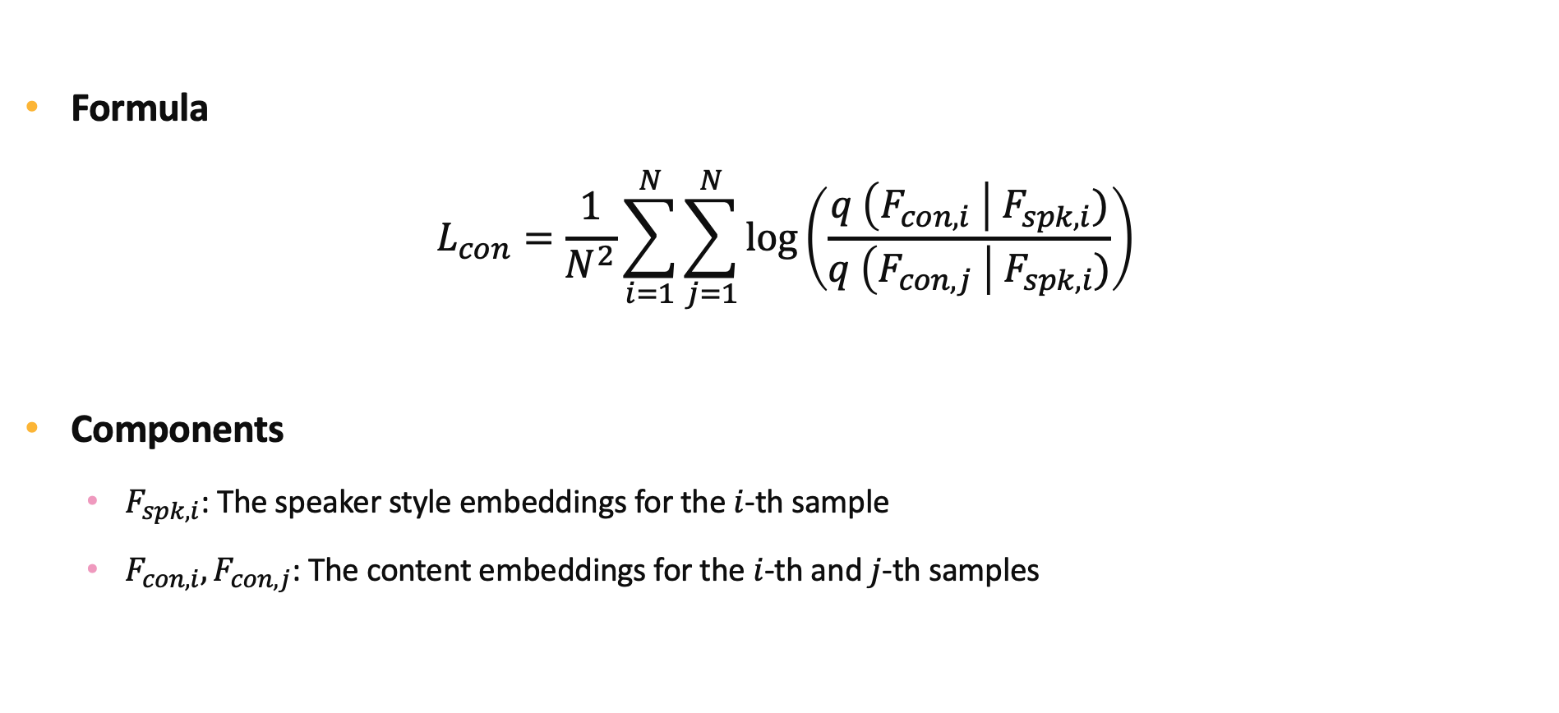
Estimation Approach
Formula
$$L_{con}=\frac{1}{N^{2}}\sum_{i=1}^{N}{\sum_{j=1}^{N}{\log\left(\frac{q \left(F_{con,i} \right| F_{spk,i})}{q \left(F_{con,j} \right| F_{spk,i})}\right)}}$$
Components
$F_{spk,i}$: The speaker style embeddings for the $i$-th sample
$F_{con,i},F_{con,j}$: The content embeddings for the $i$-th and $j$-th samples
원래 MI 식
Notes:
• 동일한 스피커(Positive pair: i = j )에 대해 q(F_{\text{con}, i} \mid F_{\text{spk}, i}) 를 최대화.
• 다른 스피커(Negative pair: i \neq j )에 대해 q(F_{\text{con}, j} \mid F_{\text{spk}, i}) 를 최소화.
• MI를 직접 계산하려면 정확한 확률 분포 p(F_{\text{con}}, F_{\text{spk}}) 가 필요하지만, 이는 고차원 데이터에서 계산이 불가능.
• **조건부 확률 q(F_{\text{con}} \mid F_{\text{spk}}) **를 파라미터화하여 학습.

Slide 31
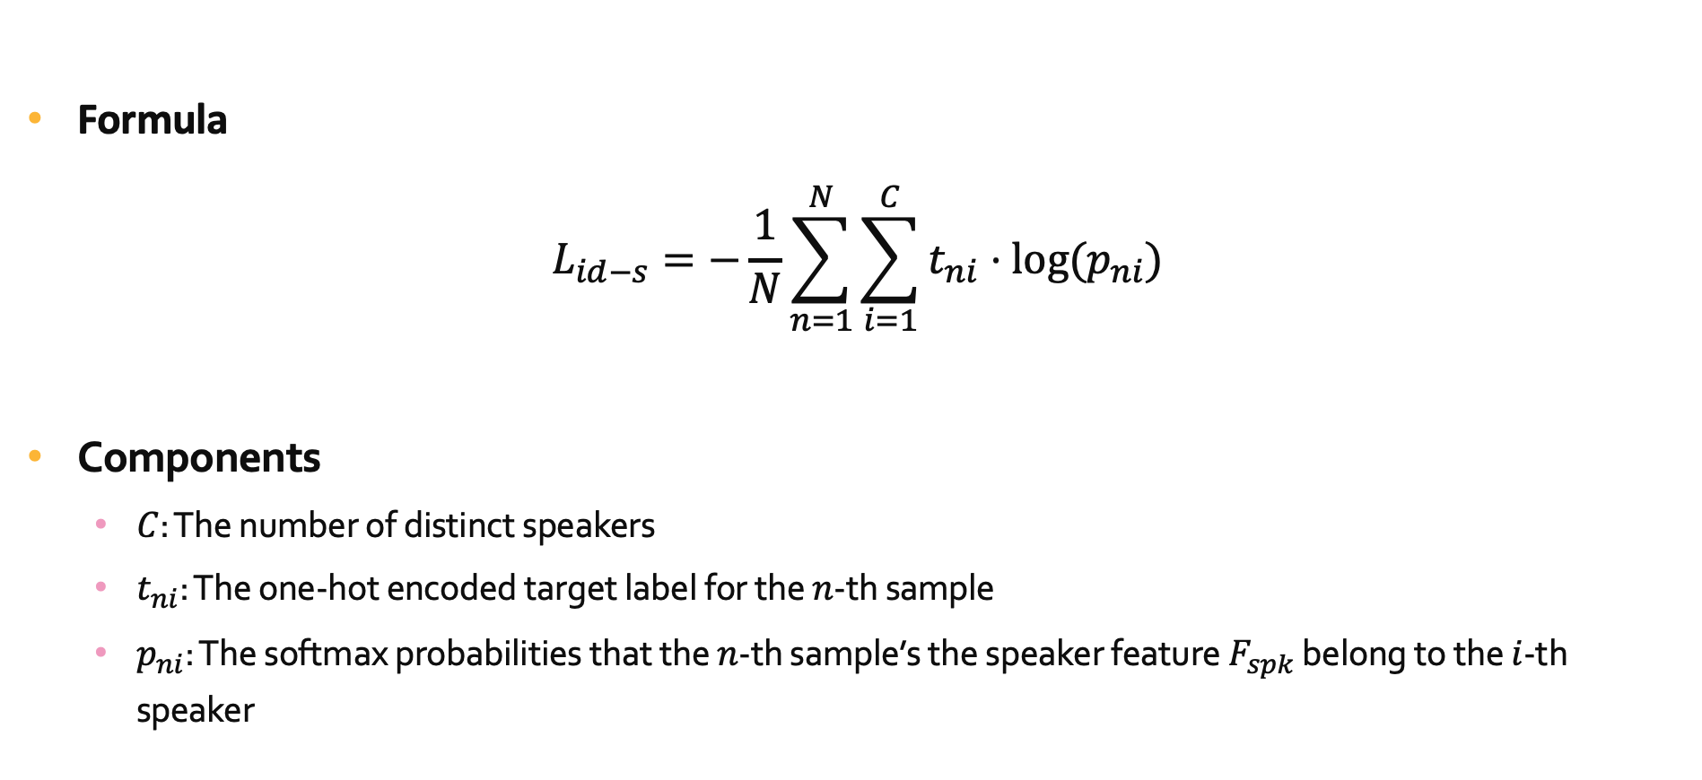
Speech-related Speaker-Identity Supervision
Formula
$$L_{id−s}=−\frac{1}{N}\sum_{n=1}^{N}{\sum_{i=1}^{C}{t_{ni}⋅log⁡(p_{ni})}}$$
Components
$C$: The number of distinct speakers
$t_{ni}$: The one-hot encoded target label for the $n$-th sample
$p_{ni}$: The softmax probabilities that the $n$-th sample’s the speaker feature $F_{spk}$ belong to the $i$-th speaker

Slide 32
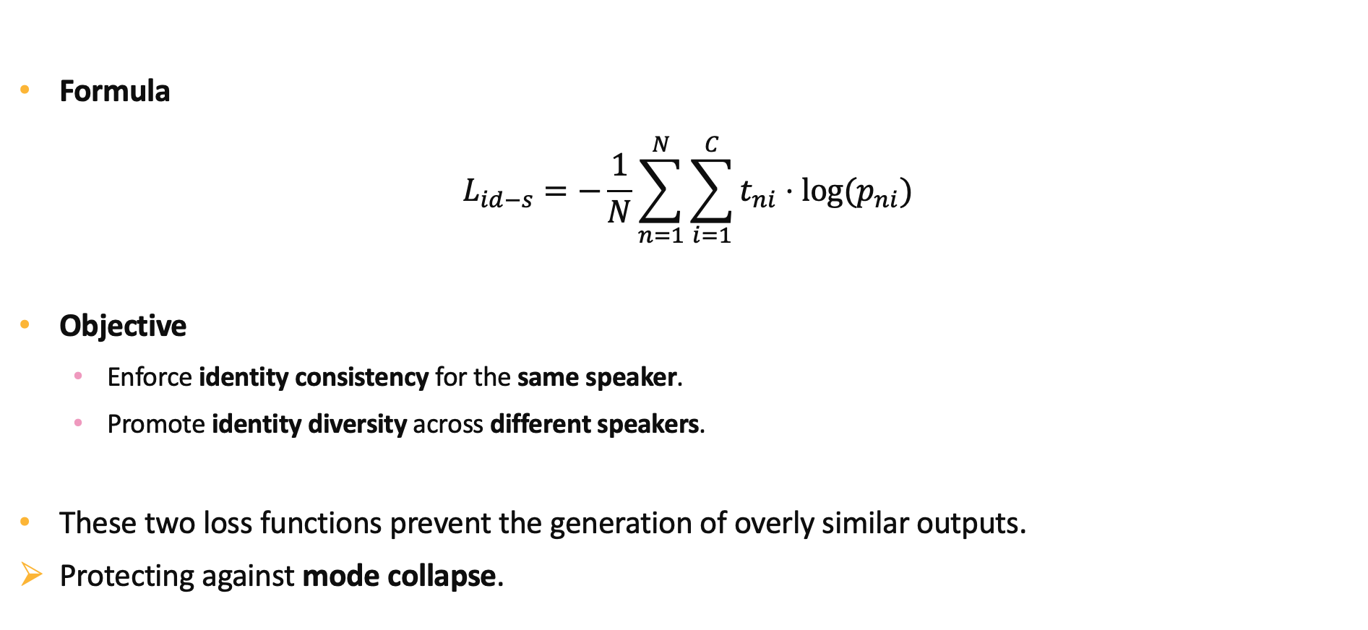
Speech-related Speaker-Identity Supervision
Formula
$$L_{id−s}=−\frac{1}{N}\sum_{n=1}^{N}{\sum_{i=1}^{C}{t_{ni}⋅log⁡(p_{ni})}}$$
Objective
Enforce identity consistency for the same speaker.
Promote identity diversity across different speakers.
These two loss functions prevent the generation of overly similar outputs.
Protecting against mode collapse.
Notes:
Mode Collapse의 정의
• 다양한 입력 데이터에 대해, 모델이 생성하는 출력이 매우 유사하거나 동일한 형태로 수렴하는 현상.
• 결과적으로 출력 데이터의 다양성이 사라지고, 특정 데이터 모드(mode, 패턴)만 반복적으로 생성.

Slide 33
Table of Contents
Introduction
Method
ID-Aware Query-based Contrastive Learning
Mutual Information-based Dual Decoupling
Alternative Text-Input with Style Control
Training Loss
Experiment and Result
Conclusion

Slide 34
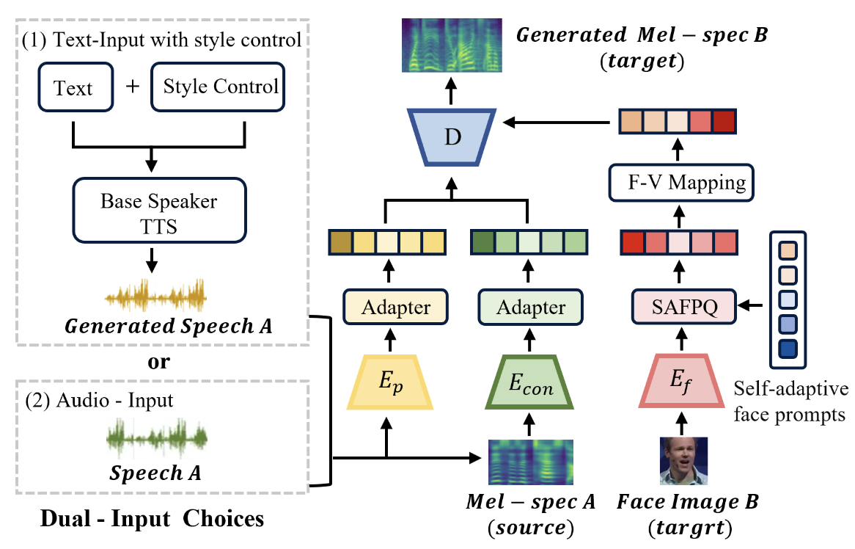
Alternative Text-Input with Style Control

Slide 35
Table of Contents
Introduction
Method
ID-Aware Query-based Contrastive Learning
Mutual Information-based Dual Decoupling
Alternative Text-Input with Style Control
Training Loss
Experiment and Result
Conclusion

Slide 36

Training Loss
Formula
$$L_{rec}={\left\|Mel−\hat{Mel}\right\|}_{2}^{2}$$
$$L=L_{rec}+λ_{1}L_{con}+λ_{2}L_{MI}+λ_{3}L_{id−f}+λ_{4}L_{id−s}+λ_{5}L_{F}$$
$L_{F}$: Inter-speaker Supervision Loss + Face-Voice Mapping Loss in FVMVC
Notes:
Inter: 얼굴 통해서 만들어진 Mel이랑 그냥 음성 통해 만들어진 mel L2+L1
Mapping: 음성, 얼굴 분포 KL

Slide 37
Table of Contents
Introduction
Method
ID-Aware Query-based Contrastive Learning
Mutual Information-based Dual Decoupling
Alternative Text-Input with Style Control
Training Loss
Experiment and Result
Conclusion

Slide 38
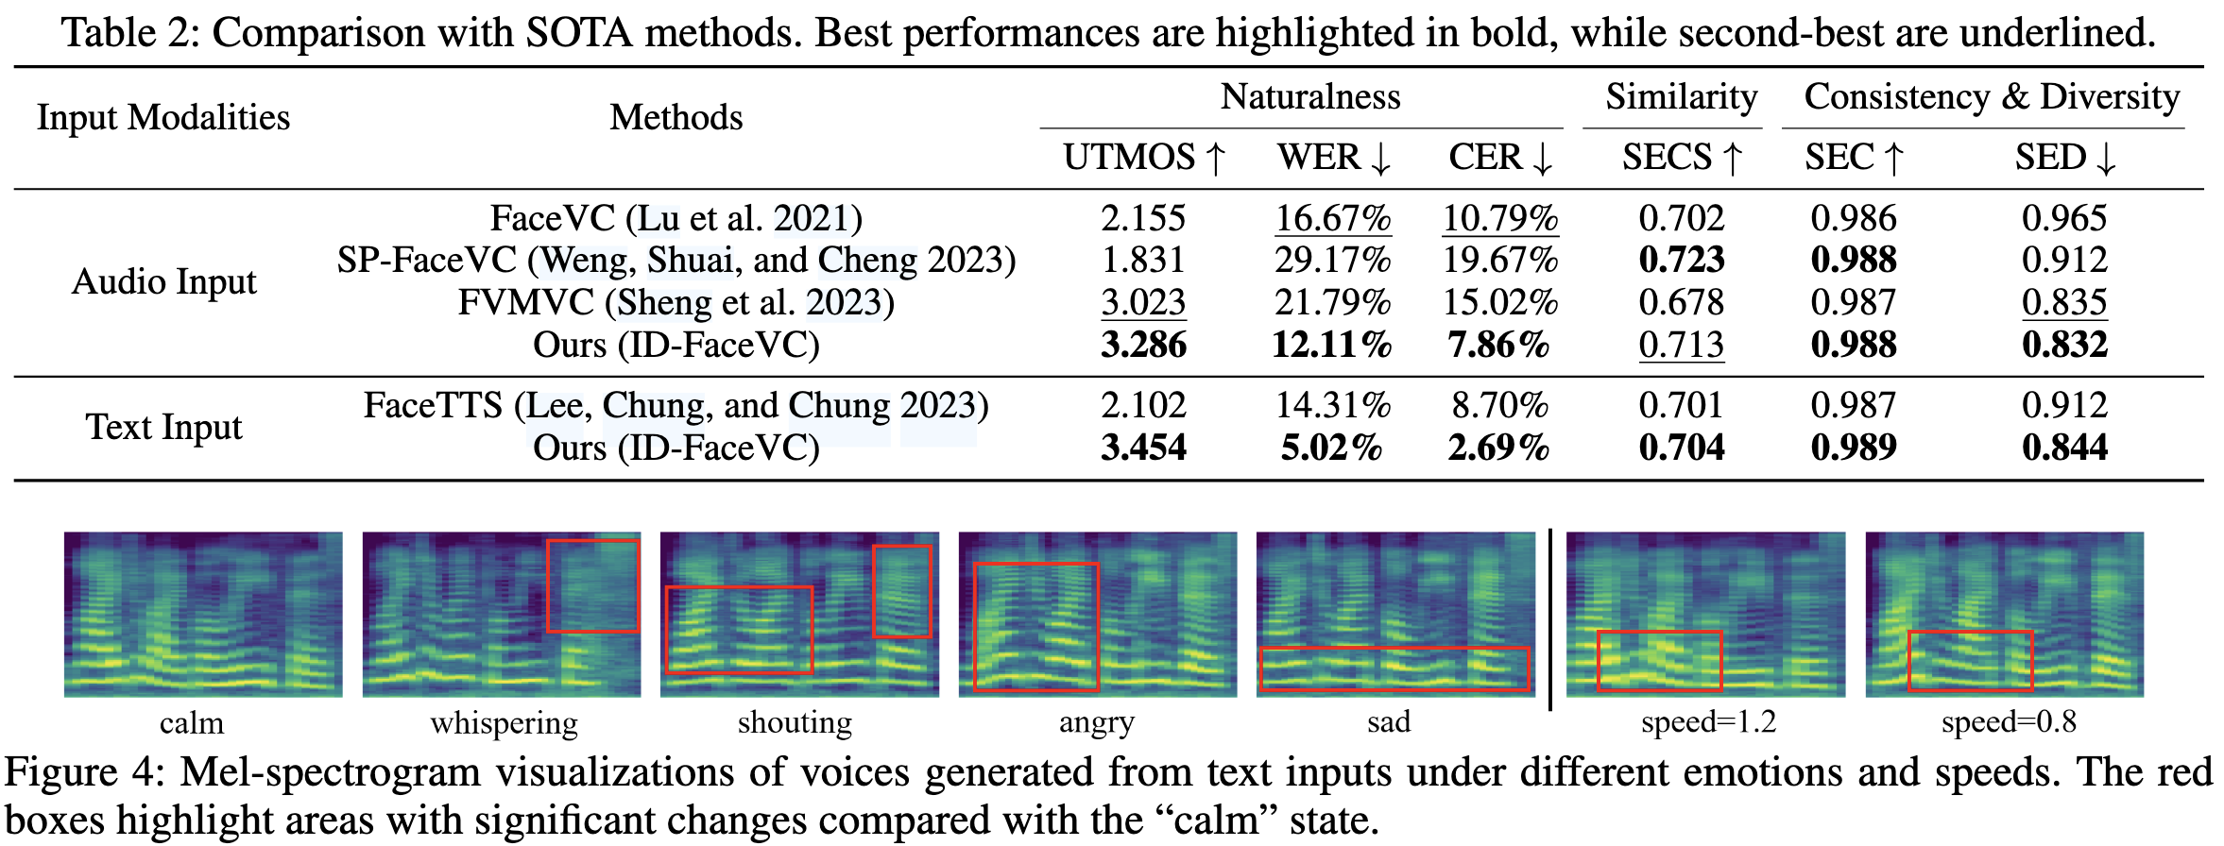
Experiment and Result
Notes:
word error rate (WER)
character error rate (CER)
Calculated by Whisper
peaker encoder cosine similarity (SECS)
speaker embedding consistency (SEC),(different facial angles of the same speaker)
speaker embedding diversity (SED),(speech outputs from different speakers.)

Slide 39
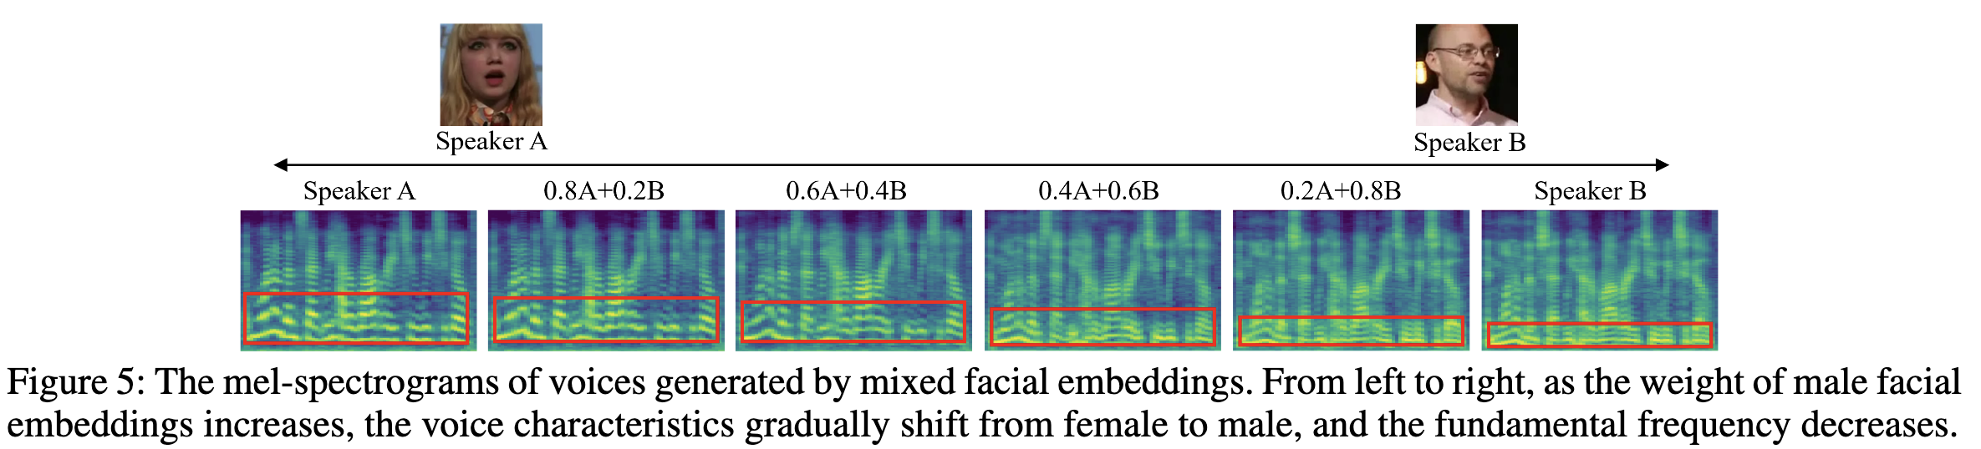
Experiment and Result

Slide 40
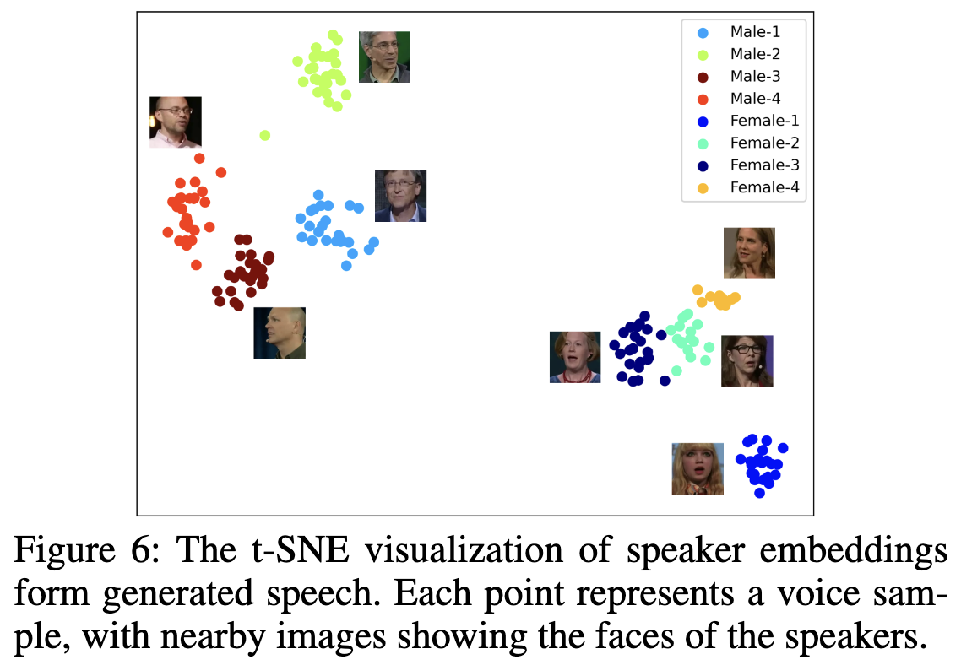
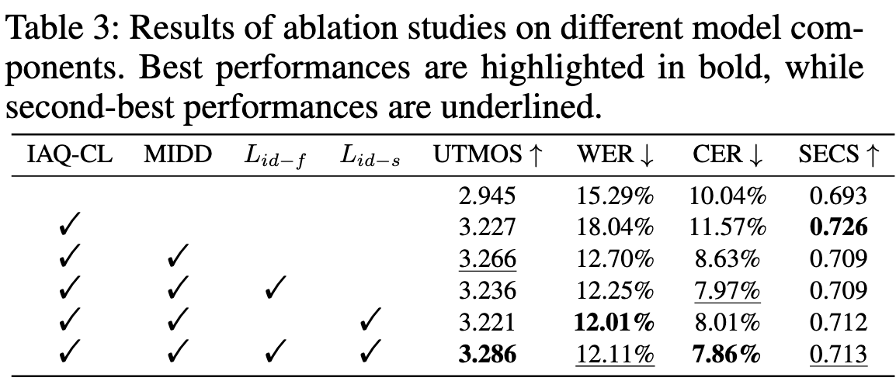
Experiment and Result

Slide 41
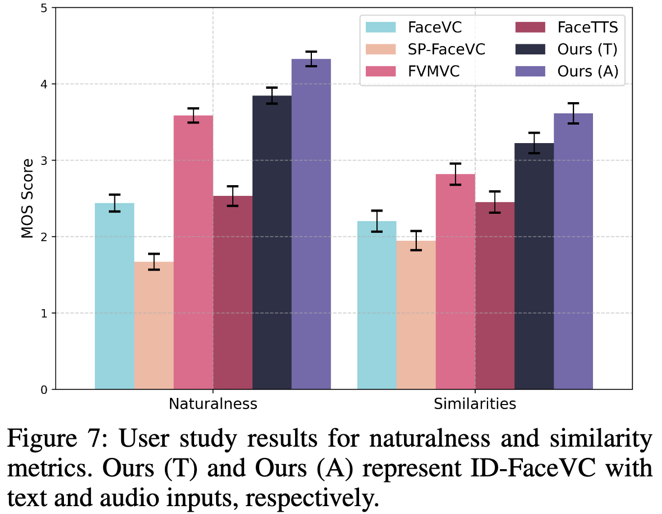
Experiment and Result

Slide 42
Table of Contents
Introduction
Method
ID-Aware Query-based Contrastive Learning
Mutual Information-based Dual Decoupling
Alternative Text-Input with Style Control
Training Loss
Experiment and Result
Conclusion

Slide 43
Conclusion
Framework
Introduced the ID-FaceVC framework to generate speech aligned with facial identity features.
Key Components
IAQ-CL Module: Maps facial features to speech.
MIDD Module: Enhances feature disentanglement for precise mapping.
Text Modality: Enables control over speech content, ensuring naturalness, rhythm, and controllability.
Future Directions
Extend beyond audio generation to include expressive facial animations, making the output both audible and visible.

