Slide 1
Beyond Entropy: Region Confidence Proxy for Wild Test-Time Adaptation
ICML 2025
Hyunoh Kang

Slide 2
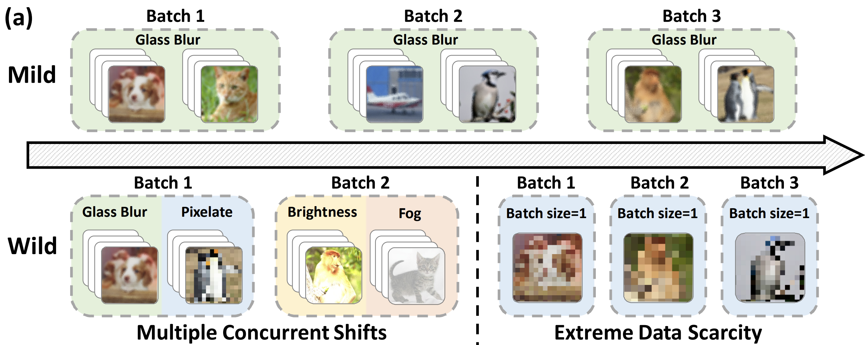
Introduction
TTA methods have achieved promising results under mild conditions
But, they show significant performance drops in wild scenarios
focus on developing selection criteria to leverage reliable samples
Notes:
only for entropy minimization

Slide 3
Introduction
TTA methods have achieved promising results under mild conditions
But, they show significant performance drops in wild scenarios
focus on developing selection criteria to leverage reliable samples
SAR (Niu et al., 2023) excluded samples with high entropy
DeYO (Lee et al., 2024) filtered out samples with sensitive prediction changes under image transformation
This paper aims to approach the more fundamental problem of entropy minimization
Not what to choose(criteria), but what to minimize(objective)
Notes:
저 SAR이 최초라는게 아님. 최초는 EATA. 근데 wild 한 상황에서는 SAR이 먼저

Slide 4
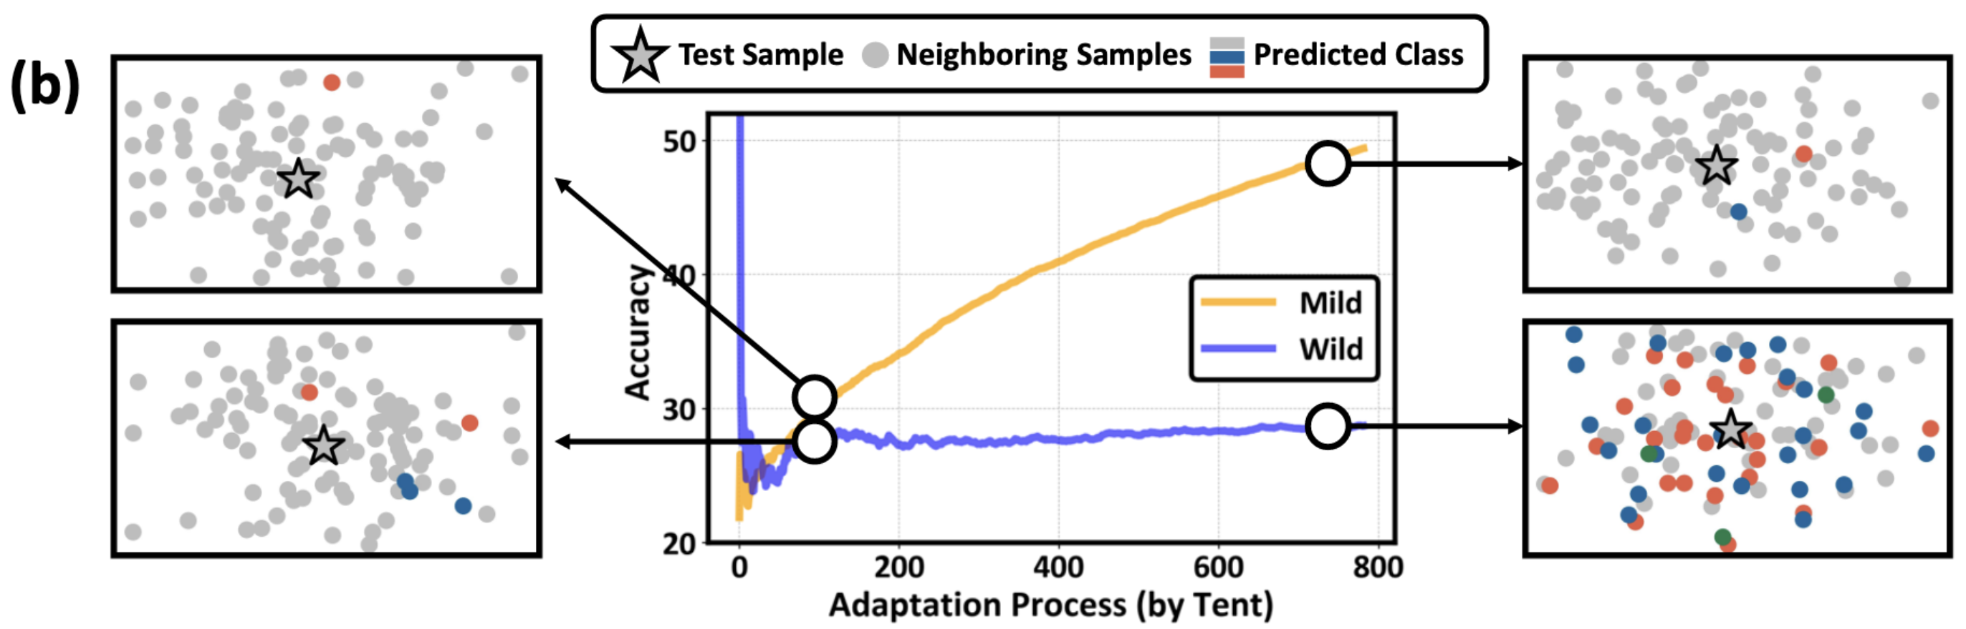
Introduction
In wild scenes, we observe a notable instability in feature space
Feature space should be grouped with samples that have semantically similar meanings
Enhance Region confidence
Notes:
저 SAR이 최초라는게 아님. 최초는 EATA. 근데 wild 한 상황에서는 SAR이 먼저
백본모델이 특징공간을 잘 학습했다는 가정하에,
다음 사진을 통해서 wild한 환경에서는 유사한 시맨틱에서 전혀 다른 예측을 함을 보임

Slide 5
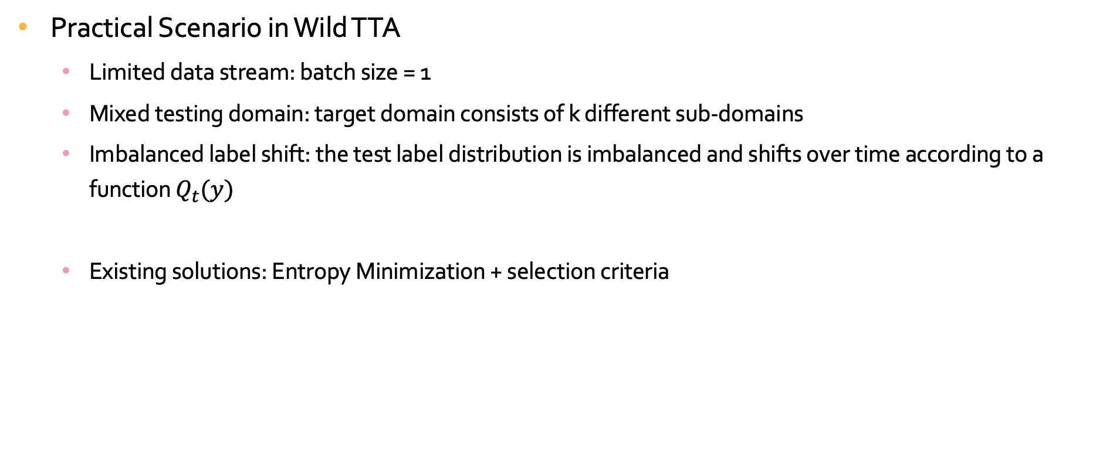
Preliminaries for Wild Test-Time Adaptation
Practical Scenario in Wild TTA
Limited data stream: batch size = 1
Mixed testing domain: target domain consists of k different sub-domains
Imbalanced label shift: the test label distribution is imbalanced and shifts over time according to a function $Q_{t}(y)$
Existing solutions: Entropy Minimization + selection criteria

Slide 6
Preliminaries for Wild Test-Time Adaptation
Practical Scenario in Wild TTA
Limited data stream: batch size = 1
Mixed testing domain: target domain consists of k different sub-domains
Imbalanced label shift: the test label distribution is imbalanced and shifts over time according to a function $Q_{t}(y)$
Existing solutions: Entropy Minimization + selection criteria

Slide 7
Exploring Entropy Minimization via Local Consistency
EM’s effectiveness heavily relies on the local consistency to extend sample-wise confidence to a regional scale
* Local consistency: nearby points share the similar prediction
local consistency
O: optimization for individual points align with the overall direction, magnifying the local effects
X: introducing noise that hinders adaptation in the affected region
it is crucial to evaluate the reliability of entropy minimization in preserving local consistency under wild scenes.
Notes:
저게 왜 저렇게 되냐?
결정경계가 한 샘플마다 변경이 되니까 주변에 샘플들이 영향받음
이게 일관성이 있으면 결정경계가 제대로 형성되는데
반대일경우 + - 막 되다가 이상해짐

Slide 8
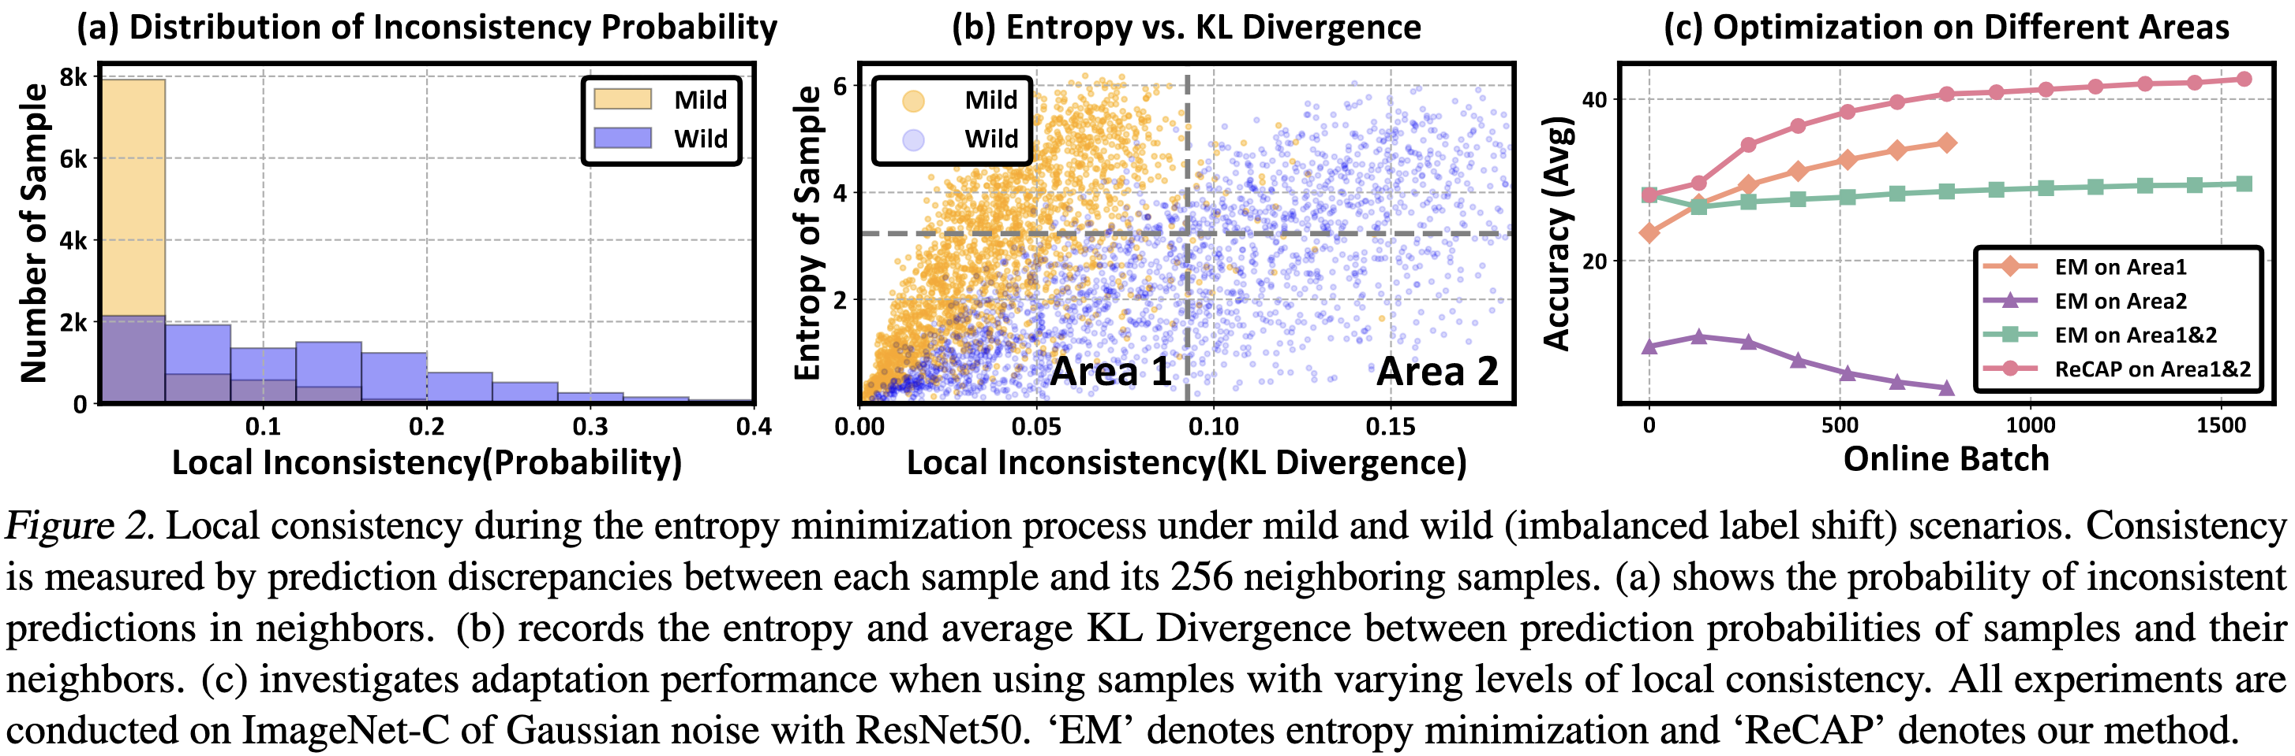
Exploring Entropy Minimization via Local Consistency
Notes:
(a): mild는 inconsistency 확률이 낮은데 wild는 높음
(b): KL로 봐도 엔트로피는 비슷해도 KL이 엄청 크게 나옴
(c): area 2는 성능저하를 유발, 1은 성능이 오름, 1+2는 좀 애매
1+2도 애매한것을 통해 EM+기존의 선택 필터 방법도 일관성을 유지하지 못해 성능이 별로다 라고 주장

Slide 9
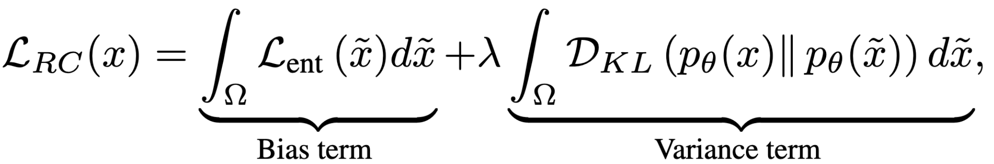
From Sample Confidence to Region Confidence
Introduce a novel objective called region confidence to replace vanilla entropy
optimizes both region-wise confidence and stability simultaneously
improving global optimization efficiency
Mathematical definition:
Notes:
local region Ω of a sample x
적분 하는 이유는 기대값 사용하기 위해(로컬을 평균)
바이어스(개별 샘플 업데이트의 방향”과 “지역적 목표” 사이의 방향 편향(bias)을 줄인다): 지역 전반의 “수준”을 맞추는 평균(엔트로피 기대값) → 방향 정렬.
분산: 지역 내부의 “흩어짐”을 줄이는 불일치 패널티(KL) → 동역학 분산 감소/일관성 증대.
둘을 합쳐 지역에서 자신감↑ + 일관성↑를 동시에 달성하자는 설계 취지라, 이름을 bias/variance로 잡은 거예요.

Slide 10
Region Confidence Proxy
There are still two considerable challenges to optimize region confidence
Uncertain region scope
The static regions fix the sample location, making it difficult to determine an appropriate local scope
Heavy computational burden
Previous term is intractable, relying on extensive sampling and additional model forwards for measurement
Propose Region Confidence Adaptive Proxy (ReCAP)
Probabilistic region modeling mechanism
Efficient proxy for optimizing region confidence

Slide 11
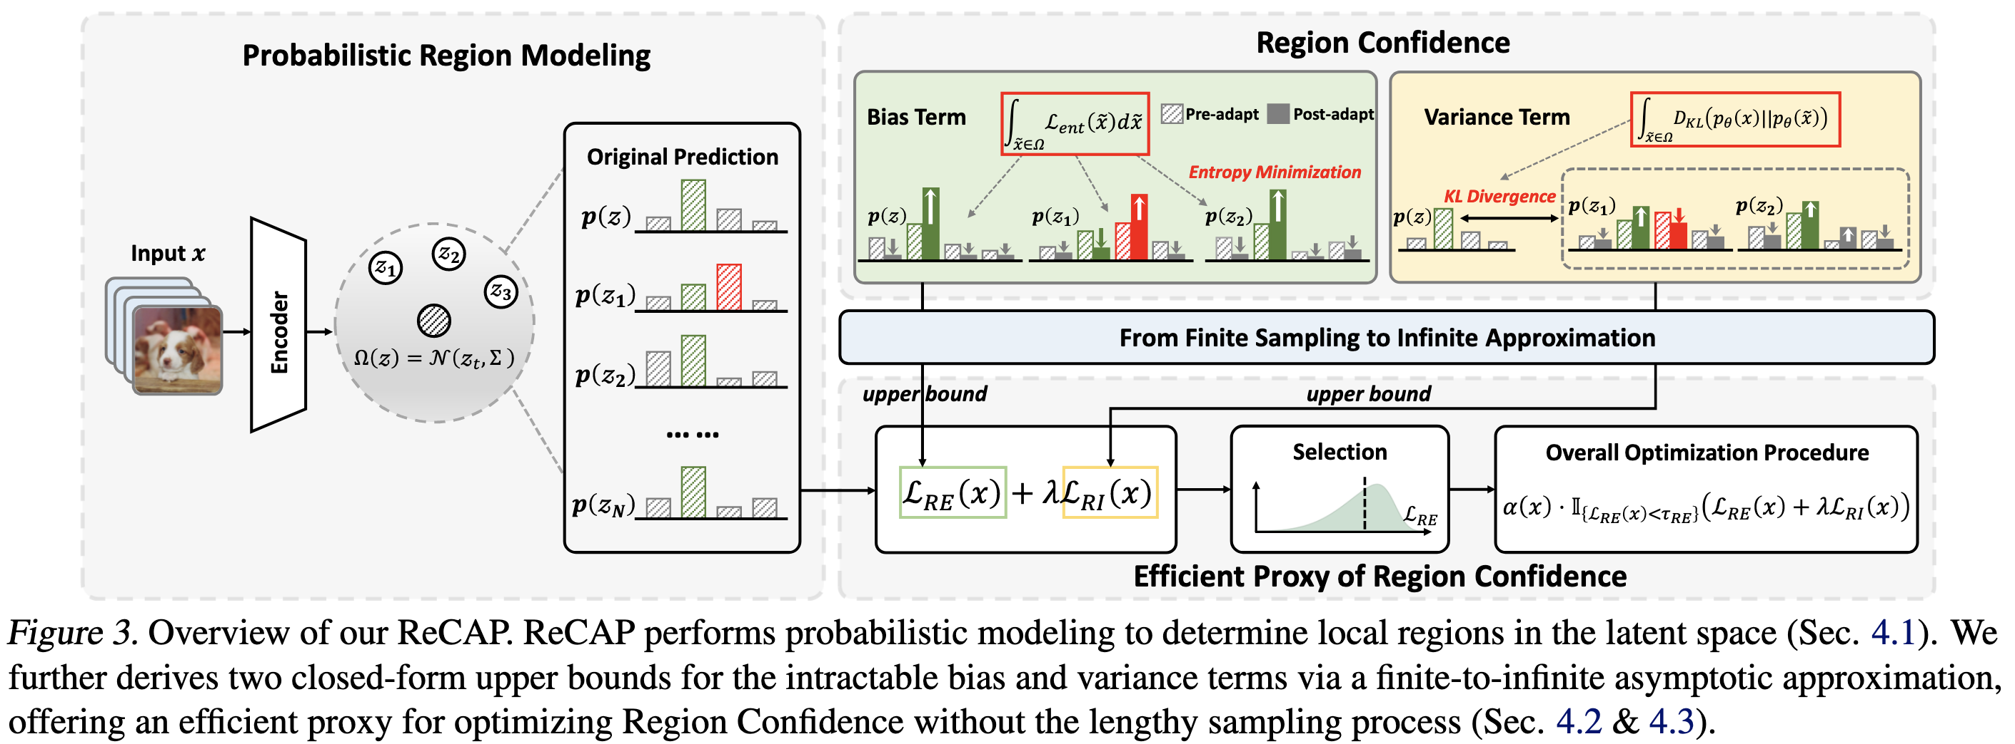
Region Confidence Proxy

Slide 12
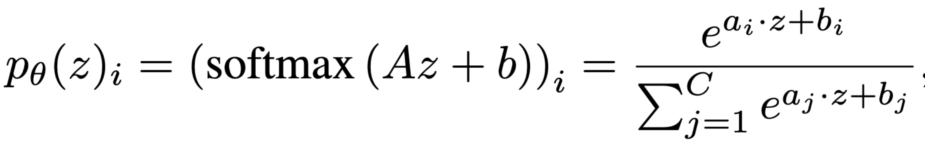
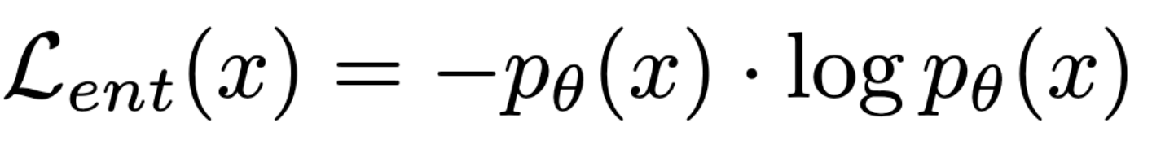
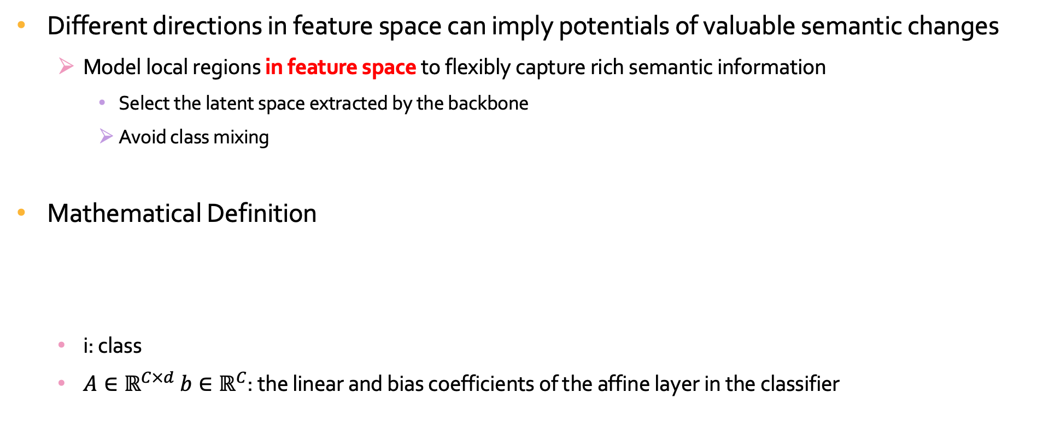
Probabilistic Region Modeling
Different directions in feature space can imply potentials of valuable semantic changes
Model local regions in feature space to flexibly capture rich semantic information
Select the latent space extracted by the backbone
Avoid class mixing
Mathematical Definition
i: class
$A∈ℝ^{C×d} b∈ℝ^{C}$: the linear and bias coefficients of the affine layer in the classifier

Slide 13
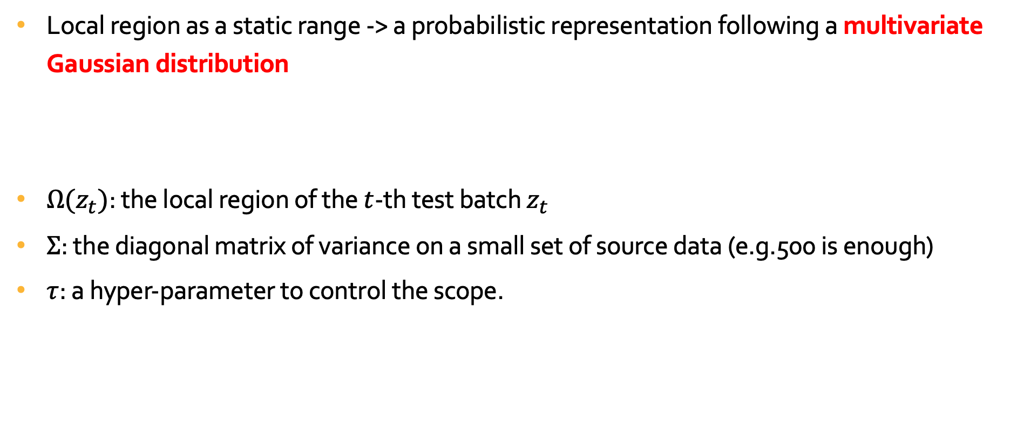
Probabilistic Region Modeling
Local region as a static range -> a probabilistic representation following a multivariate Gaussian distribution
$Ω(z_{t})$: the local region of the $t$-th test batch $z_{t}$
$Σ$: the diagonal matrix of variance on a small set of source data (e.g.500 is enough)
$τ$: a hyper-parameter to control the scope.
Notes:
소스는 원본인 imagenet의미

Slide 14
Efficient Metric of Region Confidence
the computation of two terms
depends on an infinite number of potential samples from the distribution
requires extensive sampling to capture the statistical information
Computational overhead and memory usage increase almost linearly with the number of sampling
Approximation

Slide 15
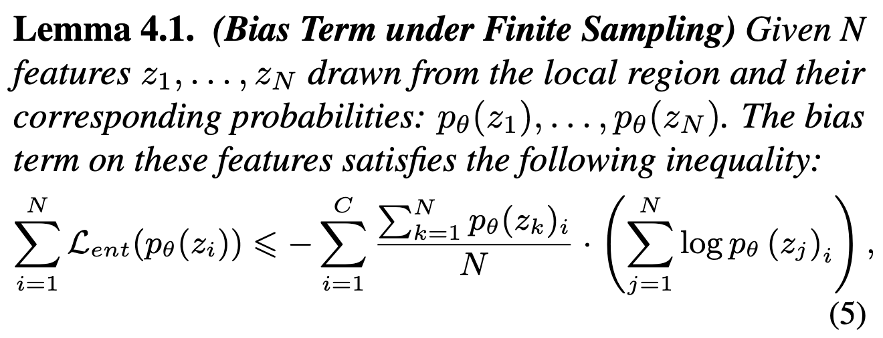
Efficient Metric of Region Confidence

Slide 16
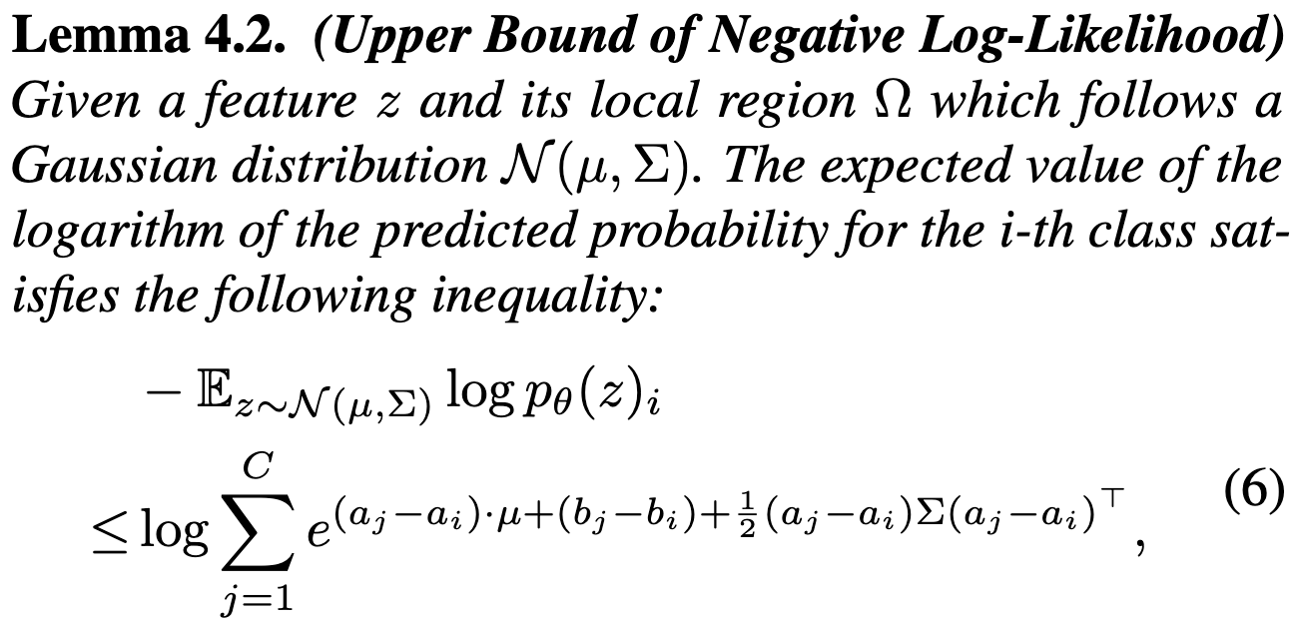
Efficient Metric of Region Confidence

Slide 17
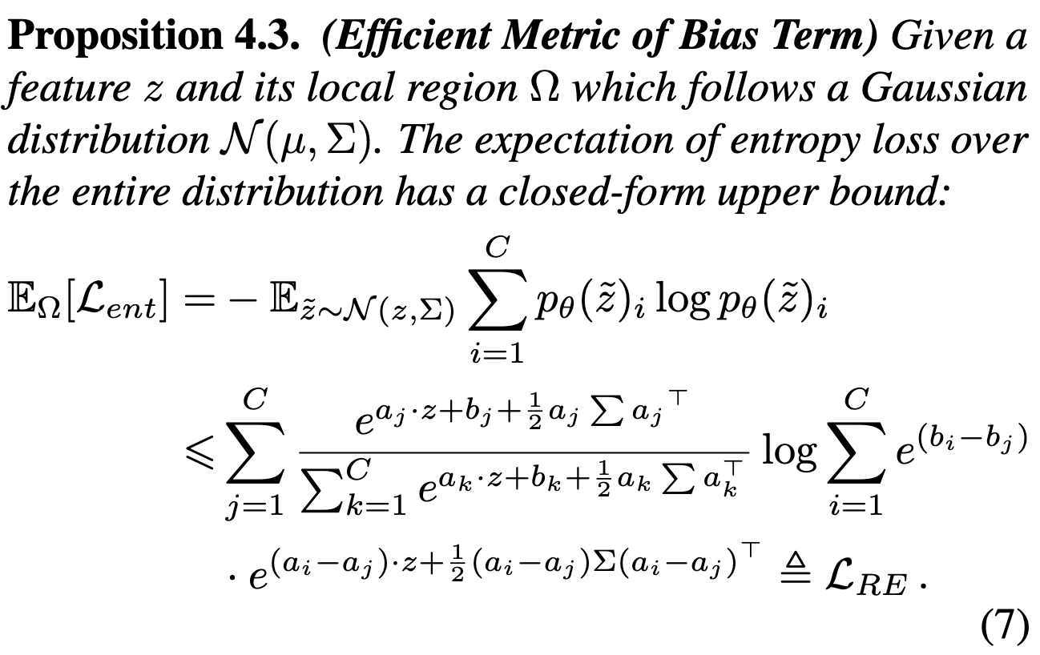

Efficient Metric of Region Confidence
$L_{RE}$: Regional Entropy

Slide 18
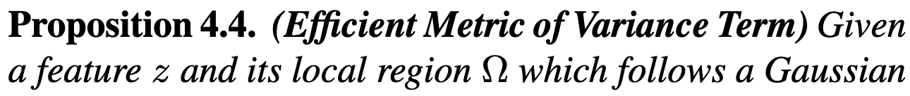
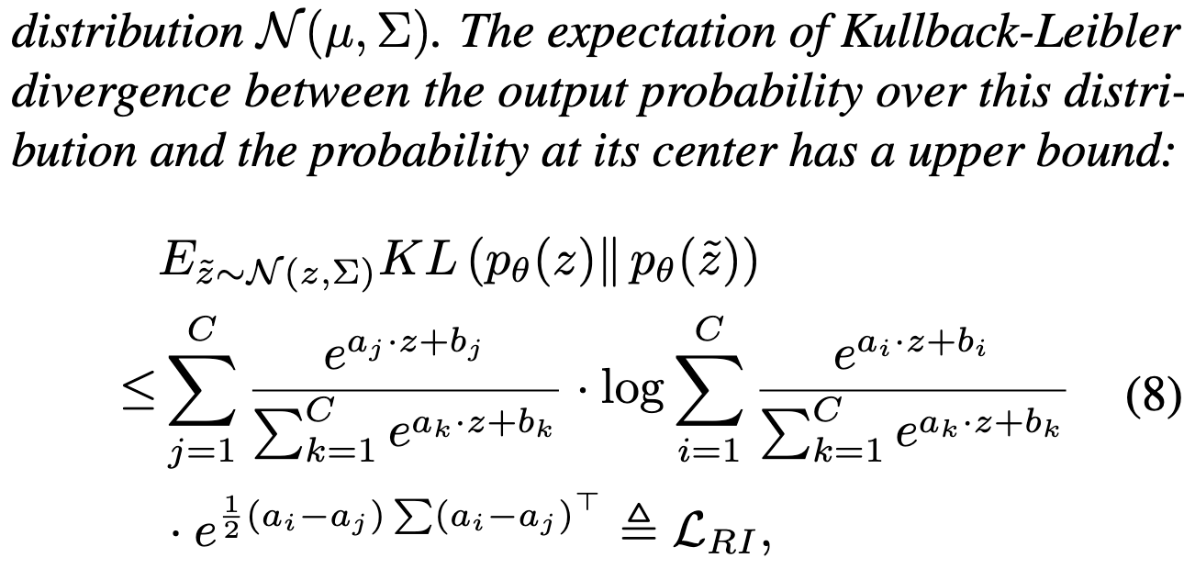

Efficient Metric of Region Confidence
$L_{RI}$: Regional Instability

Slide 19
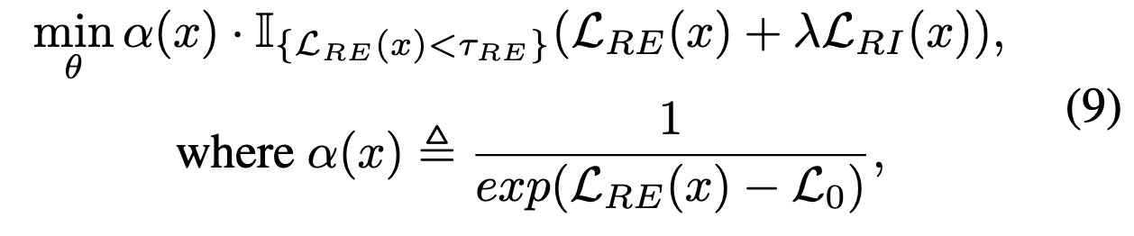
Overall Procedure of ReCAP

Slide 20
Overall Procedure of ReCAP

Slide 21
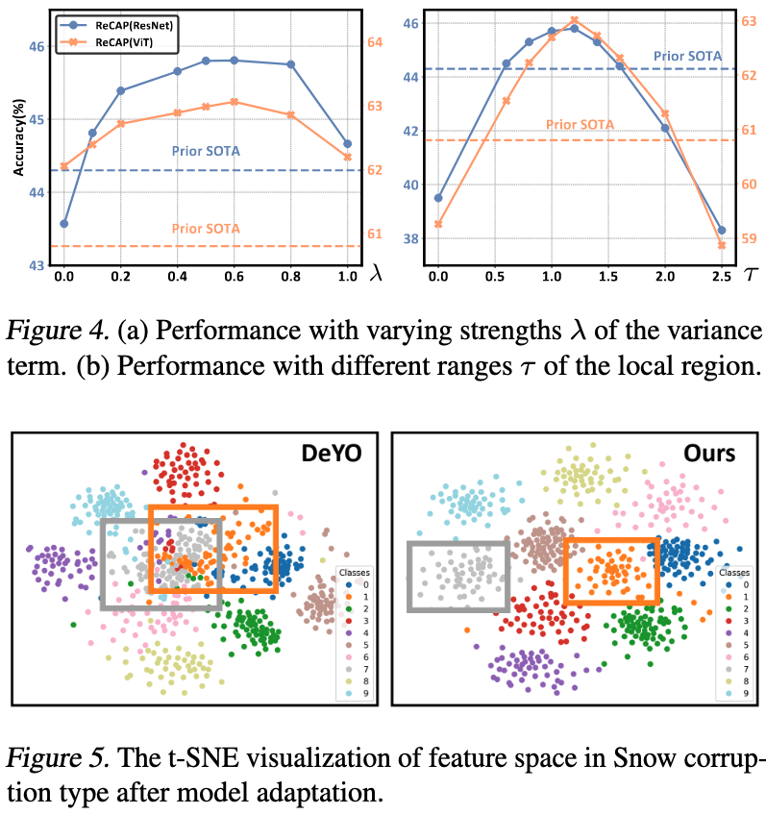
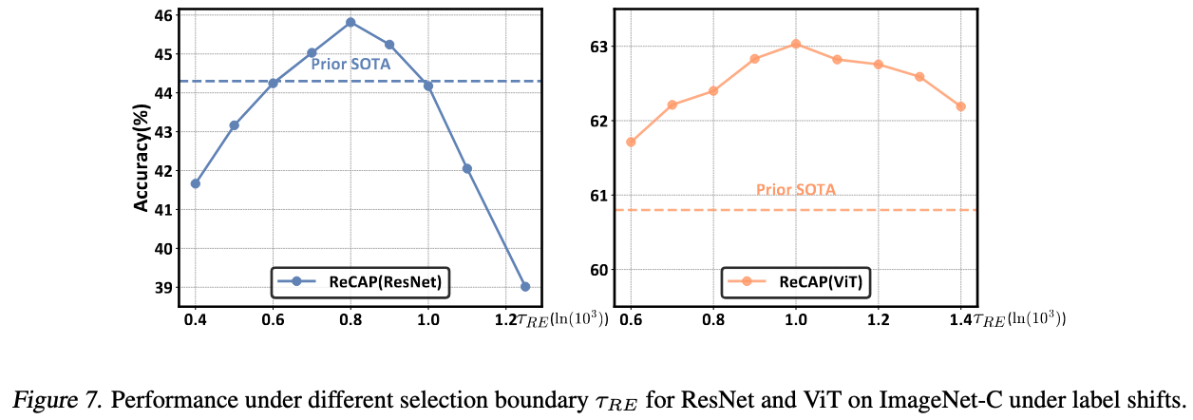
Ablation studies

Slide 22
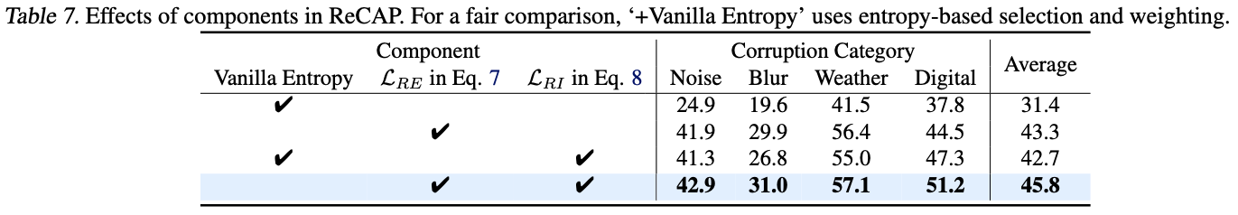
Ablation studies

Slide 23
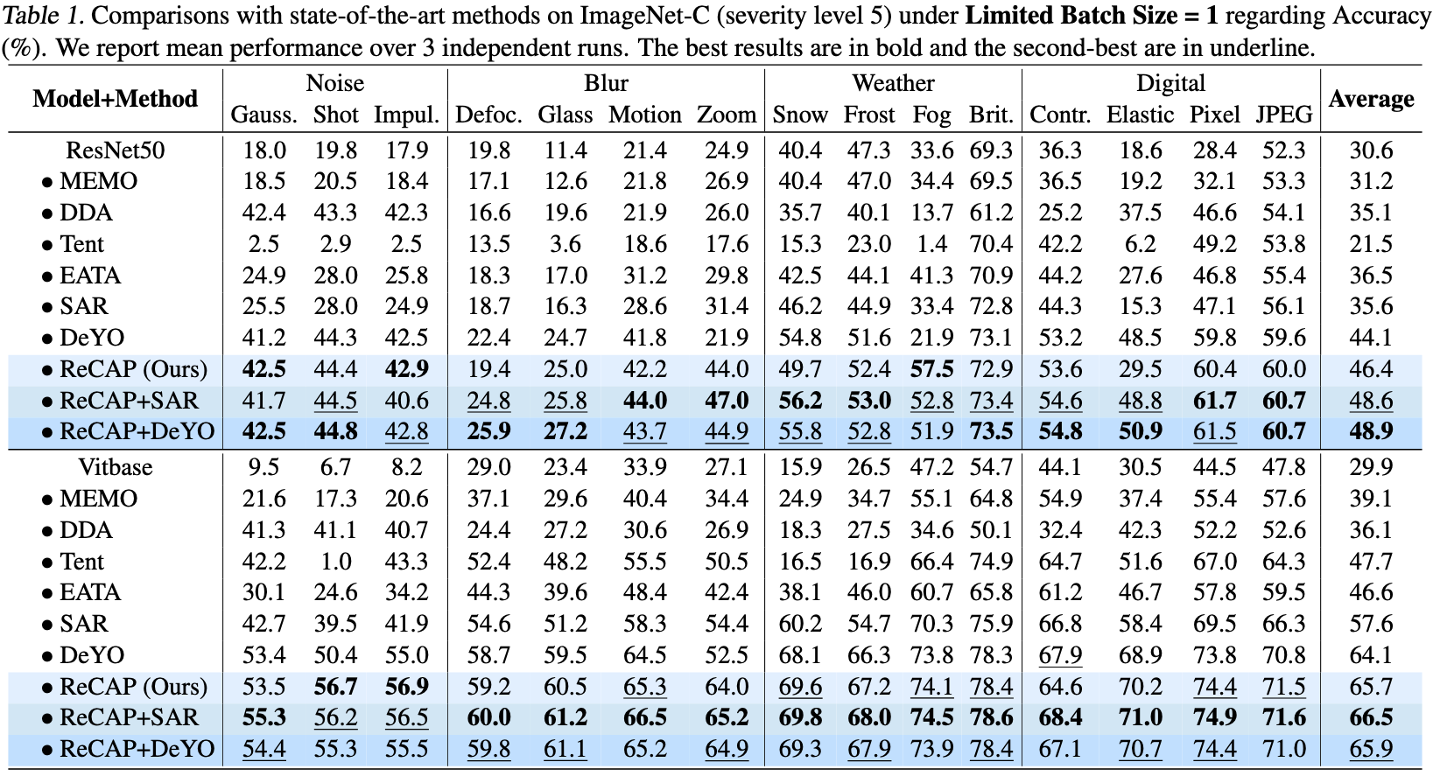
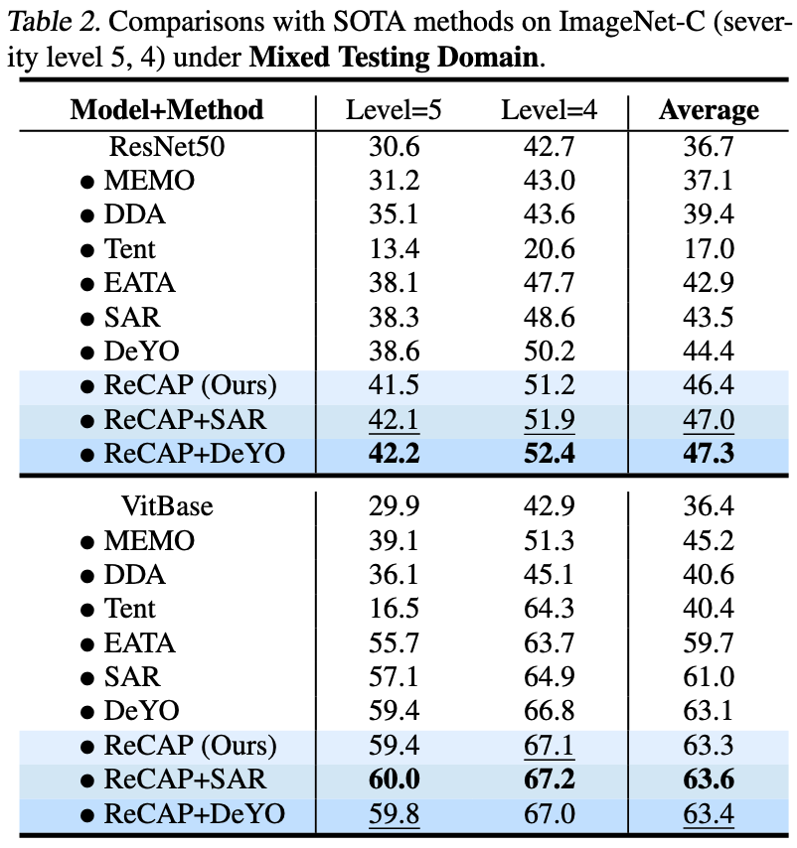
Experiments

Slide 24
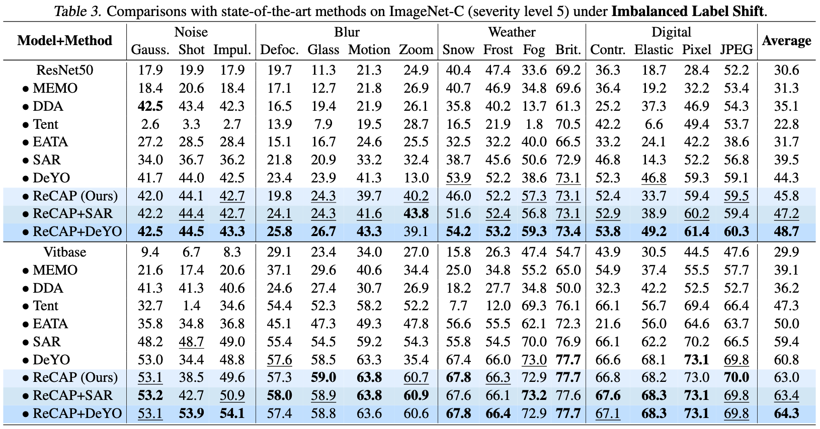
Experiments

Slide 25
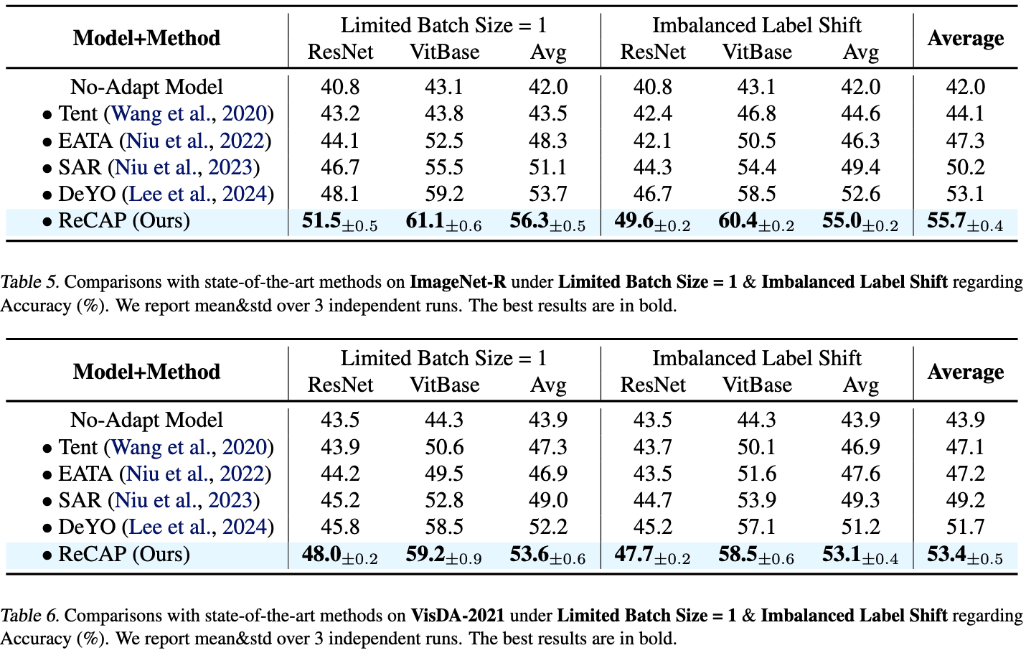
Experiments

Slide 26
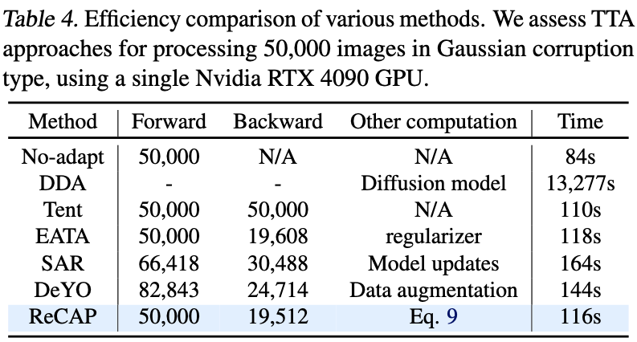
Experiments

Slide 27
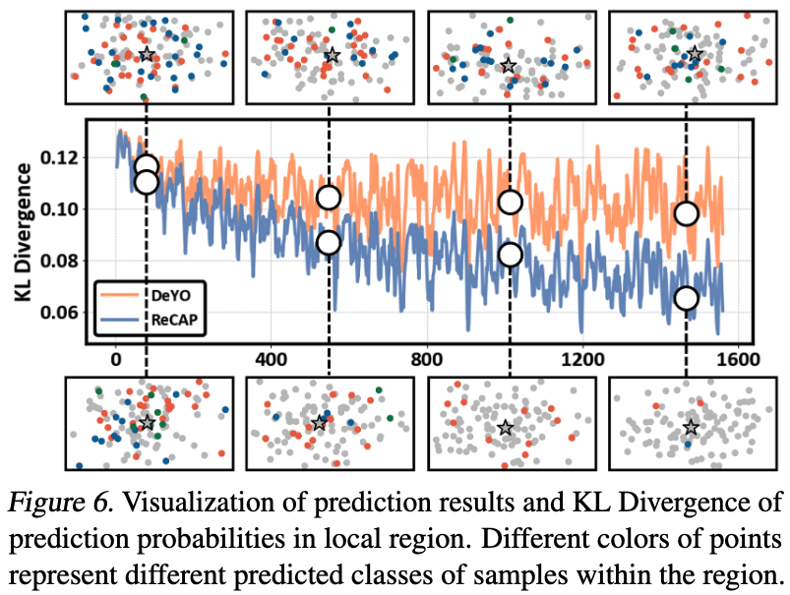
Experiments

Slide 28
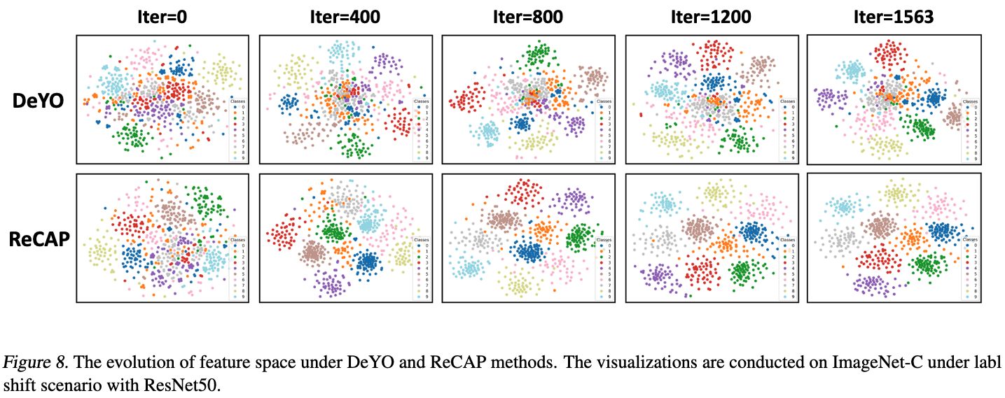
Experiments

