Slide 1
One-Minute Video Generation with Test-Time Training
CVPR 2025 / 6 citations (~6/2)
Hyunoh Kang

Slide 2
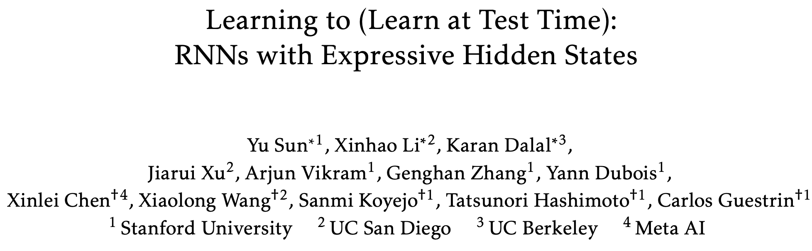
Decoding Mamba: The Next Big Leap in AI Sequence Modeling | by azhar | azhar labs | Medium

Slide 3
Introduction
Limitations
Can make only short clips
The maximum length of public APIs for video generation
Sora (OpenAI): 20 secs
MovieGen (Meta): 16 secs
Ray 2 (Luma): 10 secs
Veo2 (Google): 8 secs
Can make only single scenes without complex stories(~March 2025)
Decoding Mamba: The Next Big Leap in AI Sequence Modeling | by azhar | azhar labs | Medium

Slide 4
Introduction
Limitations
one-minute videos requires over 300k tokens in context
Transformers increases quadratically (actually linear with KV cache) with context length
generating a one-minute video
11× longer than generating 20 videos of 3 seconds each
training would have taken 12× longer

Slide 5
Introduction
Limitations
one-minute videos requires over 300k tokens in context
Transformers increases quadratically (actually linear with KV cache) with context length
generating a one-minute video
11× longer than generating 20 videos of 3 seconds each
training would have taken 12× longer

Slide 6
Introduction
Solution
To address this prob, using RNN (especially linear attention) as alternative
E.g. mamba, DeltaNet
But contain only single scenes, slow motion and simple stories
Because RNN architecture has less expressive (fixed) hidden states
E.g. cell state, A matrix
Replace linear (matrix) to two-layer MLP with 2× more hidden cells (=> 4 x hidden, richer nonlinearities)

Slide 7
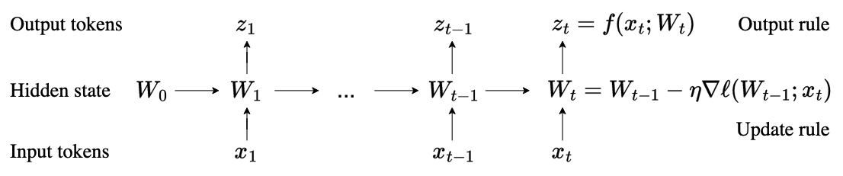
Introduction
W -> MLP * 2
Notes:
+ 256 H100 50시간 학습…

Slide 8
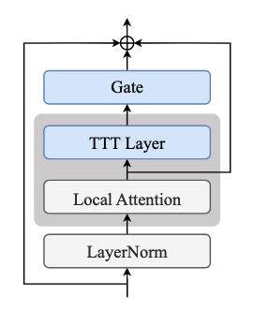
Introduction
Base model: CogVideo-X 5B (DiT)
Add TTT-layer -> use as long term memory like RNN
+ Trainig env: 50 hour 256 H100..
Notes:
그렇다고 RNN기반을 사용하겠다는건 아니고, 트랜스포머를 사용

Slide 9
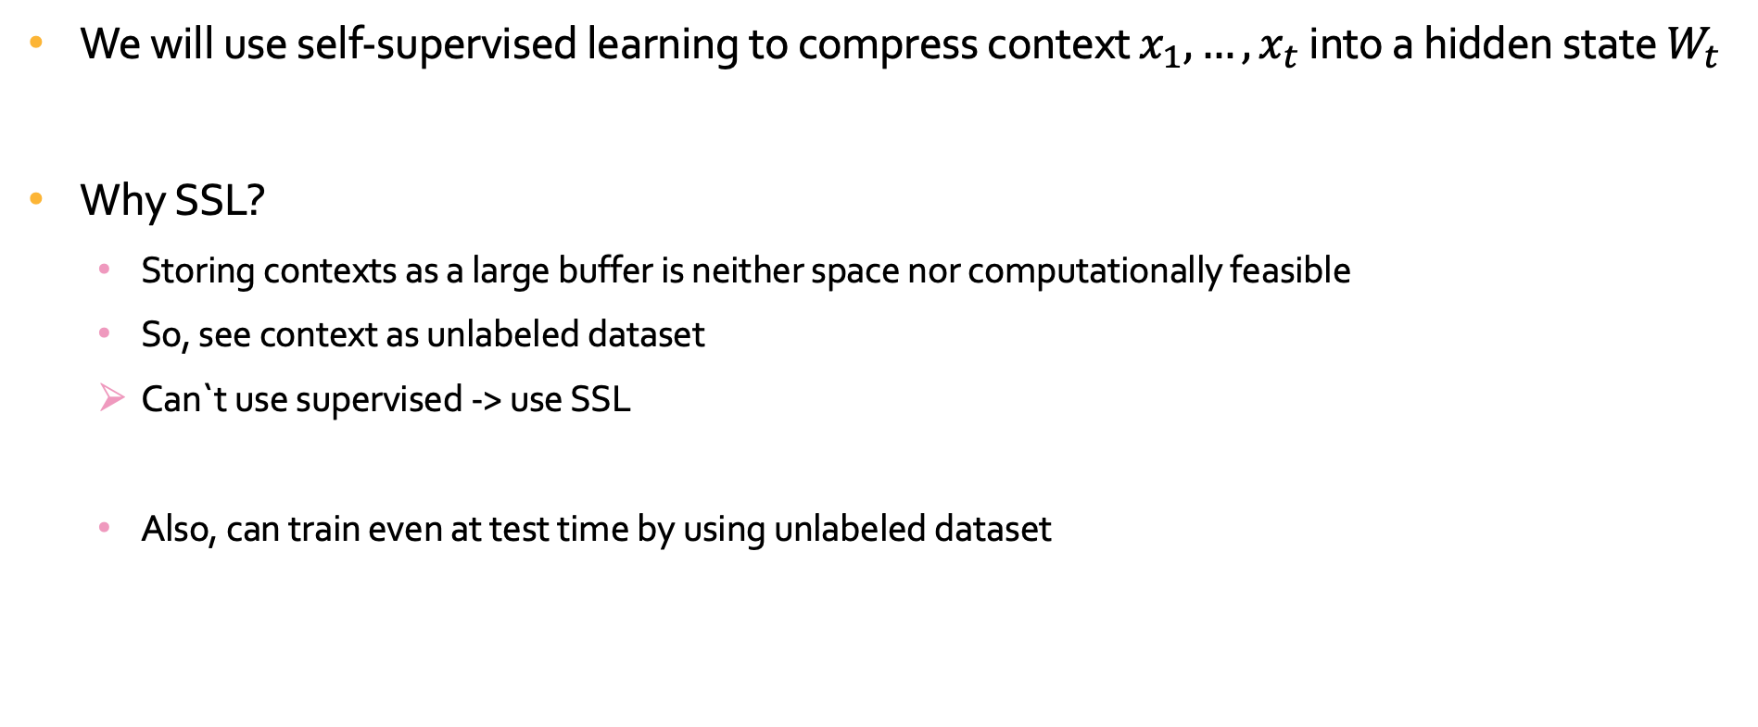
TTT as Updating a Hidden State
We will use self-supervised learning to compress context $x_{1},…,x_{t}$ into a hidden state $W_{t}$
Why SSL?
Storing contexts as a large buffer is neither space nor computationally feasible
So, see context as unlabeled dataset
Can`t use supervised -> use SSL
Also, can train even at test time by using unlabeled dataset
Notes:
SSL을 왜 쓰는가

Slide 10
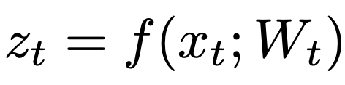
TTT as Updating a Hidden State
TTT-layer can be trained only at test time
Notes:
오직 추론때만 업데이트+denoising떄 (생성때) 사용
간단한 틀만, 자세한건 다음슬라에
로스는 SSL의 대표적인 recon을 사용.
이를 위해 x_t를 살짝 corruption (그래야 복원하는 행동을 f가 배우니까)
그렇다고 f의 역할이 인풋을 복원하는 역할은 아니고,
서론에 말했듯이 hidden state의 역할이다
그냥 recon 을 통해 SSL을 해 기능적으로 학습하고자 저렇게 하는거임.
정확히 어떻게 학습되는지도 다음 슬라에

Slide 11



Learning a Self-Supervised Task for TTT
Instead of handcrafting a SS task from human priors
more end-to-end approach, learning it as part of train
Notes:
Handcraft 예: 손상된 이미지에서 원래 픽셀 회복, 문장 일부 마스킹->원래대로
=> 사람이 고안한 손상/복원 규칙이 모델의 구조나 데이터 분포와 완전히 맞아떨어지지 않을 수 있다
Task자체를 모델 파라미터로 두고, 학습으로 최적화된 파라미터들을 사용
로스를 보시면 식을 저렇게 수정하였는데, 저게 가능한 이유는 이제 QKV의 역할을 다시 생각해보시면 이해가능
K를 통해 v를 맵핑하는데, 이를 f를 해시함수로 해서 학습시킨다고 생각하면 됨.
근데 이게 왜 f를 context가 잘 저장된 hidden state로 학습케하는가?
위 recon을 잘하려면 f는 x에 담긴 문맥정보를 잘 파악하고 보존해서 value로 변화시켜야함.
따라서 우리가 원하는 역할로 학습이 됨.
그리고 실제 인풋은 QKV 가중치에 역할에 따라 query를 넣어줌

Slide 12
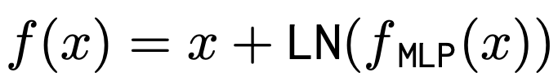
TTT-MLP Instantiation
f(x) is called TTT-MLP
f_MLP(x): a two-layer MLP (hidden dimension is 4× the input dimension)
Use GELU as activation function
Notes:
test 때 학습될 내부 모델 f를 다음과 같이 정의
사실상 TTT-layer

Slide 13
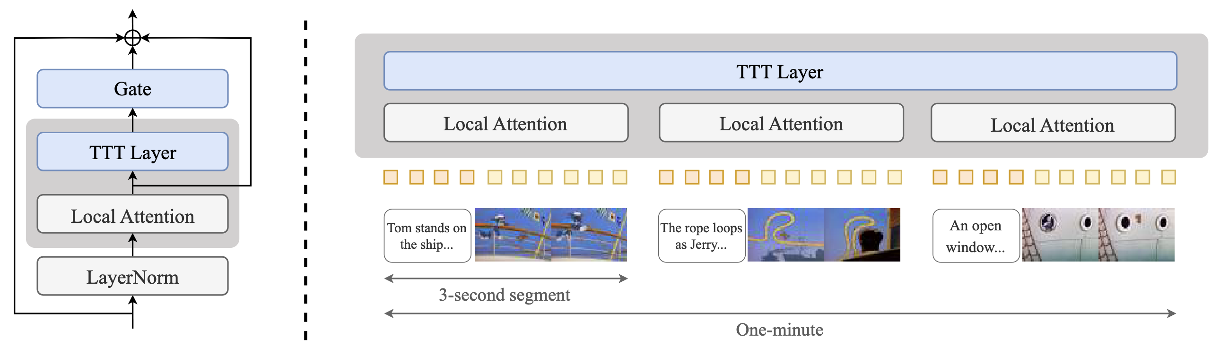
Architecture
Overview

Slide 14

TTT layer with a learnable gate
Gating
Input sequence: $X=\left(x_{1},…,x_{t}\right), x_{t}∈ℝ^{d}$
Output Sequence: $Z=\left(z_{1},…,z_{t}\right)=TTT\left(X\right), z_{t}∈ℝ^{d}$
$gate\left(TTT,X;α\right)=\tanh\left(α\right)⨂{TTT\left(X\right)}+X$
$\tanh\left(α\right)∈{\left(−1,1\right)}^{d}$

Slide 15

TTT layer with a learnable gate
$X^{′}=self_attn\left(LN\left(X\right)\right)$
$Z=gate\left(TTT,X^{′};α\right)$
$Z^{′}=gate\left(TTT^{′},Z;β\right)$
$\left(TTT^{′}=rev\left(TTT\left(rev\left(X\right)\right)\right), rev\left(X\right)=\left(x_{T},…,x_{1}\right)\right)$
$Y=Z^{′}+X$
Notes:
Diffusion은 causal(1번생성->그걸기반으로 2번 생성)
근데 diffusion은 1~T까지 한번에봐서, 이걸위해 뒤집어서 한번줌 -> 간단하게 1-T까지 다 보게

Slide 16




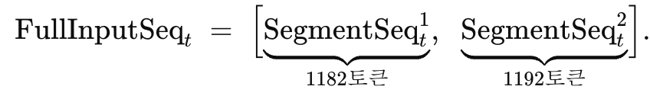
Sequence Example
Notes:
가장작은단위 3초 -> 기존 모델이 3초생성, 톰제리가 적어도 3초

Slide 17
Fine-Tuning Recipe and Dataset
Multi-stage context extension
First stage: full-tuning(adaptation), 3 secs
The others: TTT layers and gates, 9 -> 18 -> 30 -> 63

Slide 18
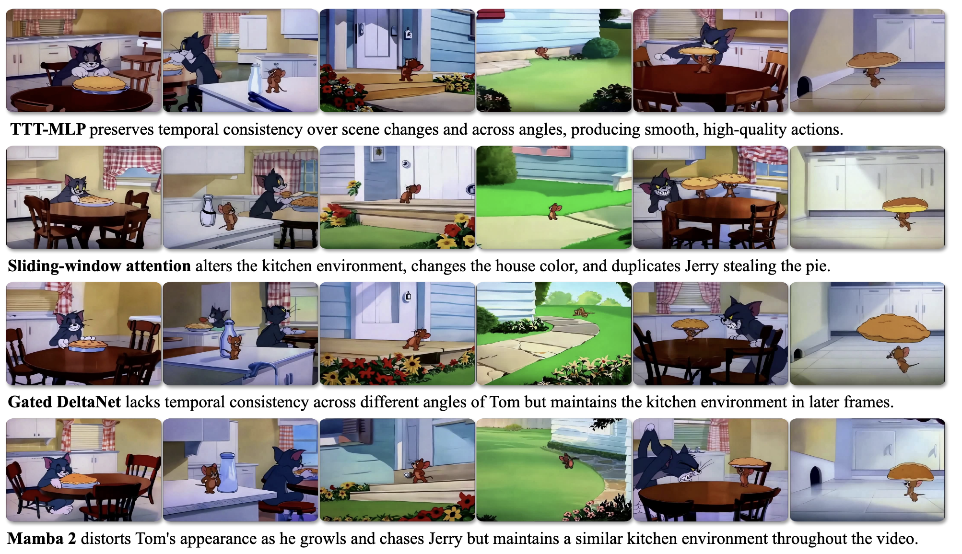
Experiments

Slide 19
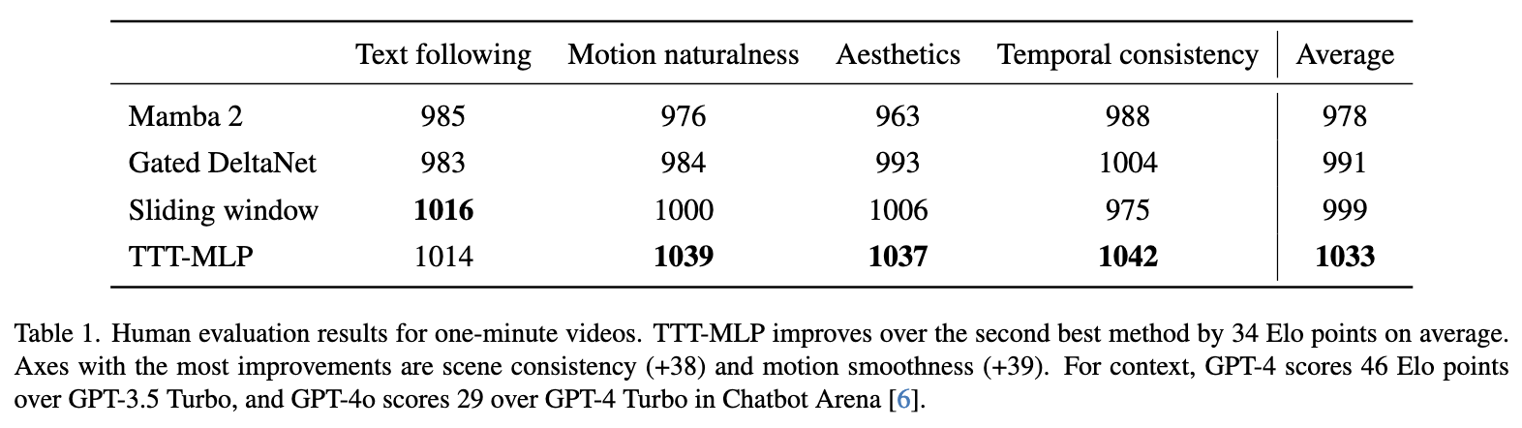
Experiments

Slide 20
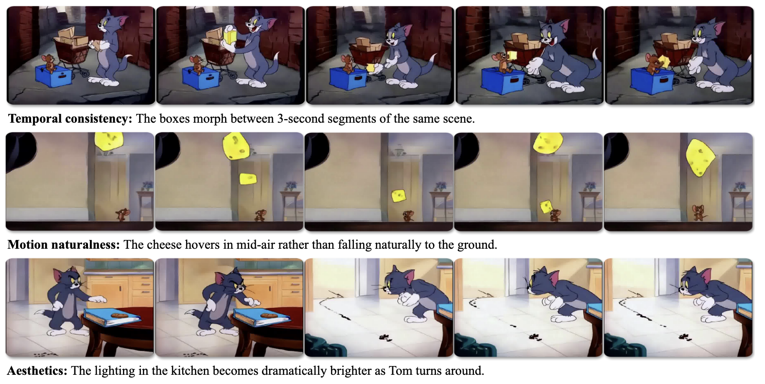
Experiments

Slide 21
Limitations
Short context
TTT-Linear > TTT-MLP for 18 secs
Wall-clock time
inference and training with TTT-MLP are 1.4× and 2.1× slower than with Gated DeltaNet
Video artifacts
still contain notable artifacts, especially in motion naturalness and aesthetics.
CogVideo-X also seem to have limited motion naturalness and aesthetics

