Slide 1
Large Language Diffusion Models
NeurIPS 2025 oral / citation: 96 (~25.12.22)
Hyunoh Kang

Slide 2
Table of Contents
Introduction
Approach
Probabilistic Formulation
Pre-training
Supervised Fine-Tuning
Inference
Experiments
Scalability of LLaDA on Language Tasks
Benchmark Results
Reversal Reasoning and Analyses
Case Studies
Conclusion and Discussion

Slide 3
Table of Contents
Introduction
Approach
Probabilistic Formulation
Pre-training
Supervised Fine-Tuning
Inference
Experiments
Scalability of LLaDA on Language Tasks
Benchmark Results
Reversal Reasoning and Analyses
Case Studies
Conclusion and Discussion

Slide 4
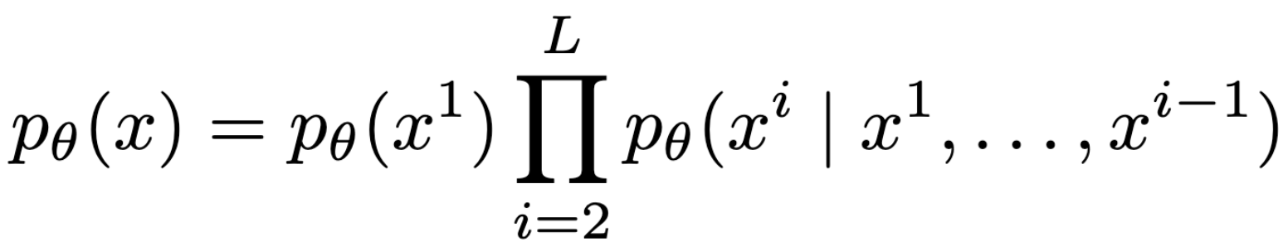
Is Autoregression Necessary for LLM Capabilities?
Generative modeling principles
Autoregressive formulation

Slide 5
Is Autoregression Necessary for LLM Capabilities?
LLMs are generative models; common practice is autoregressive factorization (left-to-right).
Core question: do scalability, in-context learning, instruction-following require autoregression?
Hypothesis: it is generative modeling principles (likelihood-based learning) that matter, not the AR factorization itself.
Autoregression induces limitations (e.g., reversal reasoning failures).

Slide 6
Headline Results
LLaDA scales to 8B from scratch and is competitive with strong AR LLMs on diverse benchmarks.
Shows strong in-context learning; after SFT, strong instruction-following in case studies.
Addresses the “reversal curse” with more balanced forward vs reversal performance

Slide 7
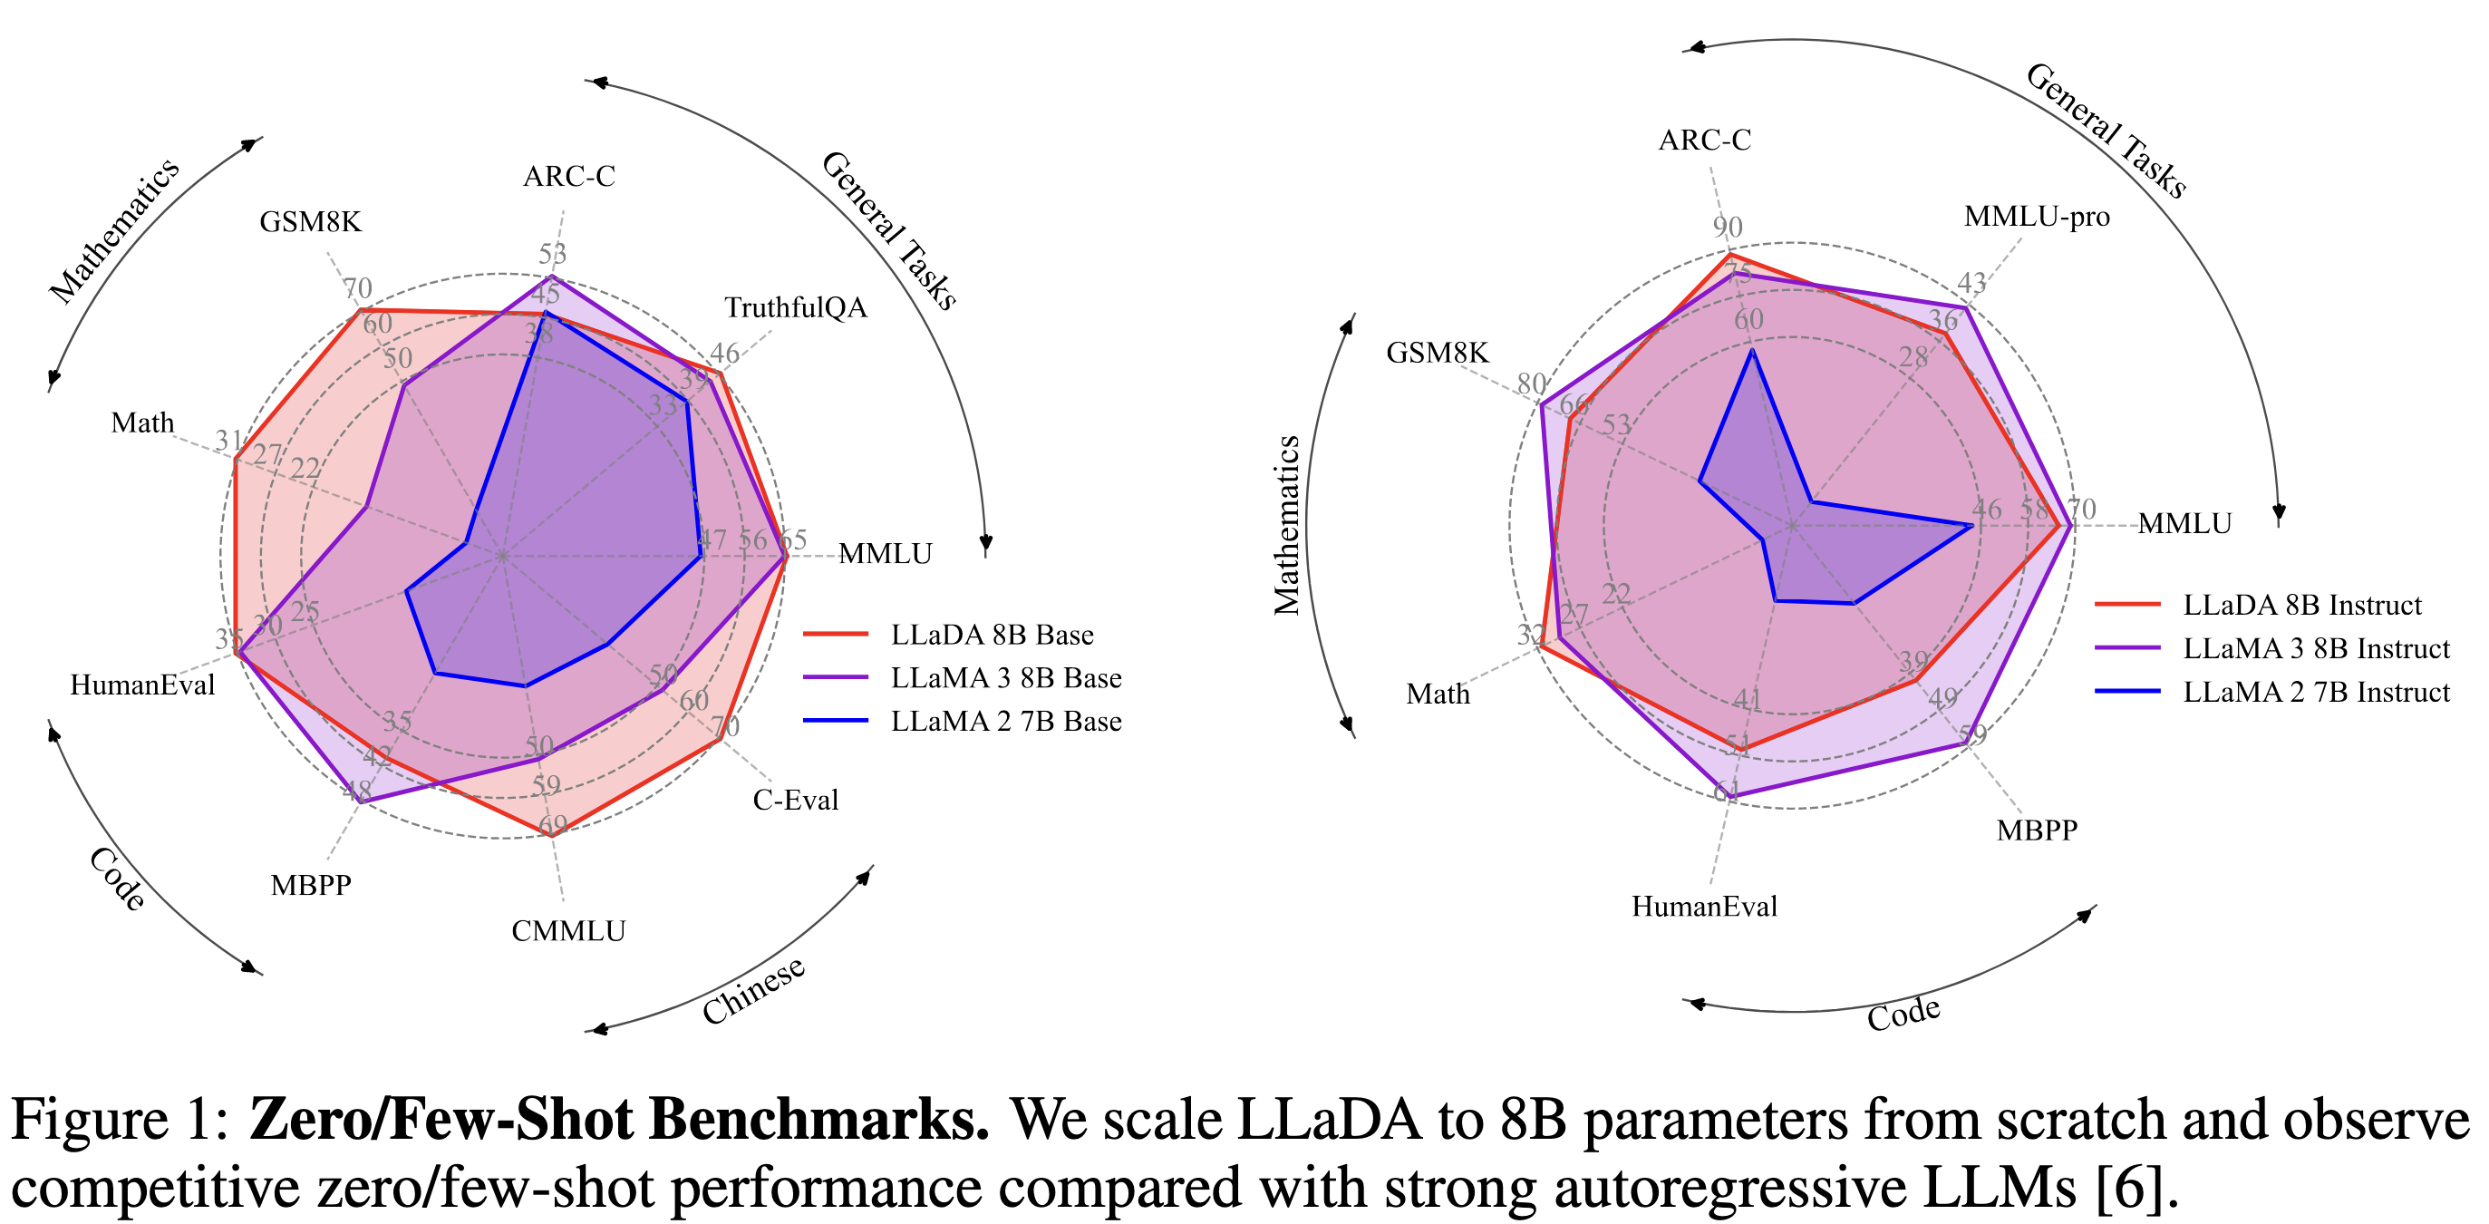
Headline Results

Slide 8
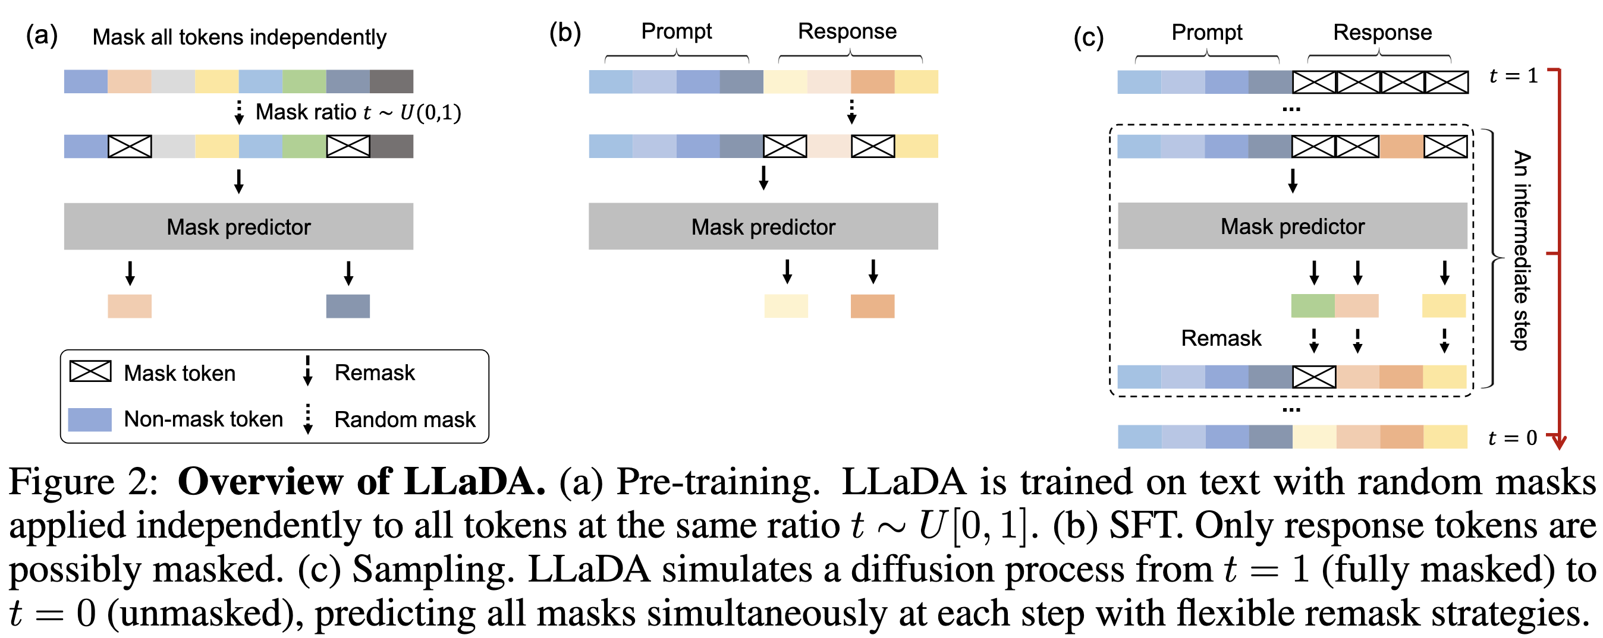
Overview of LLaDA
LLaDA = masked diffusion model for language (discrete diffusion via masking).
Emphasis: bidirectional dependencies (no causal mask), likelihood-based objective.

Slide 9
Overview of LLaDA

Slide 10
Table of Contents
Introduction
Approach
Probabilistic Formulation
Pre-training
Supervised Fine-Tuning
Inference
Experiments
Scalability of LLaDA on Language Tasks
Benchmark Results
Reversal Reasoning and Analyses
Case Studies
Conclusion and Discussion

Slide 11
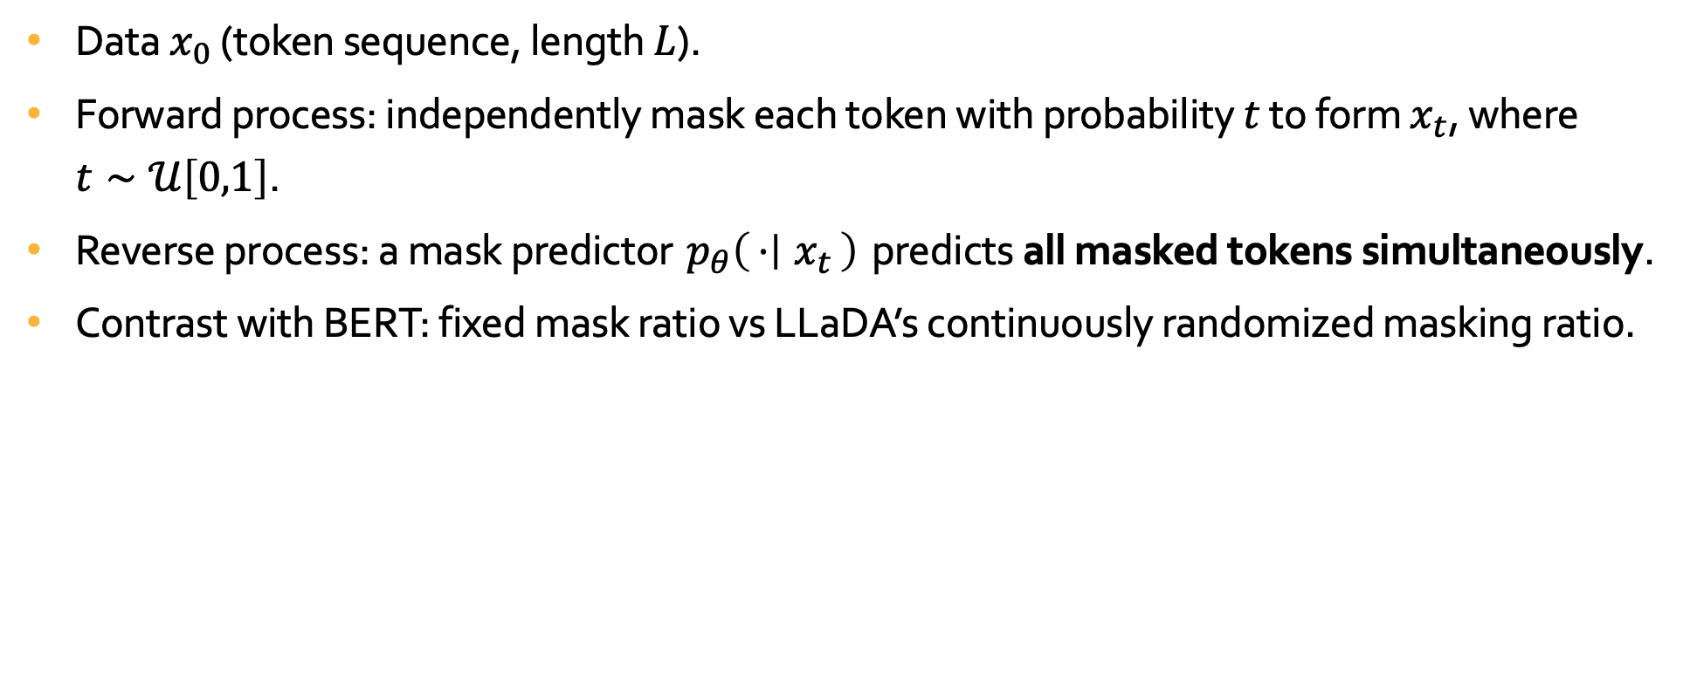
Generative Modeling Setup
Data $x_{0}$ (token sequence, length $L$).
Forward process: independently mask each token with probability $t$ to form $x_{t}$, where $t∼𝒰\left[0,1\right]$.
Reverse process: a mask predictor $p_{θ}\left(⋅ ∣ x_{t}\right)$ predicts all masked tokens simultaneously.
Contrast with BERT: fixed mask ratio vs LLaDA’s continuously randomized masking ratio.

Slide 12
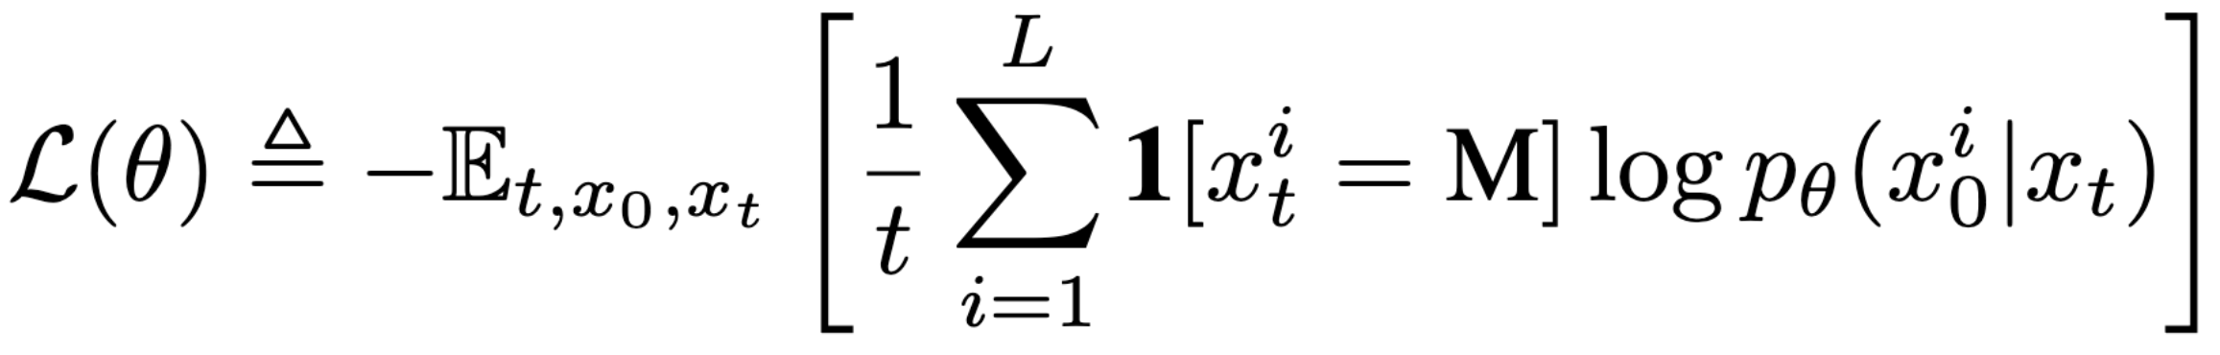
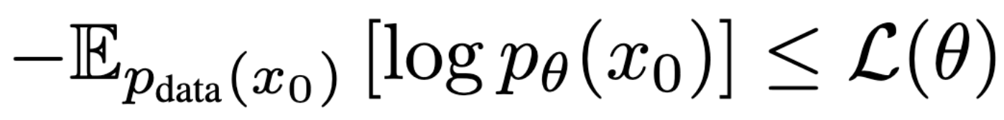
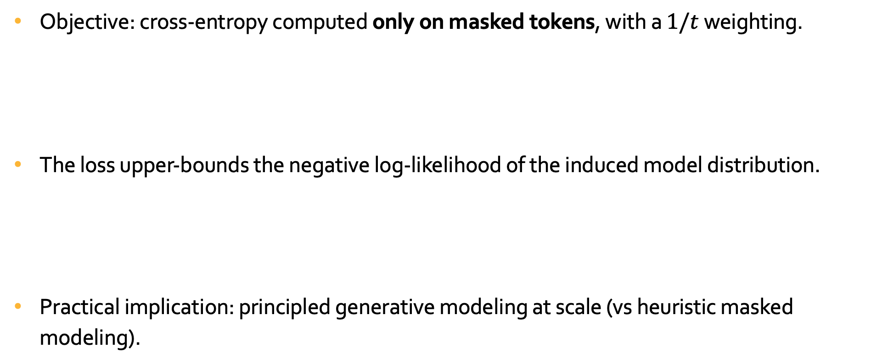
Training Objective
Objective: cross-entropy computed only on masked tokens, with a $1/t$ weighting.
The loss upper-bounds the negative log-likelihood of the induced model distribution.
Practical implication: principled generative modeling at scale (vs heuristic masked modeling).

Slide 13
Table of Contents
Introduction
Approach
Probabilistic Formulation
Pre-training
Supervised Fine-Tuning
Inference
Experiments
Scalability of LLaDA on Language Tasks
Benchmark Results
Reversal Reasoning and Analyses
Case Studies
Conclusion and Discussion

Slide 14
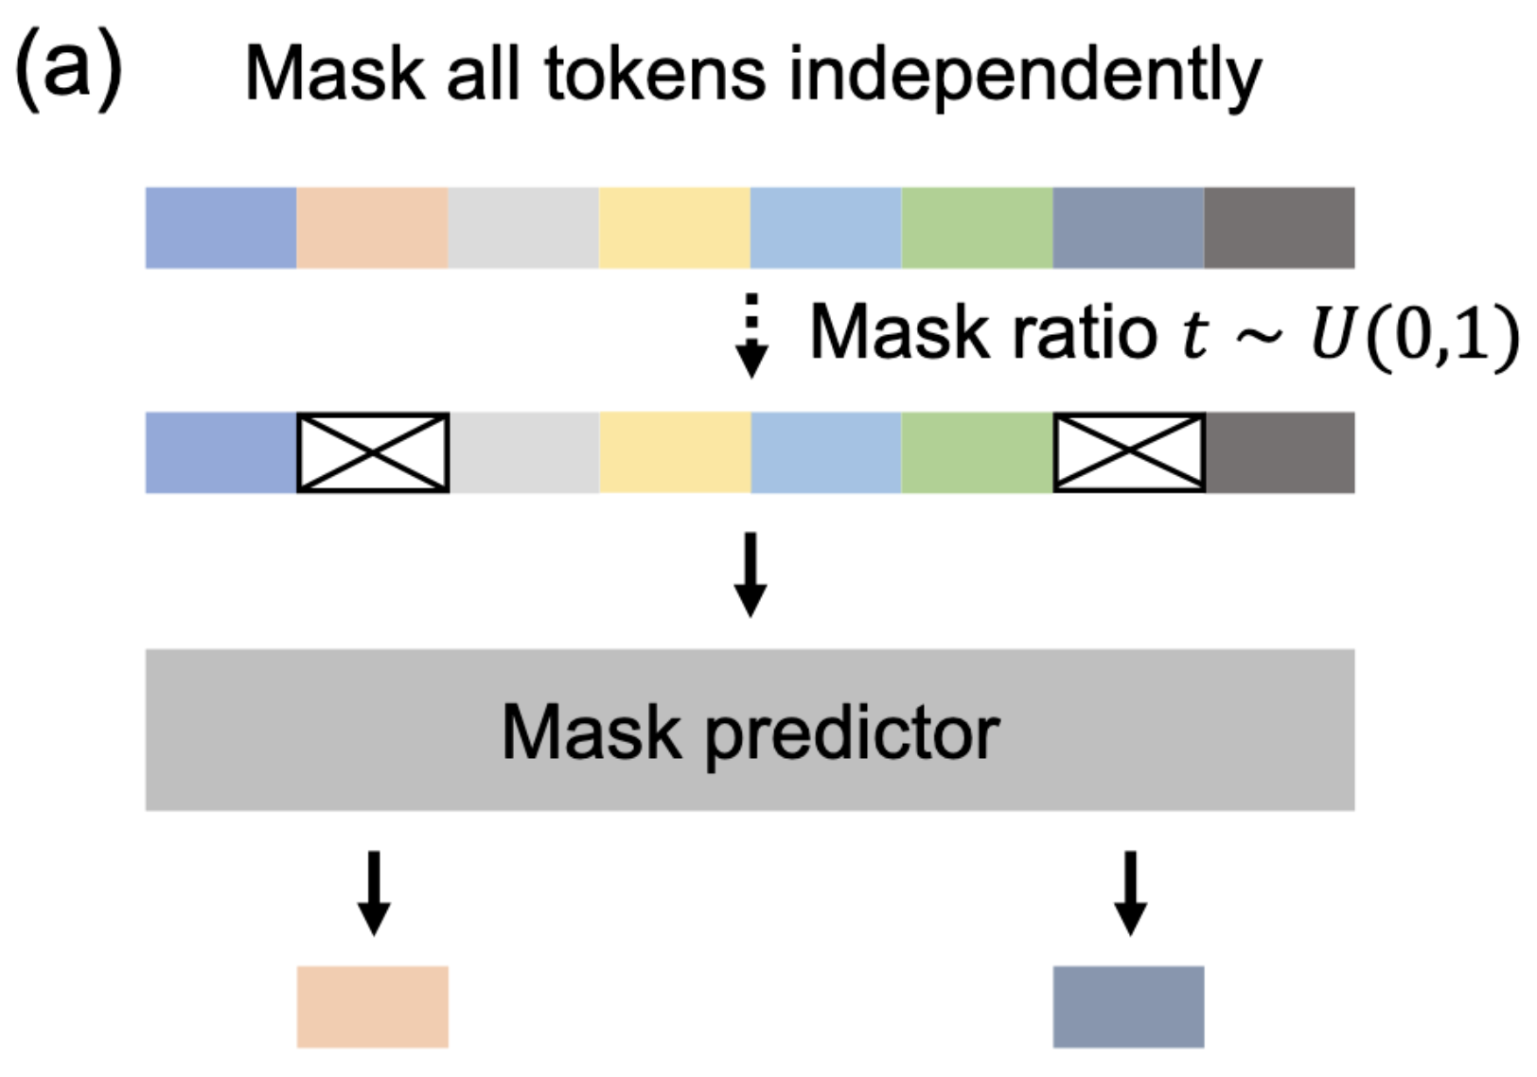
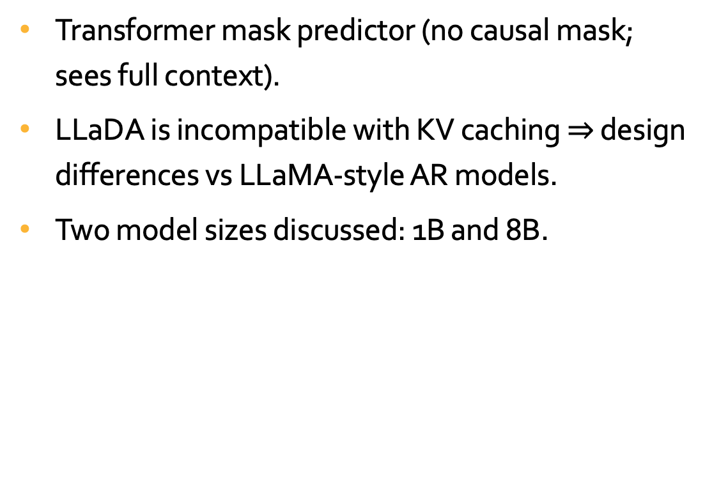
Pre-training: Architecture and Key Design Choices
Transformer mask predictor (no causal mask; sees full context).
LLaDA is incompatible with KV caching $⇒$ design differences vs LLaMA-style AR models.
Two model sizes discussed: 1B and 8B.

Slide 15
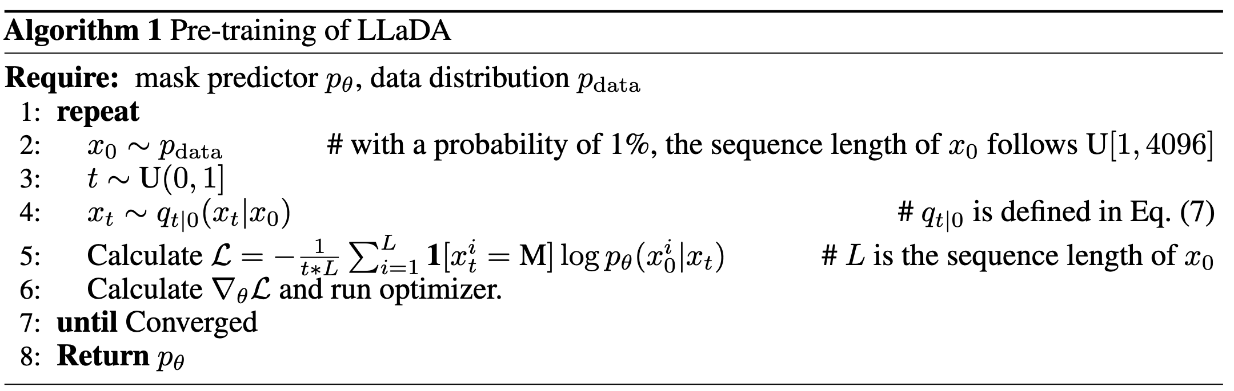
Pre-training: Algoritm

Slide 16
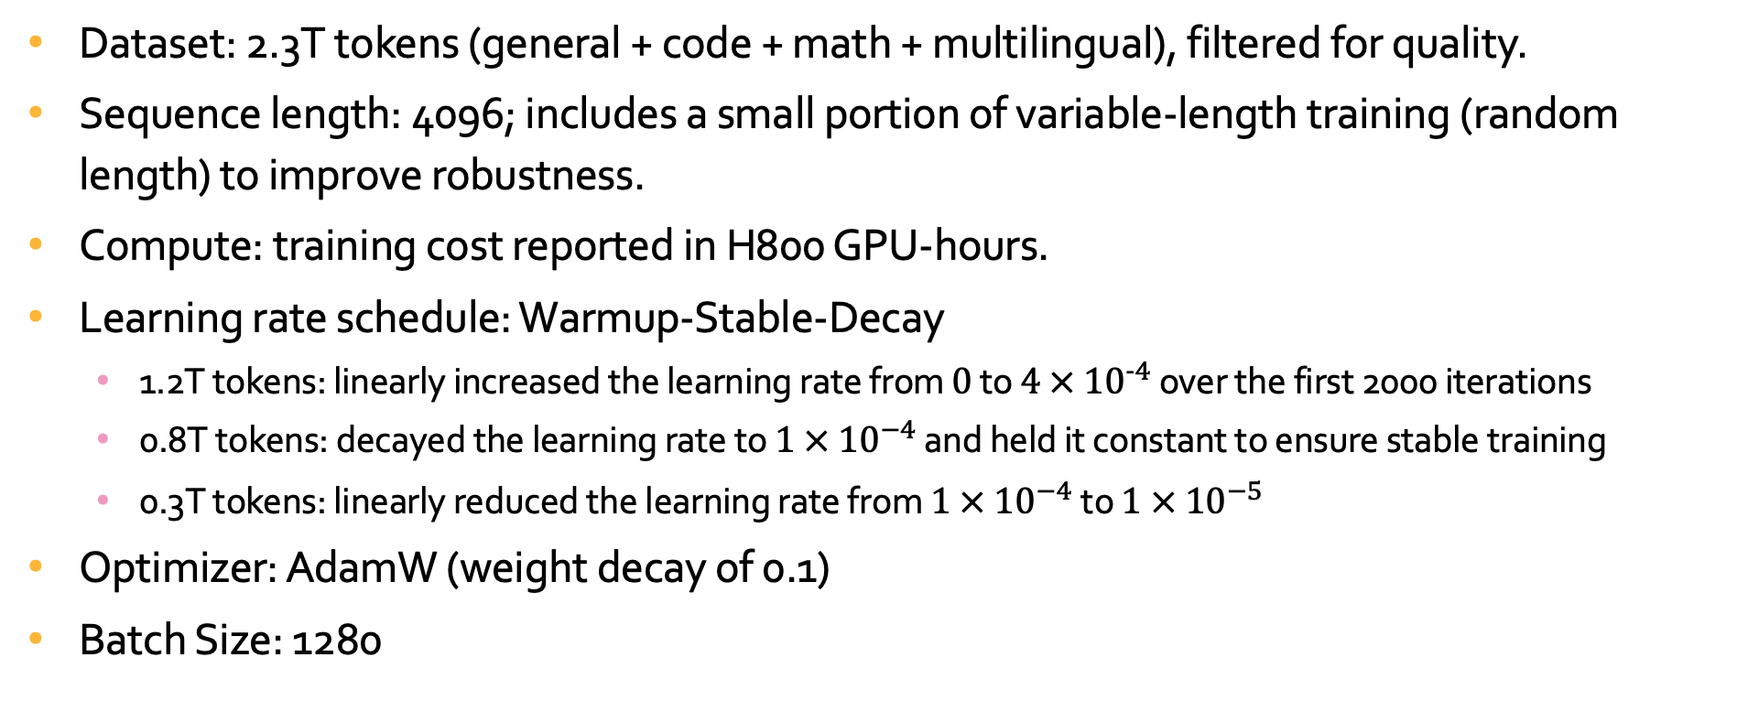
Pre-training Data and Compute
Dataset: 2.3T tokens (general + code + math + multilingual), filtered for quality.
Sequence length: 4096; includes a small portion of variable-length training (random length) to improve robustness.
Compute: training cost reported in H800 GPU-hours.
Learning rate schedule: Warmup-Stable-Decay
1.2T tokens: linearly increased the learning rate from $0$ to $4 × {10}^{-4}$ over the first 2000 iterations
0.8T tokens: decayed the learning rate to $1 × {10}^{−4}$ and held it constant to ensure stable training
0.3T tokens: linearly reduced the learning rate from $1 × {10}^{−4}$to $1 × {10}^{−5}$
Optimizer: AdamW (weight decay of 0.1)
Batch Size: 1280

Slide 17
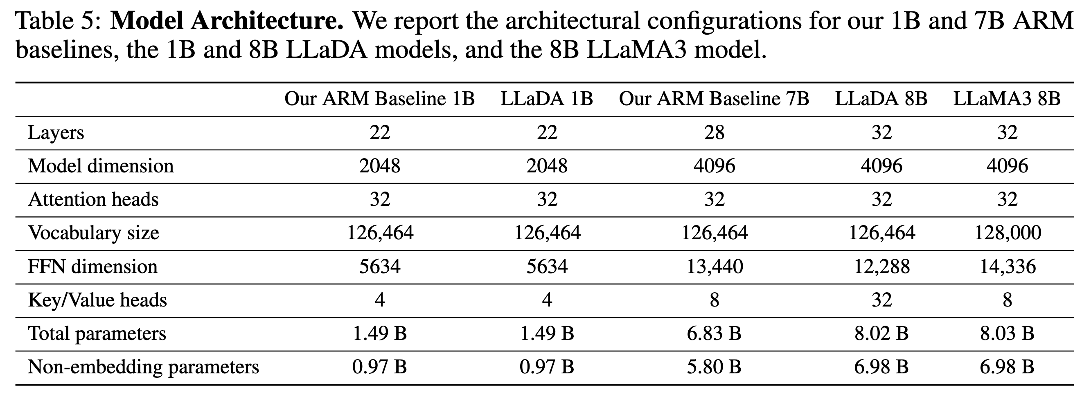
Model Architecture Comparison
Highlight how LLaDA compares to the constructed AR baselines and to LLaMA3 8B.
Call out: layers/width/heads, vocab size differences, KV-head differences, parameter counts.

Slide 18
Table of Contents
Introduction
Approach
Probabilistic Formulation
Pre-training
Supervised Fine-Tuning
Inference
Experiments
Scalability of LLaDA on Language Tasks
Benchmark Results
Reversal Reasoning and Analyses
Case Studies
Conclusion and Discussion

Slide 19
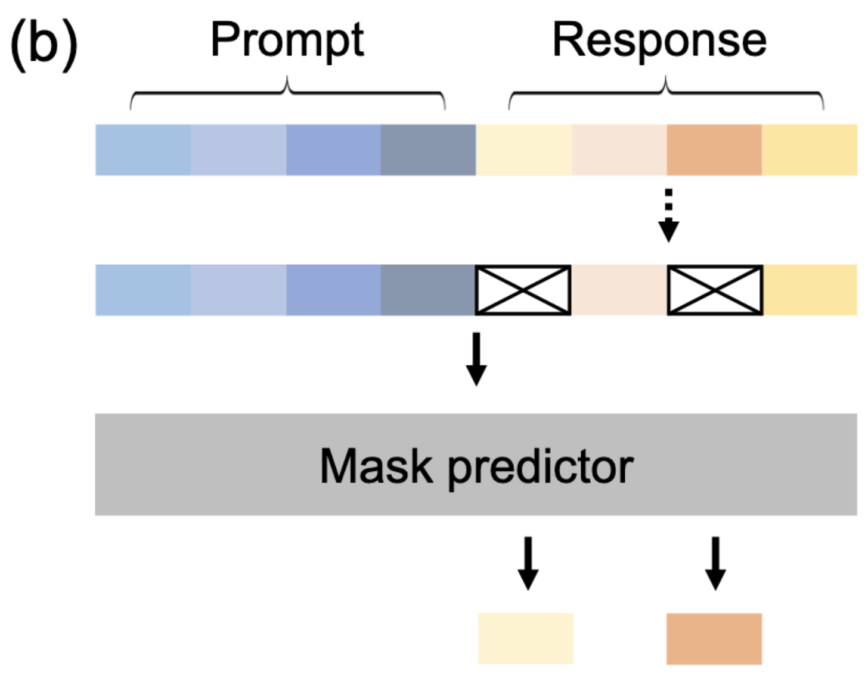
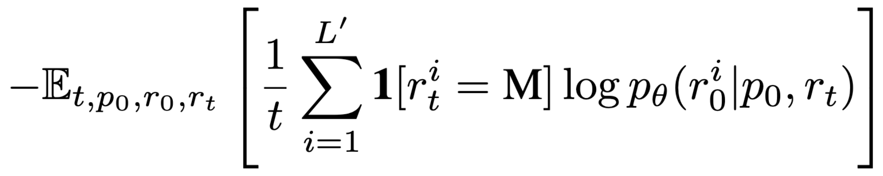
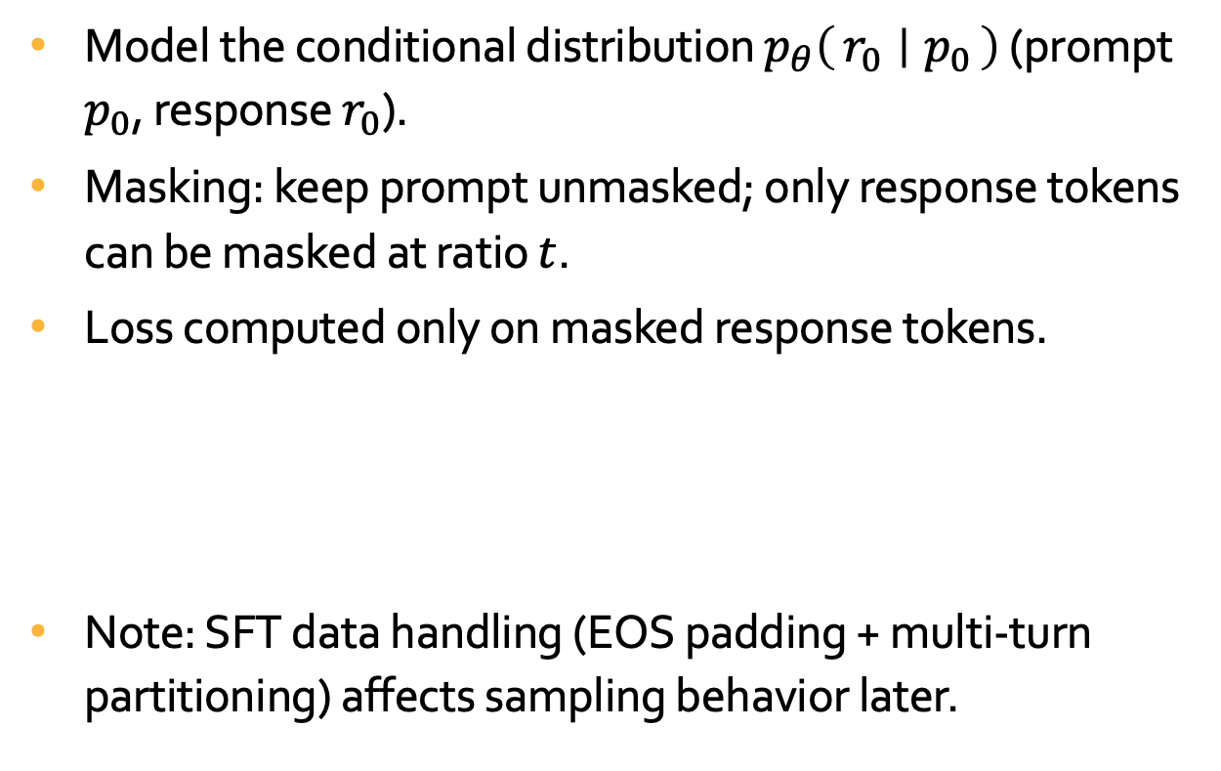
Supervised Fine-Tuning (SFT) for Instruction Following
Model the conditional distribution $p_{θ}\left(r_{0} ∣ p_{0}\right)$ (prompt $p_{0}$, response $r_{0}$).
Masking: keep prompt unmasked; only response tokens can be masked at ratio $t$.
Loss computed only on masked response tokens.
Note: SFT data handling (EOS padding + multi-turn partitioning) affects sampling behavior later.

Slide 20
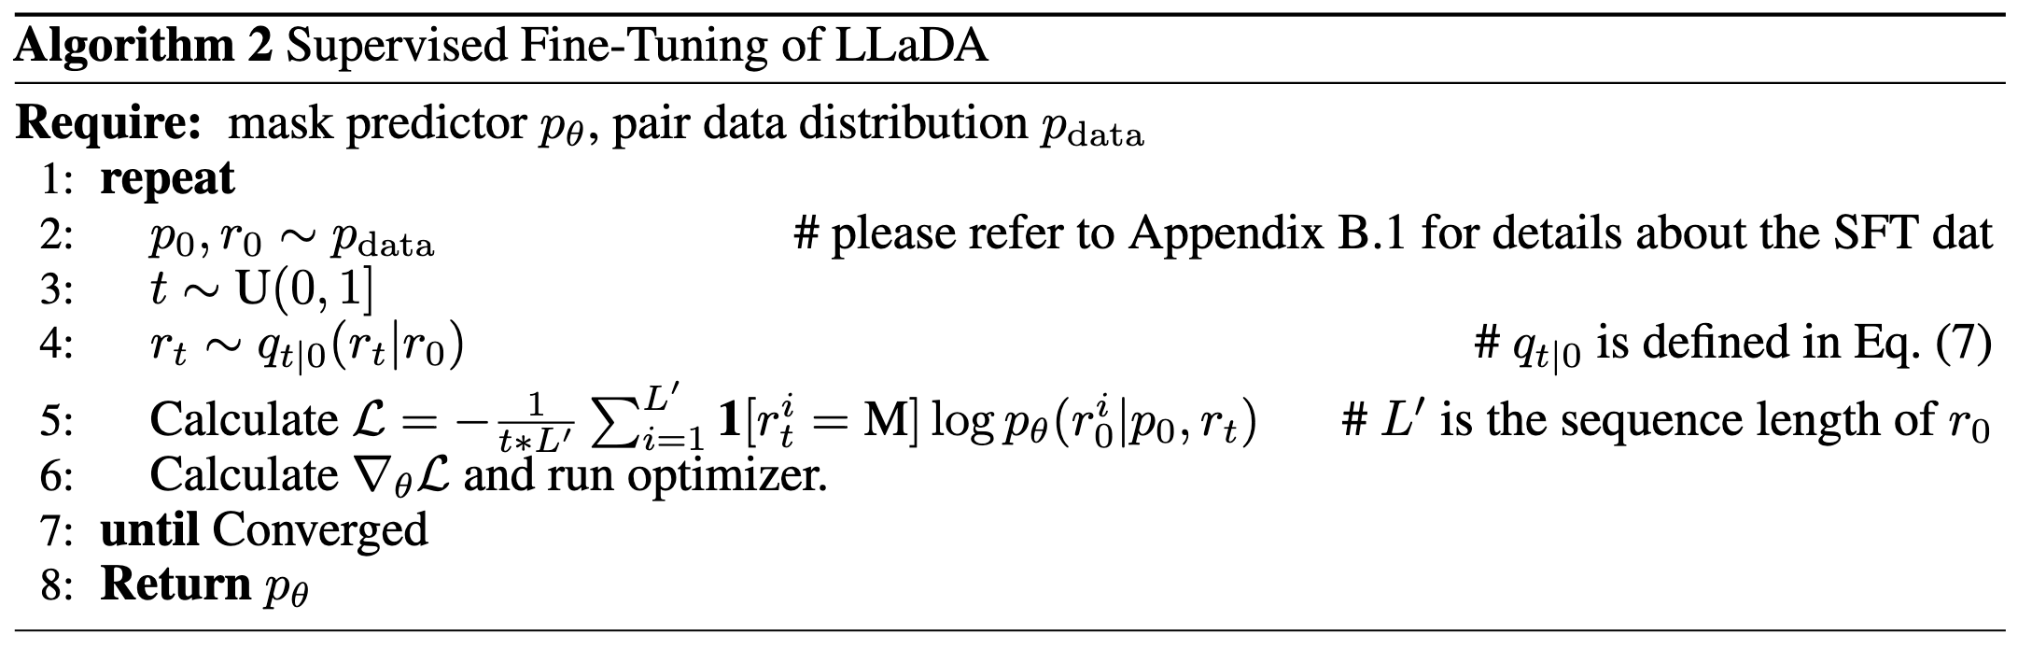
Supervised Fine-Tuning (SFT): Algorithm

Slide 21
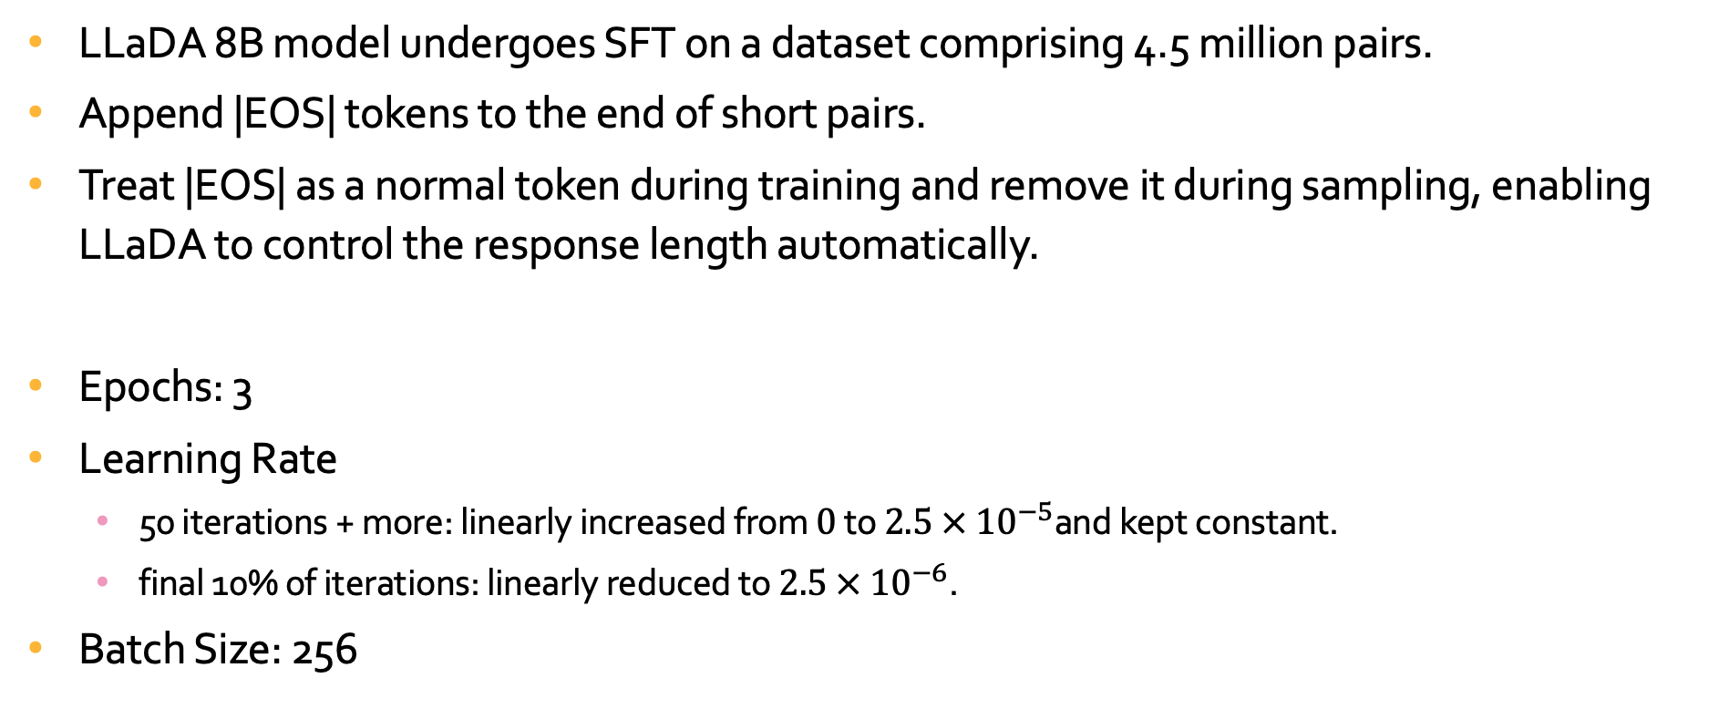
Supervised Fine-Tuning (SFT) for Instruction Following
LLaDA 8B model undergoes SFT on a dataset comprising 4.5 million pairs.
Append |EOS| tokens to the end of short pairs.
Treat |EOS| as a normal token during training and remove it during sampling, enabling LLaDA to control the response length automatically.
Epochs: 3
Learning Rate
50 iterations + more: linearly increased from $0$ to $2.5 × {10}^{−5}$and kept constant.
final 10% of iterations: linearly reduced to $2.5 × {10}^{−6}$.
Batch Size: 256

Slide 22
Table of Contents
Introduction
Approach
Probabilistic Formulation
Pre-training
Supervised Fine-Tuning
Inference
Experiments
Scalability of LLaDA on Language Tasks
Benchmark Results
Reversal Reasoning and Analyses
Case Studies
Conclusion and Discussion

Slide 23
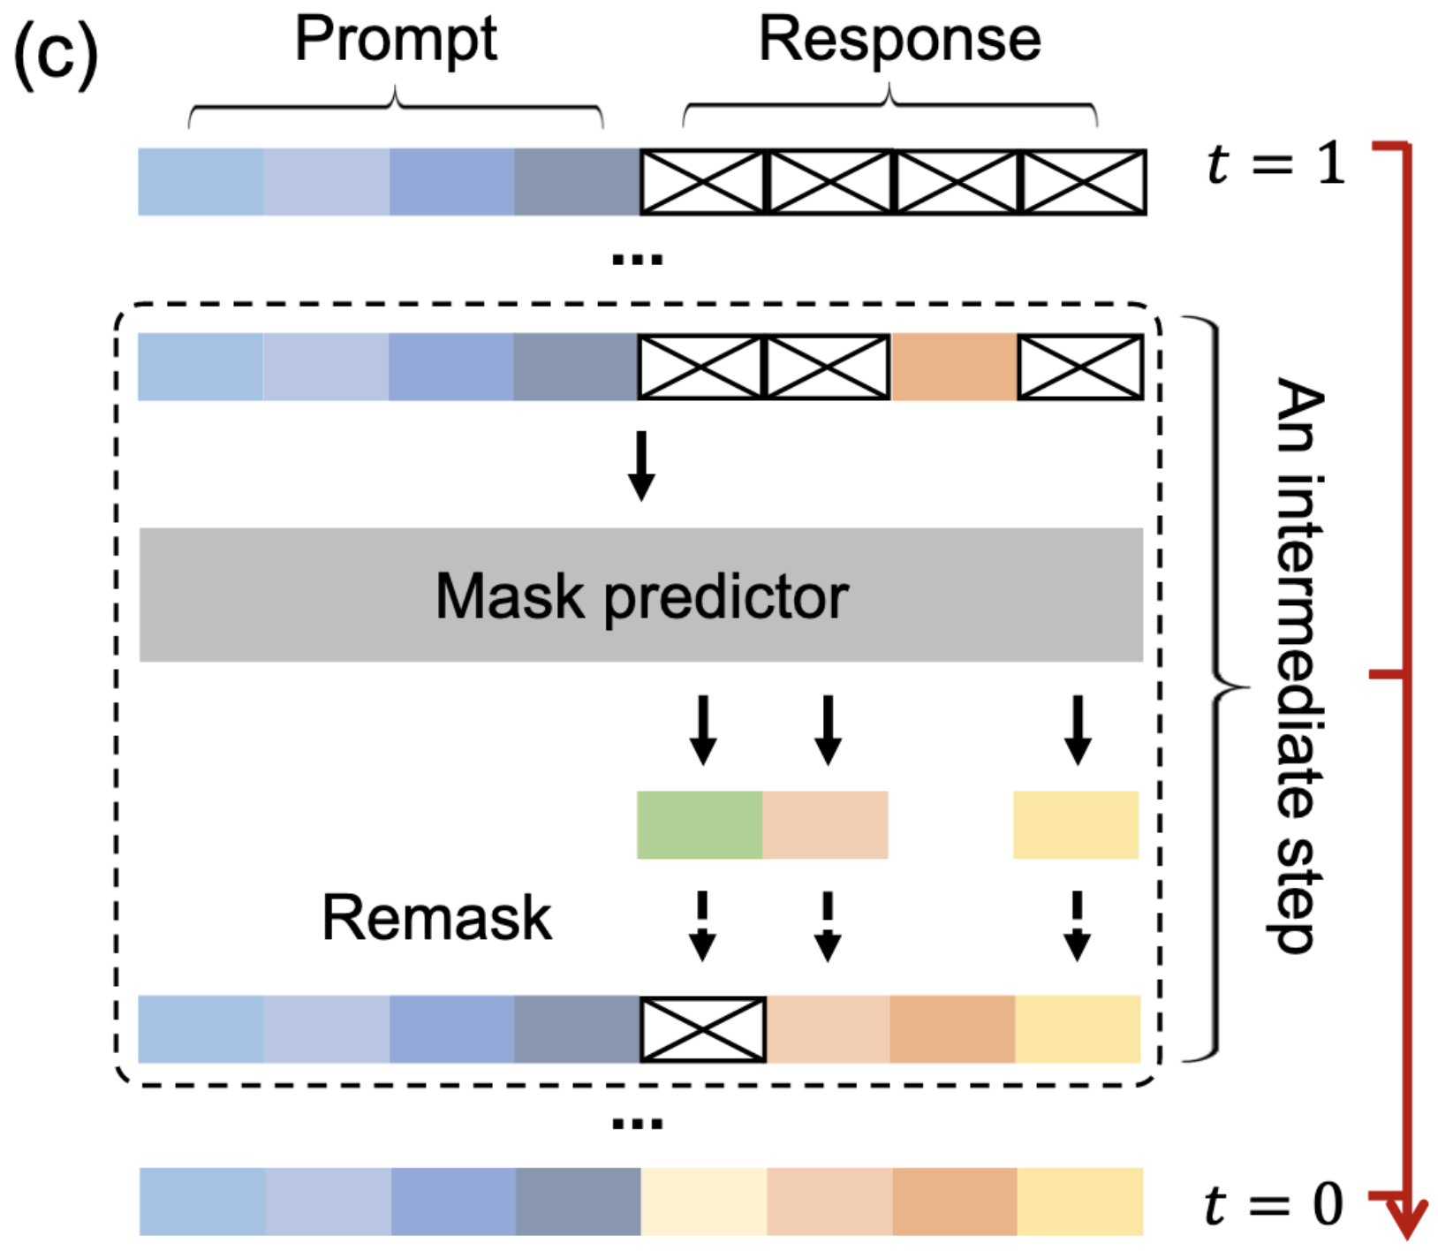
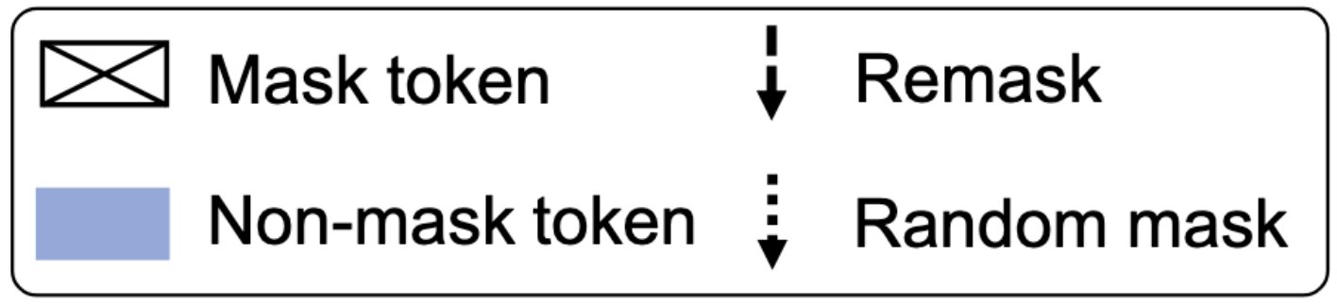
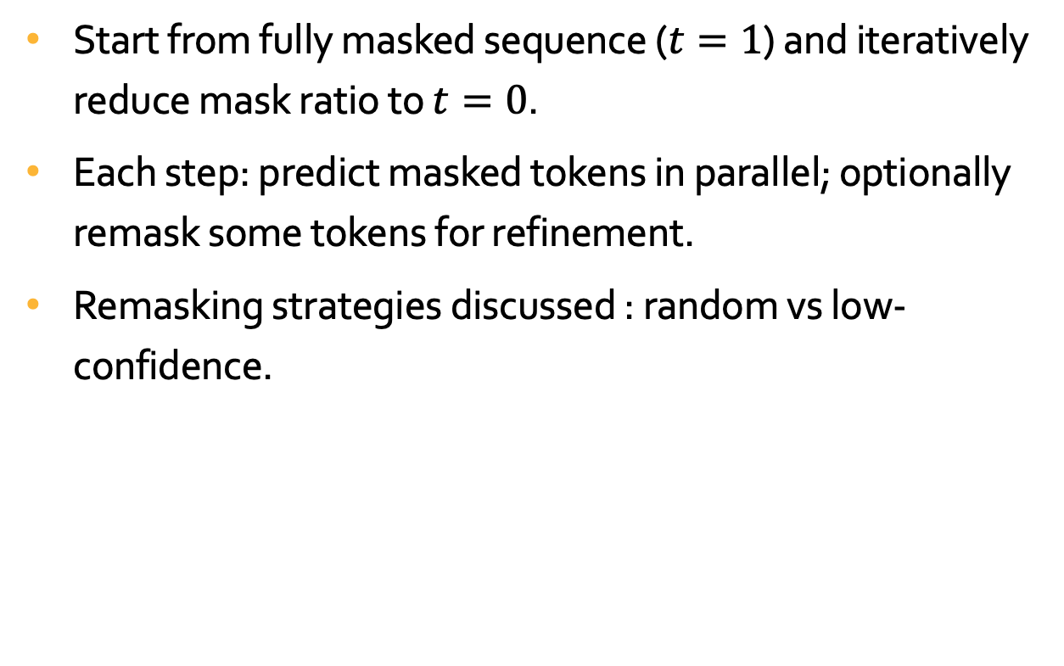
Inference: Diffusion-Style Sampling with Remasking
Start from fully masked sequence ($t=1$) and iteratively reduce mask ratio to $t=0$.
Each step: predict masked tokens in parallel; optionally remask some tokens for refinement.
Remasking strategies discussed : random vs low-confidence.

Slide 24
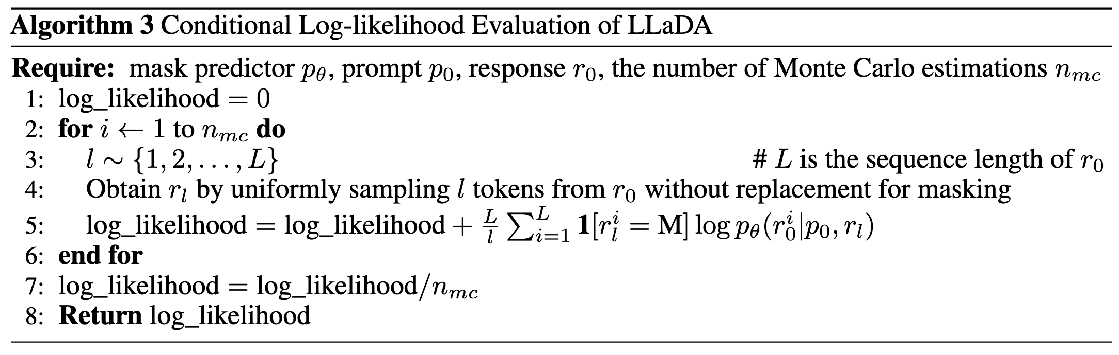
Inference: Algorithm

Slide 25
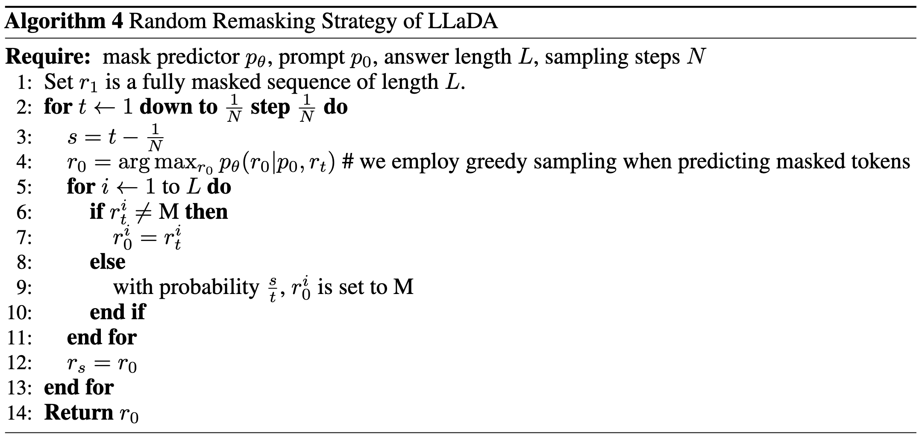
Inference: Algorithm

Slide 26
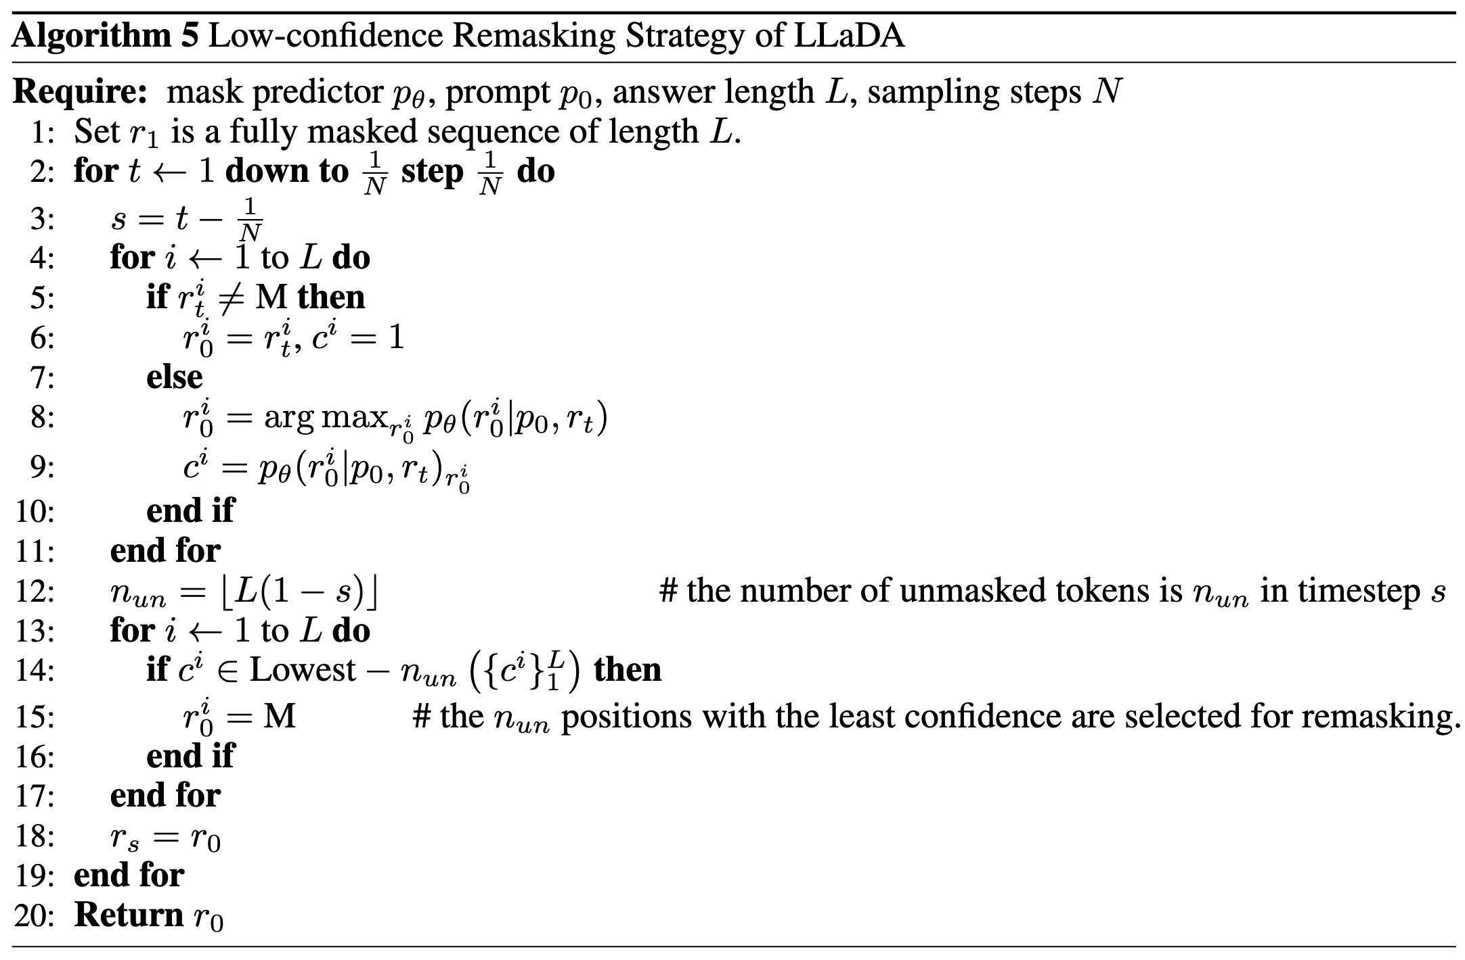
Inference: Algorithm

Slide 27
Table of Contents
Introduction
Approach
Probabilistic Formulation
Pre-training
Supervised Fine-Tuning
Inference
Experiments
Scalability of LLaDA on Language Tasks
Benchmark Results
Reversal Reasoning and Analyses
Case Studies
Conclusion and Discussion

Slide 28
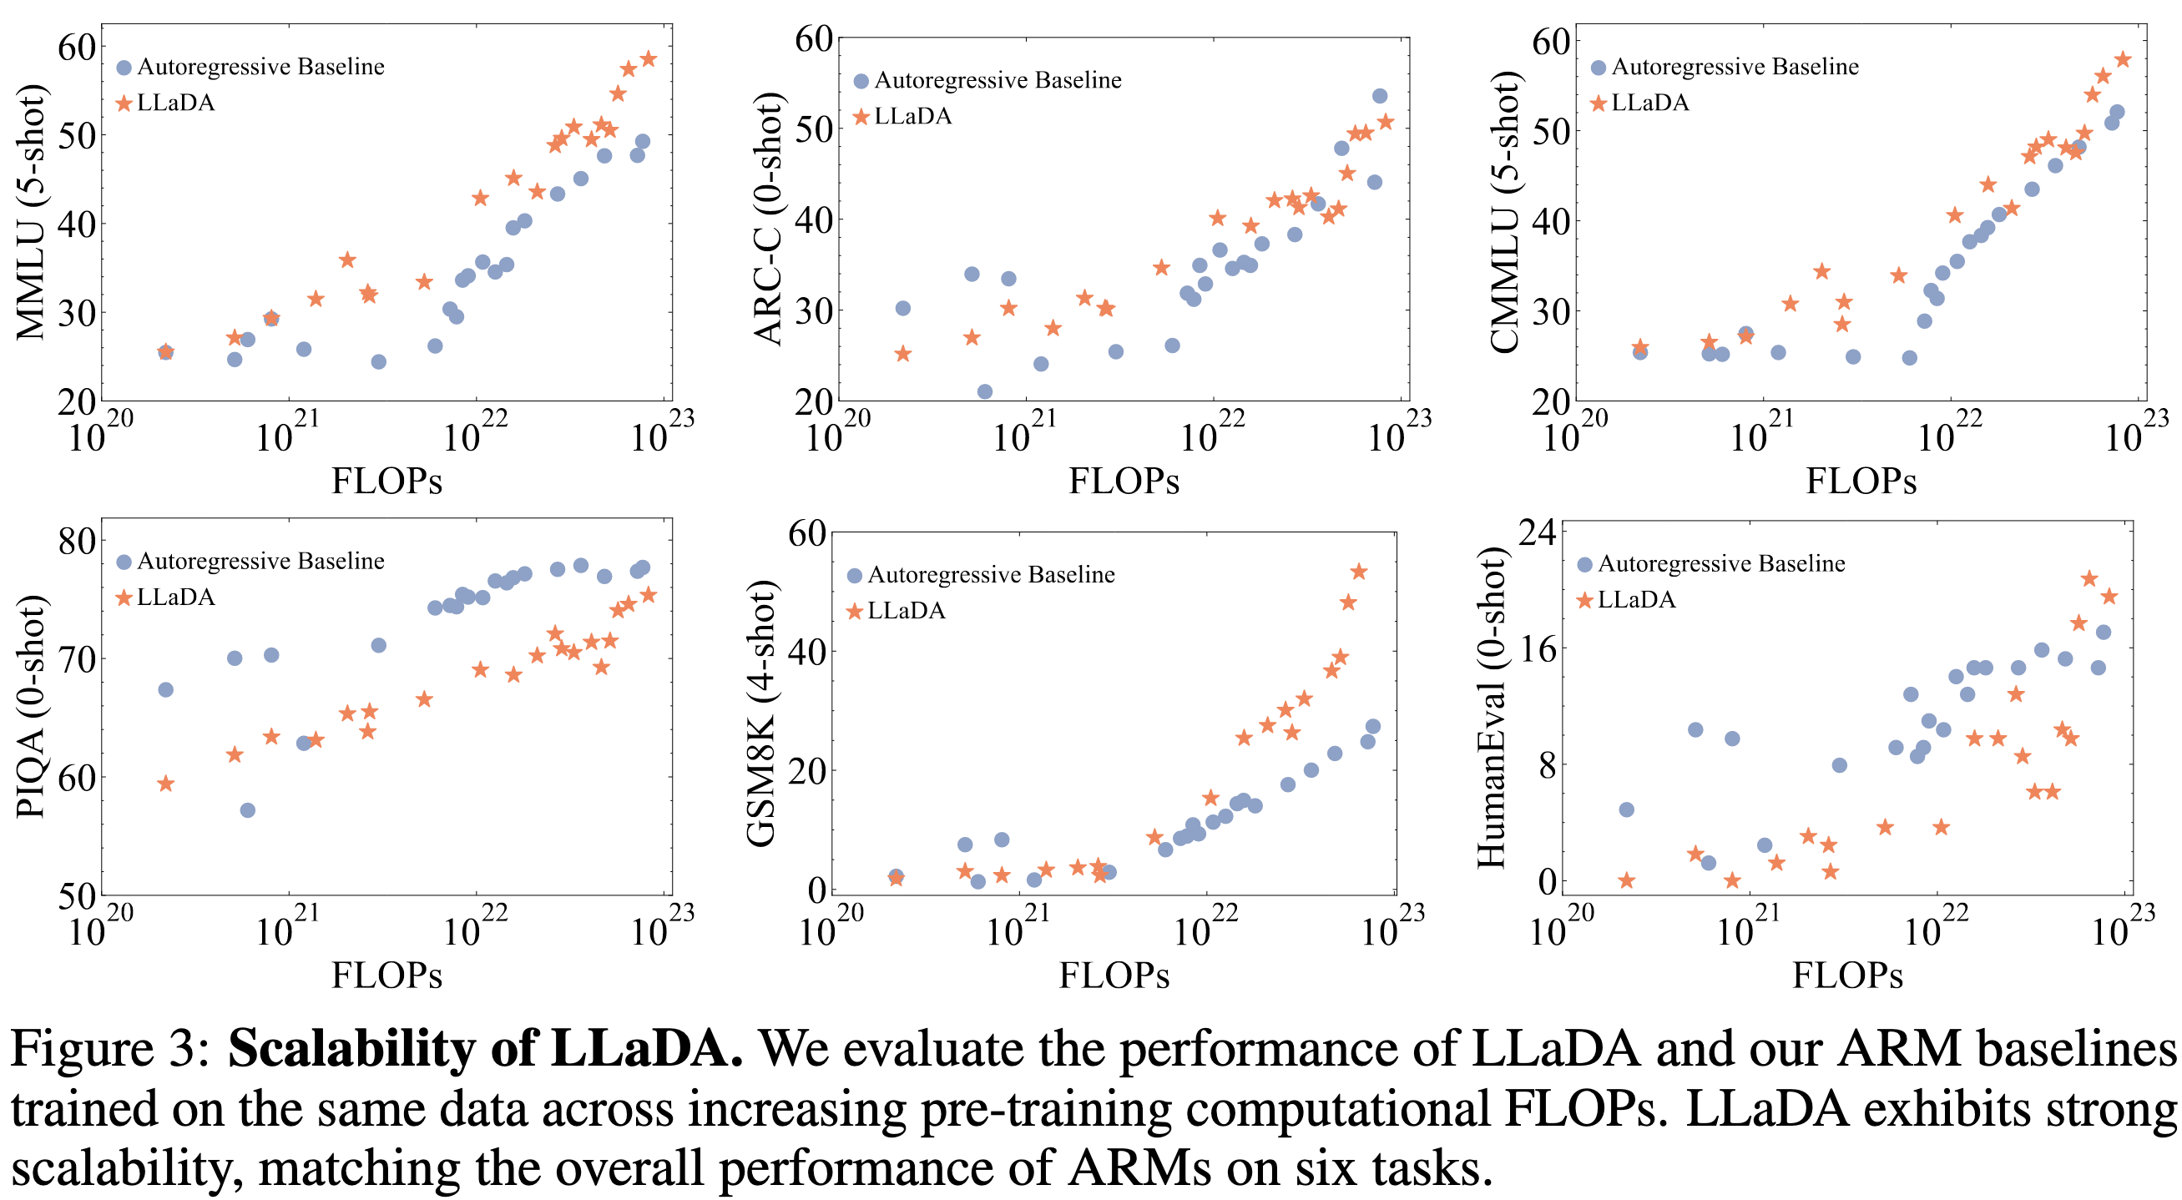
Scalability Results Across Compute

Slide 29
Scalability Results Across Compute
Compare LLaDA vs AR baselines trained on the same data, across increasing pre-training FLOPs.
Show that LLaDA scales strongly and matches ARMs on multiple tasks.

Slide 30
Table of Contents
Introduction
Approach
Probabilistic Formulation
Pre-training
Supervised Fine-Tuning
Inference
Experiments
Scalability of LLaDA on Language Tasks
Benchmark Results
Reversal Reasoning and Analyses
Case Studies
Conclusion and Discussion

Slide 31
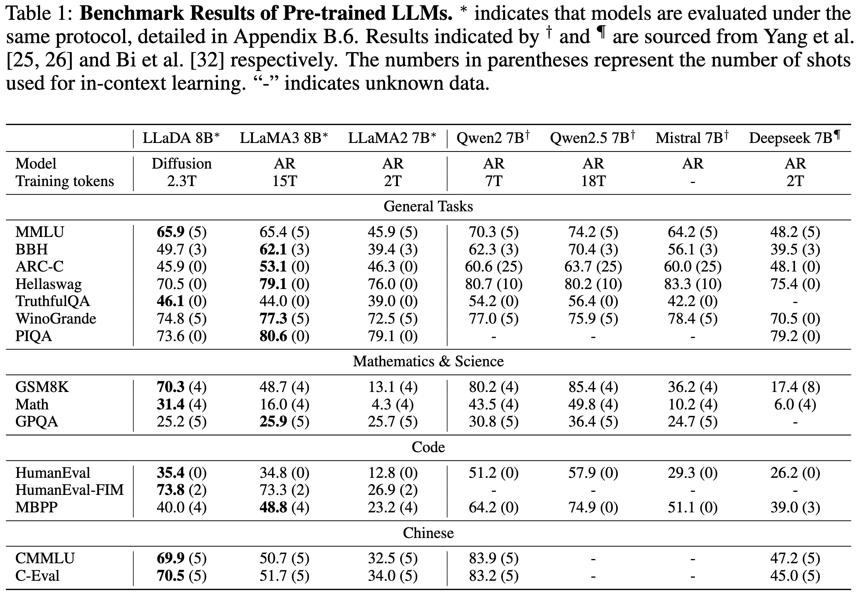
Pre-trained Benchmark Results (In-Context Learning)

Slide 32
Pre-trained Benchmark Results (In-Context Learning)
Broad comparison to similarly sized LLMs on general, math, code, Chinese tasks.
Key message: LLaDA 8B Base is competitive with strong AR baselines; advantages in some domains.

Slide 33
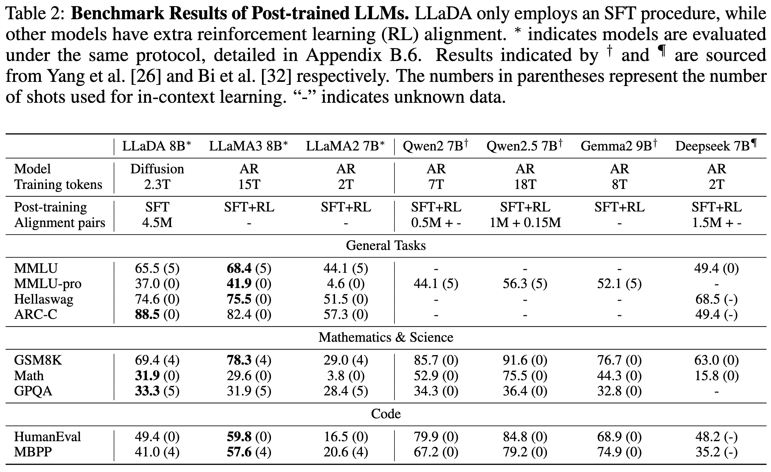
Post-trained (SFT) Benchmark Results

Slide 34
Post-trained (SFT) Benchmark Results
After SFT, LLaDA improves instruction-following and task performance under conditional generation.
Compare against instruct-tuned AR models under reported evaluation protocols.

Slide 35
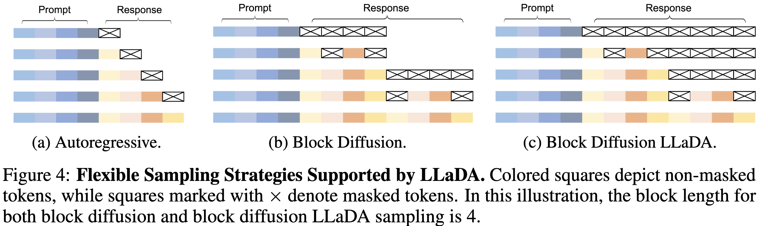
Details and Ablation on Sampling Strategies
Flexible Sampling Strategies

Slide 36
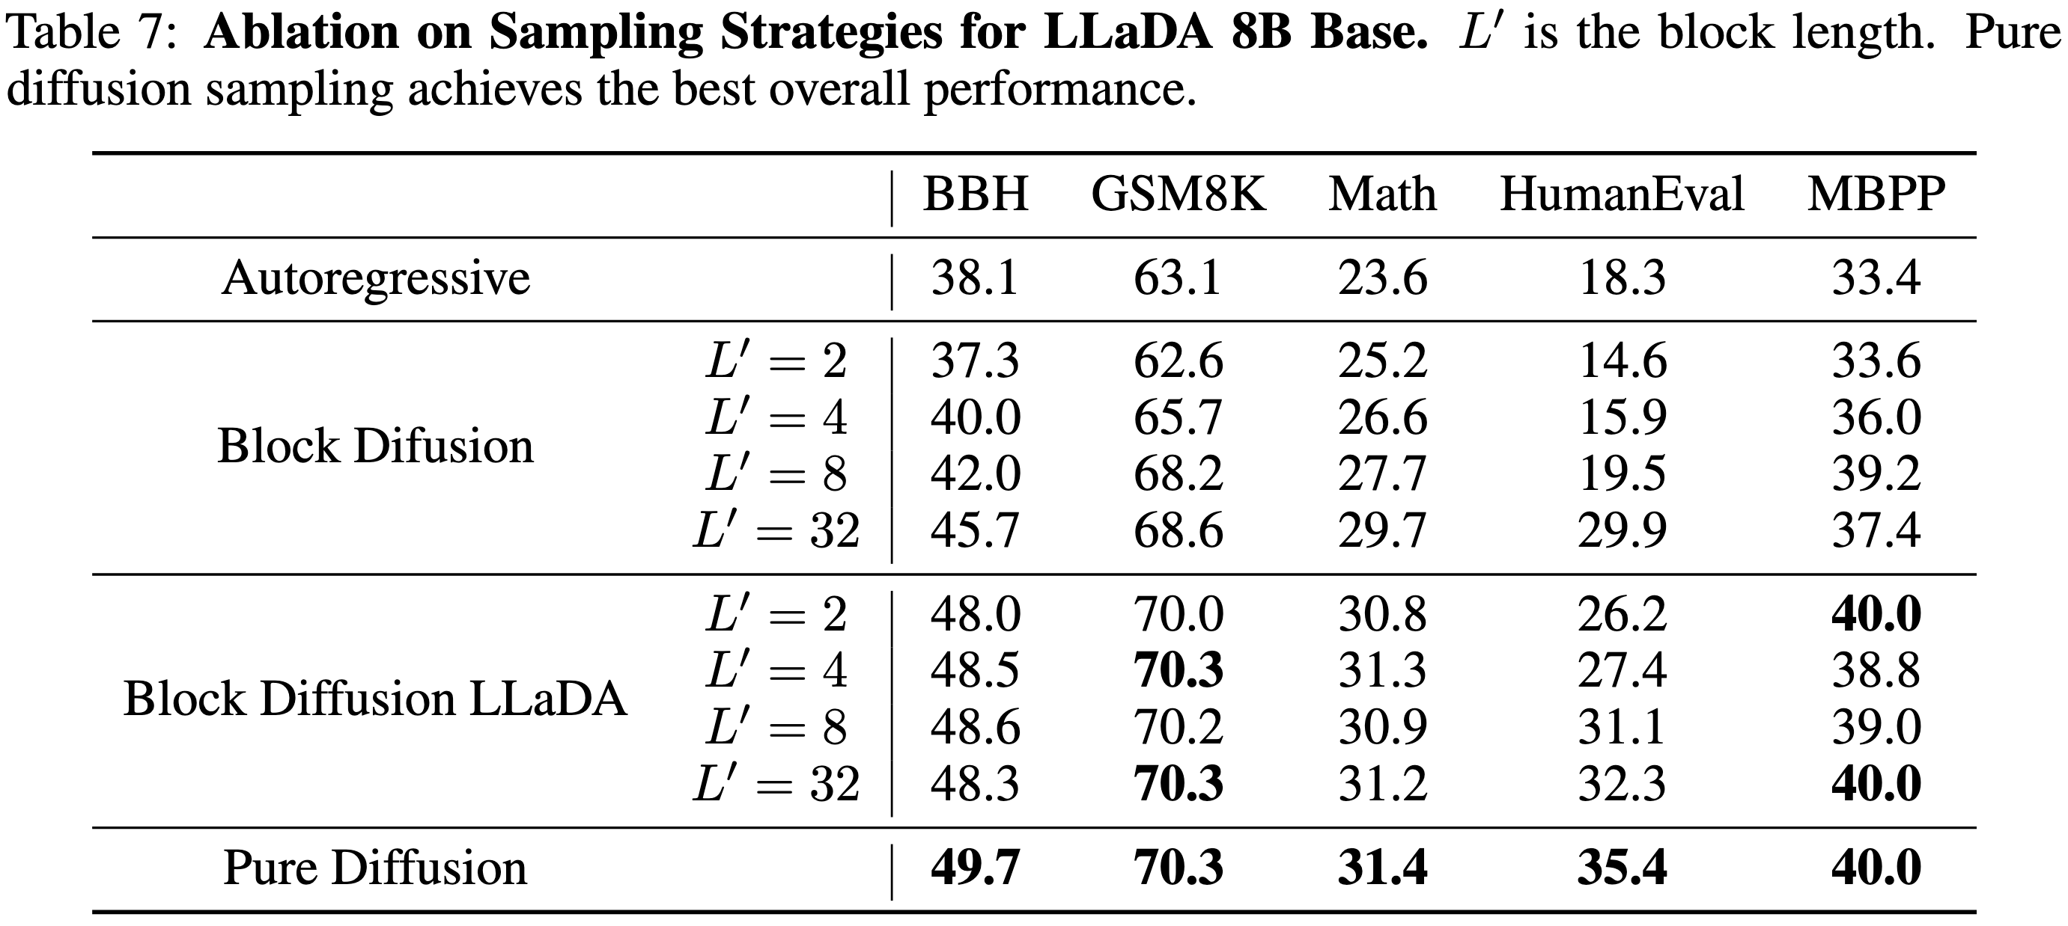
Details and Ablation on Sampling Strategies
Results

Slide 37
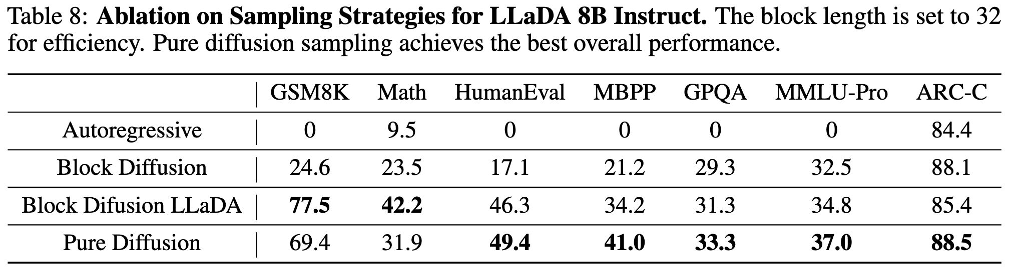
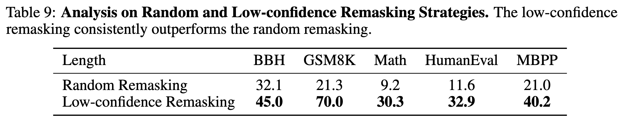
Details and Ablation on Sampling Strategies
Results

Slide 38
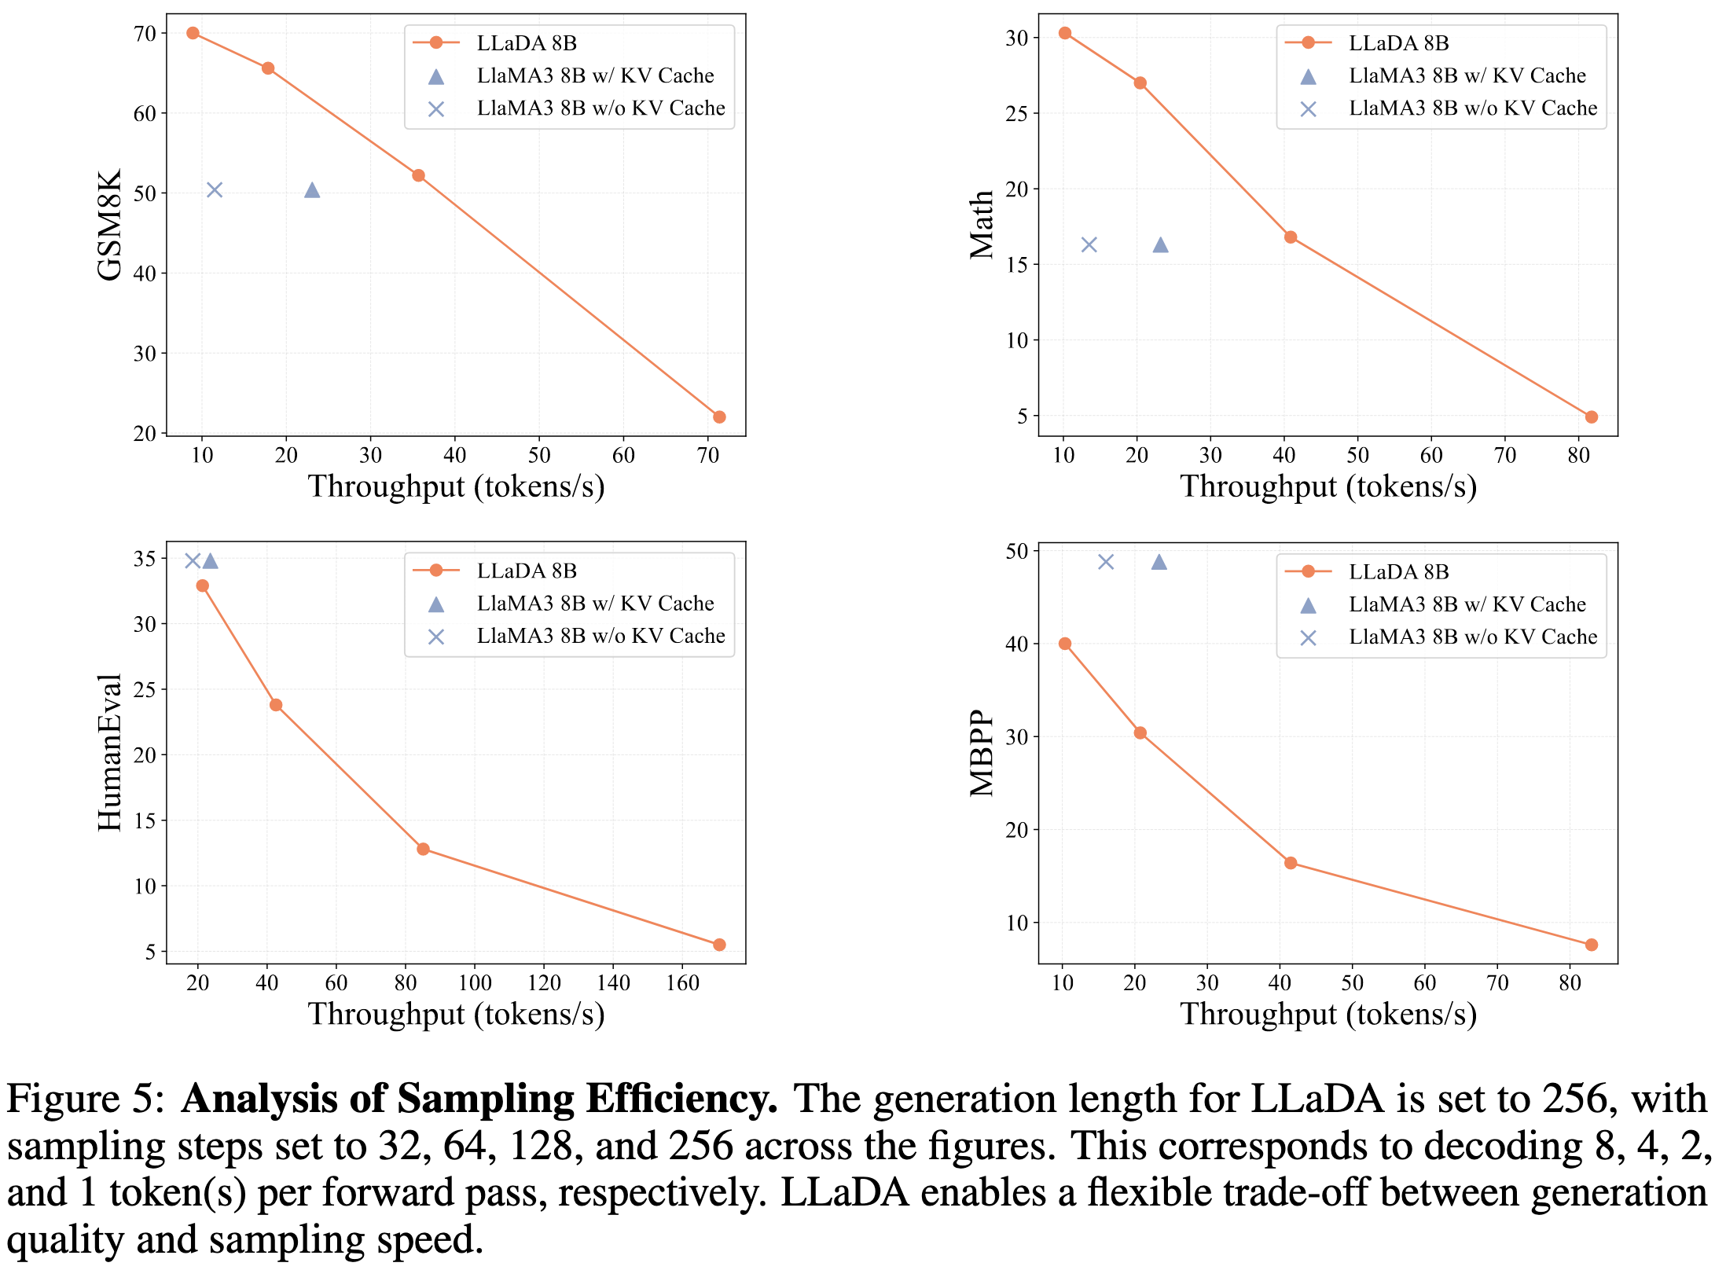
Analysis of Sampling Efficiency

Slide 39
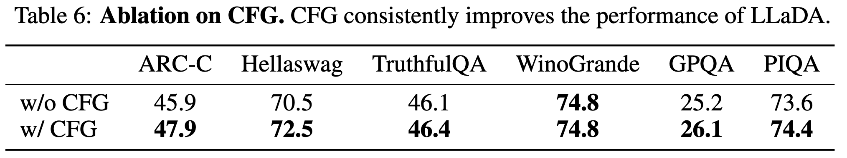
Ablation on CFG
To ensure a fair comparison with ARMs, we do not apply CFG to LLaDA in the main text.
However, LLaDA is fully compatible with CFG and consistently exhibits improved performance when it is applied.

Slide 40
Table of Contents
Introduction
Approach
Probabilistic Formulation
Pre-training
Supervised Fine-Tuning
Inference
Experiments
Scalability of LLaDA on Language Tasks
Benchmark Results
Reversal Reasoning and Analyses
Case Studies
Conclusion and Discussion

Slide 41
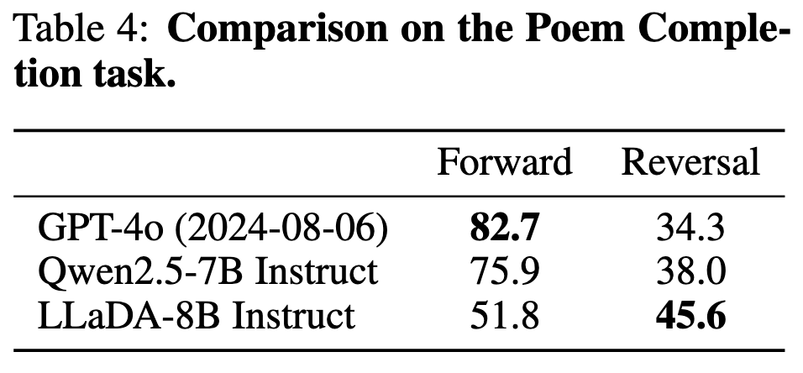
Reversal Reasoning
Motivation and Setup
Evaluate “reversal curse”: forward next-line vs reversal previous-line generation.
Dataset: Chinese poem sentence pairs; zero-shot generation without additional tuning.
Key claim: LLaDA treats tokens more uniformly (less left-to-right inductive bias).
Main Results
Show forward vs reversal performance; LLaDA narrows the gap and improves reversal accuracy.
Talking point: strong AR models excel forward but drop sharply on reversal; LLaDA is more balanced.

Slide 42
Table of Contents
Introduction
Approach
Probabilistic Formulation
Pre-training
Supervised Fine-Tuning
Inference
Experiments
Scalability of LLaDA on Language Tasks
Benchmark Results
Reversal Reasoning and Analyses
Case Studies
Conclusion and Discussion

Slide 43
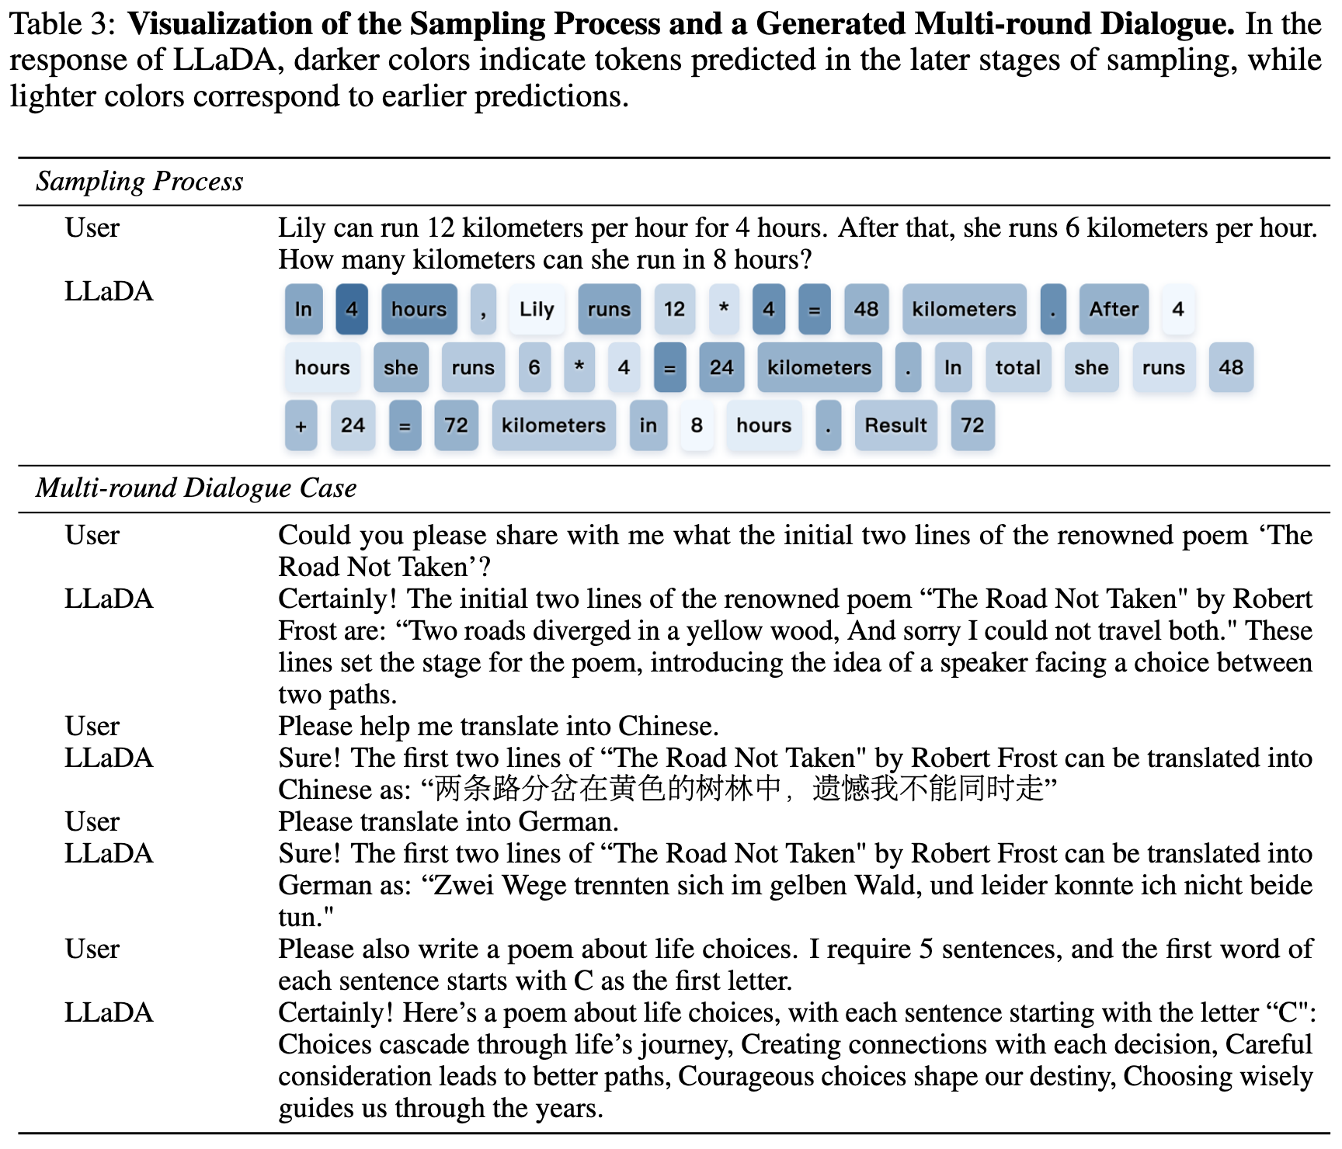
Instruction Following Case Studies (Qualitative)

Slide 44
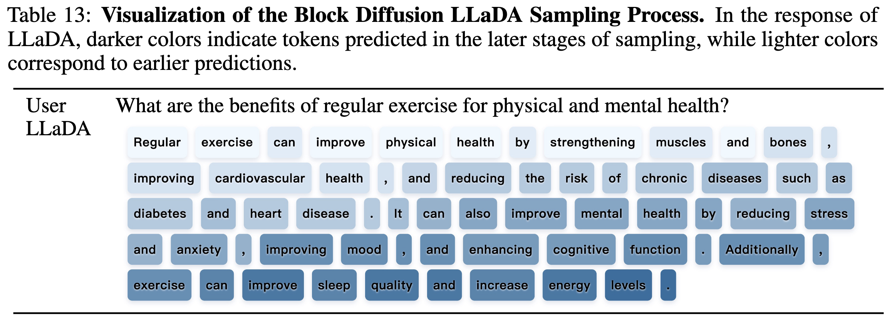
Instruction Following Case Studies (Qualitative)

Slide 45
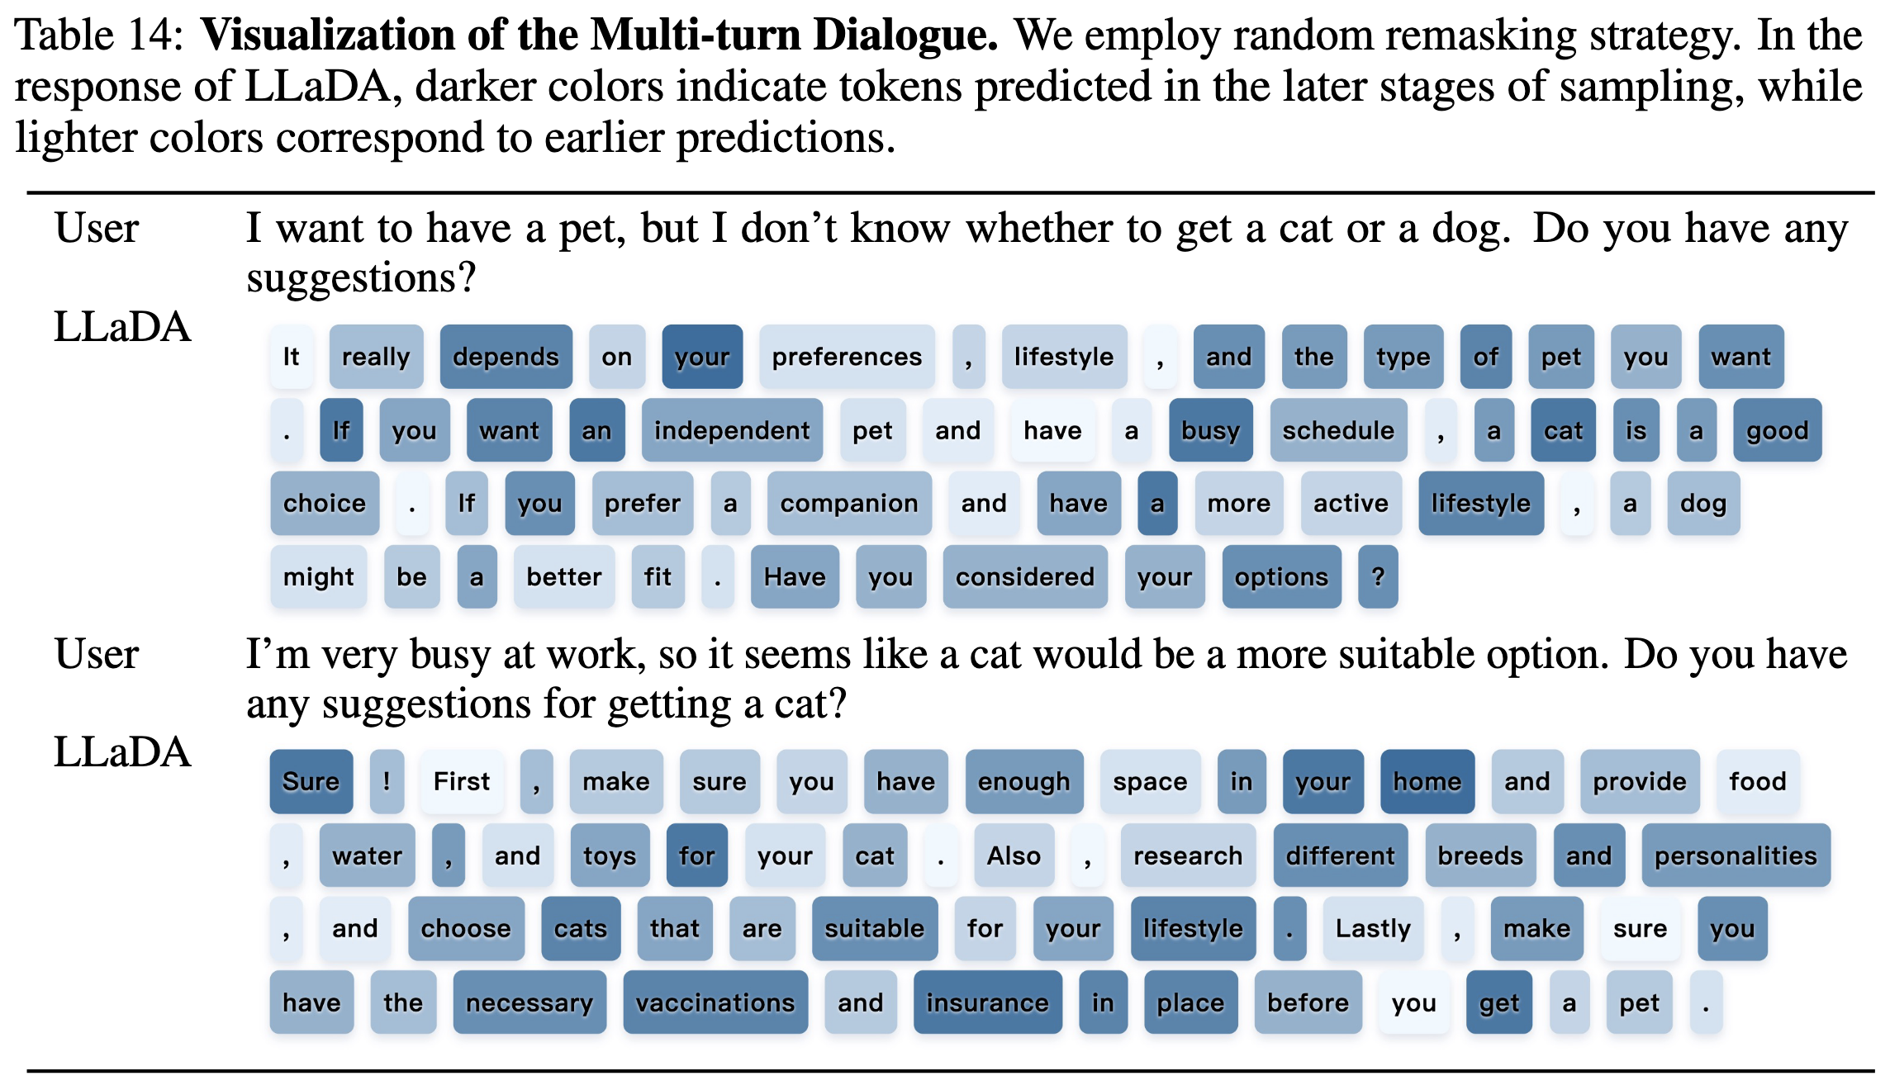
Instruction Following Case Studies (Qualitative)

Slide 46
Table of Contents
Introduction
Approach
Probabilistic Formulation
Pre-training
Supervised Fine-Tuning
Inference
Experiments
Scalability of LLaDA on Language Tasks
Benchmark Results
Reversal Reasoning and Analyses
Case Studies
Conclusion and Discussion

Slide 47
Conclusion and Discussion
Core takeaway: diffusion language models can exhibit LLM-like capabilities at scale.
Highlights: competitive benchmark performance, instruction-following after SFT, reversal robustness.
Broader impacts: similar societal concerns as LLMs (misuse, bias, environmental cost).
Limitation
The generation length is a user-specified hyperparameter.
No specialized attention mechanisms or position embeddings were designed for LLaDA, nor were any system-level architectural optimizations such as KV cache applied.

