Slide 1
제7장 HTML과 CSS로 웹사이트 만들기
학 습 목 표
지금까지 학습을 바탕으로 웹 사이트 콘텐츠를 작성하고 CSS로 스타일을 구성한다.

Slide 2

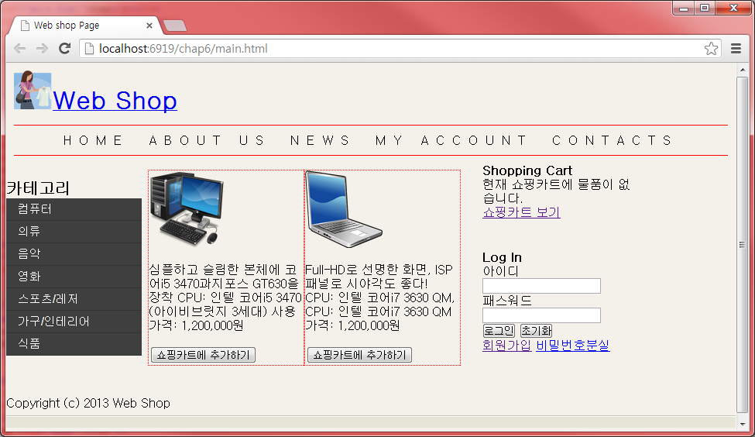

Slide 3

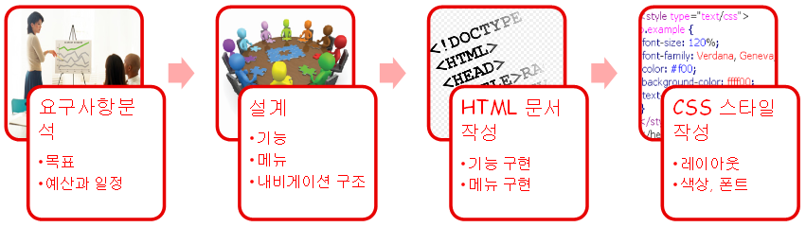

Slide 4

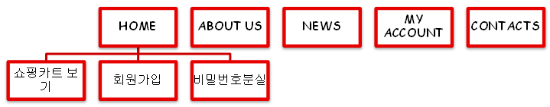
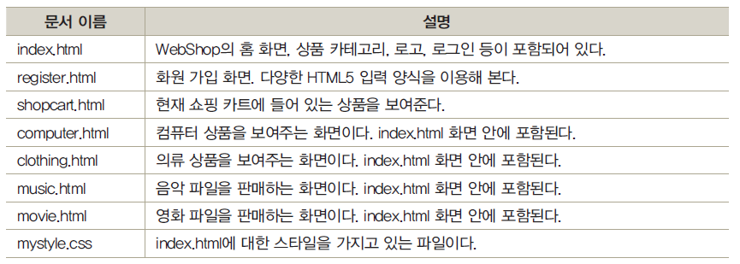

Slide 5

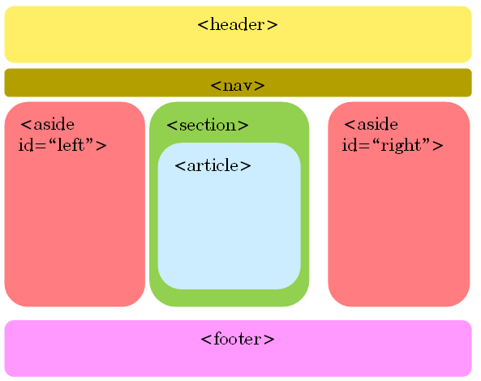

Slide 6


<header>
<h1>
<img src="images/shop.png" width="50" height="50" />
<a href="index.html">Web Shop</a>
</h1>
</header>

Slide 7

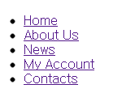
<nav>
<ul>
<li><a href="index.html">Home</a></li>
<li><a href="index.html">About Us</a></li>
<li><a href="index.html">News</a></li>
<li><a href="index.html">My Account</a></li>
<li><a href="index.html">Contacts</a></li>
</ul>
</nav>

Slide 8

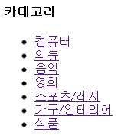
<aside id="left">
<h4>카테고리</h4>
<ul>
<li><a target="iframe1" href="computer.html">컴퓨터</a></li>
<li><a target="iframe1" href="clothing.html">의류</a></li>
<li><a target="iframe1" href="music.html">음악</a></li>
<li><a target="iframe1" href="movie.html">영화</a></li>
<li><a target="iframe1" href="computer.html">스포츠/레저</a></li>
<li><a target="iframe1" href="computer.html">가구/인테리어</a></li>
<li><a target="iframe1" href="computer.html">식품</a></li>
</ul>
</aside>

Slide 9

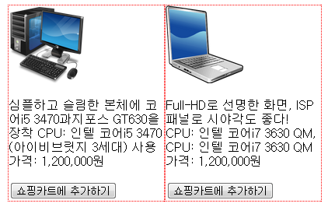
<section id="main">
<article id="article1">
<iframe name="iframe1" src="computer.html" width="440" height="300" seamless></iframe>
</article>
</section>

Slide 10

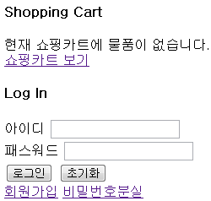
<aside id="right">
<div id="shopcart">
<h4>Shopping Cart</h4>
현재 쇼핑카트에 물품이 없습니다.<br />
<a href="shopcart.html">쇼핑카트 보기</a>
</div>
<div id="login">
<h4>Log In</h4>
<form action="#">
아이디
<input type="text" /><br />
패스워드
<input type="password" /><br />
<input type="submit" value="로그인" />
<input type="reset" value="초기화" /><br />
<a href="register.html" target="_blank" id="register">회원가입</a>
<a href="#" id="forgot">비밀번호분실</a>
</form>
</div>
</aside>

Slide 11

<footer>Copyright (c) 2013 Web Shop</footer>

Slide 12

<!DOCTYPE html>
<html>
<head>
<style>
body {
height: 100%;
background-color: #F3F1E9;
}
label {
display: inline-block;
width: 120px;
}
input {
display: inline-block;
width: 160px;
}
</style>
</head>

Slide 13
<body>
<div id="page-wrap">
<form method="post" action="process.jsp">
<fieldset>
<legend>회원정보입력</legend>
<label for="name">아이디</label>
<input type="text" name="name" id="text1" />
<button>중복검사</button><br />
<label for="password1">패스워드</label>
<input type="password" name="password1" /><br />
<label for="password2">패스워드 확인</label>
<input type="password" name="password2" /><br />
<label for="name">이름</label>
<input type="text" name="name" /><br />
<label for="tel">휴대폰 번호</label>
<input type="tel" name="tel" />
<br />
<label for="email">이메일</label>
<input type="email" name="email" />
<br />

Slide 14
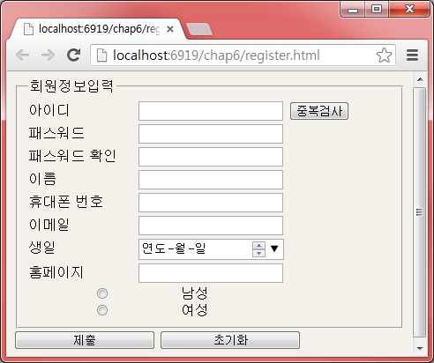
<label for="dob">생일</label>
<input type="date" name="dob" />
<br />
<label for="url">홈페이지</label>
<input type="url" name="url" />
<br />
<input type="radio" name="gender" value="Male">
남성<br>
<input type="radio" name="gender" value="Female">
여성<br>
</fieldset>
<input type="submit" name="submit" value="제출" />
<input type="reset" name="reset" value="초기화" />
</form>
</div>
</body>
</html>

Slide 15

<!DOCTYPE html>
<html>
<head>
<style>
#product1, #product2 {
width: 200px;
float: left;
border: 1px dotted red;
}
</style>
</head>
<body>
<div id="product1">
<img src="computer.png" width="100" height="100" />
<p>
심플하고 슬림한 본체에 코어i5 3470과지포스 GT630을 장착
CPU: 인텔 코어i5 3470 (아이비브릿지 3세대) 사용<br />
가격: 1,200,000원
</p>
<input type="button" value="쇼핑카트에 추가하기" />
</div>

Slide 16
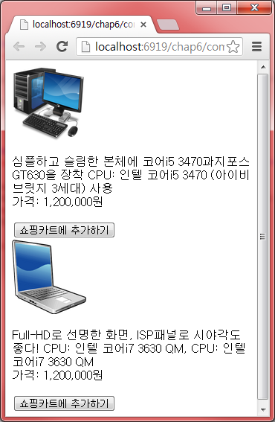
<div id="product2">
<img src="images/notebook.png" width="100" height="100" />
<p>
Full-HD로 선명한 화면, ISP패널로
시야각도 좋다! CPU: 인텔 코어i7 3630 QM, CPU: 인텔 코어i7 3630 QM
<br />
가격: 1,200,000원
</p>
<input type="button" value="쇼핑카트에 추가하기" />
</div>
</body>
</html>

Slide 17

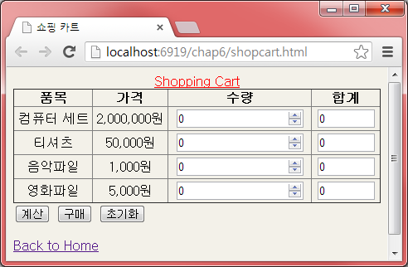
<html>
<head>
<title>쇼핑 카트</title>
<style>
body {
height: 100%;
background-color: #F3F1E9;
}
table {
width: 100%;
border-collapse: collapse;
text-align: center;
}
table caption {
color: red;
text-decoration: underline;
}
</style>
</head>

Slide 18
<body>
<form action="#">
<table border="1">
<caption>Shopping Cart</caption>
<tr>
<th>품목</th>
<th>가격</th>
<th>수량</th>
<th>합계</th>
</tr>
<tr>
<td>컴퓨터 세트</td>
<td>2,000,000원</td>
<td>
<input type="number" min="0" step="1" value="0"></td>
<td>
<input type="text" size="6" value="0" /></td>
</tr>
<tr>
<td>티셔츠</td>
<td>50,000원</td>
<td>
<input type="number" min="0" step="1" value="0"></td>
<td>
<input type="text" size="6" value="0" /></td>
</tr>

Slide 19
<tr>
<td>음악파일</td>
<td>1,000원</td>
<td>
<input type="number" min="0" step="1" value="0"></td>
<td>
<input type="text" size="6" value="0" /></td>
</tr>
<tr>
<td>영화파일</td>
<td>5,000원</td>
<td>
<input type="number" min="0" step="1" value="0"></td>
<td>
<input type="text" size="6" value="0" /></td>
</tr>
</table>
<input type="button" value="계산" />
<input type="submit" value="구매" />
<input type="reset" value="초기화" />
</form>
<a href="main.html">Back to Home</a>
</body>
</html>

Slide 20

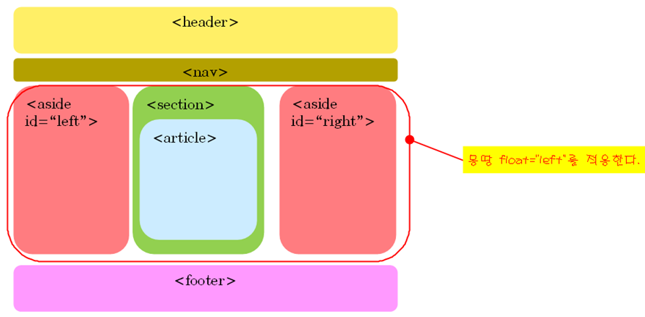

Slide 21

* {
/*border: 1px solid red;*/
padding: 0px;
margin: 0px;
}
body {
background-color: #F3F1E9;
}
header {
height: 60px;
margin: 10px;
}
nav {
margin: 10px;
}
nav ul {
list-style: none;
text-align: center;
border-top: 1px solid red;
border-bottom: 1px solid red;
padding: 10px 0;
}

Slide 22
nav ul li {
display: inline;
text-transform: uppercase;
padding: 0 10px;
letter-spacing: 10px;
}
nav ul li a {
text-decoration: none;
color: black;
}
nav ul li a:hover {
text-decoration: underline;
}
aside#left {
width: 175px;
margin-top: 20px;
float: left;
}

Slide 23
#left h4 {
font-family: Arial, Helvetica, sans-serif;
font-size: 20px;
}
#left ul {
font-family: Arial, Helvetica, sans-serif;
font-size: 15px;
color: #FFF;
list-style: none;
text-indent: 15px;
}
#left ul li {
background: #3f3f3f;
line-height: 28px;
border-bottom: 1px solid #333;
}
#left ul li a {
text-decoration: none;
color: #FFF;
display: block;
}

Slide 24
#left ul li a:hover {
background: #d40203;
}
#left ul li#active {
background: #d40203;
}
#main {
font-family: Arial, Helvetica, sans-serif;
font-size: 12px;
color: #464646;
overflow: hidden;
float: left;
width: 430px;
}
#shopcart {
margin-bottom: 20px;
}
#login {
margin-top: 40px;
}

Slide 25
aside#right {
padding: 0px;
margin-left: 10px;
width: 200px;
float: left;
}
footer {
width: 100%;
height: 50px;
clear: both;
background-image: url(images/footer_bg.gif);
background-position: top left;
background-repeat: repeat-x;
}

Slide 26



