Slide 1
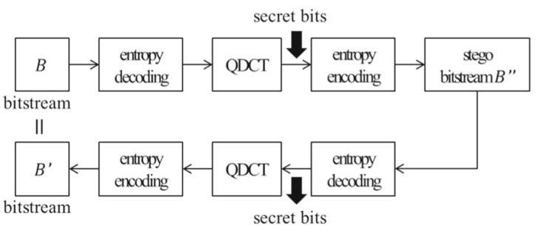
Reversible Data Hiding in H.264/AVC

Slide 2
Tables
1. RDH-Bouchama
(Reversible data hiding scheme for the H.264/AVC codec)
2. HDH
(Genuine Reversible Data Hiding Technique for H.264 Bitstream Using
Multi-Dimensional Histogram Shifting Technology on QDCT Coefficients)
3. RDH-Compensation
(Genuine reversible data hiding technology using compensation for H.264 bitstreams)
4. Compensational code mapping
(A Capacity Controllable Reversible Data Hiding Technology
for H.264/AVC Based on Compensational Code Mapping)

Slide 3

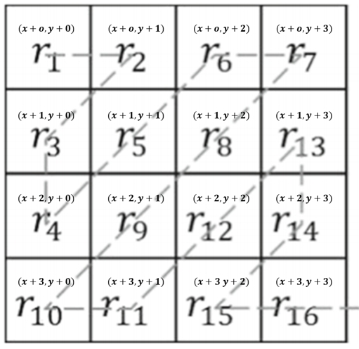
1. RDH-Bouchama
(T_{n},T_{p}) = (0,1)
V_{v =} 16개 V_{u} =5개
0000 0000
0001 0001
0010 0010
0011 0100
0100 1000
0101
0110
0111
1000
1001
1010
1011
1100
1101
1110
1111

Slide 4
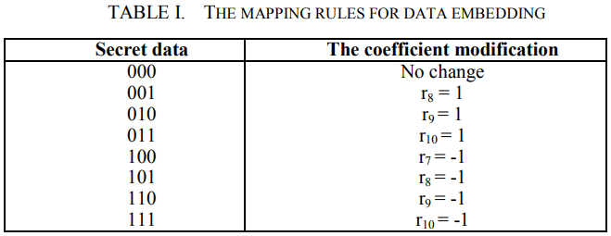


1. RDH-Bouchama
(T_{n},T_{p}) = (-1,1)
V_{u} =9
0000
0001
0010
0100
1000
000-1
00-10
0-100
-1000
Cap(R_{h}) = 3.17bit
0 0 0 0
0 1 0 0
0 0 1 0
0 0 0 1
-1 0 0 0
0 -1 0 0
0 0 -1 0
0 0 0 -1
3bit

Slide 5
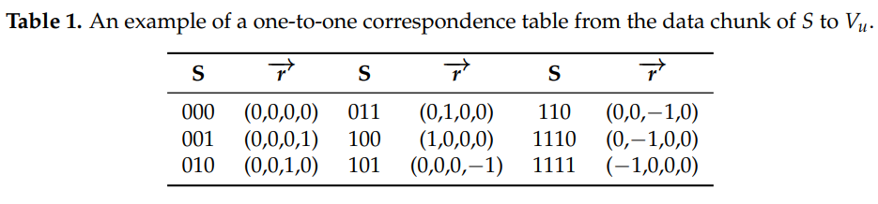

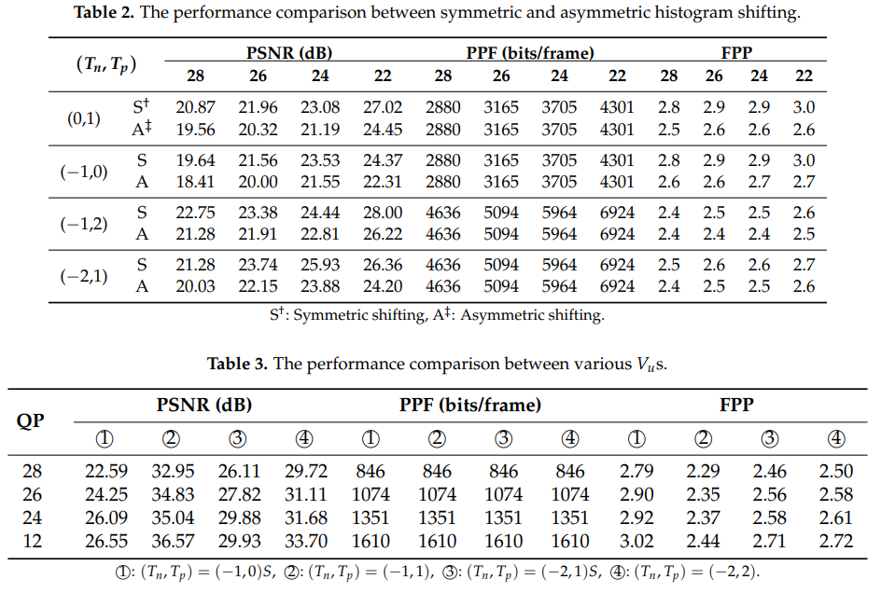
2. HDH
4bit
(T_{n},T_{p}) = (-1,1)
V_{u} =9
0000
0001
0010
0100
1000
000-1
00-10
0-100
-1000
Cap(R_{h}) = 3.17bit
fixed

Slide 6
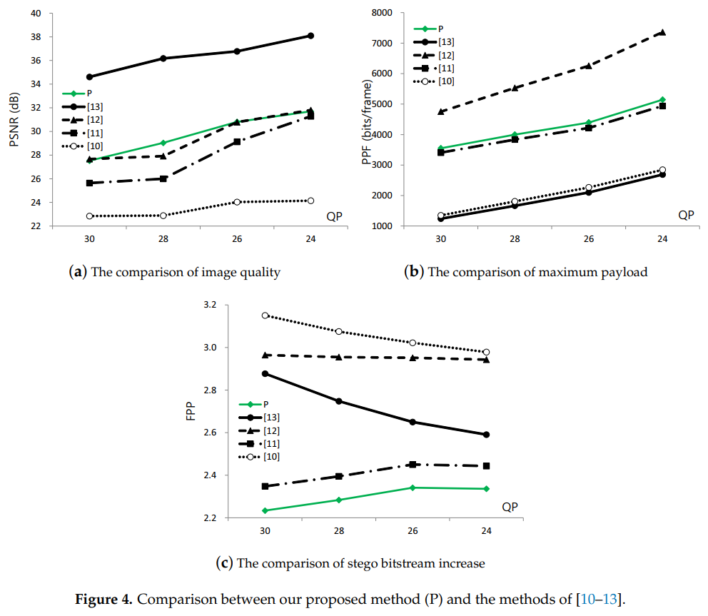
2. HDH

Slide 7

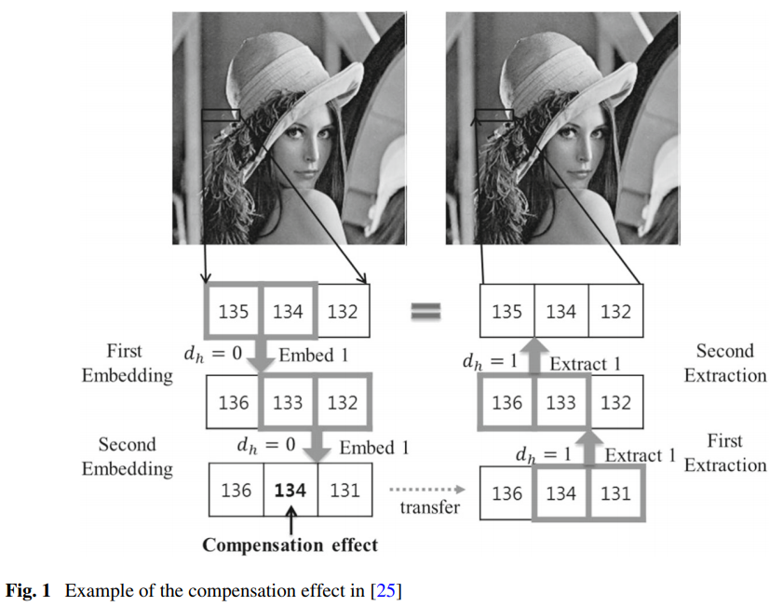
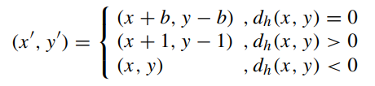
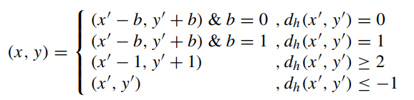
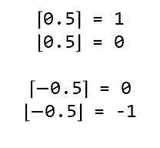
3. RDH-Compensation
$\left\lceil \text{0.5}\right\rceil$ = 1
$\left\lfloor \text{0.5}\right\rfloor$ = 0
$\left\lceil −\text{0.5}\right\rceil$ = 0
$\left\lfloor −\text{0.5}\right\rfloor$ = -1

Slide 8
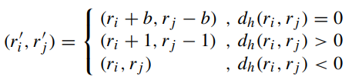
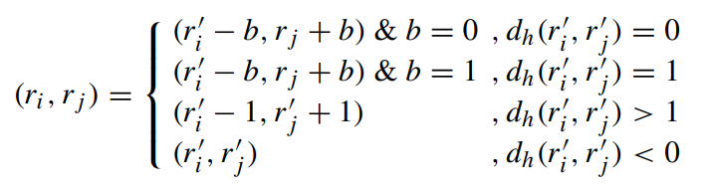

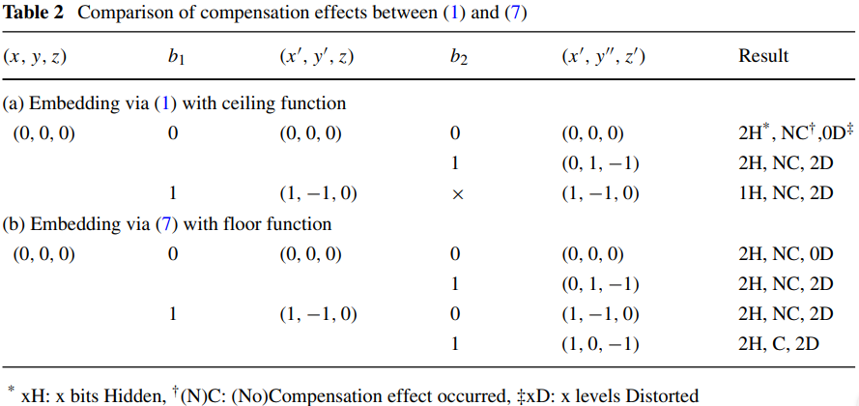
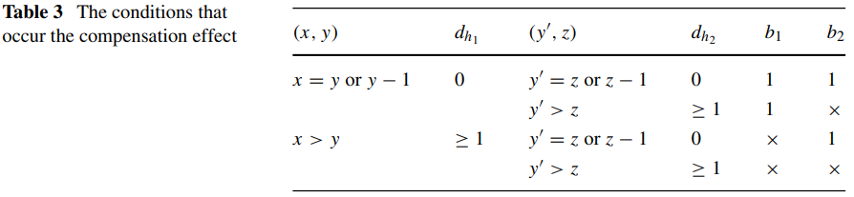
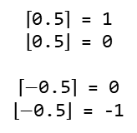
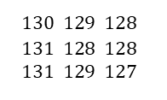
3. RDH-Compensation
$\left\lceil \text{0.5}\right\rceil$ = 1
$\left\lfloor \text{0.5}\right\rfloor$ = 0
$\left\lceil −\text{0.5}\right\rceil$ = 0
$\left\lfloor −\text{0.5}\right\rfloor$ = -1
floor
ceiling
$$130 129 128$$
$$131 128 128$$
$$131 129 127$$

Slide 9
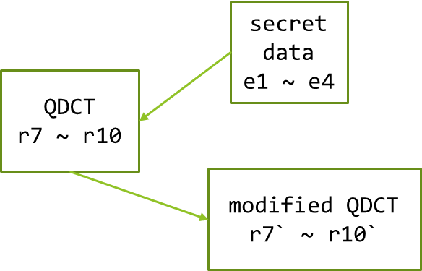
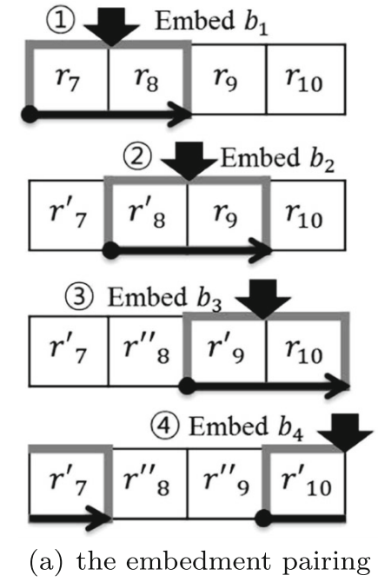
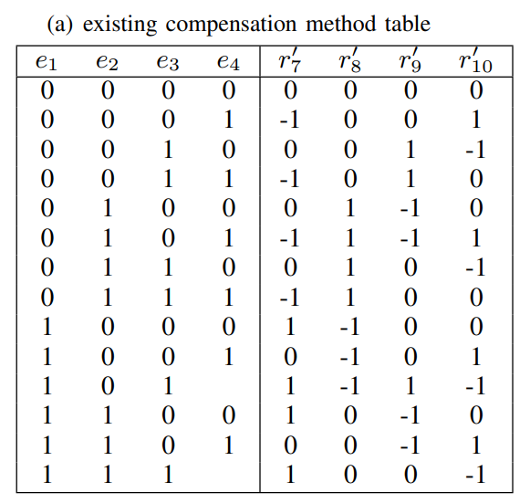
3. RDH-Compensation

Slide 10
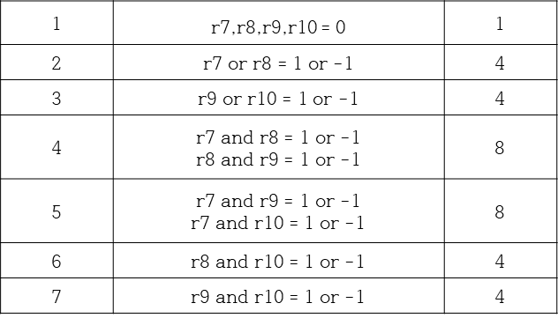
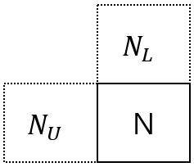
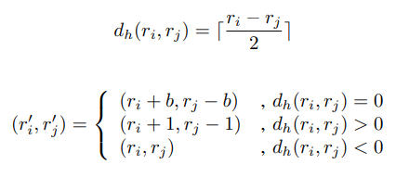
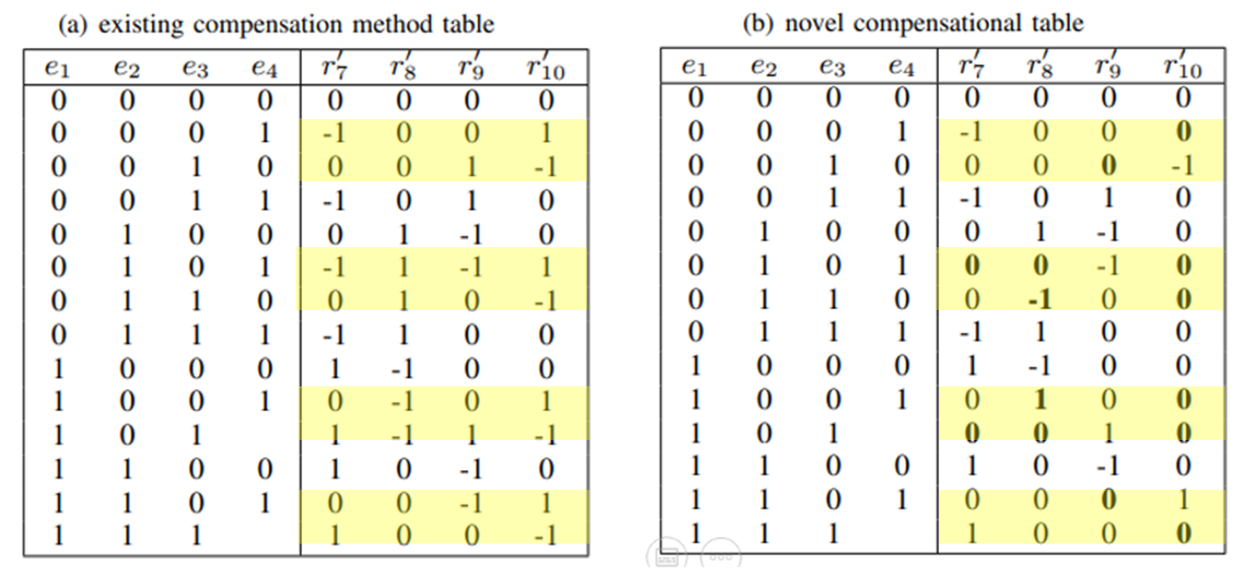
4. Compensational Code mapping
CAVLC
&
PSNR

