Slide 1
A Capacity Controllable RDH Technol. for H.264/AVC Based on Compensational Code Mapping
ICGHIT2022

Slide 2
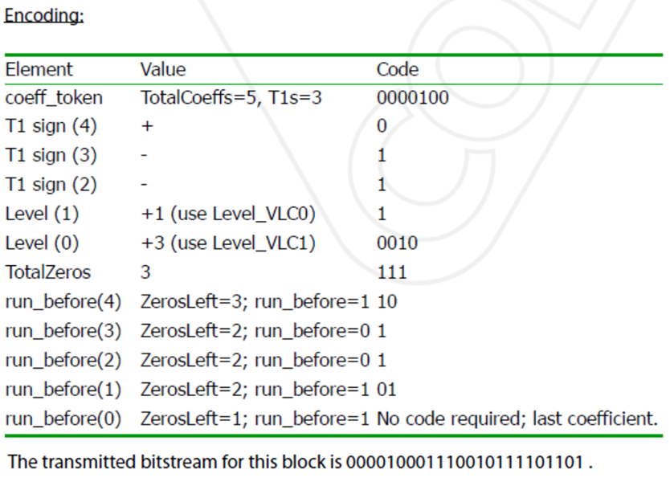
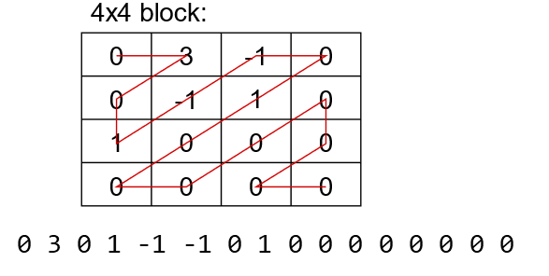
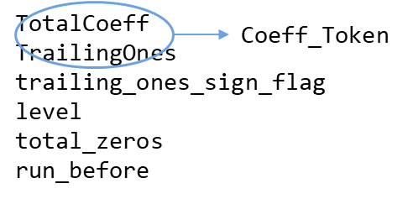
1. CAVLC
entropy coding (pattern occurrence probability) rule of CAVLC (Context-Adaptive Variable-Length Coding)
mid frequency positions as RDH places
(value change in low frequency area is more sensitive in visual quality)
(change in high frequency area affects the entropy coding)
so, PSNR, CAVLC (image quality, average code length through value modification)

Slide 3
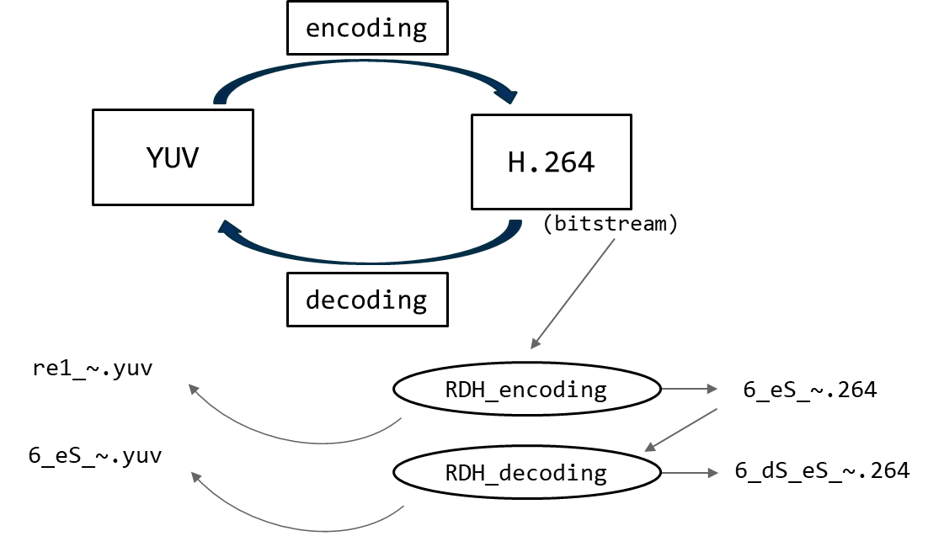
2. Ranking table (previous)
Compensational Code Mapping Algorithm
Tested by fixing the values from r1 to r6 in the 4x4 block and changing (r7, r8, r9, r10)
CAVLC CAVLC + PSNR
rank | form | number
1 | r7, r8, r9, r10 values are all zero | 1
2 | Only one of r7 or r8 is 1 or -1 | 4
3 | Only one of r9 or r10 is 1 or -1 | 4
4 | r7 and r8 =1 or-1 r8 and r9 = 1 or -1 | 8
5 | r7 and r9 =1 or-1 r7 and r10 = 1 or-1 | 8
6 | r8 and r10 = 1 or-1 | 4
7 | r9 and r10 = 1 or-1 | 4
 |  | 33
rank | form | number
1 | r7, r8, r9, r10 values are all zero | 1
2 | Only one of r7 or r8 is 1 or -1 | 4
3 | Only one of r9 or r10 is 1 or -1 | 4
4 | r7 and r8 =1 or-1 r8 and r9 = 1 or -1 | 8
5 | r7 and r10 = 1 or-1 | 4
6 | r7 and r9 =1 or-1 | 4
7 | r9 and r10 = 1 or-1 | 4
8 | r8 and r10 = 1 or-1 | 4

Slide 4
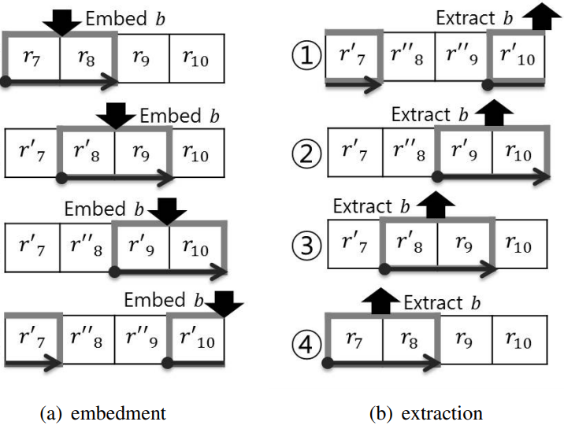

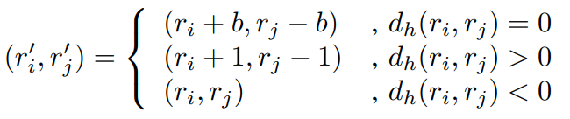
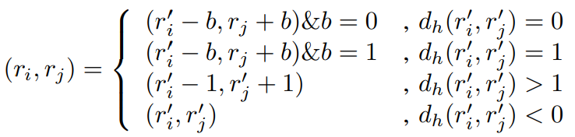
3. Proposed RDH Method
Compensational technique
Compensational Code Mapping Algorithm

Slide 5
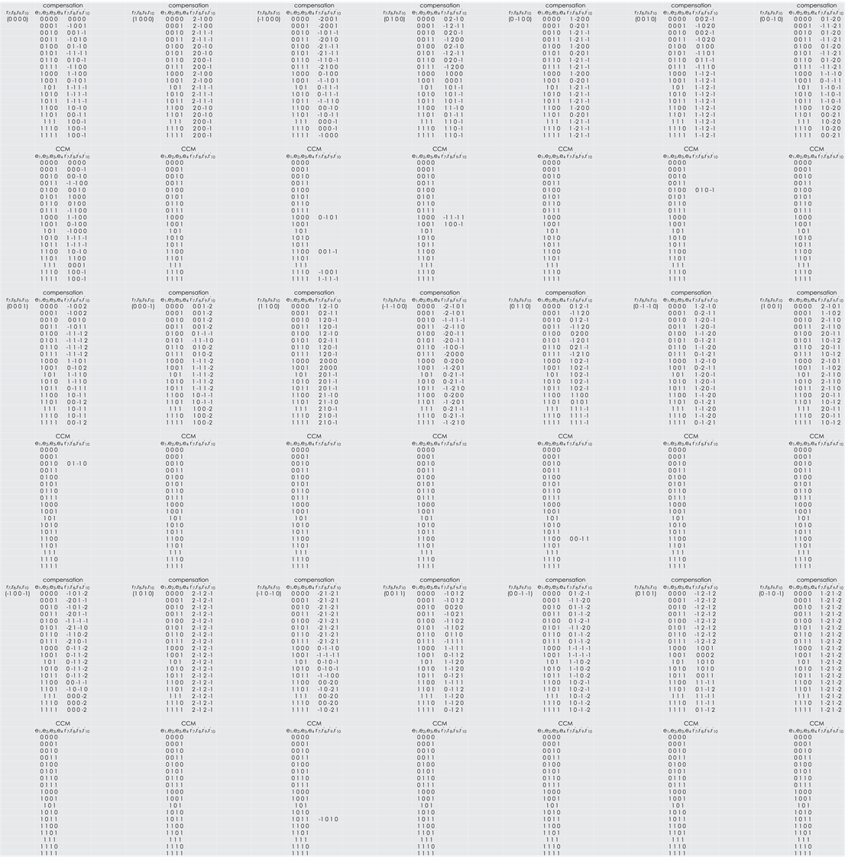

Slide 6
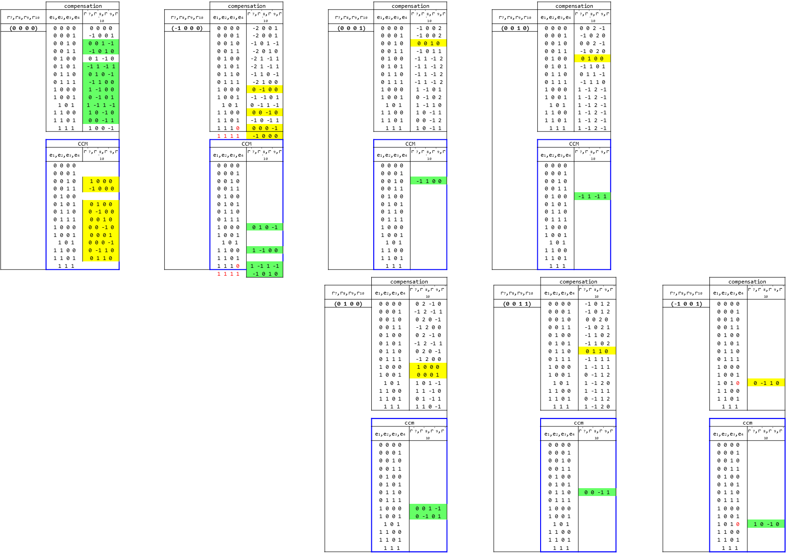
0603 ICGHIT

Slide 7
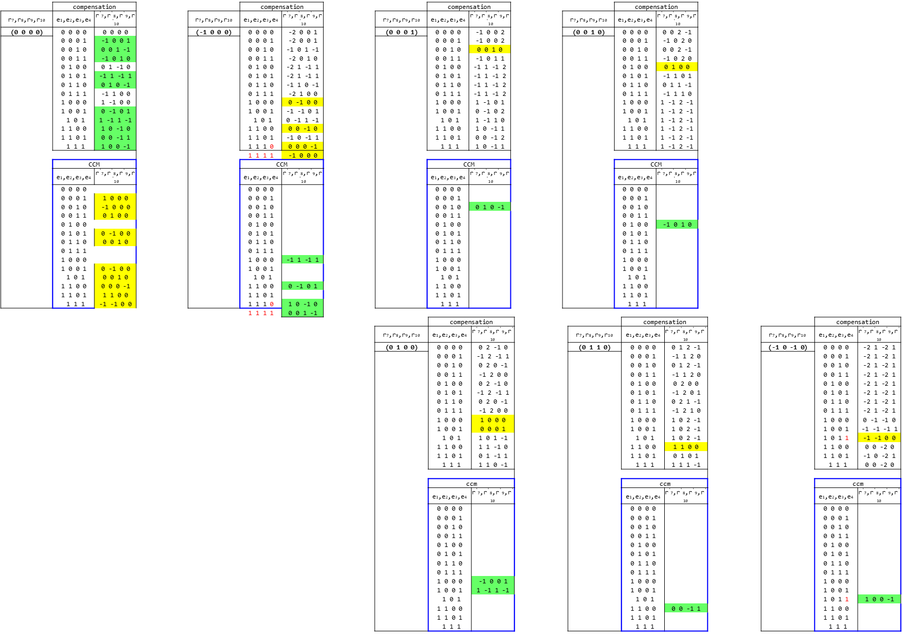
0913

Slide 8
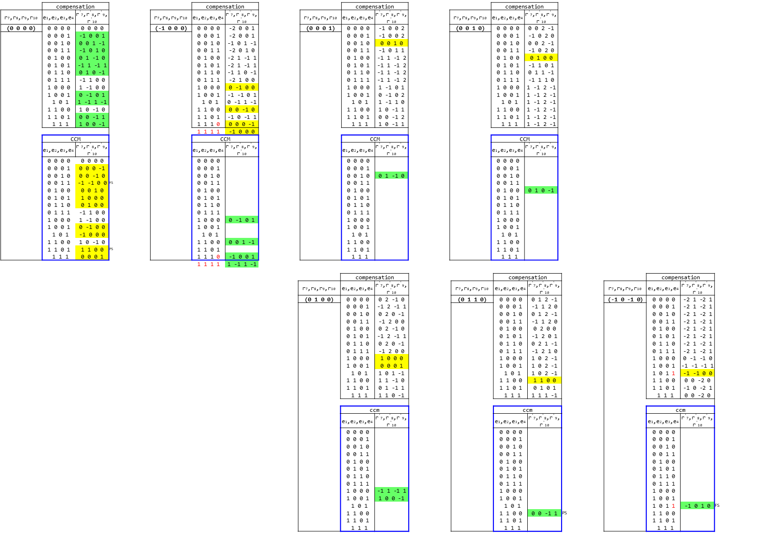
Proposed Sensors

Slide 9
4. Experimental Results
H.264/AVC JM-18 reference software
CIF(common intermediate format, 352 × 288) video sequences
Bridge(close), Coastguard, Foreman, Hall monitor, Mobile
The 300 frames of each video sequence are used in the experiments
The H.264/AVC configuration parameters set
baseline profile, 30 frame/s, with an intra period of 30 (group of frame IPPP...)
peak signal-to-noise-ratio (PSNR) and the file increase per payload (FPP) index

Slide 10
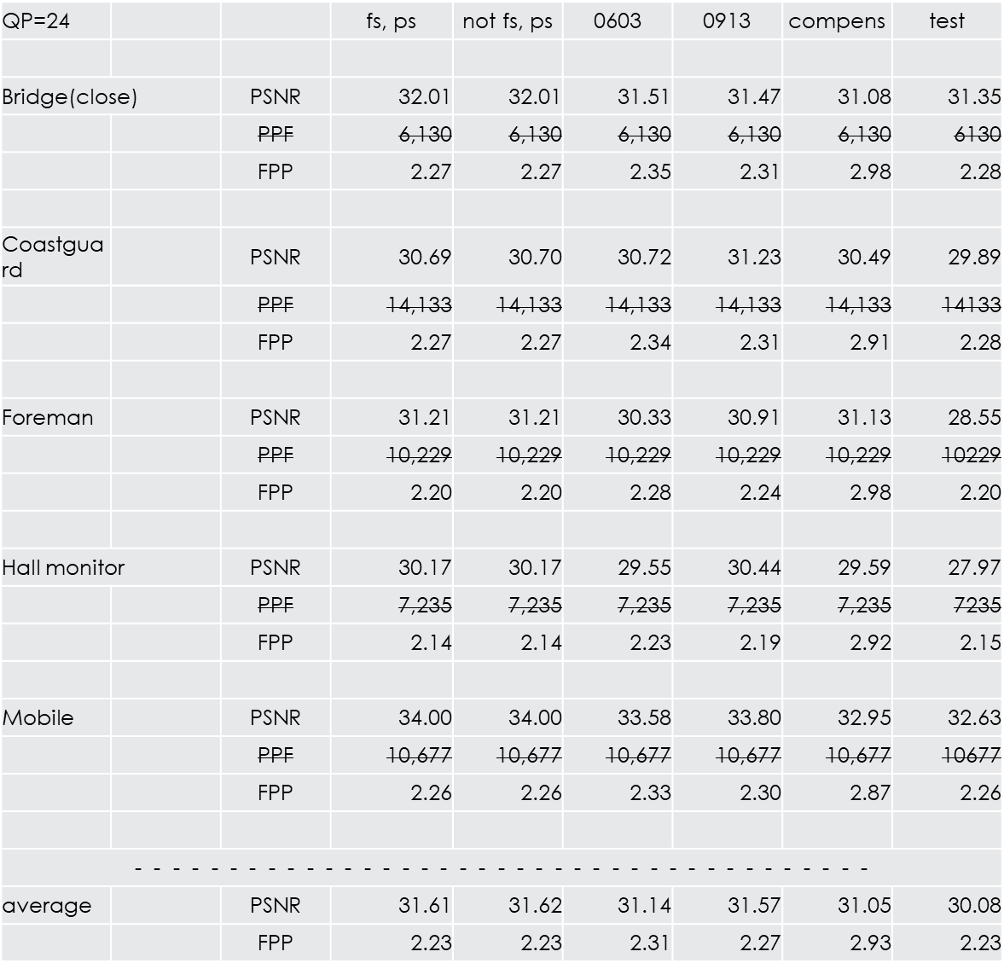
4. Experimental Results
Video | Performance | Method | Quantization Parameter |  |  |  | Average
 |  |  | 24 | 22 | 20 | 18
Bridge(close) | PSNR (dB) | Proposed | 31.51 | 31.95 | 36.54 | 40.69 | 35.17
 |  | [7] | 31.08 | 32.29 | 36.24 | 40.38 | 35.00
 | FPP | Proposed | 2.35 | 2.34 | 2.40 | 2.48 | 2.39
 |  | [7] | 2.98 | 2.96 | 2.93 | 2.90 | 2.94
Coastguard | PSNR (dB) | Proposed | 30.72 | 32.99 | 35.70 | 38.06 | 34.37
 |  | [7] | 30.49 | 32.74 | 35.09 | 38.06 | 34.09
 | FPP | Proposed | 2.34 | 2.45 | 2.57 | 2.61 | 2.49
 |  | [7] | 2.91 | 2.95 | 3.00 | 3.01 | 2.97
Hall monitor | PSNR (dB) | Proposed | 29.55 | 31.84 | 32.89 | 36.34 | 32.65
 |  | [7] | 29.59 | 31.64 | 33.91 | 36.56 | 32.92
 | FPP | Proposed | 2.23 | 2.23 | 2.22 | 2.19 | 2.22
 |  | [7] | 2.92 | 2.93 | 2.91 | 2.82 | 2.90
Mobile | PSNR (dB) | Proposed | 33.58 | 35.32 | 38.28 | 39.84 | 36.76
 |  | [7] | 32.95 | 35.16 | 38.09 | 39.80 | 36.50
 | FPP | Proposed | 2.33 | 2.34 | 2.35 | 2.31 | 2.33
 |  | [7] | 2.87 | 2.85 | 2.85 | 2.81 | 2.85

Slide 11
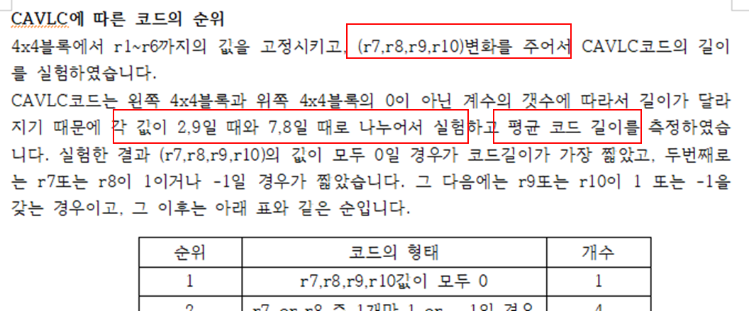
5. Ranking Table (following)

Slide 12
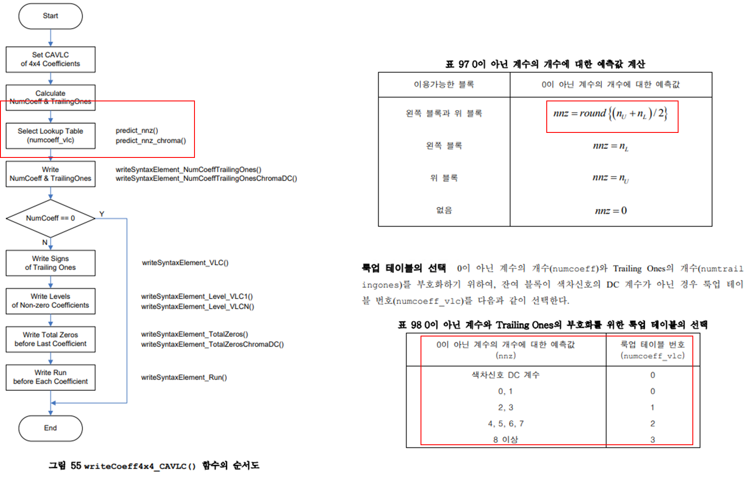

Slide 13
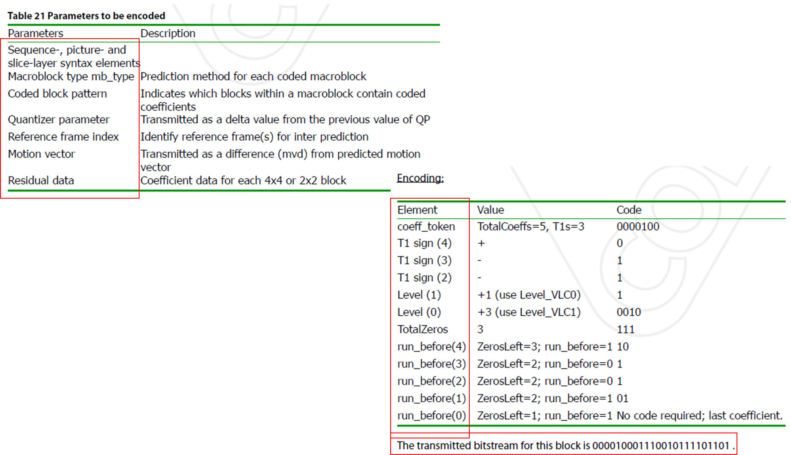
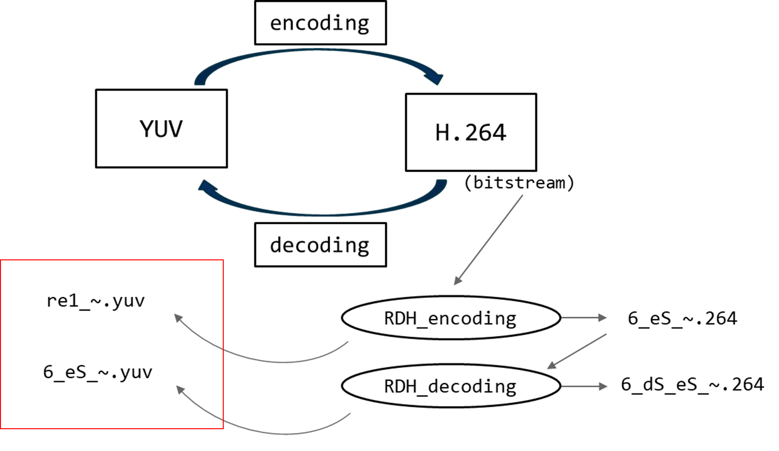
단순히 residual data 만
생각하고 룩업테이블을 고정 시 x

Slide 14
5. Ranking Table (following)
81가지로 전체실험
File size로 측정
고정할 경우 참고할 테이블도 변경 & 디코딩 시 인식하지 못함
↓ ↓
But 자연스럽게 (r7~r10)에 적응적으로 되어야함 / so, 룩업테이블을 변경x
Score 값으로
ranking table 작성

Slide 15
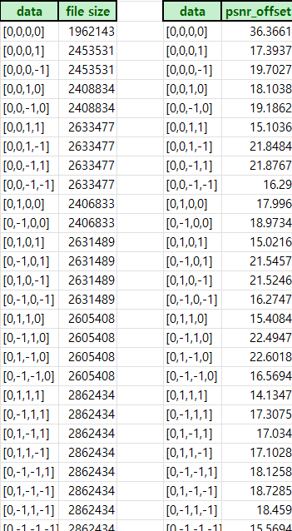
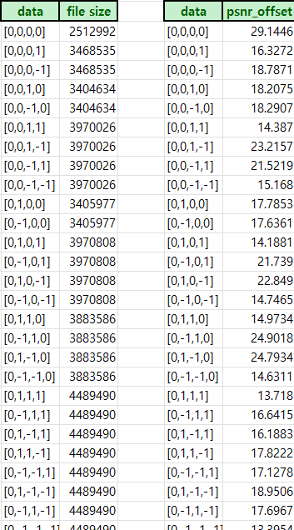
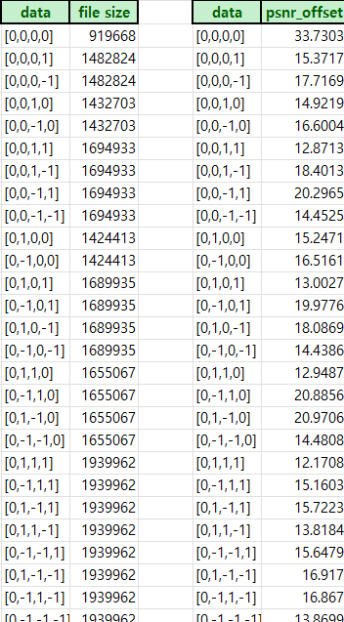
. . .

Slide 16
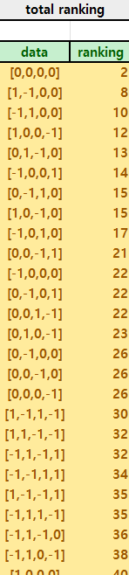
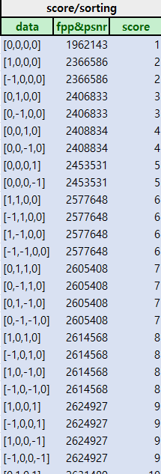
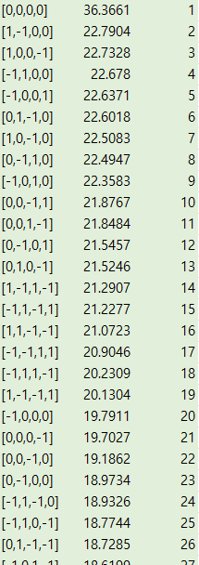

Slide 17
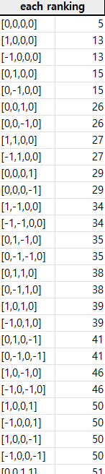
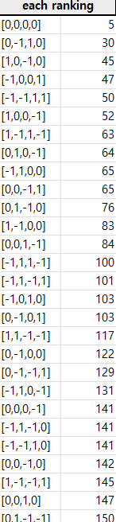
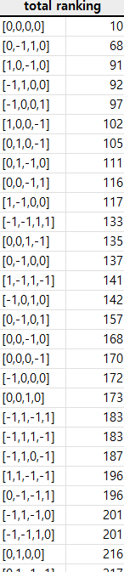

Slide 18
5. Ranking Table (following)
Q.1. HDH는 기존의 mid-freq에 의존x & 0000~1111 중 최적의 code mapping 이 우선
그리고 RDH는 기존의 mid-freq에 다양한 coefficient 값 가능하며 이에 의존
so, CCM 에서 최적의 Ranking table을 통해 code를 찾아도 RDH와 같이 mid-freq에 다양한 coefficient가 가능하다면, 대체하기 위해 가져올 value가 존재 가능한가?
그리고 가장 빈도수가 높은 value를 알 수 있나?
Q.2. CCM의 Ranking table을 만들면, file-size와 psnr에 대해 서로 다른 table이 만들어지는데 이를 어떻게 통합할 것인가?

