Slide 1
Project MGMT with Jira
Amanuel

Slide 2
What is Jira?
Create and manage project in Jira
Epic, Stories, Bugs and Tasks
Workflow

Slide 3
Recap on Agile/Scrum
Agile is an approach to software development under which requirements and solutions evolve through the collaborative effort of self-organizing and cross functional teams and their customer/end user.
Both development and testing activities are concurrent unlike the Waterfall model.

Slide 4
What is Jira
Atlassian JIRA is an issue and project tracking tool.
Allows for planning, tracking, releasing and reporting.
JIRA lets you prioritize, assign, track, report and audit your ‘issues’, from software bugs and helpdesk tickets to project tasks and change requests.
JIRA improves productivity by cutting down on time wasted on tracking issues and coordination.
JIRA improves quality by ensuring all tasks are recorded down with all the details and followed up till completion.

Slide 5
Scrum Roles
The Scrum Master:
A scrum master is the facilitator for an agile development team.
Enable close cooperation across all roles and functions.
Product Owner:
Define the features of the product.
Decide on release date and content.
Prioritize features according to market value.
Adjust features and priority every iteration, as needed.
Accept or reject work results.
Scrum Team:
Developers and QA

Slide 7
Create Jira Account
In this phase, QA team goes through the requirement document in order to identify the testable items.
The QA team may interact with various stakeholders (Client, Business Analyst, Technical Leads, System Architects etc.) to understand the requirements in detail.
Requirements could be either Functional (defining what the software must do) or Non-Functional (defining system performance /security availability)

Slide 8
Project
JIRA project is a grouping of work items or, in JIRA terms, "issues" that are held in common.
If JIRA issues are a variety of different colored, shaped, and projects is a box that hold them.
Each issue contained within it will share a common key.
Projects will have their own permissions system, i.e. which groups of users can access the project, which issues they can see, etc.
Projects will have their own versioning or release index, i.e. v. 1, v. 2, etc., as well as components.

Slide 10
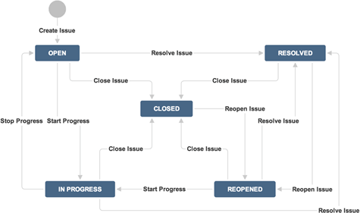
Workflow
JIRA workflow is a set of statuses and transitions that an issue goes through during its lifecycle.
JIRA workflow encompasses five main stages once the issue is created.

Slide 11
Backlog
A backlog is simply a list of features, which could be for your product, service, project, etc. These features are not detailed specifications. Rather, they are usually described in form of user stories, which are short summaries of the functionality from a user's perspective.
In Scrum, it is critical to have a prioritized backlog, so the highest priority items are ready to be included in the next sprint.

Slide 12
Epic
An epic is a large body of work that can be broken down into several smaller stories, or sometimes called “Issues” in Jira. Epics often encompass multiple teams, on multiple projects, and can even be tracked on multiple boards.
Epics are almost always delivered over a set of sprints. As a team learns more about an epic through development and customer feedback, user stories will be added and removed, as necessary.
Spans multiple sprints.
A general use case that is a collection of features (user stories).

Slide 13
Stories
A Story or user story is a software system requirement that is expressed in a few short sentences, ideally using non-technical language.
User stories are a few sentences in simple language that outline the desired outcome.
The scope of a Story should be addressed within a single Sprint.

Slide 14
Task
A Task represents a technical activity, like design a diagram, code a functionality, test a device, or prepare dataset.
A Task contains description of individual work item (detailed, technical).
Represents a set of engineering work that is not directly related to a user story.
A Task can be shared, assigned, relate to, depends/depended on by, blocks/blocks by.
A Task can be created by anyone.

Slide 15
Sub-Task
A Sub-Task is like a Task.
A Sub-Task is typically one of many tasks that make up a Story.
A Sub-Task is created from a Story.
Breaks-up stories into digestible workloads.
A Sub-Task is created by anyone

Slide 16
Epic vs Stories vs Task
Epic: User Authentication
User Stories:
User login screen
Logout screen
Forgot password
Task
Setup repository
Setup CICD pipeline

Slide 17
Work Item Attribute
Assignee
Attachment
Comment
Component
Description
Epic Link
Fix Version
Issue Type
Labels
Priority
Sprint

Slide 18
https://www.guru99.com/jira-tutorial-a-complete-guide-for- beginners.html#72

