Slide 1
As of: 20191004:0800
Baseline Assumption and Facts
01-INITIAL ACCESS:
Adversary MLCOA: Spear phishing email or drive-by website with malicious weaponized payload (executive file, macro, link, etc.).
Line of Effort: Review/Search Download histories and Browser Histories.
02-EXECUTION:
Adversary MLCOA: Via program execution of weaponized malicious payload by user.
Line of Effort: Review/Search program execution of Scripts, PowerShell, Windows System files (misspelled)
03-PERSISTENCE:
Adversary MLCOA: Will exploit via Bootkit, Component Object Model Hijacking (COM) Hijack, Hidden Files and Directories, Logon Scripts, Office Application Startup
Line of Effort: Review/Search Boot Logs, DLLs, Hidden Files and Directories, Logon Scripts, Microsoft Documents & Application Startup. Compare known good baselines to active OS footprints to identify deltas.
04-PRIVILEGE ESCALATION:
Adversary MLCOA: Access Token Manipulation, Exploitation of a software vulnerability for Privilege Escalation
Line of Effort: Detect token manipulation by auditing command-line activity. Limit permissions so that users and user groups cannot create tokens. Search for suspicious files written to disk or evidence of Process Injection to detect Exploitation for Privilege Escalation. Recommend Application Isolation and Sandboxing. Review/Search Access Tokens, Event IDs
05-DEFENSE EVASION:
Adversary MLCOA: Aggressors use several means to evade detection. May employ any of the following techniques: Obfuscate/Encode Files or Information, Exploitation for Defense Evasion, File Deletion, Indicator Removal on Host, Obfuscated Files or Information, Rootkit, Template Injection, and/or "Timestomp" technique.
Line of Effort: Review/Search use of “Certutil’ command, use of CCleaner to delete files, clearing Logs via ‘wevtutil cl System’ and ‘wevutil cl Security’ commands. Snort rules alert based on payloads encoded with Base64. Search for Rootkits and MSOffice template injection. Compare known good baselines to identify Timestomping activities.

Slide 2
As of: 20191004:0800
Baseline Assumption and Facts
06-DISCOVERY:
Adversary MLCOA: May employ Network Sniffing, File and Directory Discovery (recursion), Peripheral Device Discovery, Process Discovery
Line of Effort: Alert on any use of ‘Forfiles’ to loocate PDF , Excel, and Word docs. Use of Responder to sniff docs coming across network. Use of ‘Tasklist’ command and utility. Use of ps utility on Linux systems.
07-LATERAL MOVEMENT:
Adversary MLCOA: APT 82 may employ Exploitation of remote services SMB, RDP, MySQL.May implant ‘Logon’ scripts when a user logs on. Use of Pass the Hash method. Remote file copy in Windows through FTP, in Linux through scp, rsync, and sftp.
Line of Effort: Enforce following-- 1. Password Policies: (complex, unique passwords), 2. Privileged Account Management: Limit credential overlap across systems, 3. Update Software (patch), 4. User Account Control: Enable pass the hash mitigations to apply UAC restrictions to local accounts on network logon, and 5. User Account Management: Limit local administrator to one system per privileged user.
08-COLLECTION:
Adversary MLCOA: APT 82 may employ Automated Collection, Data Staged, Data from Information Repositories, Data from Local System, Data from Removable Media, Email Collection, Input Capture, and Screen Capture.
Line of Effort: Review/Search use of custom scripts to search and collect data. Also use of search from cmd line. Collected data is staged at a central location prior to exfiltration. Data is compressed or encrypted. Review/Search use of se of email, keyloggers, and screen capture.
09-EXFILTRATION:
Adversary MLCOA: APT 82 may employ data encoding and compression prior to exfiltration.
Line of Effort: Review/Search use of 7zip, RAR, ZIP, zlib to compress files prior to exfiltration.
10-COMMAND & CONTROL:
Adversary MLCOA: Aggressors may employ Connection Proxy, Custom Cryptographic Protocol, Data Obfuscation, Standard Application Layer Protocol.
Line of Effort: Review/Search Traffic redirection through Proxies or Port Redirection (HTRAN, ZXProxy, ZXPortMap. XOR-ing plaintext to hide CC traffic. Also adding ‘Junk Data’ to communications hides, but does not encrypt. Communicate through application layer traffic (HTTP, HTTPS, SMTP, DNS) to avoid detection by blending in with existing traffic.

Slide 3
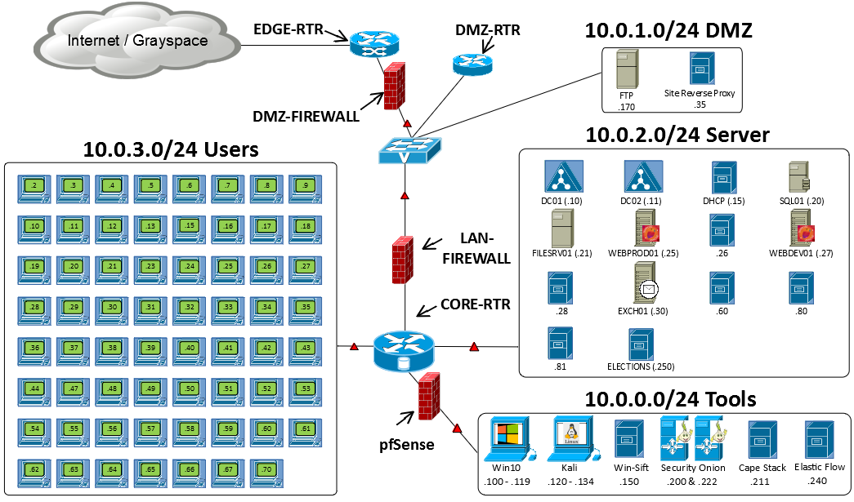
As of: 20191004:0800
Day 1
SITREP
Intel:
20191001:0830 – Initial reports indicate Russian APTs implant beaconing beachheads & other malware.
20191002:1103 – User reports finance workstation constantly rebooting
Concern:
Adversary may have completed Initial Acces and Execution , and is now trying to establish Command & Control.
Adversary MLCOA:
Will establish C2, privilege escalation and Lateral movement.
Line of Effort:
Review/Search Download Histories and Browser Histories.
Review/Search program execution of Scripts, PowerShell, Windows System files (misspelled).
Review/Search Traffic redirection through Proxies or Port Redirection (HTRAN, ZXProxy, ZXPortMap. XOR-ing plaintext to hide CC traffic. Also adding ‘Junk Data’ to communications hides, but does not encrypt. Communicate through application layer traffic (HTTP, HTTPS, SMTP, DNS) to avoid detection by blending in with existing traffic.
Reconnaissance
Weaponization
Delivery
Exploitation
Installation
Command & Control (C2)
Actions on
Objectives
Scanning
Script

Slide 4


As of: 20191004:0800
Day 2
SITREP
Intel
20191001:1103 – User reports finance workstation constantly rebooting
Evidence
20191001:0914 – malicious file “CHOST” found in Users on xxx.2 and xxx.24
20191001:1730 – Finance workstation xxx.23 found to be compromised
Attribution
Outbound IP addresses/domains linked to APT82
Adversary MLCOA:
Collection & Exfiltration
Line of Effort:
Review/Search use of custom scripts to search and collect data. Also use of search from cmd line. Collected data is staged at a central location prior to exfiltration. Data is compressed or encrypted. Review/Search use of se of email, keyloggers, and screen capture.
Review/Search use of 7zip, RAR, ZIP, zlib to compress files prior to exfiltration.
Key
Compromised Host
Likely Incursion
Beacon
Reconnaissance
Weaponization
Delivery
Exploitation
Installation
Command & Control (C2)
Actions on
Objectives
Scanning
Script
Drive-by-Download
Malware
Beaconer
Beaconing
139.5.177.205 | Malaysia | malaytravelgroup.com
80.255.6.15 | Germany | worldimagebucket.com
193.37.255.10 | Slovokia | moderntips.org
195.12.50.171 | Spain | daysheduler.org
Boot/Logon Script

Slide 5
As of: 20191004:0800
Day 3
SITREP
Intel
20191002:0800 – Hosts remain compromised and continue to beacon.
Evidence
20191002:0914 – In Users range 10..0.3.x on xxx.2 and xxx.24, “CHOST” process injected into rundll and rdpclip
20191002:1239 – DC02 found to be compromised via a scheduler exploit
Domain compromised, MimiKatz detected. Lateral movement likely.
500 MB exfiltrated data from Server enclave.
20191002:1614 – DC01 anomalies revealed Kerberos likely compromised.
Adversary MLCOA:
Defense Evasion
Line of Effort:
Review/Search use of “Certutil’ command, use of CCleaner to delete files, clearing Logs via ‘wevtutil cl System’ and ‘wevutil cl Security’ commands. Snort rules alert based on payloads encoded with Base64. Search for Rootkits and MSOffice template injection. Compare known good baselines to identify Timestomping activities.
Key
Compromised Host
Likely Incursion
Beacon
Reconnaissance
Weaponization
Delivery
Exploitation
Installation
Command & Control (C2)
Actions on
Objectives
Scanning
Script
Drive-by-Download
Malware
Beaconer
Beaconing
Data Exfil
Boot/Logon Script
Scheduler
Lateral Movement
Process Injection

Slide 6
As of: 20191004:0800
Day 3
SITREP
Intel
Threat actors established C2 on Domain Controllers.
Evidence
Process injection in VDS.exe connecting to identical remote IPs as CHOST.exe pointing to C2 activity
LSASS injection indicates Pass the Hash and use of MimiKatz
Base64 Encoded string on DC01 indicates encoded use of Sysinternals PSEXEC and Powershell
Key
Compromised Host
Likely Incursion
Beacon
Suspected C2
Reconnaissance
Weaponization
Delivery
Exploitation
Installation
Command & Control (C2)
Actions on
Objectives
Scanning
Script
Drive-by-Download
Malware
Beaconer
Beaconing
Data Exfil
Boot/Logon Script
Scheduler
Lateral Movement
Process Injection

Slide 7
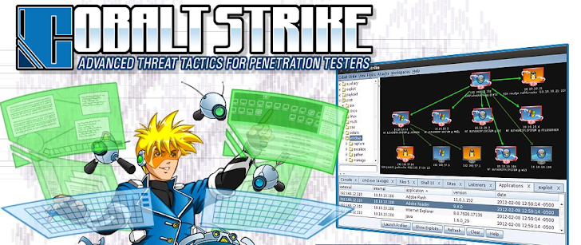
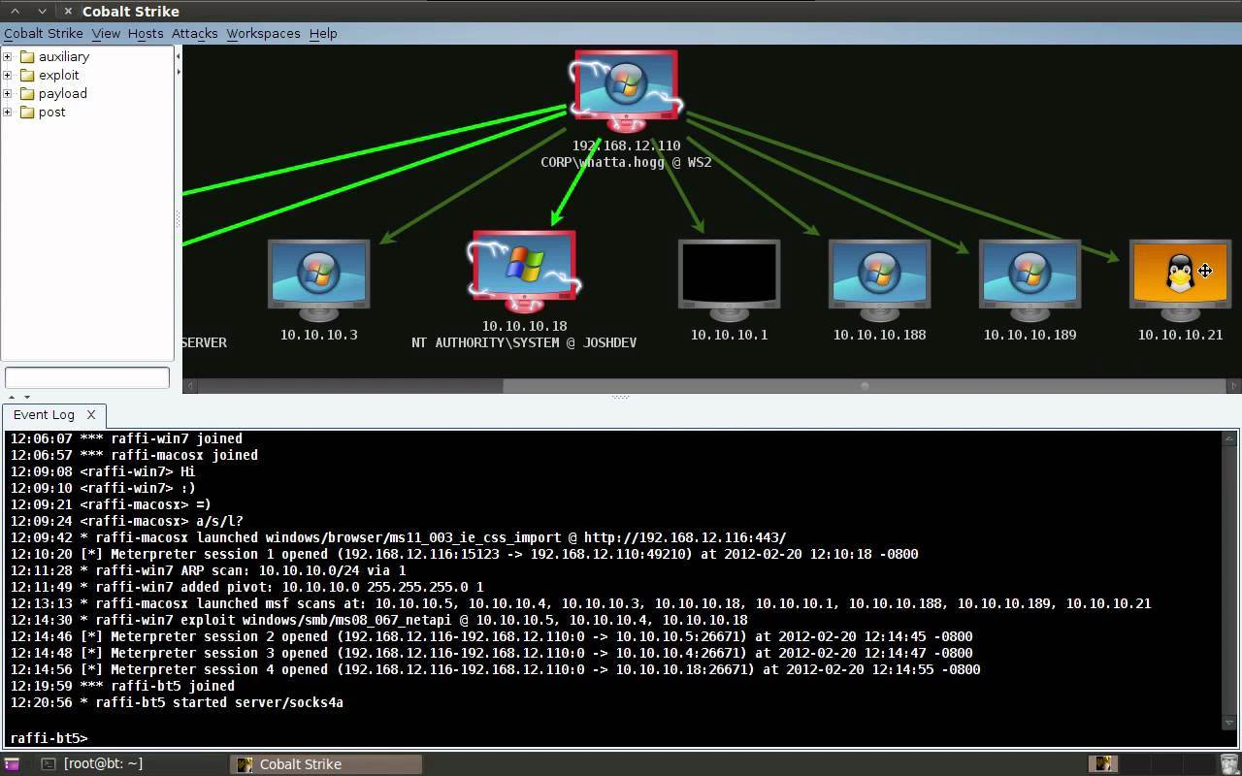

As of: 20191004:0800
Day 3
SITREP
Attribution
Threat actors believed to be using Cobalt Strike or similar tool.
Supporting Evidence for Cobalt Strike
Process injection in VDS.exe connecting to identical remote IPs as CHOST.exe pointing to C2 activity
LSASS injection indicates Pass the Hash and use of MimiKatz
Base64 Encoded string on DC01 indicates encoded use of Sysinternals PSEXEC and Powershell
Adversary MLCOA:
Utilize capabilities of tool COBALTSTRIKE.
Line of Effort:
Review/Search uses of Cobalt Strike and mitigate.
Attribution:
APT 82
KCB
Key
Compromised Host
Likely Incursion
Beacon
Suspected C2
Reconnaissance
Weaponization
Delivery
Exploitation
Installation
Command & Control (C2)
Actions on
Objectives
Scanning
Script
Drive-by-Download
Malware
Beaconer
Beaconing
Data Exfil
Boot/Logon Script
Scheduler
Lateral Movement
Process Injection

Slide 8

As of: 20191004:0800
Day 4
SITREP
Intel
20191003:1030 – PowerShell script discovered on DC01.
Evidence
Domain Admin – Juliet Sierra created PowerShell script, payload unknown.
PowerShell identified using header consistent with PowerShell Empire.
Adversary MLCOA:
Data Exfiltration & Website Defacement (Hacktonians)
Line of Effort:
Review/Search Polandia’s web interface for vulnerabilities.
Review/Search use of 7zip, RAR, ZIP, zlib to compress files prior to exfiltration.
Key
Compromised Host
Likely Incursion
Beacon
Reconnaissance
Weaponization
Delivery
Exploitation
Installation
Command & Control (C2)
Actions on
Objectives
Scanning
Script
Drive-by-Download
Malware
Beaconer
Beaconing
Data Exfil
Boot/Logon Script
Scheduler
Lateral Movement
Web Defacement
Process Injection

