Slide 1
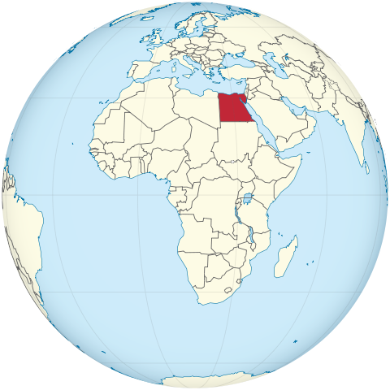
In around 250 B.C., the Greek philosopher Eratosthenes measured the circumference of the Earth in Egypt by finding the difference in shadows between nearby places
For more info, see http://www.astro.cornell.edu/academics/courses/astro201/eratosthenes.htm

