Slide 1
Разработчик ПО

Slide 2

6 лет работы в Рексофт
Ведущий инженер разработчик
Notes:
Для того чтобы выглядеть более убедительным, представлюсь. Меня зовут Роман, работаю я в компании рексофт уже 6 лет. Большую часть из которых мне приходится заниматсья созданием, контролем и поддержкой архитектуры проекта. Но как понять что у меня это получается? Как оценить качество архитектуры?

Slide 3
1960
Notes:
In 1960 nobody knew what a programmer was. How many programmers were? A few thousand. What about 1950? A few hundred. And when was there just one? 1946

Slide 4
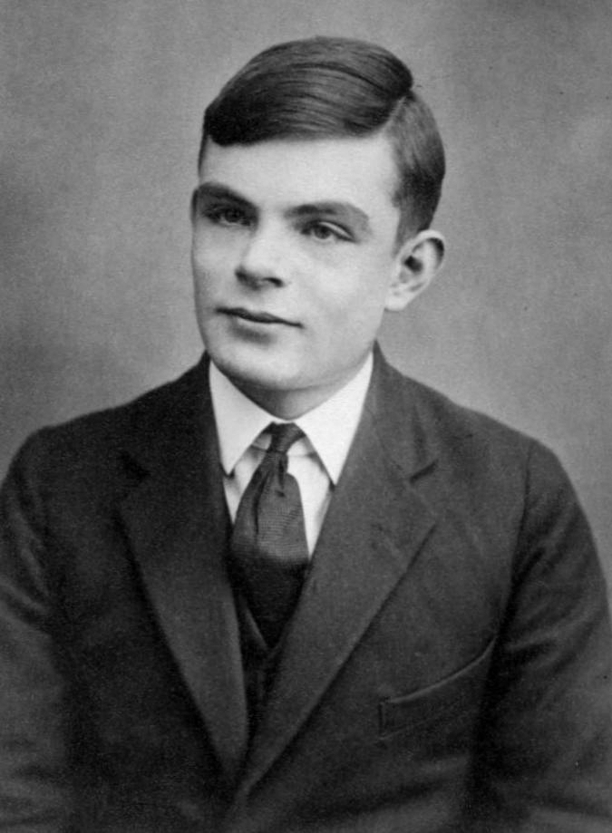
Alan Turing
Notes:
Alan Turing. He is a first programmer to program an electronic computer. He had a program to manipulate numbers, it was integers. And he wrote a program for floating point numbers. Where he needed to be to call some bits of his program and receive a result. Architecture did not allow for this, so he invented the concept of the stack. Тяжело было мужику и в частности из за этого появились и другие разработчики.
Think about it, there was a moment in time when there was only one programmer in the world. But how many there are today?

Slide 5
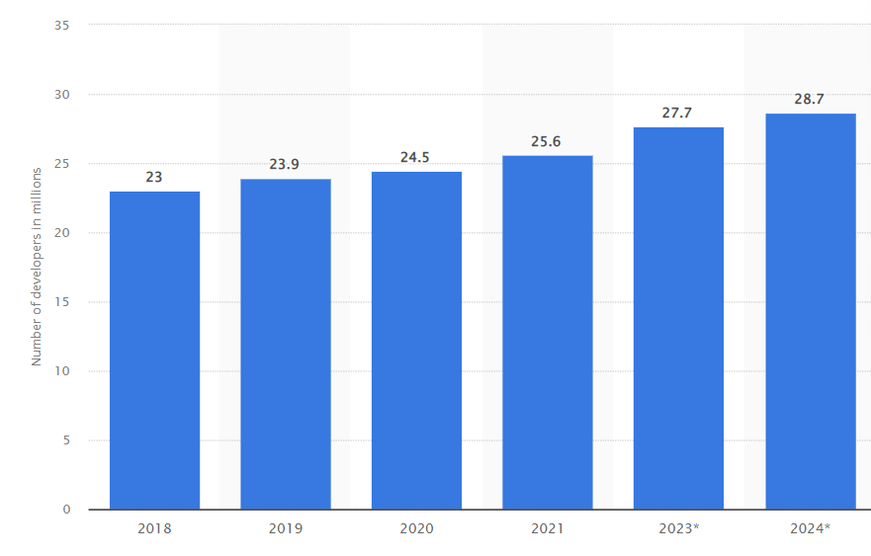
1960
Notes:
Think about it, there was a moment in time when there was only one programmer in the world. But how many there are today? log_a(2). Увеличивается на 3~5 лет. If that is true, every five years the amount of under experienced developers doubles. Core direction of developers activity is increasing labor performance. The reason behind this is constantly increasing demand. As a side effect - it also increasing the amount of technologies around as. There are many devices.
Computers are now cheap (in majority) and so they are everywhere.

Slide 6
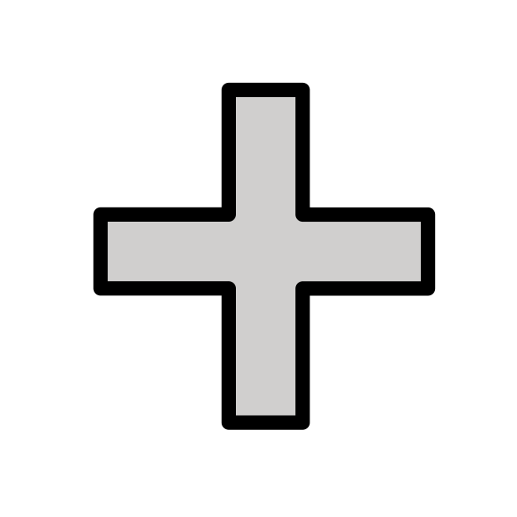
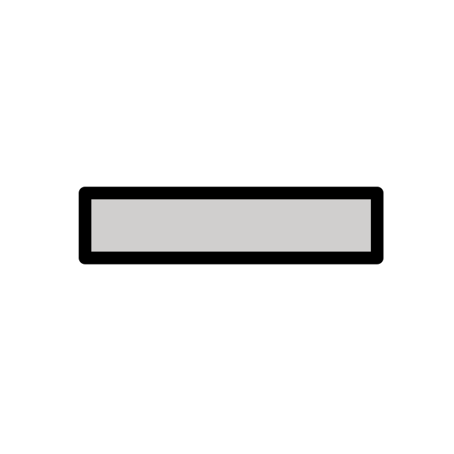

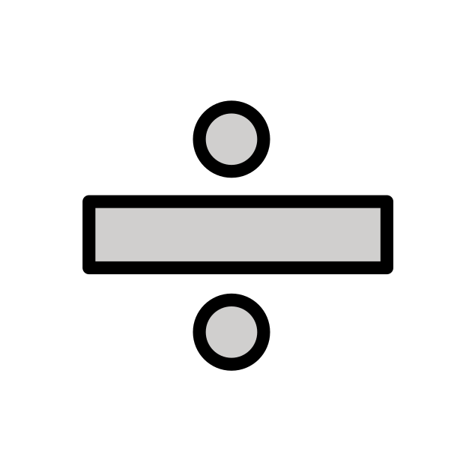
ПОВЕДЕНИЕ
Notes:
Every software system provides two different values to the stakeholders: behavior and structure. Software developers are responsible for ensuring that both those values remain high. Unfortunately, they often focus on one to the exclusion of the other. Even more unfortunately, they often focus on the lesser of the two values, leaving the software system eventually valueless.
The first value of software is its behavior. Programmers are hired to make machines behave in a way that makes or saves money for the stakeholders. We do this by helping the stakeholders develop a functional specification, or requirements document. Then we write the code that causes the stakeholder’s machines to satisfy those requirements. When the machine violates those requirements, programmers get their debuggers out and fix the problem.

Slide 7


ЭФФЕКТ
Notes:
Наблюдаемое поведение
Не важно каким образом оно реализовано (парадигма, стек или язык)
Приносит ли оно деньги, доставляет ли оно ценность

Slide 8

ЭФФЕКТ
Notes:
Отсюда следует что любое отклонение от заданного курса приводит к нарушению указанной ценности
Из за этого заводятся задачи со специальным типом (баги) и специалисты QA
Часто забывают про вторую сторону ПО – структур, она же архитектура, она же дизайн

Slide 9
ТЕСТИРОВАНИЕ
Notes:
Programmers should not (and can not) continually verify behaviour of a system. For that, automatic program verifiers should be used (they are called tests).
Many programmers believe that is the entirety of their job. They believe their job is to make the machine implement the requirements and to fix any bugs. They are sadly mistaken.

Slide 10
SOFTWARE
Notes:
Software — a compound word composed of “soft” and “ware.” The word “ware” means “product”; the word “soft”… Well, that’s where the second value lies. Software was invented to be “soft.” It was intended to be a way to easily change the behavior of machines. If we’d wanted the behavior of machines to be hard to change, we would have called it hardware. To fulfill its purpose, software must be soft—that is, it must be easy to change. When the stakeholders change their minds about a feature, that change should be simple and easy to make. The difficulty in making such a change should be proportional only to the change itself, and not to the state of a program. It is the reason that costs grow out of proportion to the size of the requested changes. It is the reason that the first year of development is much cheaper than the second, and the second year is much cheaper than the third. From the stakeholders’ point of view, they are simply providing a stream of changes of roughly similar scope. From the developers’ point of view, the stakeholders are giving them a stream of jigsaw puzzle pieces that they must fit into a puzzle of ever-increasing complexity. Each new request is harder to fit than the last, because the shape of the system does not match the shape of the request. Software developers often feel as if they are forced to jam square pegs into round holes. The problem, of course, is the architecture of the system. The more this architecture prefers one shape over another, the more likely new features will be harder and harder to fit into that structure.

Slide 11
SOFTWARE
HARDWARE
Notes:
Software — a compound word composed of “soft” and “ware.” The word “ware” means “product”; the word “soft”… Well, that’s where the second value lies. Software was invented to be “soft.” It was intended to be a way to easily change the behavior of machines. If we’d wanted the behavior of machines to be hard to change, we would have called it hardware. To fulfill its purpose, software must be soft—that is, it must be easy to change. When the stakeholders change their minds about a feature, that change should be simple and easy to make. The difficulty in making such a change should be proportional only to the change itself, and not to the state of a program. It is the reason that costs grow out of proportion to the size of the requested changes. It is the reason that the first year of development is much cheaper than the second, and the second year is much cheaper than the third. From the stakeholders’ point of view, they are simply providing a stream of changes of roughly similar scope. From the developers’ point of view, the stakeholders are giving them a stream of jigsaw puzzle pieces that they must fit into a puzzle of ever-increasing complexity. Each new request is harder to fit than the last, because the shape of the system does not match the shape of the request. Software developers often feel as if they are forced to jam square pegs into round holes. The problem, of course, is the architecture of the system. The more this architecture prefers one shape over another, the more likely new features will be harder and harder to fit into that structure.

Slide 12
SOFTWARE
HARDWARE
Notes:
Software — a compound word composed of “soft” and “ware.” The word “ware” means “product”; the word “soft”… Well, that’s where the second value lies. Software was invented to be “soft.” It was intended to be a way to easily change the behavior of machines. If we’d wanted the behavior of machines to be hard to change, we would have called it hardware. To fulfill its purpose, software must be soft—that is, it must be easy to change. When the stakeholders change their minds about a feature, that change should be simple and easy to make. The difficulty in making such a change should be proportional only to the change itself, and not to the state of a program. It is the reason that costs grow out of proportion to the size of the requested changes. It is the reason that the first year of development is much cheaper than the second, and the second year is much cheaper than the third. From the stakeholders’ point of view, they are simply providing a stream of changes of roughly similar scope. From the developers’ point of view, the stakeholders are giving them a stream of jigsaw puzzle pieces that they must fit into a puzzle of ever-increasing complexity. Each new request is harder to fit than the last, because the shape of the system does not match the shape of the request. Software developers often feel as if they are forced to jam square pegs into round holes. The problem, of course, is the architecture of the system. The more this architecture prefers one shape over another, the more likely new features will be harder and harder to fit into that structure.

Slide 13
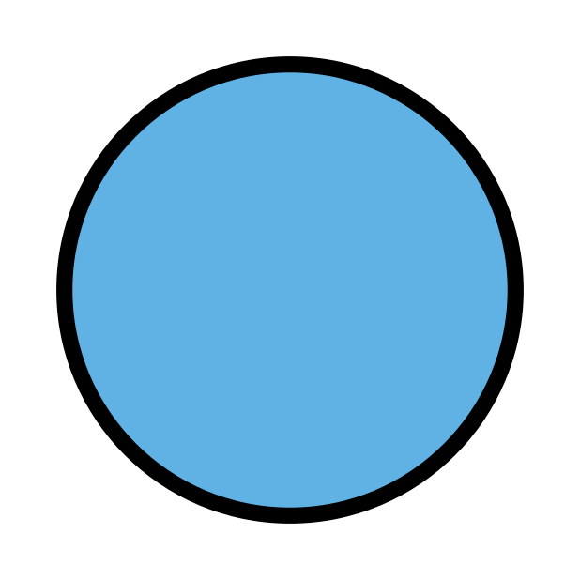

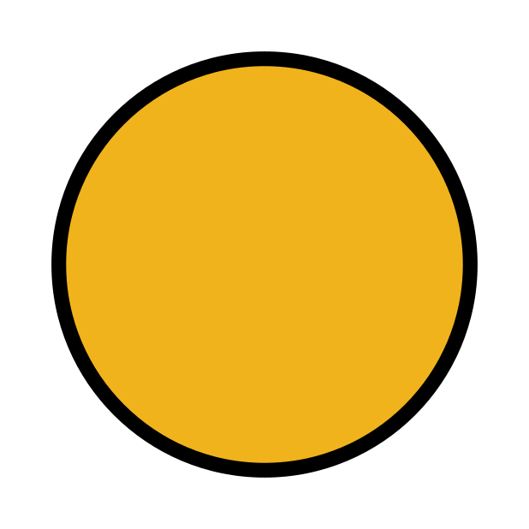
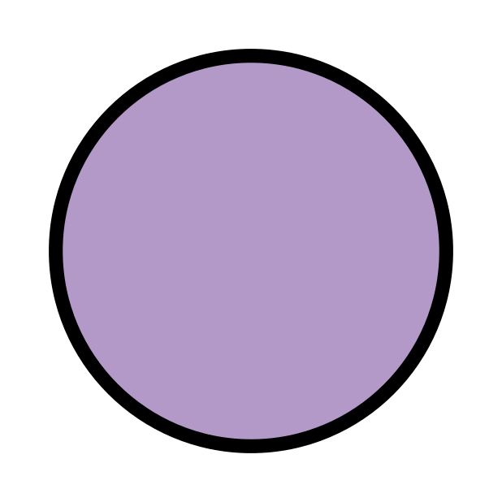
СТРУКТУРА

Slide 14

ПОВЕДЕНИЕ
СТРУКТУРА
Notes:
любая программа обладающая поведением, также содержит в себе и структуру

Slide 15
СТРУКТУРА_0
ПОВЕДЕНИЕ
СТРУКТУРА_1
СТРУКТУРА_2
Notes:
может быть реализовано с использованием совершено разных структур

Slide 16
СТРУКТУРА_0
ПОВЕДЕНИЕ
СТРУКТУРА_1
СТРУКТУРА_2
Notes:
Но что заставляет квалифицированных инженеров отдавать предпочтения одному дизайну, игнорируя другие?

Slide 17
ЭФФЕКТ
Расширяемость системы
Notes:
Эффект структуры, архитектуры или дизайна прямое влияние на производительность труда

Slide 18
ЭФФЕКТ
Производительность труда
Notes:
Эффект структуры, архитектуры или дизайна прямое влияние на производительность труда

Slide 19
ПРАВИЛЬНАЯ СТРУКТУРА
Ускорять и не противоречить
Notes:
поведения

Slide 20
НЕПРАВИЛЬНАЯ СТРУКТУРА
Замедлять и блокировать
Notes:
Разщработку и новые требования

Slide 21
Производительность труда
Notes:
Большинство продуктов призваны увеличивать производительность труда. Дать определение

Slide 22
Производительность труда
Высокий спрос
Notes:
On the surface this leads for stakeholders to make more money, thus expanding their business allowing for more projects to evolve and increasing demand for programmers.

Slide 23
Производительность труда
Высокий спрос
Низкая квалификация
Notes:
High demand and low experience turns out to be bad mixture.
Высокий спрос не всегда получается удовлетворить, законы спроса и предложения по всей видимости работают не очень хорошо.
Привести пример банковского проекта. Дурные деньги.

Slide 24
ТЕХНОЛОГИИ
Notes:
Низкая квалификация и простота языковой технологии порождают огромное кол-во фреймворков и библиотек с не самой лучшей структурой, на примерах воспитывая разработчика в неверном русле.

Slide 25
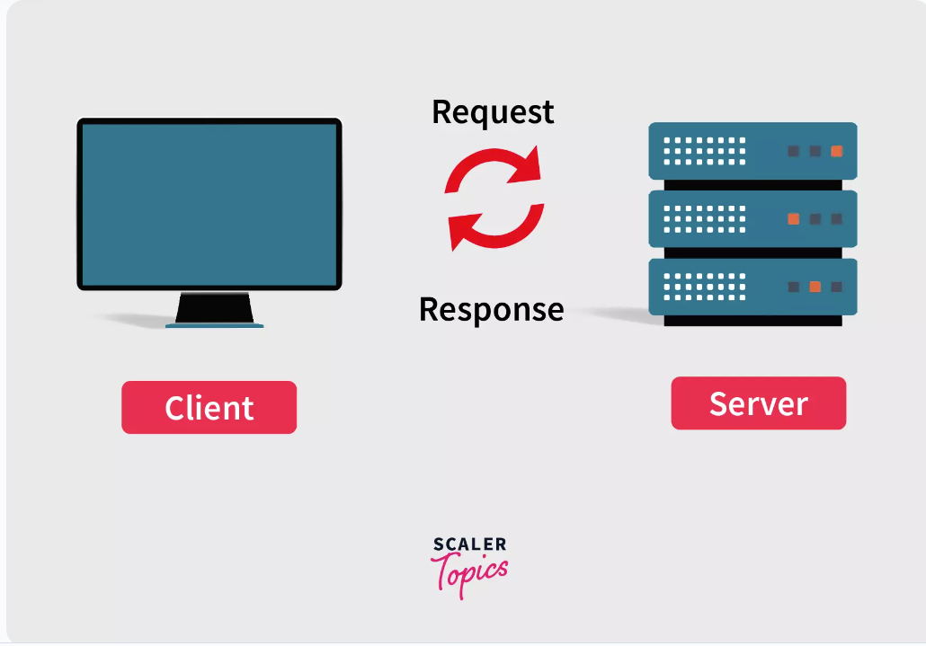
Notes:
Each, solve completely different tasks because the environment and purposes are different.

Slide 26
Notes:
Server, solves other problems. For example by being stable and reliable. By providing different data constraints maintaining integrity

Slide 27

Notes:
Usually, there are more clients than servers, so different scaling strategies might be used, which again, bring complexities in to the game.

Slide 28
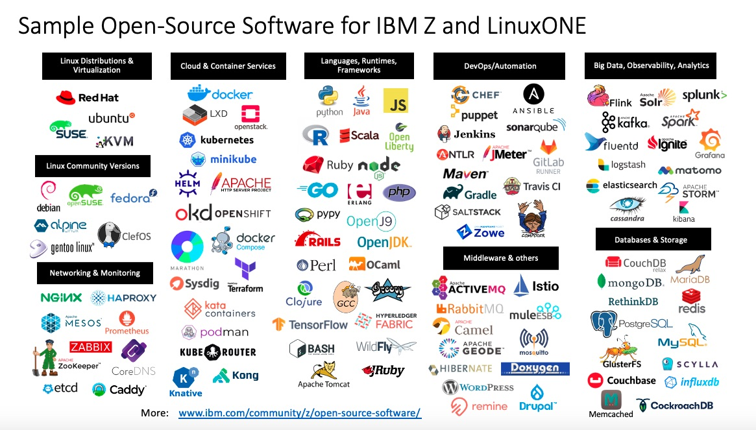
Notes:
Это требует построение распределенных систем, дополнительной аркестрации и общего управления, балансировки нагрузки, импелементации стратегий разрешения сбоев как на аппаратном, так и на программных уровнях. Построения процессов непрерывной разработки, сборки и поставки артефактов сборки, профилирования нагрузки

Slide 29
Notes:
Client applications should provide smooth, responsive and adaptive experience. Often time restricted by hardware capabilities (hard to update, low on recourses, battery restrictions)

Slide 30

Notes:
Мы не имеем контроля над аппаратным обеспечением. Приходится работать в разрезе широкой выборки устройств, это застравляет более грамотно проектировать распределение нагрузки в системе. Не блокировать основной поток для предоставления гладкого, динамичного интерфейса. Адаптивность (разные форматы отображения, не только размер экрана, но и форма, цветопередача и плотность пикселей, разные парадигмы поведения в зависимости от выбранной платформы). Доступность. Web 3.0 интеграции с различными сенсорами, оффлайн режим. Оптимизация загрузки приложения, SEO оптимизации, аналитика.

Slide 31
WEB vs NATIVE
Notes:
There are two major groups of apps: * Native applications * Web applications
There are a lot of platforms around us and we as developers must create software which is able to run on most if not on all of them fluently. But it is usually hard to separately develop programs for each and every case.

Slide 32
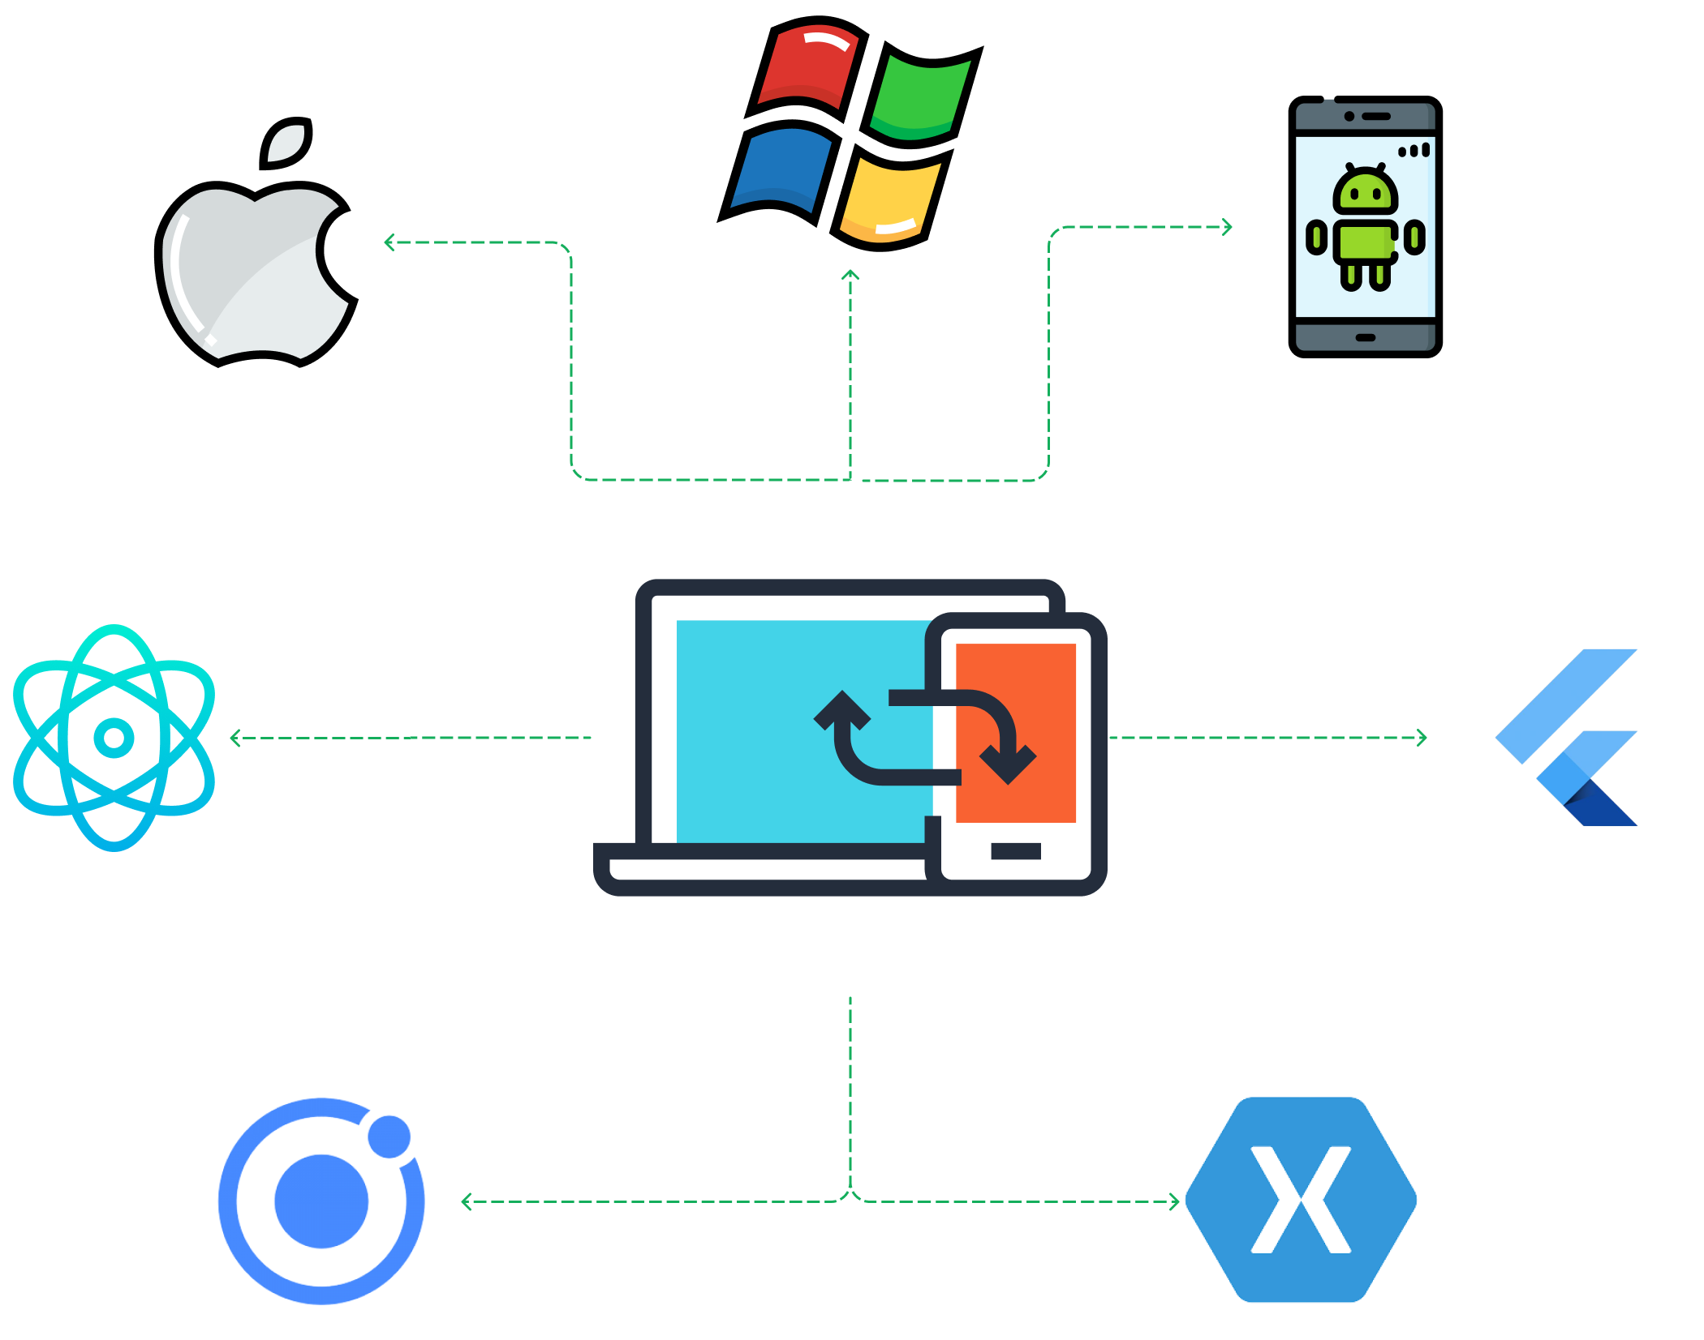
Notes:
For that, cross-platform technologies are used.

Slide 33
ПОВЕДЕНИЕ

Slide 34
ПОВЕДЕНИЕ
Client-side web framework/library

Slide 35
ПОВЕДЕНИЕ
Client-side web framework/library
Client-side native framework/library

Slide 36
ПОВЕДЕНИЕ
Client-side web framework/library
Client-side native framework/library
Server-side framework

Slide 37
LANGUAGE / ЯЗЫК
Notes:
There are a lot of languages. But historically, the most popular one's have similar C-like syntax, so it is not that important. What is important is the type system.

Slide 38
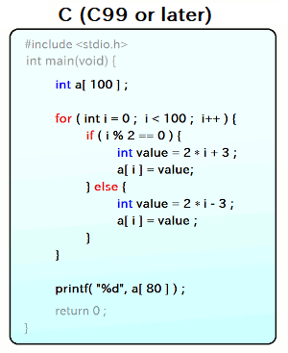

Slide 39
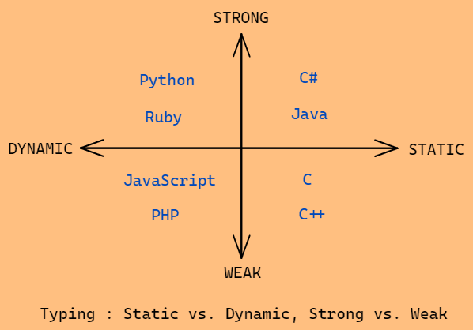
Notes:
* Static - types are determined on the phase of writing a program * Dynamic - types are determined on runtime * Weak - values of unrelated types can be substituted * Strong - only values of compatible types can be substituted
There are of course other subgroups like (nominal or structural types, type variance support, soundness, algebraic support etc.)

Slide 40
STRONG STATIC
type system
Notes:
For a lot of purposes the most popular ones are languages with static strong type system. It provides the highest protection against bugs and allows to model behavior in most precise way.

Slide 41
FULL-STACK
Notes:
Можно, но сложность таких проектов минимальна, как и оплата вследствии. Компании обычно пытаются таким образом сэкономить на разработчике

Slide 42
LEGACY-КОД
Notes:
есть проект с низкой производительностью труда, где она вызвана эффектами исходящими от плохой структуры ПО. Подавляющие кол-во времени придется работать именно с таким

Slide 43
AGILE
Notes:
Частые показы заказчику. Это требует построения итеративного плана разработки (Agile) и приоритизации в сторону функциональностей, а не инфраструктуры
Как вакцина

