Slide 1
TypeScript

Slide 2



Slide 3







Slide 4
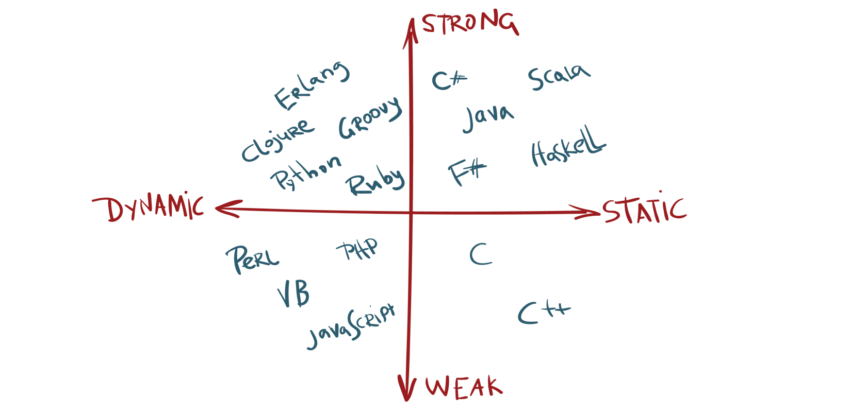

Slide 6



Slide 7
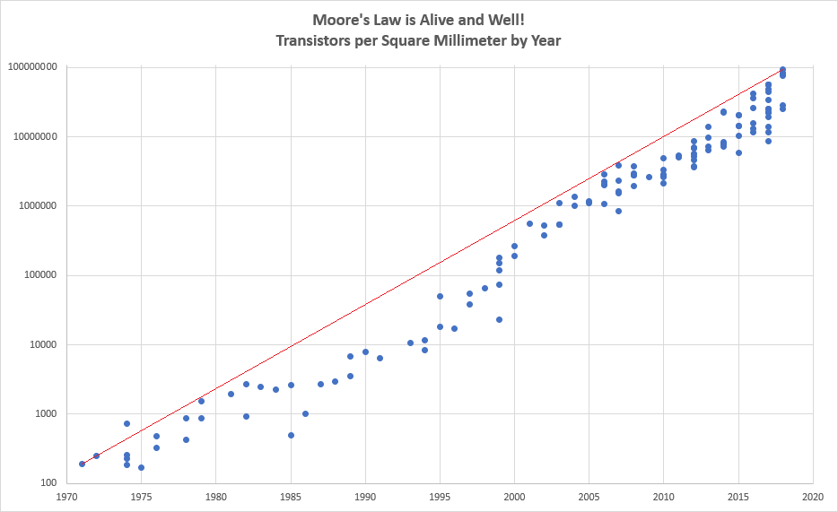

Slide 8



Slide 9


Slide 10


Slide 11



Slide 13
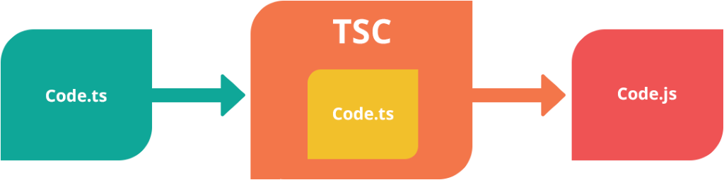

Slide 14
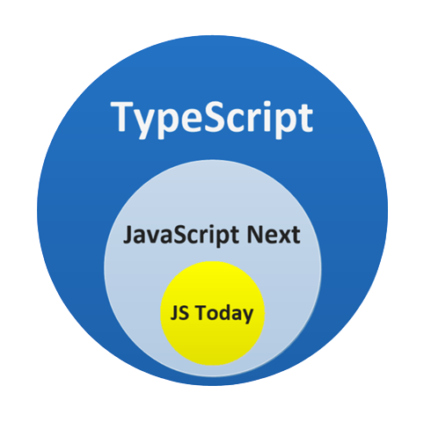

Slide 15
Basic types

Slide 16
Any

