Slide 1
TypeScript

Slide 2



Slide 3







Slide 4
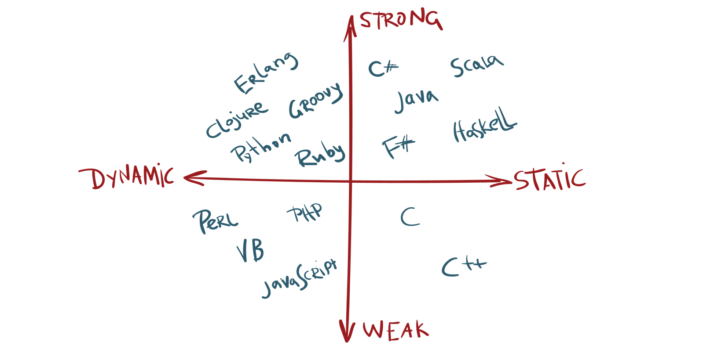

Slide 6



Slide 7


Slide 8



Slide 9


Slide 10


Slide 11



Slide 13
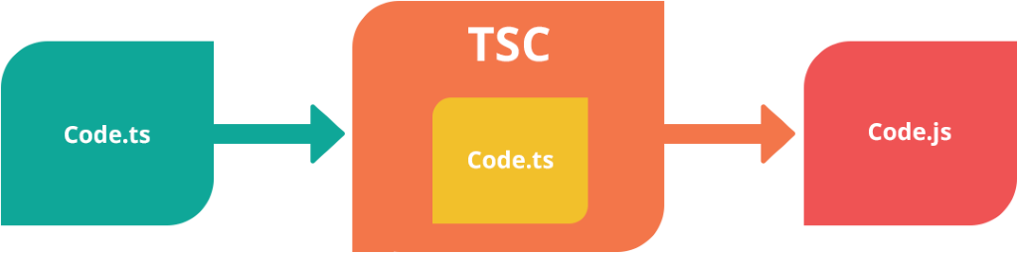

Slide 14
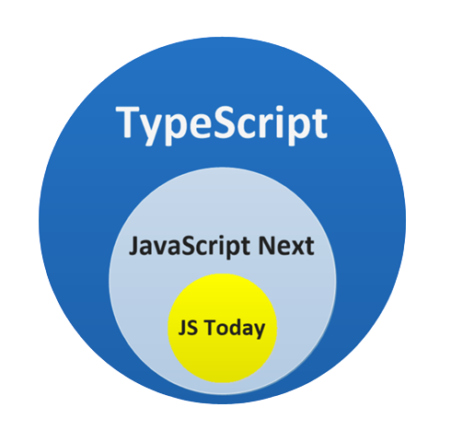

Slide 15
Basic types

Slide 16
Any
Built-in
types
User-defined
types

Slide 17
Built-in
types
Boolean
Number
String
Void
Null
Undefined

Slide 18
Boolean
(boolean)

Slide 19
Number
{ 1_0, 0x, 0b, 0o }

Slide 20
String
`Hello ${world}`

Slide 21
Any
Built-in
types
User-defined
types

Slide 22
User-defined
types
Array, Enum, Class, Interface

Slide 23
Array
type[] Array<type>

Slide 24
Tuple
readonly [T1, T2]

Slide 25
Enum
Number type

Slide 26
enum Colors {
R = 1,
G = 2,
B = 3
}

Slide 27
String type
Enum

Slide 28
enum Colors {
R = ‘Red’,
G =
B = ‘Blue’
}
1,
‘Green’,

Slide 29
Reverse mapping

Slide 30
===
Any

Slide 31
Any
===

Slide 32
object !== any

Slide 33
Void
(void !== any)

Slide 34
Null and Undefined

Slide 35
--strictNullChecks
Type
Undefined
Null

Slide 36
Optional arg === type | undefined

Slide 37
Never
{Error, while (true), unreachable}

Slide 38
Void vs Never

Slide 39
any
unknown
unknown
Top
type
Bottom
never

Slide 40
object
Unknown

Slide 41
object
Referenced types only

Slide 42
Type assertions
Animal as Cat

Slide 43
Type assertions !== Type cast
No runtime garanties

Slide 44
as or <type>var

Slide 45
as
as
>

Slide 46


Abstractions
{
name: string,
color: enum,
legs: number,
makeSound(): void
}
=>

Slide 47
Nominal vs Structural

Slide 48
Interface
{ ...members }, interface keyword

Slide 49
Optional properties

Slide 50
Optional means weak*

Slide 51
Readonly
readonly, ReadonlyArray<type>

Slide 52
Const assertions
as const

Slide 53
Redundant properties checking

Slide 54
IFunction
Call signature (...args): return

Slide 55
Index types
list[0], map[‘key’]

Slide 56
Number, String, Symbol

Slide 57
[number]: type assignable [string] type

Slide 58
readonly [number]: type

Slide 59
class A implements IInterface

Slide 60
class
static
this

