Slide 1
CSI2132 Tutorial 6
Relational Algebra
Presented By: Rana Khalil

Slide 2
Review #1
OPERATION | PURPOSE | NOTATION
THETA JOIN | Produces all combinations of tuples from R1 and R2 that satisfy a join condition.
LEFT OUTER JOIN | Keeps every tuple in the first, or left relation R1. If no matching tuple is found in R2, then the attributes of R2 in the join result are filled or padded with null values.
RIGHT OUTER JOIN | Keeps every tuple in the second, or right, relation R2. If no matching tuple is found in R1, then the attributes of R2 in the join result are filled or padded with null values.
UNION | Produces a relation that includes all the tuples in R1 or R2 or both R1 and R2; R1 and R2 must be union compatible.

Slide 3
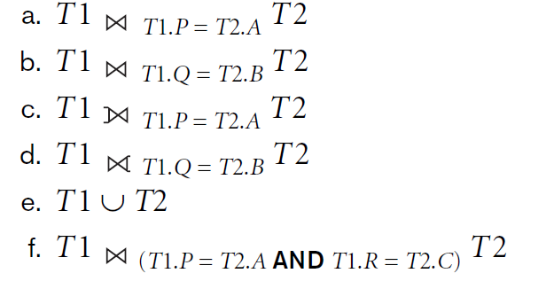
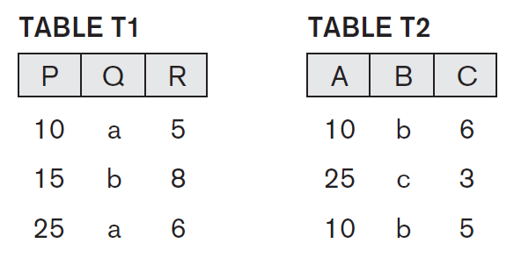
Exercise #1
Consider the two tables T1 and T2 below. Show
the results of the following operations:

Slide 4
Exercise #1
Consider the two tables T1 and T2 below. Show
the results of the following operations:

Slide 5
Exercise #1
Consider the two tables T1 and T2 below. Show
the results of the following operations:
Result:
P | Q | R | A | B | C
10 | a | 5 | 10 | b | 6
10 | a | 5 | 10 | b | 5
25 | a | 6 | 25 | c | 3

Slide 6
Exercise #1
Consider the two tables T1 and T2 below. Show
the results of the following operations:

Slide 7
Exercise #1
Consider the two tables T1 and T2 below. Show
the results of the following operations:
Result:
P | Q | R | A | B | C
15 | b | 8 | 10 | b | 6
15 | b | 8 | 10 | b | 5

Slide 8
Exercise #1
Consider the two tables T1 and T2 below. Show
the results of the following operations:

Slide 9
Exercise #1
Consider the two tables T1 and T2 below. Show
the results of the following operations:
Result:
P | Q | R | A | B | C
10 | a | 5 | 10 | b | 6
10 | a | 5 | 10 | b | 5
15 | b | 8 | null | null | null
25 | a | 6 | 25 | c | 3

Slide 10
Exercise #1
Consider the two tables T1 and T2 below. Show
the results of the following operations:

Slide 11
Exercise #1
Consider the two tables T1 and T2 below. Show
the results of the following operations:
Result:
P | Q | R | A | B | C
15 | b | 8 | 10 | b | 6
null | null | null | 25 | c | 3
15 | b | 8 | 10 | b | 5

Slide 12
Exercise #1
Consider the two tables T1 and T2 below. Show
the results of the following operations:

Slide 13
Exercise #1
Consider the two tables T1 and T2 below. Show
the results of the following operations:
Result:
P | Q | R
10 | a | 5
15 | b | 8
25 | a | 6
10 | b | 6
25 | c | 3
10 | b | 5

Slide 14
Exercise #1
Consider the two tables T1 and T2 below. Show
the results of the following operations:

Slide 15
Exercise #1
Consider the two tables T1 and T2 below. Show
the results of the following operations:
Result:
P | Q | R | A | B | C
10 | a | 5 | 10 | b | 5

Slide 16
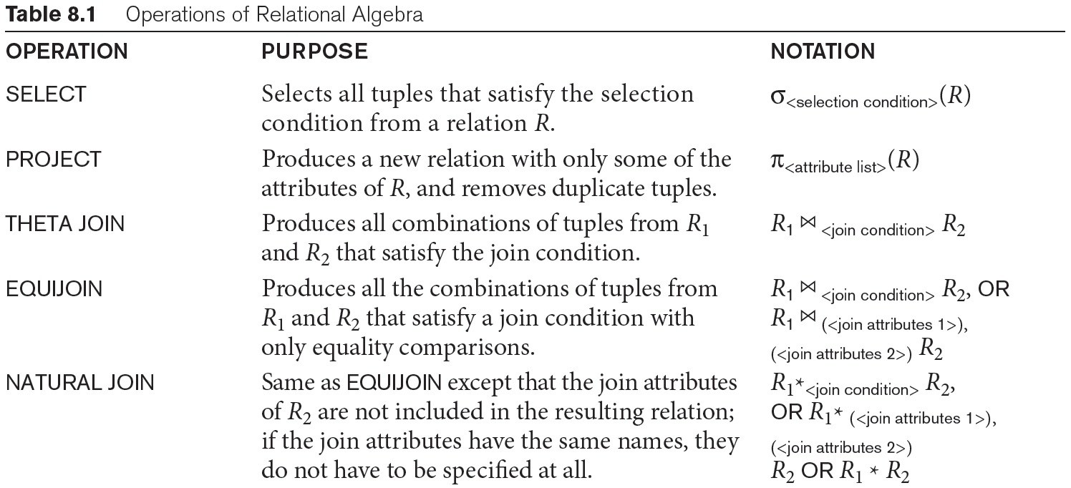
Review #2

Slide 17
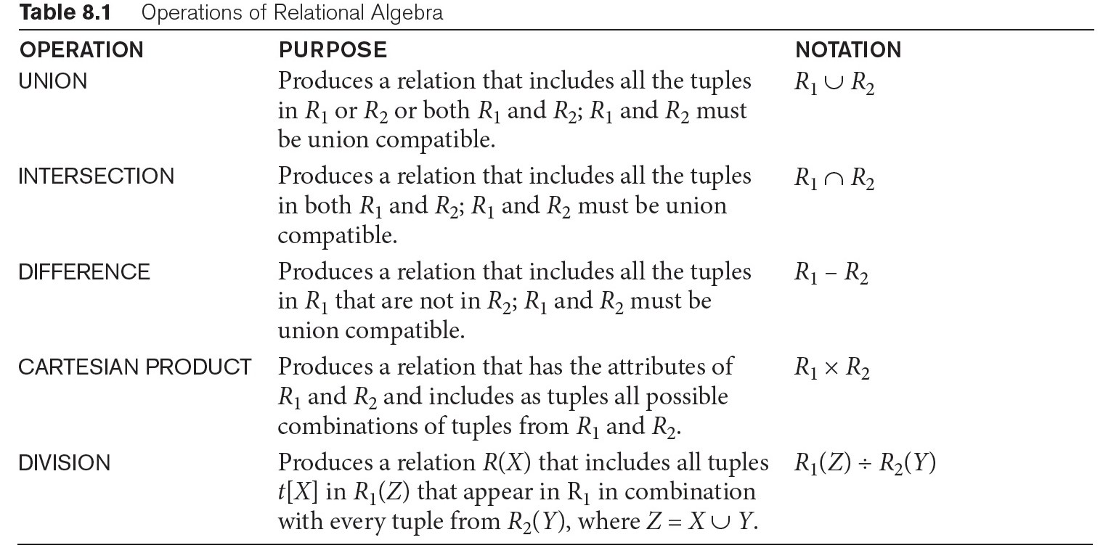
Review #2

Slide 18
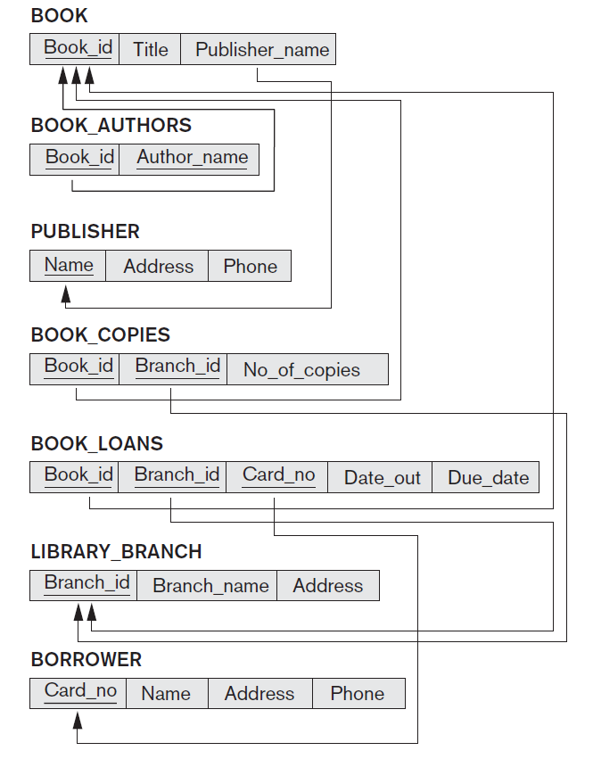
Exercise #2
Consider the LIBRARY relational schema shown in the Figure, which is used to keep track of books, borrowers, and book loans. Write down relational expressions for the following queries on the LIBRARY database.
Note: We will use S for SELECT, P for PROJECT, * for NATURAL JOIN, - for
SET DIFFERENCE, F for AGGREGATE FUNCTION

Slide 19
Exercise #2
(a) How many copies of the book titled The Lost Tribe are owned by the library branch whose name is "Sharpstown"?

Slide 20
Exercise #2
How many copies of the book titled The Lost Tribe are owned by the library branch whose name is "Sharpstown"?
A <-- BOOKCOPIES * LIBRARY-BRANCH * BOOK
RESULT <-- P No_Of_Copies ( S BranchName= 'Sharpstown' and Title='The Lost Tribe'
Joins the three tables on their common attributes and saves the output in table A.

Slide 21
Exercise #2
How many copies of the book titled The Lost Tribe are owned by the library branch whose name is "Sharpstown"?
A <-- BOOKCOPIES * LIBRARY-BRANCH * BOOK
RESULT <-- P No_Of_Copies ( S Branch_name= 'Sharpstown' and Title='The Lost Tribe’ (A))
Joins the three tables on their common attributes and saves the output in table A.
The Select statement filters table A on the rows that have a branch name of
Sharpstown and a title of The Lost Tribe.
The Project statement produces a new table with only one column of A.

Slide 22
Exercise #2
How many copies of the book titled The Lost Tribe are owned by the library branch whose name is "Sharpstown"?
A better query would be to do the SELECTs before the JOIN:
A <-- P No_Of_Copies ( ( S BranchName='Sharpstown' (LIBRARY_BRANCH) ) *
(BOOKCOPIES *
( S Title='The Lost Tribe’ (BOOK) ) ) )

Slide 23
Exercise #2
(b) How many copies of the book titled The Lost Tribe are owned by each library branch?

Slide 24
Exercise #2
(b) How many copies of the book titled The Lost Tribe are owned by each library branch?
P BranchID, No_Of_Copies (
( S Title='The Lost Tribe' (BOOK)) *BOOK_COPIES)
First, do a SELECT on the table book where the title of the book is The Lost Tribe.
Then, do a natural join on the result with the table BOOK_COPIES.

Slide 25
Exercise #2
(b) How many copies of the book titled The Lost Tribe are owned by each library branch?
P BranchID, No_Of_Copies (
( S Title='The Lost Tribe' (BOOK)) *BOOK_COPIES)
First, do a SELECT on the table book where the title of the book is The Lost Tribe.
Then, do a natural join on the result with the table BOOK_COPIES.
Last, use PROJECT to only display the columns BranchID and No_Of_Copies

Slide 26
Exercise #2
(c) Retrieve the names of all borrowers who do not have any books checked out.

Slide 27
Exercise #2
(c) Retrieve the names of all borrowers who do not have any books checked out.
NO_CHECKOUT_B <-- P Card_no (BORROWER) - P Card_no (BOOK_LOANS)
RESULT <-- P Name (BORROWER *NO_CHECKOUT_B)
Use Project on tables Borrower and Book_Loans to output the columns that contain the card numbers.
Take the set difference between the CardNo column of table Borrower and the CardNo column of table Book_Loans. This gives you the card numbers of all borrowers who do not have books checked out.

Slide 28
Exercise #2
(c) Retrieve the names of all borrowers who do not have any books checked out.
NO_CHECKOUT_B <-- P Card_no (BORROWER) - P Card_no (BOOK_LOANS)
RESULT <-- P Name (BORROWER *NO_CHECKOUT_B)
Use Project on tables Borrower and Book_Loans to output the columns that contain the card numbers.
Take the set difference between the CardNo column of table Borrower and the CardNo column of table Book_Loans. This gives you the card numbers of all borrowers who do not have books checked out.
Join the tables No_Checkout_B and Borrower and output the Name column.

Slide 29
Exercise #2
(d) For each book that is loaned out from the "Sharpstown" branch and whose due date is today, retrieve the book title, the borrower's name, and the borrower's address.

Slide 30
Exercise #2
(d) For each book that is loaned out from the "Sharpstown" branch and whose due date is today, retrieve the book title, the borrower's name, and the borrower's address.
S <-- P BranchId ( S BranchName='Sharpstown' (LIBRARY_BRANCH) )
B_FROM_S <-- P BookId,CardNo ( ( S DueDate='today' (BOOK_LOANS) ) * S )
RESULT <-- P Title,Name,Address ( BOOK * BORROWER * B_FROM_S )
Save the branch ids that have a library branch name Sharpstown in table S.

Slide 31
Exercise #2
(d) For each book that is loaned out from the "Sharpstown" branch and whose due date is today, retrieve the book title, the borrower's name, and the borrower's address.
S <-- P BranchId ( S BranchName='Sharpstown' (LIBRARY_BRANCH) )
B_FROM_S <-- P BookId,CardNo ( ( S DueDate='today' (BOOK_LOANS) ) * S )
RESULT <-- P Title,Name,Address ( BOOK * BORROWER * B_FROM_S )
Save the branch ids that have a library branch name Sharpstown in table S.
Save the book ids and card #s of books that have a due date of today in table B_FROM_S

Slide 32
Exercise #2
(d) For each book that is loaned out from the "Sharpstown" branch and whose due date is today, retrieve the book title, the borrower's name, and the borrower's address.
S <-- P BranchId ( S BranchName='Sharpstown' (LIBRARY_BRANCH) )
B_FROM_S <-- P BookId,CardNo ( ( S DueDate='today' (BOOK_LOANS) ) * S )
RESULT <-- P Title,Name,Address ( BOOK * BORROWER * B_FROM_S )
Save the branch ids that have a library branch name Sharpstown in table S.
Save the book ids and card #s of books that have a due date of today in table B_FROM_S
Save the book titles, names and addresses of books that are in branch Sharpstown and are due today in table RESULT

Slide 33
Exercise #2
(e) For each library branch, retrieve the branch name and the total number of books loaned out from that branch.

Slide 34
Exercise #2
(e) For each library branch, retrieve the branch name and the total number of book loans that have been made from that branch.
R(BranchId,Total) <-- BranchId F COUNT(BookId) (BOOK_LOANS)
RESULT <-- P BranchName,Total (R * LIBRARY_BRANCH)
Retrieve the branch_id and total number of books for each branch id in the Book_Loans table.

Slide 35
Exercise #2
(e) For each library branch, retrieve the branch name and the total number of books loaned out from that branch.
R(BranchId,Total) <-- BranchId F COUNT(BookId) (BOOK_LOANS)
RESULT <-- P BranchName,Total (R * LIBRARY_BRANCH)
Retrieve the branch_id and total number of books for each branch id in the Book_Loans table.
Retrieve the branch name and total number of books for each library branch id

Slide 36
Exercise #2
(f) Retrieve the names, addresses, and number of books checked out for all borrowers who have more than five books checked out.

Slide 37
Exercise #2
(f) Retrieve the names, addresses, and number of books checked out for all borrowers who have more than five books checked out.
B(CardNo,TotalCheckout) <-- CardNo F COUNT(BookId) (BOOK_LOANS)
B5 <-- S TotalCheckout > 5 (B)
RESULT <-- P Name,Address,TotalCheckout ( B5 * BORROWER)

Slide 38
Exercise #2
(f) Retrieve the names, addresses, and number of books checked out for all borrowers who have more than five books checked out.
B(CardNo,TotalCheckout) <-- CardNo F COUNT(BookId) (BOOK_LOANS)
B5 <-- S TotalCheckout > 5 (B)
RESULT <-- P Name,Address,TotalCheckout ( B5 * BORROWER)
Retrieve the number of books checked out for each card number and save it in B

Slide 39
Exercise #2
(f) Retrieve the names, addresses, and number of books checked out for all borrowers who have more than five books checked out.
B(CardNo,TotalCheckout) <-- CardNo F COUNT(BookId) (BOOK_LOANS)
B5 <-- S TotalCheckout > 5 (B)
RESULT <-- P Name,Address,TotalCheckout ( B5 * BORROWER)
Retrieve the number of books checked out for each card number and save it in B
Save the rows in table B that have ore than 5 books checked out in table B5.

Slide 40
Exercise #2
(f) Retrieve the names, addresses, and number of books checked out for all borrowers who have more than five books checked out.
B(CardNo,TotalCheckout) <-- CardNo F COUNT(BookId) (BOOK_LOANS)
B5 <-- S TotalCheckout > 5 (B)
RESULT <-- P Name,Address,TotalCheckout ( B5 * BORROWER)
Retrieve the number of books checked out for each card number and save it in B
Save the rows in table B that have ore than 5 books checked out in table B5.
Join tables B5 and Burrower and retrieve the name address and number of books checked out for each burrower.

Slide 41
Exercise #2
(g) For each book authored (or co-authored) by "Stephen King", retrieve the title and the number of copies owned by the library branch whose name is "Central".

Slide 42
Exercise #2
(g) For each book authored (or co-authored) by "Stephen King", retrieve the title and the number of copies owned by the library branch whose name is "Central".
SK <-- P Book_id, Title ( S AuthorName='Stephen King' ( BOOK_AUTHORS)) * BOOK
CENTRAL(BranchId) <-- S BranchName='Central' ( LIBRARY_BRANCH )
RESULT <-- P Title,NoOfCopies ( SK * BOOKCOPIES * CENTRAL )

Slide 43
Exercise #2
(g) For each book authored (or co-authored) by "Stephen King", retrieve the title and the number of copies owned by the library branch whose name is "Central".
SK <-- P Book_id, Title ( S AuthorName='Stephen King' ( BOOK_AUTHORS)) * BOOK
CENTRAL(BranchId) <-- S BranchName='Central' ( LIBRARY_BRANCH )
RESULT <-- P Title,NoOfCopies ( SK * BOOKCOPIES * CENTRAL )
Retrieve the book id and title of the book that was authored by Sephan King

Slide 44
Exercise #2
(g) For each book authored (or co-authored) by "Stephen King", retrieve the title and the number of copies owned by the library branch whose name is "Central".
SK <-- P Book_id, Title ( S AuthorName='Stephen King' ( BOOK_AUTHORS)) * BOOK
CENTRAL(BranchId) <-- S BranchName='Central' ( LIBRARY_BRANCH )
RESULT <-- P Title,NoOfCopies ( SK * BOOKCOPIES * CENTRAL )
Retrieve the book id and title of the book that was authored by Sephan King
Retrieve the branch ids of the library branches whose name is Central

Slide 45
Exercise #2
(g) For each book authored (or co-authored) by "Stephen King", retrieve the title and the number of copies owned by the library branch whose name is "Central".
SK <-- P Book_id, Title ( S AuthorName='Stephen King' ( BOOK_AUTHORS)) * BOOK
CENTRAL(BranchId) <-- S BranchName='Central' ( LIBRARY_BRANCH )
RESULT <-- P Title,NoOfCopies ( SK * BOOKCOPIES * CENTRAL )
Retrieve the book id and title of the book that was authored by Sephan King
Retrieve the branch ids of the library branches whose name is Central
Retrieve the Titles and # of copies of books that have been authored by Stephan king and owned by Central library branch.

