Slide 1
CSI2132 Lab 5
Triggers in SQL
Presented By: Rana Khalil
12 Feb 2018

Slide 2
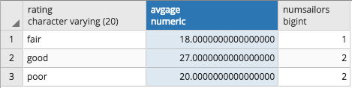
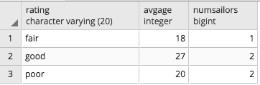


Questions from Last Lab
Casting Aggregate Functions
﻿SELECT S.rating, AVG(S.age) AS avgage, COUNT(*) numsailors
……
﻿SELECT S.rating, CAST (AVG(S.age) AS INTEGER) AS avgage, COUNT(*) numsailors
….....
If a variable is set to integer however the output is a decimal does it get rounded up or down?
﻿Select 9.5 as original, cast(9.5 as int);
﻿Select 9.4 as original, cast(9.4 as int);
Not Exists Explanation – covered that in the DGD

Slide 3
Outline
(30 min) Revision and students have the chance to complete any missing part of lab 4 (if students need it). We will not use backup file this time.
(10 min) Quiz on sailor DB
(40 min) Lab 05 material, assertion and triggers. The first 5 pages of the lab will be self-reading.
Specifying Constraints in the Database Schema
Constraint Checking
Declaring Assertions in SQL (will not cover)
Declaring Triggers in SQL

Slide 4
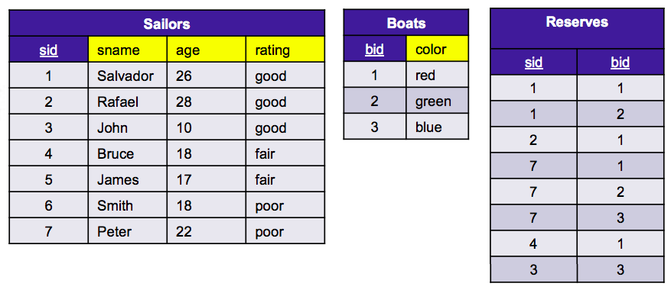
Example
First, make sure you have the following tuples in each relation of the Sailors schema.
If not, create them accordingly
Create a new schema named: “sailors”. Download and execute all the queries within: “Create Sailors DB” file

Slide 5
QUIZ TIME!

Slide 6
Integrity Constraints: a Recap
To ensure the validity of the data held at the database schema, the relational model defines different types of integrity constraints:
Primary key constraints
Foreign key constraints
Referential integrity constraints
Domain constraints
General constraints
Operations that violate any integrity constraint at the tuple level are disallowed.

Slide 7
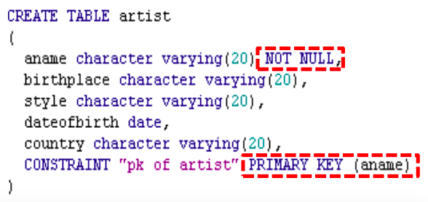
Integrity Constraints: a Recap
Primary key constraints: By default, DBMS checks that the combination of values for those attributes declared as primary key remains unique in the relation and that none of them are null.

Slide 8
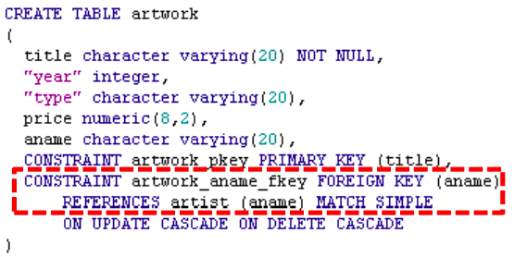
Integrity Constraints: a Recap
Foreign key constraints: Control what attribute values can be stored in the relation holding the foreign key field. It can point to a primary key attribute in another relation or to a non-PK attribute having the UNIQUE constraint.
Notes:
There are three match types: MATCH FULL, MATCH PARTIAL, and MATCH SIMPLE, which is also the default. MATCH FULL will not allow one column of a multicolumn foreign key to be null unless all foreign key columns are null. MATCH SIMPLE allows some foreign key columns to be null while other parts of the foreign key are not null.

Slide 9
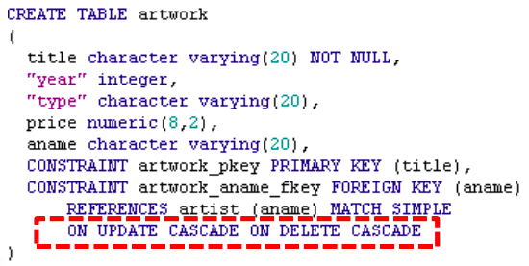
Integrity Constraints: a Recap
Referential integrity constraints: Specifies what happens to the tuples in the foreign relation when a deletion or update of a primary key attribute value is about to occur in the main table.

Slide 10
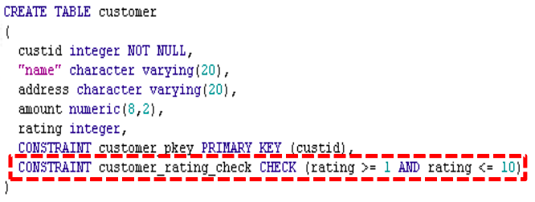
Integrity Constraints: a Recap
Domain constraints: Restricts the set of values an attribute can take to lie within a particular domain.
A CHECK clause is added to the attribute definition.

Slide 11
Triggers in SQL
It is important to monitor the database schema and take appropriate action upon the occurrence of an event.
For example, if an artwork is appraised in over five million dollars, we notify the manager of the museum where it is located so as to enforce tighter anti-theft security measures.
Or when an artist is removed from the database, we execute a stored procedure that forwards his/her customer list to a foreign server for cross validation.
In such cases, we rely on triggers to notify about the event and take further action.

Slide 12
Components of a Trigger
Event(s): An INSERT, UPDATE or DELETE operation on a particular tuple.
Condition: Determines whether the action should be executed. If no condition is specified, the trigger is executed once the event takes place.
Action: Usually a sequence of SQL statements, but could be also a database transaction or running an external program.

Slide 13
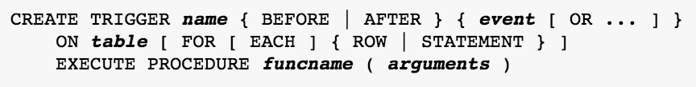
Triggers in PostgreSQL
name: The name to give the new trigger. This must be distinct from the name of any other trigger for the same table.
BEFORE/AFTER: Determines whether the function is called before or after the event.
event: One of INSERT, UPDATE, or DELETE; this specifies the event that will fire the trigger. Multiple events can be specified using OR.
table: The name of the table the trigger is for.
FOR EACH ROW/STATEMENT: This specifies whether the trigger procedure should be fired once for every row affected by the trigger event, or just once per SQL statement. If neither is specified, FOR EACH STATEMENT is the default.
funcname: A user-supplied function that is declared as taking no arguments and returning type trigger, which is executed when the trigger fires.
arguments: An optional comma-separated list of arguments to be provided to the function when the trigger is executed.
Notes:
Example of function declared with no arguments but takes in arguments: https://stackoverflow.com/questions/7726237/postgresql-trigger-function-with-parameters

Slide 14
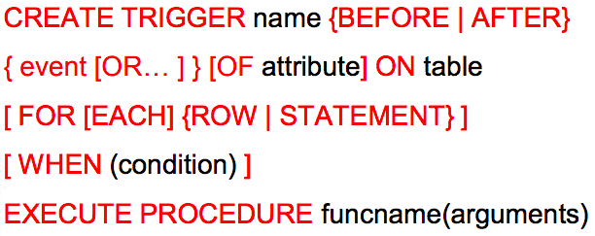
Triggers in PostgreSQL

Slide 15
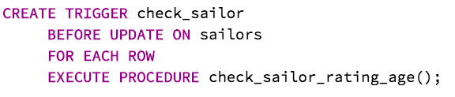
Trigger Examples
Execute the check_sailor_rating_age( ) function whenever a row of the SAILORS table is about to be updated.
Notes:
CREATE TRIGGER check_sailor BEFORE UPDATE ON sailors FOR EACH ROW EXECUTE PROCEDURE check_sailor_rating_age();

Slide 16
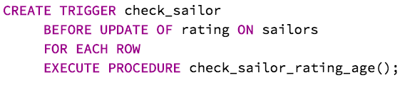
Trigger Examples
Same as before, but only if the sailor’s rating is to be updated.
Notes:
CREATE TRIGGER check_sailor BEFORE UPDATE OF rating ON sailors FOR EACH ROW EXECUTE PROCEDURE check_sailor_rating_age();

Slide 17
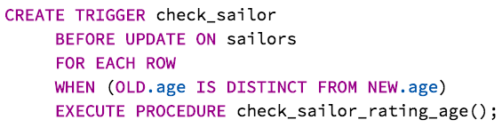
Trigger Examples
Same as before, but only if the sailor’s age will in fact change its value. Notice the WHEN clause.
Notes:
NEW: Data type RECORD; variable holding the new database row for INSERT/UPDATE operations in row-level triggers. This variable is NULL in statement-level triggers and for DELETE operations.
OLD: Data type RECORD; variable holding the old database row for UPDATE/DELETE operations in row-level triggers. This variable is NULL in statement-level triggers and for INSERT operations.

Slide 18
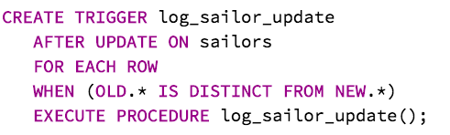
Trigger Examples
Call a function to log any sailors’ updates, but only if something changed:
Notes:
CREATE TRIGGER log_sailor_update AFTER UPDATE ON sailors FOR EACH ROW WHEN (OLD.* IS DISTINCT FROM NEW.*) EXECUTE PROCEDURE log_sailor_update();

Slide 19
Trigger Procedures (functions)
Must be defined before the CREATE TRIGGER statement can execute.
Must be declared as a function taking no arguments and returning type trigger.
Can be written in C (low-level) or PL-PGSQL (high-level)
We will use PL-PGSQL (Procedural Language for PostgreSQL) from pgAdmin
Notes:
SQL is the language PostgreSQL and most other relational databases use as query language. It's portable and easy to learn. But every SQL statement must be executed individually by the database server.
That means that your client application must send each query to the database server, wait for it to be processed, receive and process the results, do some computation, then send further queries to the server. All this incurs interprocess communication and will also incur network overhead if your client is on a different machine than the database server.
With PL/pgSQL you can group a block of computation and a series of queries inside the database server, thus having the power of a procedural language and the ease of use of SQL, but with considerable savings of client/server communication overhead.
Extra round trips between client and server are eliminated
Intermediate results that the client does not need do not have to be marshaled or transferred between server and client
Multiple rounds of query parsing can be avoided
This can result in a considerable performance increase as compared to an application that does not use stored functions.
Also, with PL/pgSQL you can use all the data types, operators and functions of SQL.

Slide 20
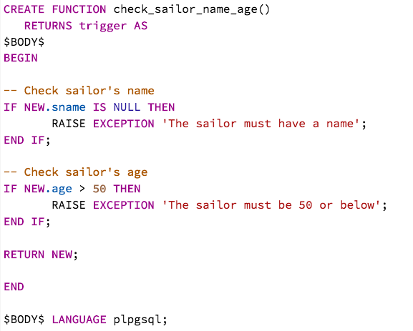
Writing Trigger Procedures with PL-PGSQL
Open the Query Editor and type the following:
Notes:
CREATE OR REPLACE FUNCTION check_sailor_name_age() RETURNS trigger AS
$BODY$
BEGIN
-- Check sailor's name
IF NEW.sname IS NULL THEN RAISE EXCEPTION 'The sailor must have a name';END IF;
-- Check sailor's age
IF NEW.age > 50 THEN RAISE EXCEPTION 'The sailor must be 50 or below';END IF;
RETURN NEW;
END
$BODY$
LANGUAGE plpgsql;

Slide 21

Writing Trigger Procedures with PL-PGSQL
Open the Query Editor and type the following:
Notes:
CREATE TRIGGER check_sailor BEFORE UPDATE ON sailors FOR EACH ROW EXECUTE PROCEDURE check_sailor_name_age()

Slide 22
Writing Trigger Procedures with PL-PGSQL
Some variables that are often needed:
NEW = Holds the contents of the row to insert or update.
OLD = Holds the contents of the original row.
TG_NARGS = Number of input arguments passed on to the trigger procedure.
TG_ARGV[ ] = Text array containing the arguments, accessed as $1, $2, etc.

Slide 23
Writing Trigger Procedures with PL-PGSQL
Testing the Trigger Procedure
Go to the Edit Data window of the Sailors table.
Try to update Peter’s age to 51. What do you get?
Now update it to 23. Was the operation successful?

Slide 24
Implementing Triggers
When does the event below happen?
There must never be more than two sailors traveling in the green boat because it is fragile and could sink.
When a new tuple in the RESERVES relation is inserted or an existing one is updated.
Then we create triggers accordingly.
But first, we define the trigger procedure.

Slide 25
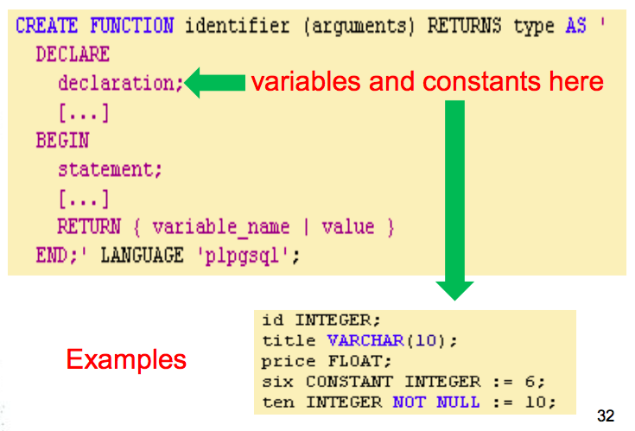
A Glimpse Into PL-PGSQL
Structure of the Main Code Block

Slide 26
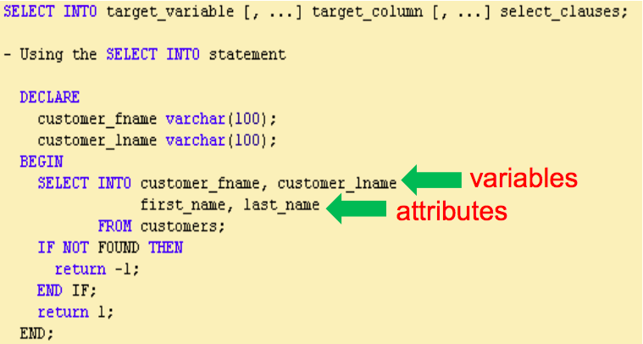
A Glimpse Into PL-PGSQL
Assigning Query Results to Variables

Slide 27
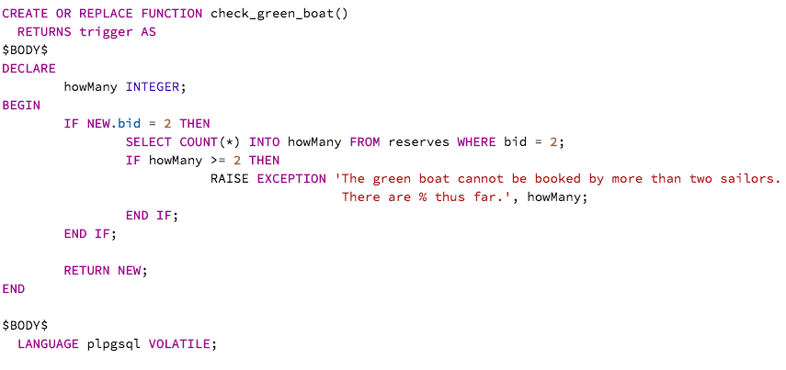
The Fragile Green Boat Procedure
Type it in the Query Tool and run it.
Notes:
CREATE OR REPLACE FUNCTION check_green_boat()
RETURNS trigger AS
$BODY$
DECLARE howMany INTEGER;
BEGIN IF NEW.bid = 2 THEN
SELECT COUNT(*) INTO howMany FROM reserves WHERE bid = 2;
IF howMany >= 2 THEN
RAISE EXCEPTION 'The green boat cannot be booked by more than two sailors. There are % thus far.', howMany; END IF; END IF;
RETURN NEW;
END
$BODY$
LANGUAGE plpgsql VOLATILE;
-----Function Volatility Categories: https://www.postgresql.org/docs/8.2/static/xfunc-volatility.html

Slide 28
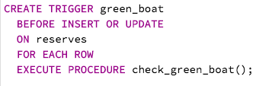

The Fragile Green Boat Procedure
Then declare the corresponding trigger.
Now try it. Go to the Edit Data window for the RESERVES table and try to break the green boat rule by inserting a new record or updating an existing one in such a way that its capacity is overloaded.
Notes:
CREATE TRIGGER green_boat BEFORE INSERT OR UPDATE ON reserves FOR EACH ROW EXECUTE PROCEDURE check_green_boat();

Slide 29
Your turn: The Blue Boat Rule
Write the trigger and its corresponding PL-PGSQL procedure to enforce the blue boat rule.
The blue boat can only be booked by an inexperienced sailor if he travels along with an expert sailor.
Inexperienced sailor = poor rating
Expert sailor = good rating

Slide 30
Your turn: Artist DB
It is impossible to admire Caravaggio and not Josefa.
It happens when
A Caravaggio fan is inserted -> add Josefa tuple
A Caravaggio fan is deleted -> delete Josefa tuple
A Josefa fan is inserted -> disallow insertion if no Caravaggio tuple for that fan is found
A Josefa fan is updated -> disallow update if a Caravaggio tuple for that fan is found.
A Josefa tuple is deleted -> disallow deletion if a Caravaggio tuple for that fan is found.

Slide 31
References
Triggers in PostgreSQL
https://www.postgresql.org/docs/10/static/triggers.html
Quick Intro to PL-PGSQL
https://www.codeproject.com/Articles/33734/How-to-write-PL-pgSQL-functions-for-PostgreSQL
Basic PL-PGSQL statements
https://www.postgresql.org/docs/10/static/plpgsql-statements.html
Creating trigger procedures with PL-PGSQL
https://www.postgresql.org/docs/10/static/plpgsql-trigger.html

