Slide 1
CSI2132 Tutorial 5
The Structured Query Language (SQL)
Presented By: Rana Khalil

Slide 2
About Me
Rana Khalil
Master in Computer Science – 2nd year
Email: rkhal101@uottawa.ca
Office Hours: Tuesdays 12:00 PM – 1:00 PM in SITE 5000G
Teach the next 3 tutorials

Slide 3
Chapter 4: “Basic SQL”
Exercise 4.7
Consider the schema for the LIBRARY database in Fig. 4.6
Choose the appropriate action (reject, cascade, set to null, set to default) for each referential integrity constraint, both for a deletion of a referenced tuple and for the update of a primary key attribute value in a referenced tuple. Justify your choices.

Slide 4
Actions on DELETE and UPDATE
CASCADE: Make the same deletion/update in the referring tuple.
SET NULL: Set the corresponding value in the referring tuple to null.
REJECT: Don’t allow the deletion/update.

Slide 5
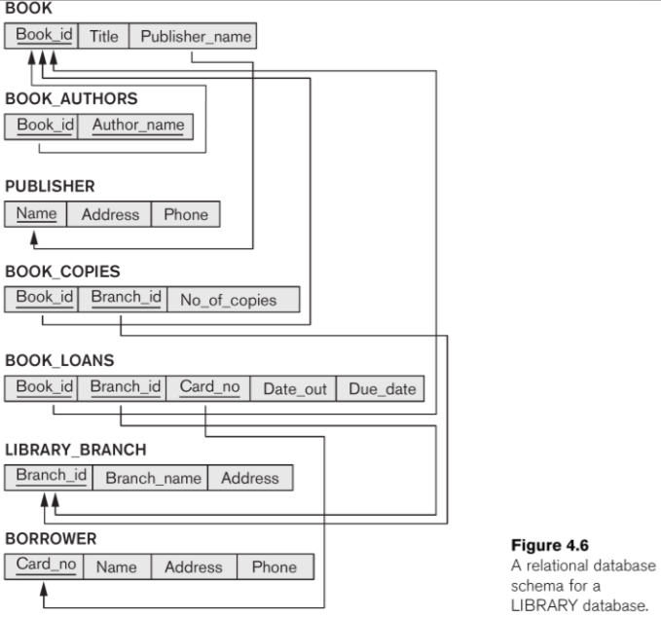
Notes:
CREATE TABLE BOOK ( BookId CHAR(20) NOT NULL,
Title VARCHAR(30) NOT NULL,
PublisherName VARCHAR(20),
PRIMARY KEY (BookId),
FOREIGN KEY (PublisherName) REFERENCES PUBLISHER (Name) ON UPDATE CASCADE );
CREATE TABLE BOOK_AUTHORS ( BookId CHAR(20) NOT NULL,
AuthorName VARCHAR(30) NOT NULL,
PRIMARY KEY (BookId, AuthorName),
FOREIGN KEY (BookId) REFERENCES BOOK (BookId)
ON DELETE CASCADE ON UPDATE CASCADE );

Slide 6
Chapter 4: “Basic SQL”
BOOK_AUTHORS.(BookId) --> BOOK.(BookId)
ON DELETE CASCADE
ON UPDATE CASCADE
Automatically propagate the deletion or change of a BOOK to the referencing BOOK_AUTHORS.

Slide 7
Chapter 4: “Basic SQL”
BOOK.(PublisherName) --> PUBLISHER.(Name)
ON DELETE REJECT
ON UPDATE CASCADE
Do not delete a PUBLISHER tuple which has linked BOOK tuples.
Update the PUBLISHER’s name on all BOOK tuples which refer to it.

Slide 8
Chapter 4: “Basic SQL”
BOOK_LOANS.(BookID) --> BOOK.(BookID)
ON DELETE CASCADE
ON UPDATE CASCADE
If a BOOK record is deleted, then delete all its associated BOOK_LOAN records.
Idem with updates.
REJECT on DELETE also possible!

Slide 9
Chapter 4: “Basic SQL”
BOOK_COPIES.(BookID) --> BOOK.(BookID)
ON DELETE CASCADE
ON UPDATE CASCADE
If a BOOK record is deleted, then delete all its associated BOOK_COPIES tuples.
Do likewise with updates.

Slide 10
Chapter 4: “Basic SQL”
BOOK_LOANS.(CardNo) --> BORROWER.(CardNo)
ON DELETE CASCADE
ON UPDATE CASCADE
If a BORROWER record is deleted, then delete all its associated BOOK_LOANS tuples.
Do likewise with updates.
REJECT on DELETE also possible!

Slide 11
Chapter 4: “Basic SQL”
BOOK_COPIES.(BranchID) --> LIBRARY_BRANCH.(BranchID)
ON DELETE CASCADE
ON UPDATE CASCADE
If a LIBRARY_BRANCH record is deleted, then delete all its linked BOOK_COPIES tuples.
Do likewise with updates.
REJECT on DELETE also possible!

Slide 12
Chapter 4: “Basic SQL”
BOOK_LOANS.(BranchID) --> LIBRARY_BRANCH.(BranchID)
ON DELETE CASCADE
ON UPDATE CASCADE
If a LIBRARY_BRANCH record is deleted, then delete all its linked BOOK_LOANS tuples.
Do likewise with updates.
REJECT on DELETE also possible!

Slide 13
Chapter 4: “Basic SQL”
Exercise 4.15
Consider the EMPLOYEE table’s constraint EMPSUPERFK as in Fig 4.2

Slide 14
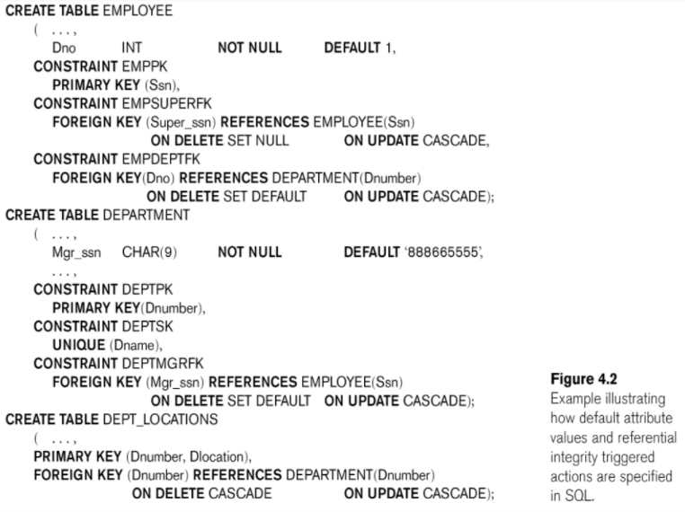

Slide 15

Chapter 4: “Basic SQL”
Exercise 4.15
If the constraint is changed to read as follows:

Slide 16
Chapter 4: “Basic SQL”
Exercise 4.15
What happens when the following command is run on the COMPANY database state shown in Fig. 3.6?
Notes:
wrong

Slide 17
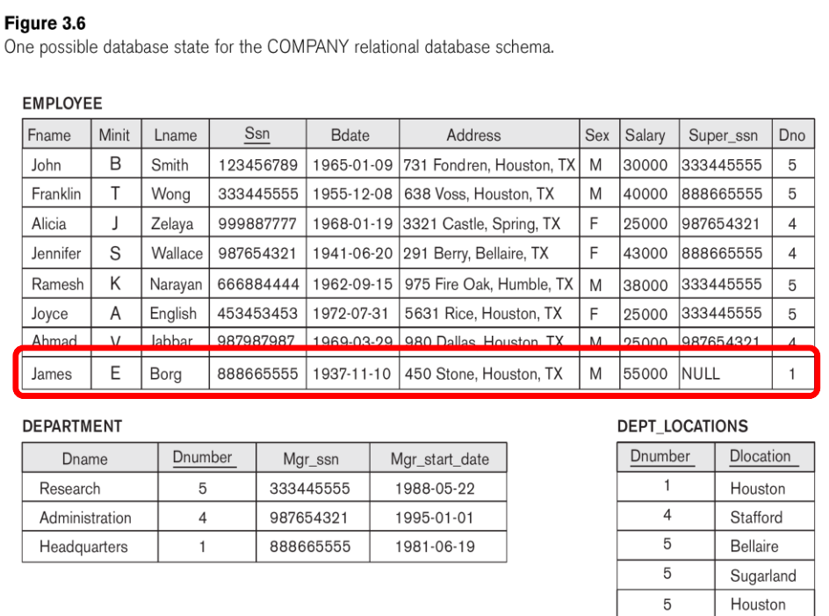

Slide 18
Chapter 4: “Basic SQL”
Answer:
➢ Triggers a deletion of all subordinate records in James Borg’s supervision hierarchy.
Notes:
wrong

Slide 19
Chapter 4: “Basic SQL”
Exercise 4.15
Is it better to CASCADE or SET NULL in case of EMPSUPERFK constraint ON DELETE?

Slide 20
Chapter 4: “Basic SQL”
Answer:
SET NULL is preferred, since an EMPLOYEE is not fired (deleted) when his/her supervisor is deleted.
Instead, the SUPERSSN field should be SET NULL so a new supervisor could be assigned later on.

Slide 21
Chapter 4: “More SQL”
Exercise 5.5
Specify the following additional SQL queries on the COMPANY database of Fig. 3.5

Slide 22
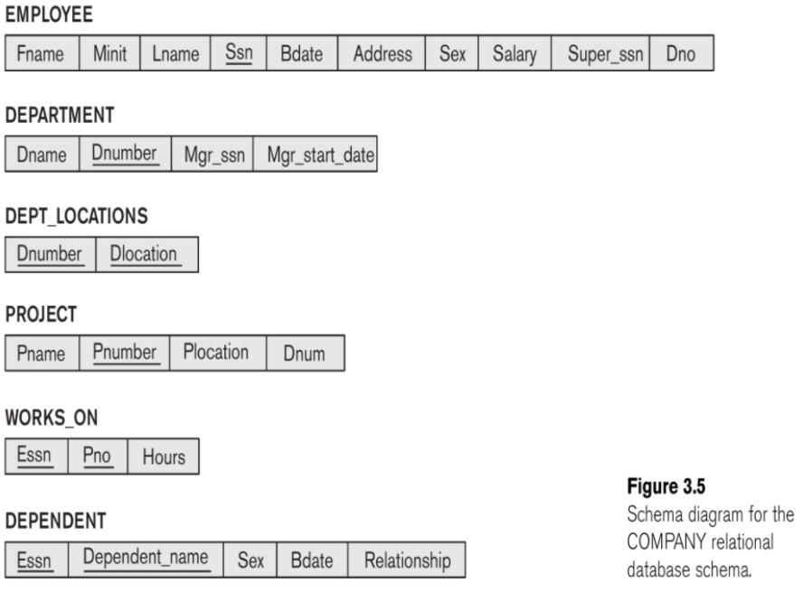

Slide 23
Chapter 4: “More SQL”
Exercise 5.5
a) For each department whose average employee salary is over 30K, retrieve the department name and the number of employees working for it.

Slide 24
Chapter 4: “More SQL”
Exercise 5.5
a) For each department whose average employee salary is over 30K, retrieve the department name and the number of employees working for it.
﻿SELECT
FROM
WHERE

Slide 25
Chapter 4: “More SQL”
Exercise 5.5
a) For each department whose average employee salary is over 30K, retrieve the department name and the number of employees working for it.
﻿SELECT
FROM ﻿DEPARTMENT, EMPLOYEE
WHERE

Slide 26
Chapter 4: “More SQL”
Exercise 5.5
a) For each department whose average employee salary is over 30K, retrieve the department name and the number of employees working for it.
﻿SELECT
FROM ﻿DEPARTMENT, EMPLOYEE
WHERE ﻿DNUMBER=DNO

Slide 27
Chapter 4: “More SQL”
Exercise 5.5
a) For each department whose average employee salary is over 30K, retrieve the department name and the number of employees working for it.
﻿SELECT
FROM ﻿DEPARTMENT, EMPLOYEE
WHERE ﻿DNUMBER=DNO
﻿GROUP BY DNAME
HAVING AVG (SALARY) > 30000

Slide 28
Chapter 4: “More SQL”
Exercise 5.5
a) For each department whose average employee salary is over 30K, retrieve the department name and the number of employees working for it.
﻿SELECT ﻿DNAME, COUNT(*)
FROM ﻿DEPARTMENT, EMPLOYEE
WHERE ﻿DNUMBER=DNO
﻿GROUP BY DNAME
HAVING AVG (SALARY) > 30000

Slide 29
Chapter 4: “More SQL”
Exercise 5.5
b) Suppose we want the number of male employees in each department rather than all employees.
Can we specify this in SQL? Why or why not?
Yes, via a nested query

Slide 30
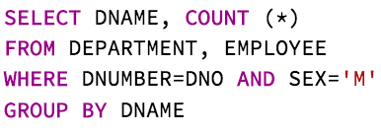
Chapter 4: “More SQL”
b) For each department whose average employee salary is over 30K, retrieve the department name and the number of male employees working for it.

Slide 31
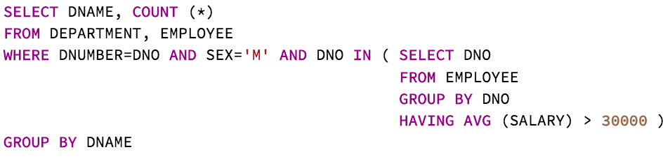
Chapter 4: “More SQL”
b) For each department whose average employee salary is over 30K, retrieve the department name and the number of male employees working for it.

Slide 32
Chapter 5: “More SQL”
Exercise 5.6
Specify the following SQL queries on the UNIVERSITY database schema of Fig. 1.2

Slide 33
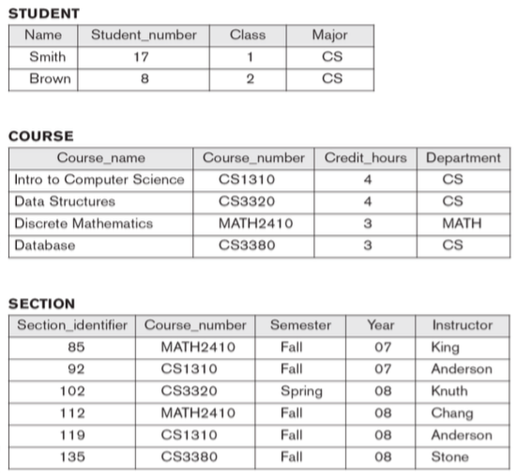

Slide 34
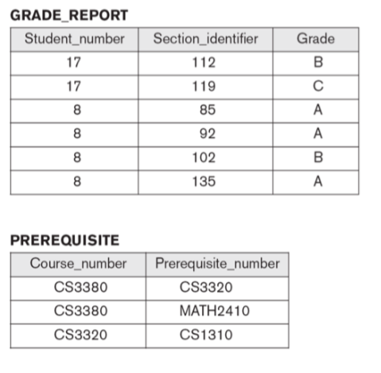

Slide 35
Chapter 5: “More SQL”
Exercise 5.6
Retrieve the names and major departments of all straight-A students (i.e. those who got ‘A’ in all their courses)
Idea: Find all the names of the students such that they received at least one grade that is not A and filter them out of the query.

Slide 36
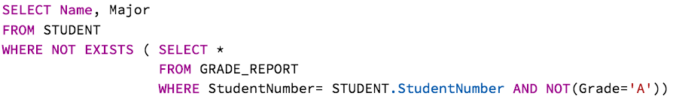
Chapter 5: “More SQL”
Exercise 5.6
a) Retrieve the names and major departments of all straight-A students (i.e. those who got ‘A’ in all their courses)
Retrieve all the columns in GRADE_REPORT such that the student did not receive a grade A
Notes:
The EXISTS operator is used to test for the existence of any record in a subquery.
The EXISTS operator returns true if the subquery returns one or more records.

Slide 37
Chapter 5: “More SQL”
Exercise 5.6
a) Retrieve the names and major departments of all straight-A students (i.e. those who got ‘A’ in all their courses)
Retrieve the names and majors of all the students such that they got an ‘A’ in all their courses
Retrieve all the columns in GRADE_REPORT such that the student did not receive a grade A
Notes:
The EXISTS operator is used to test for the existence of any record in a subquery.
The EXISTS operator returns true if the subquery returns one or more records.

Slide 38
Chapter 5: “More SQL”
b) Retrieve the names and major departments of all students who do not have any grade of A in any of their courses.

Slide 39
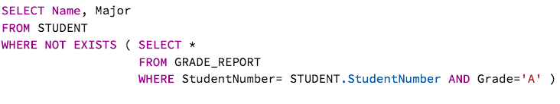
Chapter 5: “More SQL”
b) Retrieve the names and major departments of all students who do not have any grade of A in any of their courses.
Retrieves all columns from GRADE_REPORT such that the student received a grade of A

Slide 40
Chapter 5: “More SQL”
b) Retrieve the names and major departments of all students who do not have any grade of A in any of their courses.
Retrieves the names and majors of all students such that do not have any grade of A in any of their courses
Retrieves all columns from GRADE_REPORT such that the student received a grade of A

Slide 41
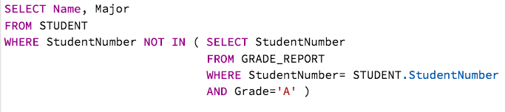
Chapter 5: “More SQL”
Another way

Slide 42
Chapter 5: “More SQL”
Exercise 5.7
In SQL, specify the following queries on the COMPANY database in Fig. 3.5 using the concept of nested queries
a) Retrieve the names of all employees who work in the department that has the employee with the highest salary among all employees.

Slide 43
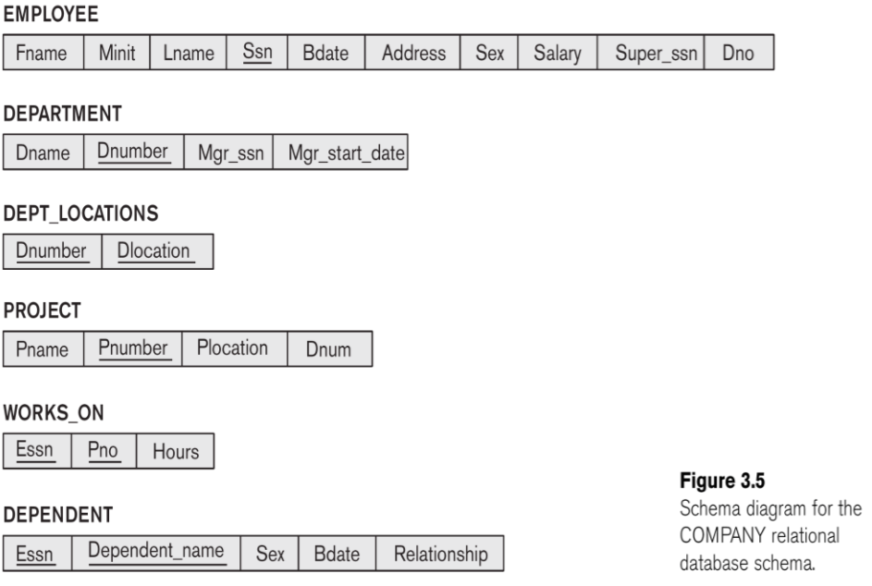

Slide 44
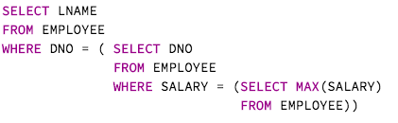
Chapter 5: “More SQL”
a) Retrieve the names of all employees who work in the department that has the employee with the highest salary among all employees.
Calculates the highest salary among all employees

Slide 45
Chapter 5: “More SQL”
a) Retrieve the names of all employees who work in the department that has the employee with the highest salary among all employees.
Outputs the department number that has the employee with the highest salary
Calculates the highest salary among all employees

Slide 46
Chapter 5: “More SQL”
a) Retrieve the names of all employees who work in the department that has the employee with the highest salary among all employees.
Retrieve the last names of all employees who work in the department that has the employee with the highest salary among all employees.
Outputs the department number that has the employee with the highest salary
Calculates the highest salary among all employees

Slide 47
Chapter 5: “More SQL”
Exercise 5.7
b) Retrieve the names of all employees whose supervisor’s supervisor has ‘888665555’ for SSN.

Slide 48
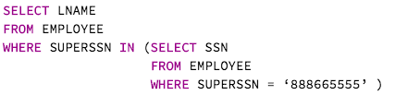
Chapter 5: “More SQL”
Exercise 5.7
b) Retrieve the names of all employees whose supervisor’s supervisor has ‘888665555’ for SSN.
Retrieve the SSN of all employees who have a supervisor that has ‘888665555’ for SSN

Slide 49
Chapter 5: “More SQL”
Exercise 5.7
b) Retrieve the names of all employees whose supervisor’s supervisor has ‘888665555’ for SSN.
Retrieve the names of all employees whose supervisor’s supervisor has ‘888665555’ for SSN
Retrieve the SSN of all employees who have a supervisor that has ‘888665555’ for SSN

Slide 50
Chapter 5: “More SQL”
Exercise 5.7
c) Retrieve the names of employees who make at least 10K more than the employee who is paid the least in the company.

Slide 51

Chapter 5: “More SQL”
Exercise 5.7
c) Retrieve the names of employees who make at least 10K more than the employee who is paid the least in the company.
Retrieves the minimum salary across all employees

Slide 52
Chapter 5: “More SQL”
Exercise 5.7
c) Retrieve the names of employees who make at least 10K more than the employee who is paid the least in the company.
Retrieve the last names of employees who make at least 10K more than the employee who is paid the least in the company
Retrieves the minimum salary across all employees

