Slide 1
CSI2132 Lab #4
Advanced SQL queries
Presented by: Rana Khalil, 5 Feb 2018

Slide 2
Outline
Review advanced queries that involve:
Join of Multiple Tables
Group By and Having keywords
Nested queries and IN keyword
Aggregate functions
GROUP BY and HAVING clauses.
NOT EXISTS keyword
Using temporary tables in queries

Slide 3
Restore the database
Delete all the tables within “laboratories” schema.
Download from the course website the following file:
EndLab03.backup
This file contains the backup of the database as it should be after done all the queries presented in Lab 03
Restore the database (explained during previous lab).

Slide 4
Write SQL queries for the following
Note that these queries involve more than one table.
List the names and customer ids of all customers who like Picasso.
List the names of all customers who like Artists from the Cubism style and having an amount larger than 30000.

Slide 5
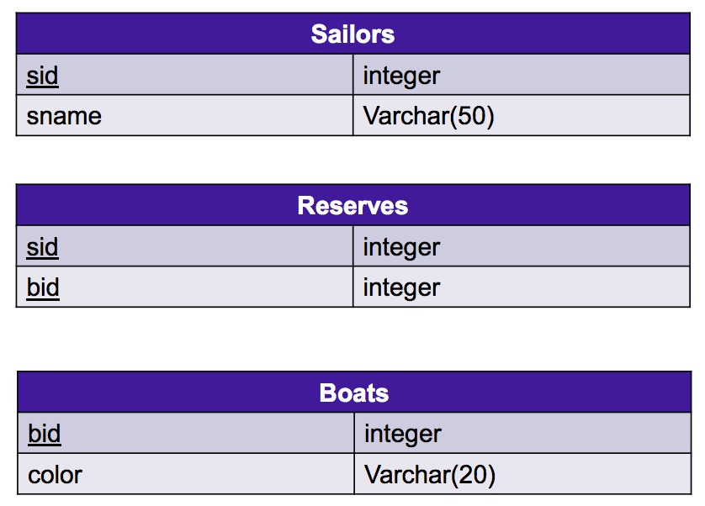
Example: Sailors DB 1

Slide 6
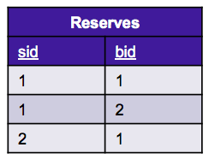
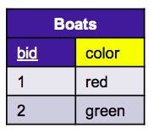
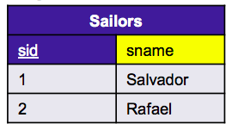
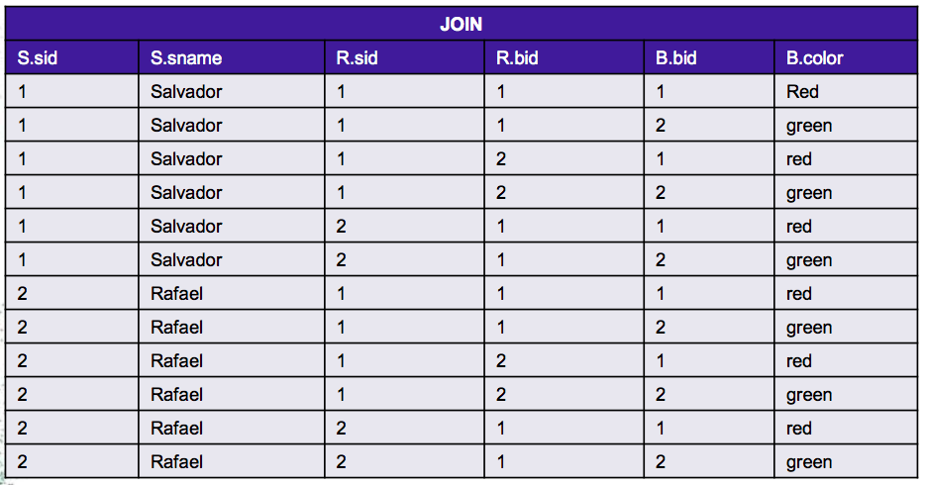
A nested query using IN keyword in Sailors DB
Find the names of sailors who have reserved both a red and a green boat
Query: SELECT * FROM Sailors S, Reserves R, Boats B

Slide 7
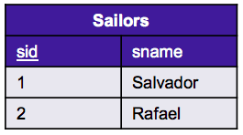
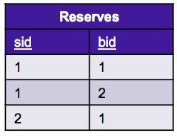
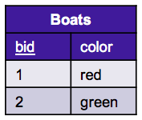
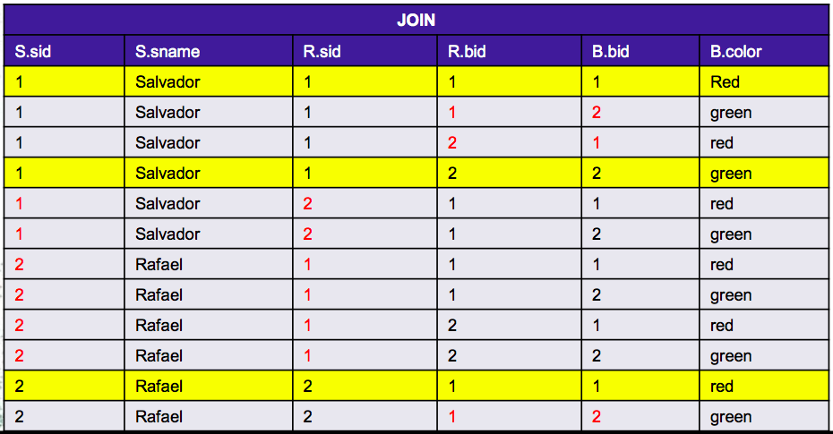
A nested query using IN keyword in Sailors DB
Find the names of sailors who have reserved both a red and a green boat.
Query: SELECT * FROM Sailors S, Reserves R, Boats B
WHERE S.sid = R.sid AND R.bid = B.bid

Slide 8
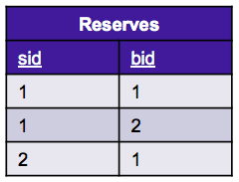
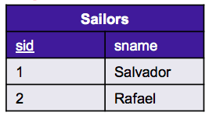
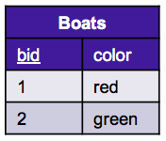
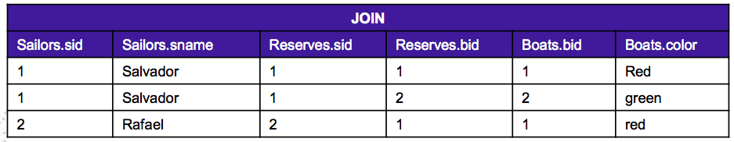
A nested query using IN keyword in Sailors DB
Find the names of sailors who have reserved both a red and a green boat.
Query: SELECT * FROM Sailors S, Reserves R, Boats B
WHERE S.sid = R.sid AND R.bid = B.bid
AND ……

Slide 9
A nested query using IN keyword in Sailors DB
Find the names of sailors who have reserved both a red and a green boat.
SELECT S.sname
FROM Sailors S, Reserves R, Boats B
WHERE S.sid = R.sid AND R.bid = B.bid AND B.color = ‘red’
AND S.sid IN (SELECT S2.sid
FROM Sailors S2,Boats B2, Reserves R2
WHERE S2.sid = R2.sid AND R2.bid = B2.bid AND B2.color = ‘green’ );
The query between () will return the sailor IDs who have reserved a green boat.
First three lines of the query will find sailors who reserved a red boat.
Thus, in the 4th line, we will have the ID of a sailor who reserved a red boat, and check if this same sailor also reserved a green boat by IN keyword.

Slide 10
Your turn
You need the data that we inserted in Lab2 and Lab3. Answer this question by writing a similar query that is described in previous slide.
Using our Artist database, find names of Customers who likes both an artist born in Malaga and an artist born in Florence.

Slide 11
Load Sailor DB SQL
Download the Sailor.sql file from virtual campus
Create a schema “sailor” as part of your DB using pgadmin
Open pgadmin query tool and load sailor.sql and execute it.

Slide 12
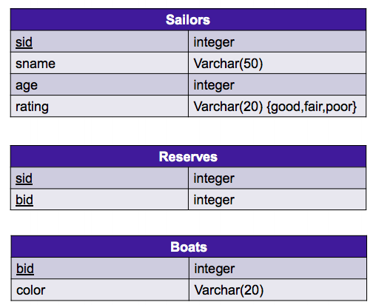
Sailors DB (2)

Slide 13
More on SELECT statements
Remember (previous lab) the order and the syntax for GROUP BY and HAVING clauses
SELECT <attribute-list>
FROM <table-list>
WHERE <record-qualification>
GROUP BY <grouping-list>
HAVING <group-qualification>

Slide 14
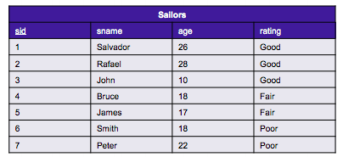
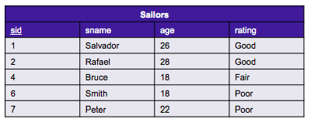
A query using aggregate function AVG, and GROUP BY and HAVING clauses in Sailors DB
Find the average age of sailors who are at least 18 years old, for each rating level that has at least two such sailors.
Run the query
SELECT *
FROM Sailors S
WHERE S.age >= 18
WHERE clause eliminates all the sailors whose age is lesser than 18.

Slide 15
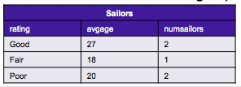
A query using aggregate function AVG, and GROUP BY and HAVING clauses in Sailors DB
Find the average age of sailors who are at least 18 years old, for each rating level that has at least two such sailors.
Run the query
SELECT S.rating, AVG(S.age) AS avgage, COUNT(*) numsailors
FROM Sailors S
WHERE S.age >= 18 GROUP BY S.rating;
The remaining rows will be grouped by their rating using GROUP BY clause and we also obtain the average age and the number of sailors in each group.
Up to now, we have sailors who are older than 17 grouped by their rating.

Slide 16
A query using aggregate function AVG, and GROUP BY and HAVING clauses in Sailors DB
Find the average age of sailors who are at least 18 years old, for each rating level that has at least two such sailors.
Run the query
SELECT S.rating, AVG(S.age) AS avgage
FROM Sailors S
WHERE S.age >= 18
GROUP BY S.rating
HAVING COUNT(*) > 1;
HAVING clause allows us to specify a qualification (filter) for each group.
COUNT(*) >1 in the HAVING clause eliminates all the rating groups which do not have at least two sailors.
TIP: WHERE --> SELECT
HAVING --> GROUP BY
Sailors
rating | avgage
Good | 27
Poor | 20

Slide 17
Another query similar to previous one
Find the age of the youngest sailor with age > 18, for each rating level with at least 2 sailors (of any age).
SELECT S.rating, MIN(S.age) AS minage
FROM Sailors S
WHERE S.age >= 18
GROUP BY S.rating
HAVING ( SELECT COUNT (*)
FROM Sailors S2
WHERE S.rating=S2.rating ) >= 2;
All clauses except HAVING clause are similar to the previous query.
This time, since group qualification is having 2 sailors of any age, we get the total number of rows for that rating group with the query inside HAVING clause, and check if this number is at least 2.

Slide 18
Your turn
You need to insert following rows to Artwork table.
('Saints', 1470, 'Renaissance', 30000.00, 'Leonardo')
('Hand of god', 1510, 'Renaissance', 52000.00, 'Michelangelo')
('Murder', 1600, 'Baroque', 15000.00, 'Caravaggio')
('Green', 1950, 'Modern', 5000.00, 'John')
Write queries similar to what is described in previous slides to answer the question
Find the average price of artworks which are painted after 1490, for each artwork type that has at least two such artworks.
And find the average price of artworks which are painted after 1490, for each artwork type that has at least two artworks (painted in any year).

Slide 19
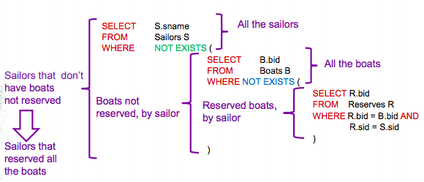
A nested query using NOT EXISTS
Find name of the sailors who reserved all the boats
The intuition behind this query is:
Find name of the sailors such that; there is no boat that he/she did not reserve.
Logically equivalent to ‘Find name of the sailors who reserved all the boats’ .

Slide 20
Your turn
You need the following values inserted into LikeArtist table first.
(2,'Caravaggio')
(2,'Hans Hofmann')
(2,'John')
(2,'Josefa')
(2,'Michelangelo')
Find names of customers who like all the artists. You can answer this query using what you have learned in previous slide.

Slide 21
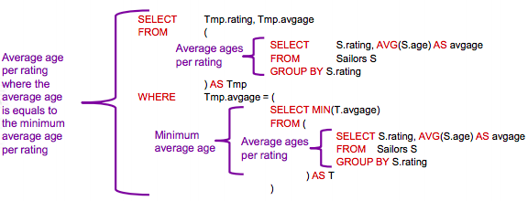
Using temporary tables in queries.
We can generate temporary tables and refer to their rows in our queries.
Find those ratings for which the average age is minimum over all ratings.
Table Tmp and T will store average ages for all the ratings.
Query in WHERE clause will return a single value, which is the minimum of all the average ages.
WHERE clause selects the rows where avgage equals to minimum average age.

Slide 22
Your turn
First, delete a row that we have inserted in previous lab.
DELETE FROM Artwork WHERE price = 4000.00;
Find those painting types for which the average price is the minimum over all types.

Slide 23
End of lab
If the time was not enough, please complete today’s lab before next lab, since we might use the data that we have created in this lab.

