Slide 1

CSI 2132 Lab#2
Basic SQL Programming
Presented by: Rana Khalil, 22 Jan 2018
uOttawa.ca
uOttawa.ca

Slide 2
Updates / Comments
Lab attendance is mandatory starting this week
If we don’t finish the lab during the lab time, you need to complete it on your own time – labs might build on each other.
Updated slides are not posted on Brightspace. You can access them through my github account: https://github.com/rkhal101/CSI2132-Databases-I

Slide 3
Outline
Review syntax of:
Creating a new Schema
CREATE TABLE
INSERT
SELECT
UPDATE
DELETE
Exercises to cover:
Create a new schema and set it as default
Creating tables from ER Diagrams
Inserting data to tables
Querying the database
Updating specific data
Deleting specific data

Slide 4
Create a new Schema and set it to default
Right click on Schemas in tree control > click on Create > click on Schema
In the Create-Schema window, in General tab name the new schema “laboratories” and owner “your username”.
In order to use this newly created schema as the default one for the queries instead of the “public” schema, execute this statement using the Query Tool:
SET search_path = laboratories;
Note that this will be applied for the current session ONLY.

Slide 5
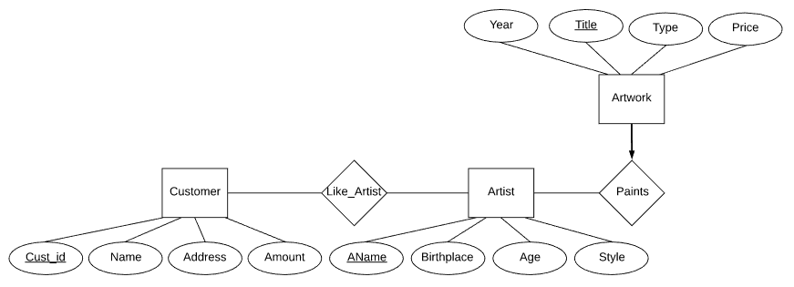
ER Diagram
Tables Artist, Artwork, Customer, LikeArtist (many to many relationship)
Remember the primary key and foreign key constraints.
A good convention is declaring the primary key(s) as the first attribute in the tables.
Some Useful Data Types:
VARCHAR(n)
NUMERIC(n,m)
INTEGER
Notes:
The scale of a numeric is the count of decimal digits in the fractional part, to the right of the decimal point. The precision of a numeric is the total count of significant digits in the whole number, that is, the number of digits to both sides of the decimal point. So the number 23.5141 has a precision of 6 and a scale of 4. Integers can be considered to have a scale of zero.

Slide 6
SQL CREATE TABLE Statement
Syntax
CREATE TABLE TableName
(
column1 datatype1,
column2 datatype2,
...
columnN datatypeN,
constraint1, constraint2, ... , constraintM
);
Example
CREATE TABLE Artist
(
AName VARCHAR(20),
Birthplace VARCHAR(20),
Style VARCHAR(20),
Age INTEGER,
PRIMARY KEY (AName)
);

Slide 7
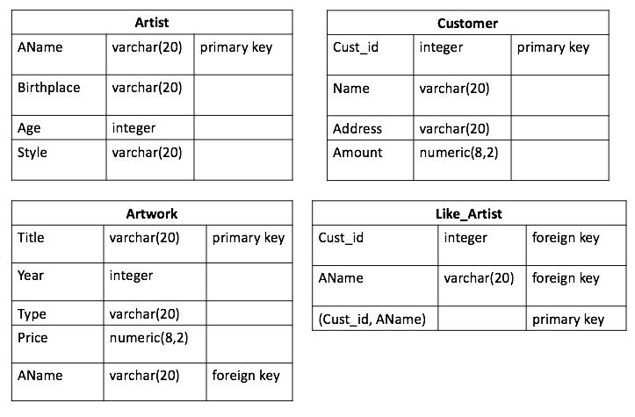
Tables to be Created

Slide 8
The Code for all the Tables
CREATE TABLE Artist
(
AName VARCHAR(20),
Birthplace VARCHAR(20),
Style VARCHAR(20),
Age INTEGER,
PRIMARY KEY (AName)
);
CREATE TABLE Customer
(
Cust_id INTEGER,
Name VARCHAR(20),
Address VARCHAR(20),
Amount NUMERIC(8,2),
PRIMARY KEY (Cust_id)
);
CREATE TABLE Artwork
(
Title VARCHAR(20),
Year INTEGER,
Type VARCHAR(20),
AName VARCHAR(20),
Price NUMERIC(8,2),
PRIMARY KEY (Title),
FOREIGN KEY (AName) REFERENCES Artist
);
CREATE TABLE LikeArtist
(
Cust_id INTEGER,
AName VARCHAR(20),
PRIMARY KEY(AName, Cust_id),
FOREIGN KEY (AName) REFERENCES Artist,
FOREIGN KEY (Cust_id) REFERENCES Customer
);

Slide 9
SQL INSERT INTO Statment
Syntax
INSERT INTO TableName(column1, ... ,columnN) VALUES (value1, ... ,valueN);
Example
INSERT INTO Artist(AName, Birthplace, Style, Age) VALUES ('Caravaggio', 'Milan', 'Baroque', '59');
Character values are quoted by ' ', and numerical values are unquoted when inserting.
Several inserts can be done consecutively in the Query Tool.

Slide 10
Values to be Inserted
Customer(Cust_id, Name, Address, Amount) Table
(1, ‘John’, ‘Ottawa’, 8.5)
(2, ‘Amy’, ‘Orleans’, 9.0)
(3, ‘Peter’, ‘Gatineau’, 6.3)
Artist(AName, Birthplace, Style, Age)
(‘Caravaggio’, ‘Milan’, ‘Baroque’, ‘59’)
(‘Smith’, ‘Ottawa’, ‘Modern’, ‘33’)
(‘Picasso’, ‘Malaga’, ‘Cubism’, ‘40’)
Artwork(Title, Year, Type, Price, AName)
(‘Blue’, 2000, ‘Modern’, 10000.00, ‘Smith’)
(‘The Cardsharps’, 1594, ‘Baroque’, 40000.00, ‘Caravaggio’)

Slide 11
The Code for Insertion
-- Insert into Customer table
INSERT INTO Customer(Cust_id, Name, Address, Amount) VALUES (1,'John','Ottawa',8.5);
INSERT INTO Customer(Cust_id, Name, Address, Amount) VALUES (2, 'Amy', 'Orleans', 9.0);
INSERT INTO Customer(Cust_id, Name, Address, Amount) VALUES (3, 'Peter', 'Gatineau', 6.3);
-- Insert into Artist table
INSERT INTO Artist(AName, Birthplace, Style, Age) VALUES ('Caravaggio', 'Milan', 'Baroque', '59');
INSERT INTO Artist(AName, Birthplace, Style, Age) VALUES ('Smith', 'Ottawa', 'Modern', '33');
INSERT INTO Artist(AName, Birthplace, Style, Age) VALUES ('Picasso', 'Malaga', 'Cubism', '40');
-- Insert into Artwork table
INSERT INTO Artwork(Title, Year, Type, Price, AName) VALUES ('Blue', 2000, 'Modern', 10000.00, 'Smith');
INSERT INTO Artwork(Title, Year, Type, Price, AName) VALUES ('The Cardsharps', 1594, 'Baroque', 40000.00, 'Caravaggio');

Slide 12
SQL SELECT STATEMENT
Syntax
SELECT column1, column2, ... ,columnN
FROM table_name;
WHERE condition;
Example
SELECT Style
FROM Artist
WHERE AName='Smith';

Slide 13
Exercise: Create the following Queries
List all artists that are born in Ottawa
List the titles and prices of all artworks painted in 2000.

Slide 14
Answer: Create the following Queries
List all artists that are born in Ottawa
SELECT *
FROM Artist
WHERE Birthplace='Ottawa';
List the titles and prices of all artworks painted in 2000.
SELECT Title, Price
FROM Artwork
WHERE Year=2000;

Slide 15
SQL UPDATE Statement
We can also modify certain data satisfying a condition from a table with UPDATE command. Condition is the same as WHERE clause of SELECT query. If you omit the WHERE clause, all records will be updated permanently.
Syntax
UPDATE table_name
SET column1 = value1, column2 = value2, ... , columnN = valueN
WHERE condition;
Example
UPDATE Customer
SET Name ='Bruce'
WHERE Cust_id = 1;

Slide 16
Exercise: Update the Following Data
Update Customer Name John to Bruce.
Update the Amount value for all the Customers in the Database to be 9.8 and the address to be Gatineau.

Slide 17
Answer: Create the following Queries
Update Customer Name John to Bruce.
UPDATE Customer
SET Name='Bruce'
WHERE Name='John';
Update the Amount value for all the Customers in the Database to be 9.8 and the address to be Gatineau.
UPDATE Customer
SET Amount=9.8, Address='Gatineau';

Slide 18
SQL DELETE STATEMENT
We can delete certain rows satisfying a condition from a table with DELETE command. Condition is the same as WHERE clause of SELECT query. If you omit the WHERE clause, all records will be deleted permanently.
Syntax
DELETE FROM table_name
WHERE condition;
Example
DELETE FROM Customer
WHERE Cust_id=1;

Slide 19
Exercise: Delete the Following Rows
Remove Customer Amy from our Database.
Remove all the remaining Customers from the database.
Suppose the artist ‘Smith’ moved to another gallery, and we have to remove him from our database. (Note that Artwork table has a foreign key to Artist table)

Slide 20
Answer: Delete the Following Rows
Remove Customer Amy from our Database.
DELETE FROM Customer
WHERE Name='Amy';
Remove all the remaining Customers from the database.
DELETE FROM Customer;
Suppose the artist ‘Smith’ moved to another gallery, and we have to remove him from our database. (Note that Artwork table has a foreign key to Artist table)
--First delete entry from Artwork table
DELETE FROM Artwork WHERE AName='Smith';
-- Second delete entry from Artist table
DELETE FROM Artist WHERE AName='Smith';

Slide 21
For Detailed Information
About SQL Syntax
http://www.faqs.org/docs/ppbook/c22759.htm

