Slide 1

CSI 2132 Lab#1
Setting up PostgreSQL
Presented by: Rana Khalil, 15 Jan 2018
uOttawa.ca
uOttawa.ca

Slide 2
About Me
Rana Khalil
Master in Computer Science – 2nd year
Email: rkhal101@uottawa.ca
Office Hours: Tuesdays 12:00 PM – 1:00 PM in SITE 5000D

Slide 3
Updates / Comments
Lab attendance is mandatory starting next week
Attend the lab section you’re registered in

Slide 4
Outline
Overview of PostgreSQL
Using pgAdmin 4 in SITE labs
Setting up pgAdmin 4 in your home computer.
Overview of pgAdmin

Slide 5
OVERVIEW OF POSTGRESQL

Slide 6
PostgreSQL
It is a powerful, open source object-relational database management system (ORDBMS)
Since it is open source, it is not controlled by any single company. Thus, its development relies on the global community of developers and companies
We can download, install, use and inspect its source code at no cost.

Slide 7
Software Tools:
We will be using the following software products in this course:
PostgreSQL (database server)
pgAdmin 4 (client tool)
PostgreSQL is the core DBMS, including command line tools, programming language libraries etc. SITE already has a PostgreSQL server, and we will connect to it regularly.
pgAdmin 4 is the graphical user interface(client tool) we use to connect to our database located in SITE server.

Slide 8
Your PostgreSQL Account
SITE’s PostgreSQL server already created accounts for you.
Your login is the standard Infoweb account name, i.e. if your email is rkhal101@uottawa.ca,then your username is rkhal101.
Your password is the one you use to log into the SITE computers.
First-time users need to run the AUTOPASS feature in SITE computers to create their username and password.

Slide 9
SETTING UP PGADMIN 4

Slide 10
Using pgAdmin 4 at SITE
pgAdmin is already installed in SITE computer labs.
Go to
Start Menu > All Programs > Software Development > pgAdmin 4 > pgAdmin 4 v2
Under Quick Links click on Add New Server

Slide 11
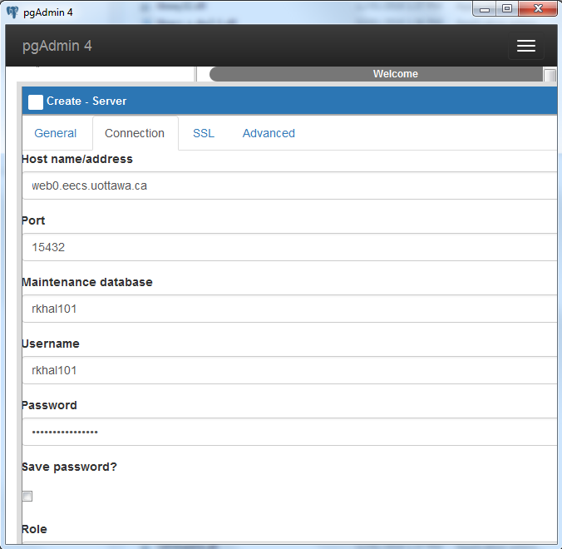
Server Parameters for SITE
General Tab
Name: Anything you want
Connection Tab
Host name/address: web0.eecs.uottawa.ca
Port: 15432
Maintenance DB & Username: Your SITE account’s username
Password: Your SITE account’s password

Slide 12
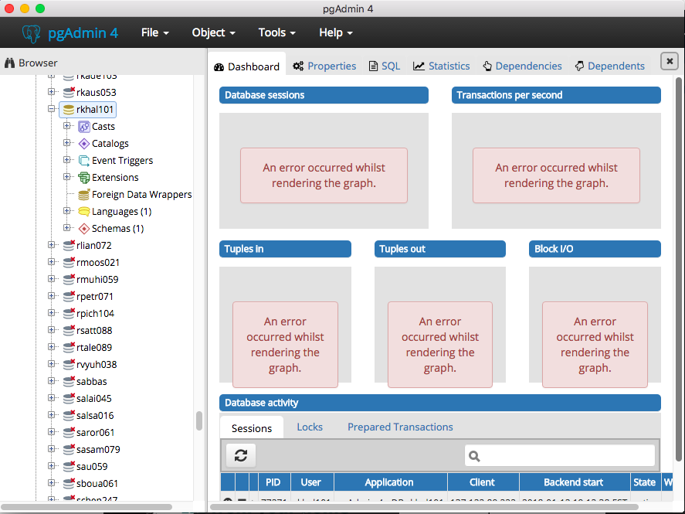
Successful connection and pgAdmin GUI.
Note that you only have access to the DB associated with your SITE account.

Slide 13
Setting up and using pgAdmin 4 from your home
Go to
https://www.pgadmin.org/download/
Click on the PostgreSQL mirror network link.
Select the latest version (v2.1)
Select your operating system (e.g. macos)
Click on pgadmin4-2.1.dmg (depends on your operating system)
Extract the contents of the compressed file
Follow the installation instructions

Slide 14
Home Setup (Continued)
Open pgAdmin 4
In the Dashboard tab click on Add New Server
Warning: You may need to restart pgAdmin after adding the server.

Slide 15
Server Parameters for Home (same as SITE)
General Tab
Name: Anything you want
Connection Tab
Host name/address: web0.eecs.uottawa.ca
Port: 15432
Maintenance DB & Username: Your SITE account’s username
Password: Your SITE account’s password

Slide 16
OVERVIEW OF PGADMIN

Slide 17
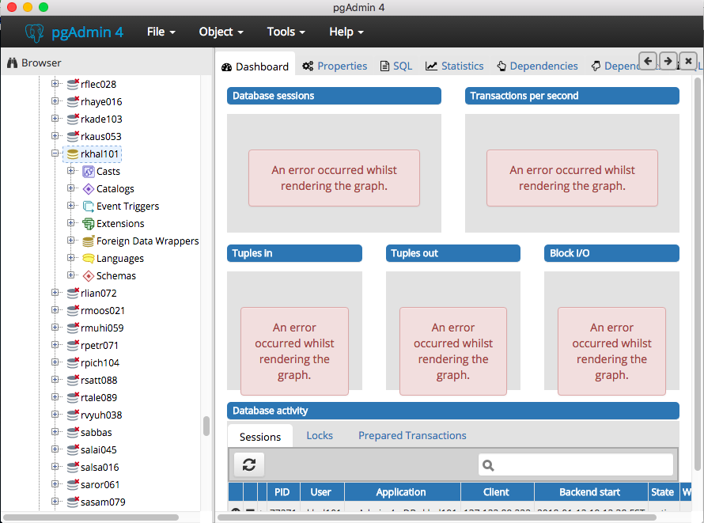
Main Window - Tree Control
Server tree
and the objects objects that reside on a server.

Slide 18
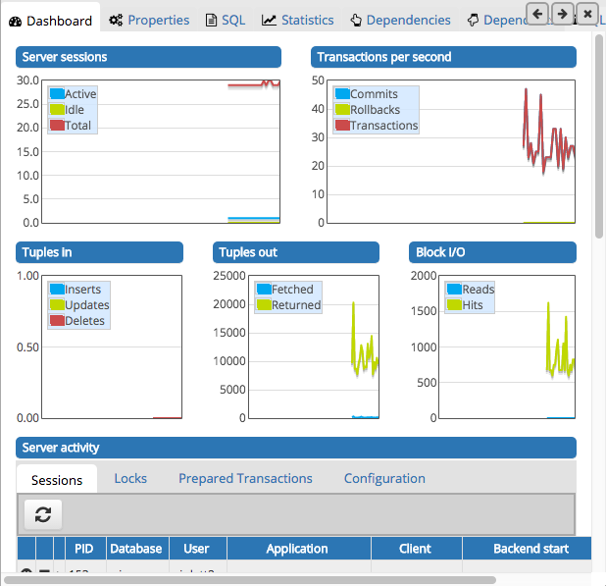
Main Window - Dashboard
Provides an active analysis of the usage statistics for the selected server or database

Slide 19
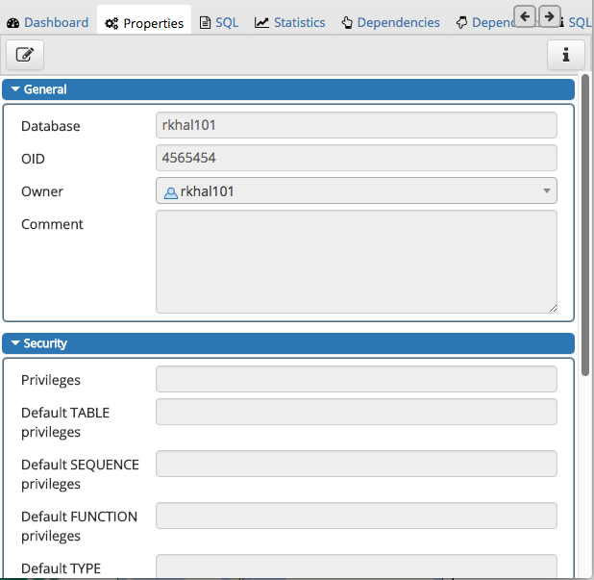
Main Window - Properties
Displays information about the object selected

Slide 20
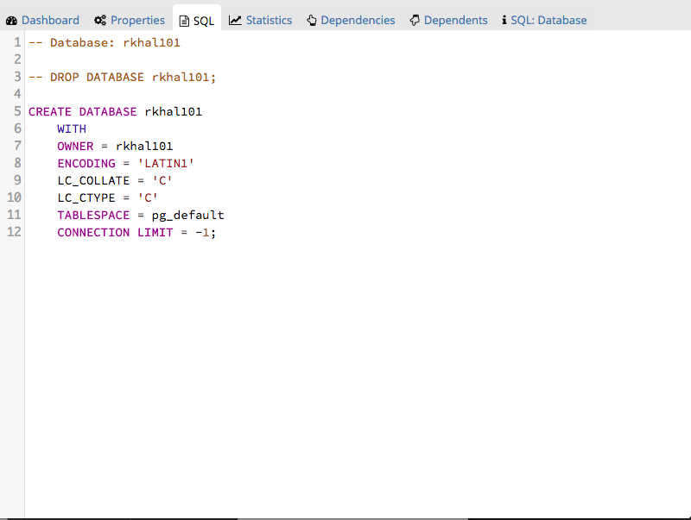
Main Window - SQL
Displays the SQL script that created the highlighted object, and a (commented out) SQL statement that will DROP the selected object.

Slide 21
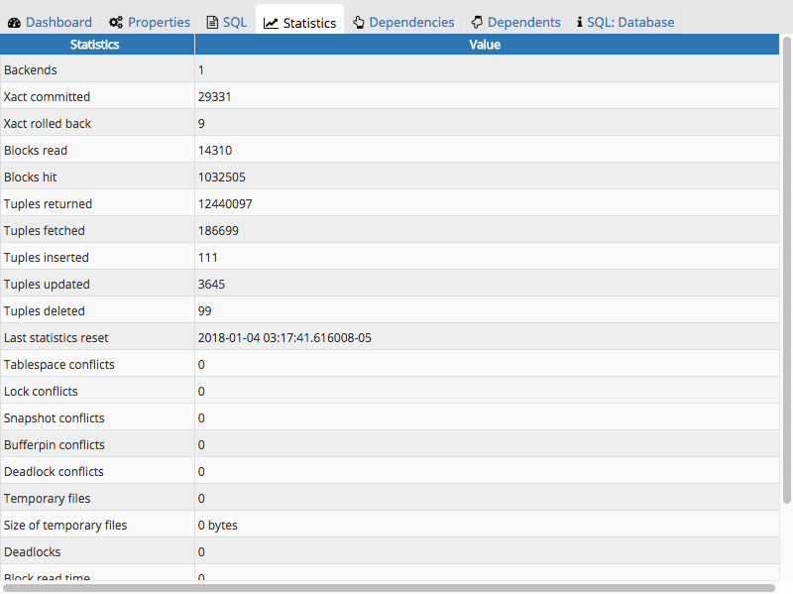
Main Window - Statistics
Displays the statistics gathered for each object on the tree control

Slide 22
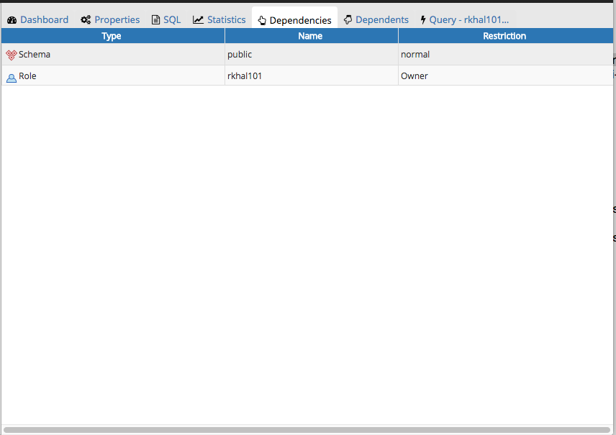
Main Window - Dependencies
Displays the objects on which the currently selected object depends.

Slide 23
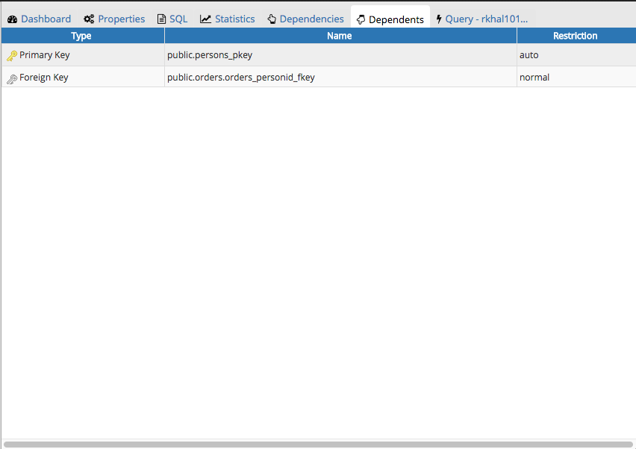
Main Window - Dependents
Displays a table of objects that depend on the object currently selected in the pgAdmin
browser.

Slide 24
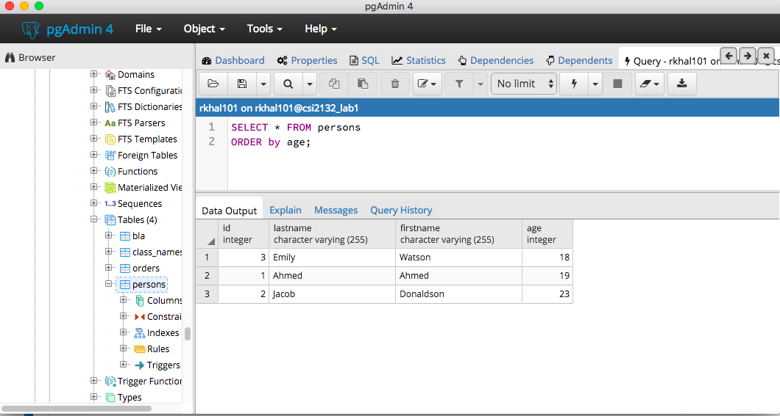
The Query Tool
Can be accessed through Tools > Query Tool
Type SQL statements to create the query

Slide 25
The Query Tool
Can be accessed through Tools > Query Tool
Query results displayed here

Slide 26
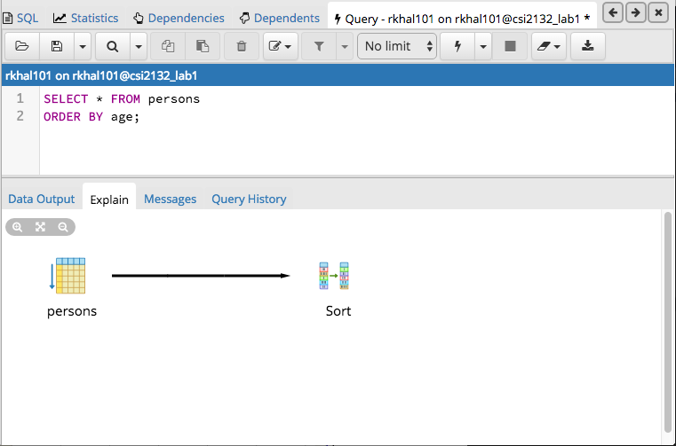
The Query Tool
Can be accessed through Tools > Query Tool
Schematic representation of the DBMS operations via the EXPLAIN command

Slide 27
For Detailed Information
About PostgreSQL:
https://www.postgresql.org/
About pgAdmin 4:
https://www.pgadmin.org/
Connectivity for remote and SITE users
http://www.site.uottawa.ca/local/labinfo/software/postgresql.html

