Slide 1
CSI2132 Lab 7*
Web Programming JSP
Presented By: Rana Khalil
*Similar slides to the ones posted on Brightspace. except that the IDE used is Eclipse.

Slide 2
Outline
Web Applications
Model View Controller
Architectures for Web Applications
Creation of a JSP application using JEE as JDK, Apache Tomcat as Server and Eclipse as IDE
View Layer: JSP pages
Definition of the Servlet
Logical / Controller Layer: Java code
Database Layer: Enterprise Java Beans

Slide 3
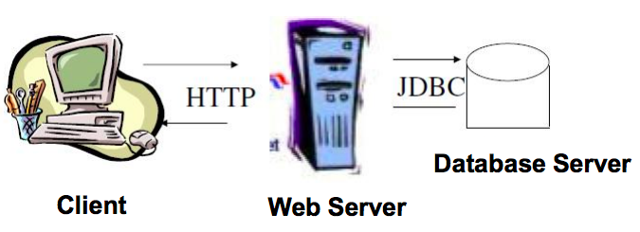
Web Applications
To add logic (program code) inside a web server, Sun
Microsystems extended the Java language with the
introduction of the API Java Servlets.
Notes:
A web application can be seen as a client-server program where the client runs in a web browser (such as firefox or google chrome) and the data is stored and retrieved from a database server (which in our case that is postgresql). Last week we learnt JDBC. This week, we’ll run a working sample web application that uses our database server PostgreSQL, uses an Apache Tomcat web server and displays information on the client machine using java servlets and client side programming languages such as html and css.
Web Server -
Server on which your website is hosted. This server will have installed web servers such as IIS, apache, etc.
Application Server -
Server on which your created applications which are utilizing your database, web service, etc. This application server will host business layer (wrapped with web services), scheduled jobs, windows services, etc.
Database Server -
Database server will have your one or more database hosted such as Oracle, Sql Server, MySql, etc.

Slide 4
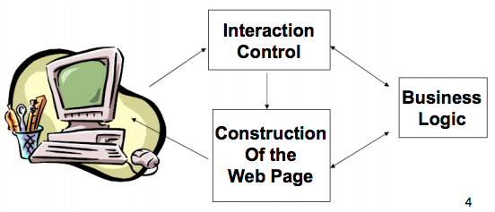
Model View Controller
Web applications are usually built following the three layers model.
According to this model three separate and perfectly defined process or modules are executed in different platforms.
Notes:
A Model View Controller is an is an architectural pattern that divides an application into three interconnected parts.
Components
The model is the central component of the pattern. It expresses the application's behavior in terms of the problem domain, independent of the user interface.^{[6]} It directly manages the data, logic and rules of the application.
A view can be any output representation of information
The third part or section, the controller, accepts input and converts it to commands for the model or view.

Slide 5
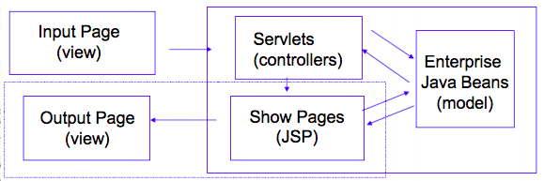
Model View Controller
An architecture that separates the application components:
Model: Represents the data
View: User Interface
Controller: Handles the user input and the application flow. It is implemented as a Java Servlet.

Slide 6
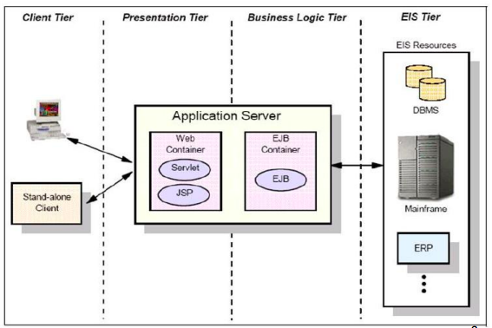
Architectures for Web Applications
Model View Controller

Slide 7
Architectures for Web Applications
Model:
Encapsulates the business domain. It is completely independent from the Controller and the View.
View:
Presentation of the model, it can access to the model, but never change it state. It can be notified when there is a change in the model state.
Controller:
Responds to the client request, executing the appropriate action and creating the pertinent model.

Slide 8
Web Project in Eclipse (in General)
Download Apache Tomcat 9.0 from https://tomcat.apache.org/download-90.cgi
File > New > Project
In the New Project Window Select Web > Dynamic Web Project > Click Next (NOTE: If you can’t see this option go to next slide)
Give the project a name
Under Target runtime, select New Runtime > Apache > Apache Tomcat v9.0 > Click Next
Under Tomcat installation directory click Browse > Browse to the location of the extracted the installation files of Apache Tomcat.

Slide 9
Install Web
Note: Implement the fix in this slide ONLY if you can’t see
the Web option when creating a new Project
Go to the Main toolbar in Eclipse and click on Help > Install New Software
In the Work with section select the name of your eclipse from the dropdown menu. Ex: Neon - http://download.eclipse.org/releases/neon
Select Web, XML, Java EE….. option
Click Next > Next > Accept the license agreement > click Finish
After the software installation, Eclipse will be restarted.
Now go back to the previous slide and create a new project.

Slide 10
Download Web Project to Work on
From the course website, download the file: lab7.rar
Decompress it.
In the Eclipse main toolbar, click on File > Open Projects from File System..
Click on the Directory button > Navigate to where lab 7 was saved.
If you have errors:
Right click on the project > select Properties > Java Build Path > Libraries > Add/Update JRE System Library
To add a runtime server:
Right click on the project > select Properties > Project Facets > Runtimes > Add / Select Apache Tomcat version you downloaded earlier.

Slide 11
Issues with Project on Eclipse
postgresql file should be in the directory WebContent/WEB-INF/lib
EITHER
Eclipse will have an issue with naming your package java. For ex. java.connection, java.control, etc. I think on runtime it is viewing it as a folder instead of a package. A quick fix would be to change the package name. Right click on the package > refractor > rename.
In web.xml change <servlet-class>control.Control</servlet-class> to <servlet-class>yourpackagename.control.Control</servlet-class>
This will introduce errors into your code which involve changing the package name. Navigate to the files that have errors and fix them.
OR
Remove Java from the path:
Remove java from lines 12 and 13 in LikeArtist.jsp
In Java Resources, change the package structure so that you no longer have a java package. eg: src.dbbeans, src.connection, etc.
If you encounter other errors, let me know.

Slide 12
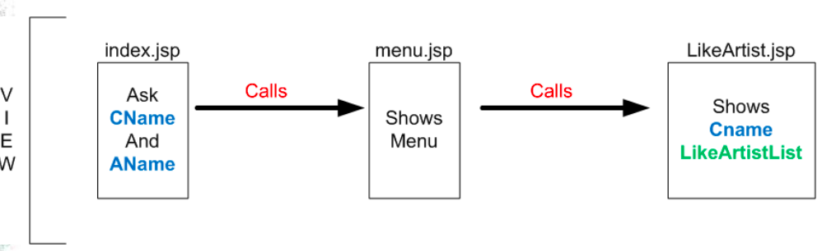
JSP Lab 7 Application
Note: This is how the application was before, however the professor provided you with the completed application.
Take a look at each jsp file
Notes:
index.jsp : Contains HTML code that displays the content of the index page. It contains a list of choices on who is your favorite artist. (It asks for your name and your choice of favourit artist and asks you to login or sign up)
Menu.jsp: Contains HTML code that displays the content of the page after you have signed up. It will also contain two links which call other servlets. One is logout which calls the closesession servlet and see the artists fans which calls LikeArtist.jsp.
LikeArtist.jsp: It locates the classes that call the database and display the artist fans that are stored in the database.

Slide 13
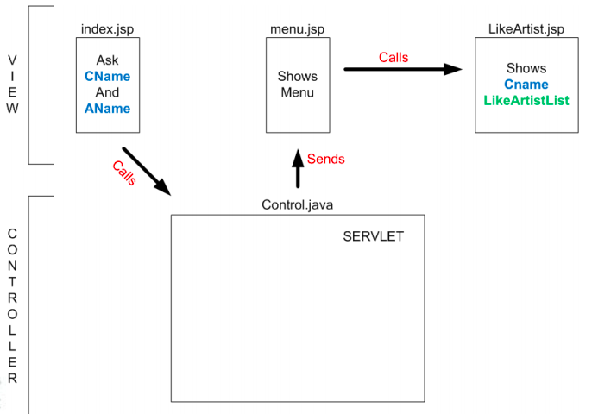
JSP Application (Controller)
Create the controller that manages user requests (already done for you)

Slide 14
JSP Application (Controller)
Note: This has already been done for you
Create a new Java package (control)
Create a new Java Class under this package (Control.java)
Basic methods in Control.java
Modify Index.jsp to call the servlet
<form action=“Control” method=“POST”>

Slide 15
JSP Application (Controller)
Note: This has already been done for you
Modify the web.xml file to use control as servlet
WEB-INF > Web.xml
Servlets tab > Add Servlet Element
Test the application so far (by running it)

Slide 16
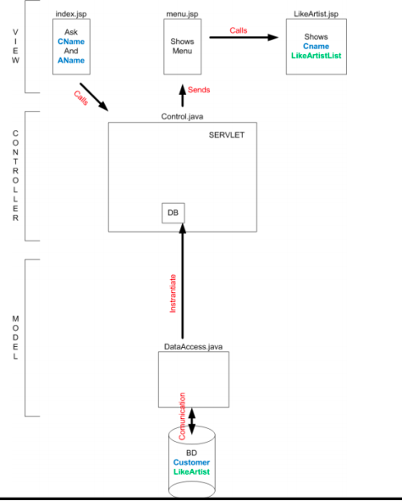
JSP Application (DB Connection)

Slide 17
JSP Application (DB Connection)
Note: You need to implement this!
Take a look at java classes under connection package
Password
Set your own password
DataAccess
Comment / Uncomment the appropriate connection line (using lab computers or Laptops)
Notice that PostgreSQL JDBC driver is already imported under Libraries folder

Slide 18
Run your Application
Before you run your application, go to Java Resources > dbbeans > Make sure that the names of the attributes in your Postgresql database match with the names called in the files LikeArtistBean.java and CustomerBean.java.
One mistake I noticed is cust_id in LikeTable is referred to as custid. Therefore, your application won’t find it at runtime. You either have to change the names in your database or in your web application to make sure they match.
After your sure of the naming conventions, database connection, username and password run your application. It should be fully functional.

Slide 19
JSP Application (DB Connection)
Note: This has already been done for you.
Instantiate the DB object from the Servlet
Create connection
Open connection
Close Connection

Slide 20
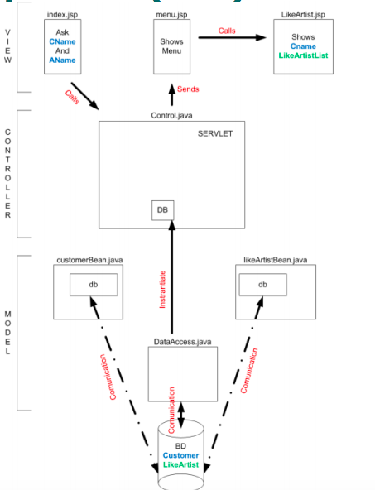
JSP Application (EJBs)

Slide 21
JSP Application (Create EJBs)
CustomerBean
Import
DataAccess
java.sql
Attributes
Connection
Statement
ResultSet
Customer Name
Customer id

Slide 22
JSP Application (Create EJBs)
Note: This has already been done for you.
CustomerBean
Methods
setName
getName
setCustid
getCustid
existsCustomer
Receives
name to look for
DB object db
Returns
Customer id or -1 if not found
insertCustomer
Receives
name to look for
DB object db
Returns
Customer id

Slide 23
JSP Application (Create EJBs)
CustomerBean
Methods
setName
getName
setCustid
getCustid
existsCustomer
Receives
name to look for
DB object db
Returns
Customer id or -1 if not found
insertCustomer
Receives
name to look for
DB object db
Returns
Customer id

Slide 24
JSP Application (Create EJBs)
Note: This has already been done for you.
LikeArtistBean
Import
DataAccess
java.sql
Attributes
Connection
Statement
DataAccess
ResultSet
LikeArtistList

Slide 25
JSP Application (Create EJBs)
Note: This has already been done for you.
LikeArtistBean
Methods
setDataAccess
existsLikeArtist
Receives
Customer id
Artist name
DB object db
Returns
True if it this record already exists, false otherwise
insertLikeArtist
Receives
Customer id
Artist name
DB object db
getLikeArtistList
Returns
All info in LikeArtist table in HTML table format

Slide 26
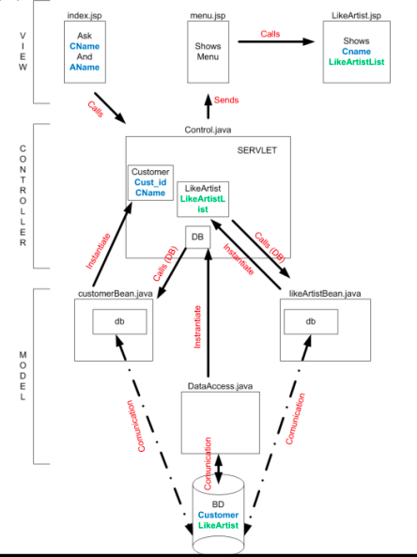
JSP Application (Implement Logic)

Slide 27
JSP Application (Implement Logic)
Note: This has already been done for you.
Within the Servlet (Control.java)
Check the customer exists
Insert the Customer if it doesn’t exist
Check relation Customer – Artist already exists
Insert relation if it doesn’t exist

Slide 28
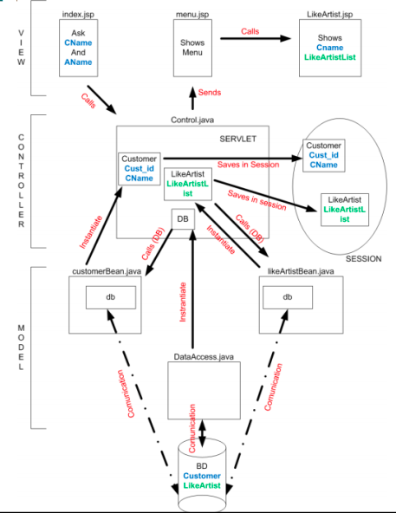
JSP Application (Implement Session)

Slide 29
JSP Application (Implement Session)
Note: This has already been done for you.
Create Session within our Servlet (Control.java)
Save EJBs with information within Session
Check Session is valid in menu.jsp
Close Session in closesession.jsp

Slide 30
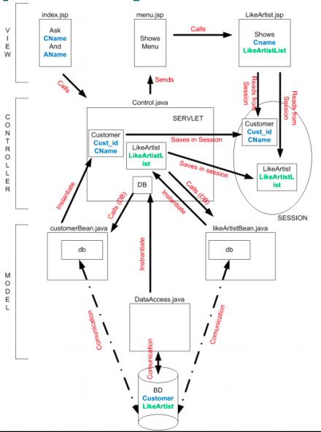
JSP Application (Show LikeArtist tbl)

Slide 31
JSP Application (Show LikeArtist tbl)
Note: This has already been done for you.
Retrieve information from Session and show LikeArtist table

Slide 32
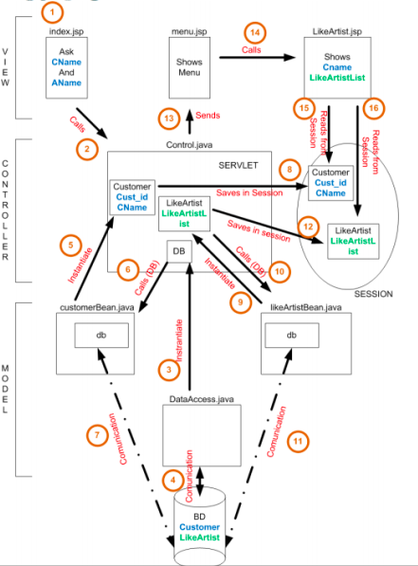
JSP Application (Show LikeArtist tbl)

