Slide 1
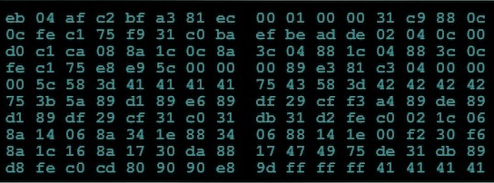
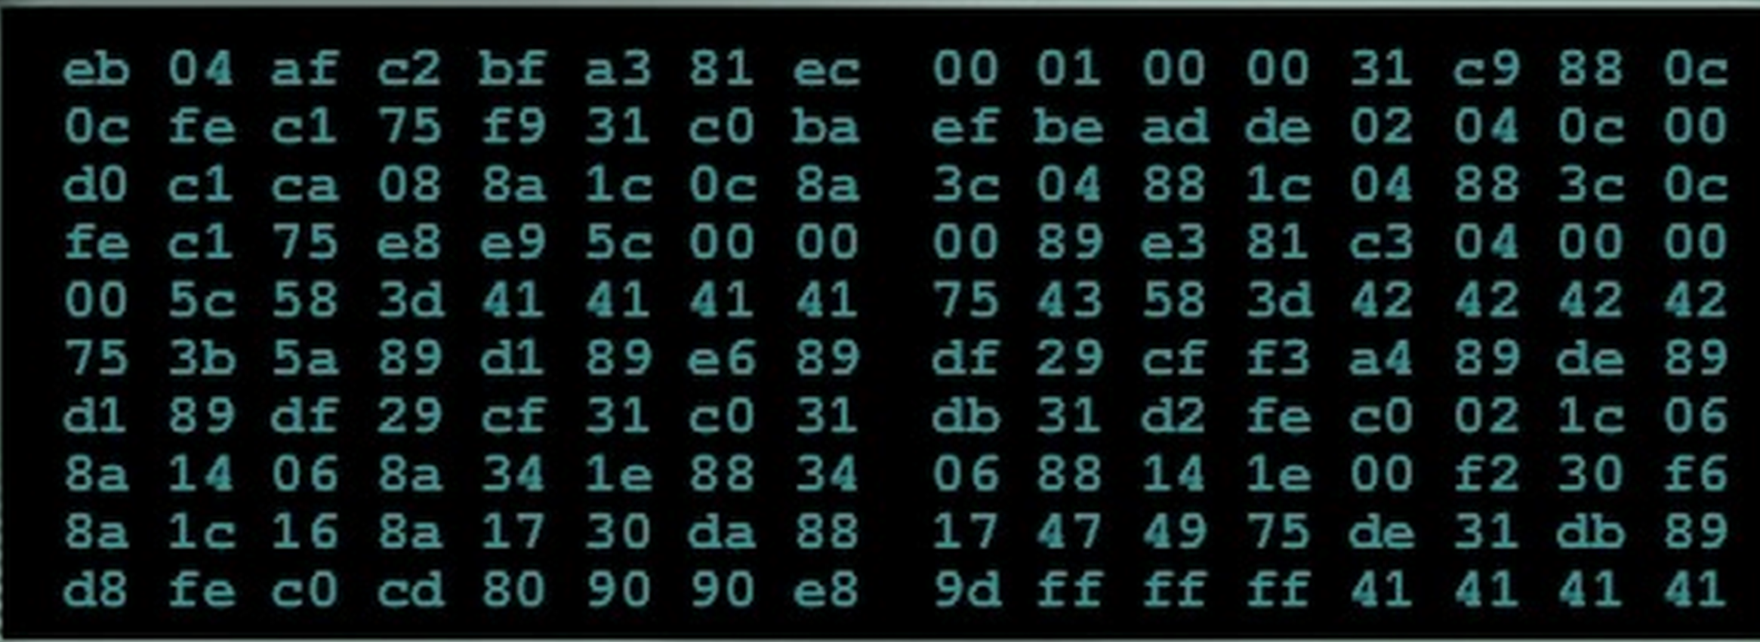

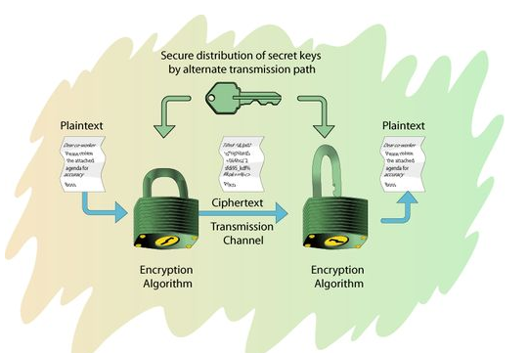
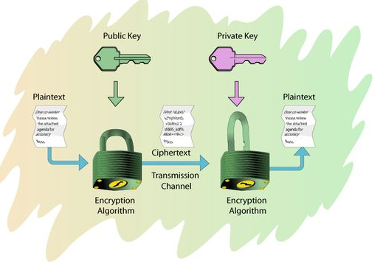
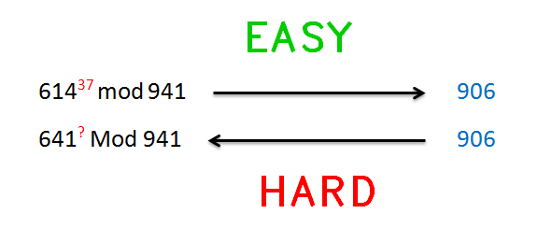
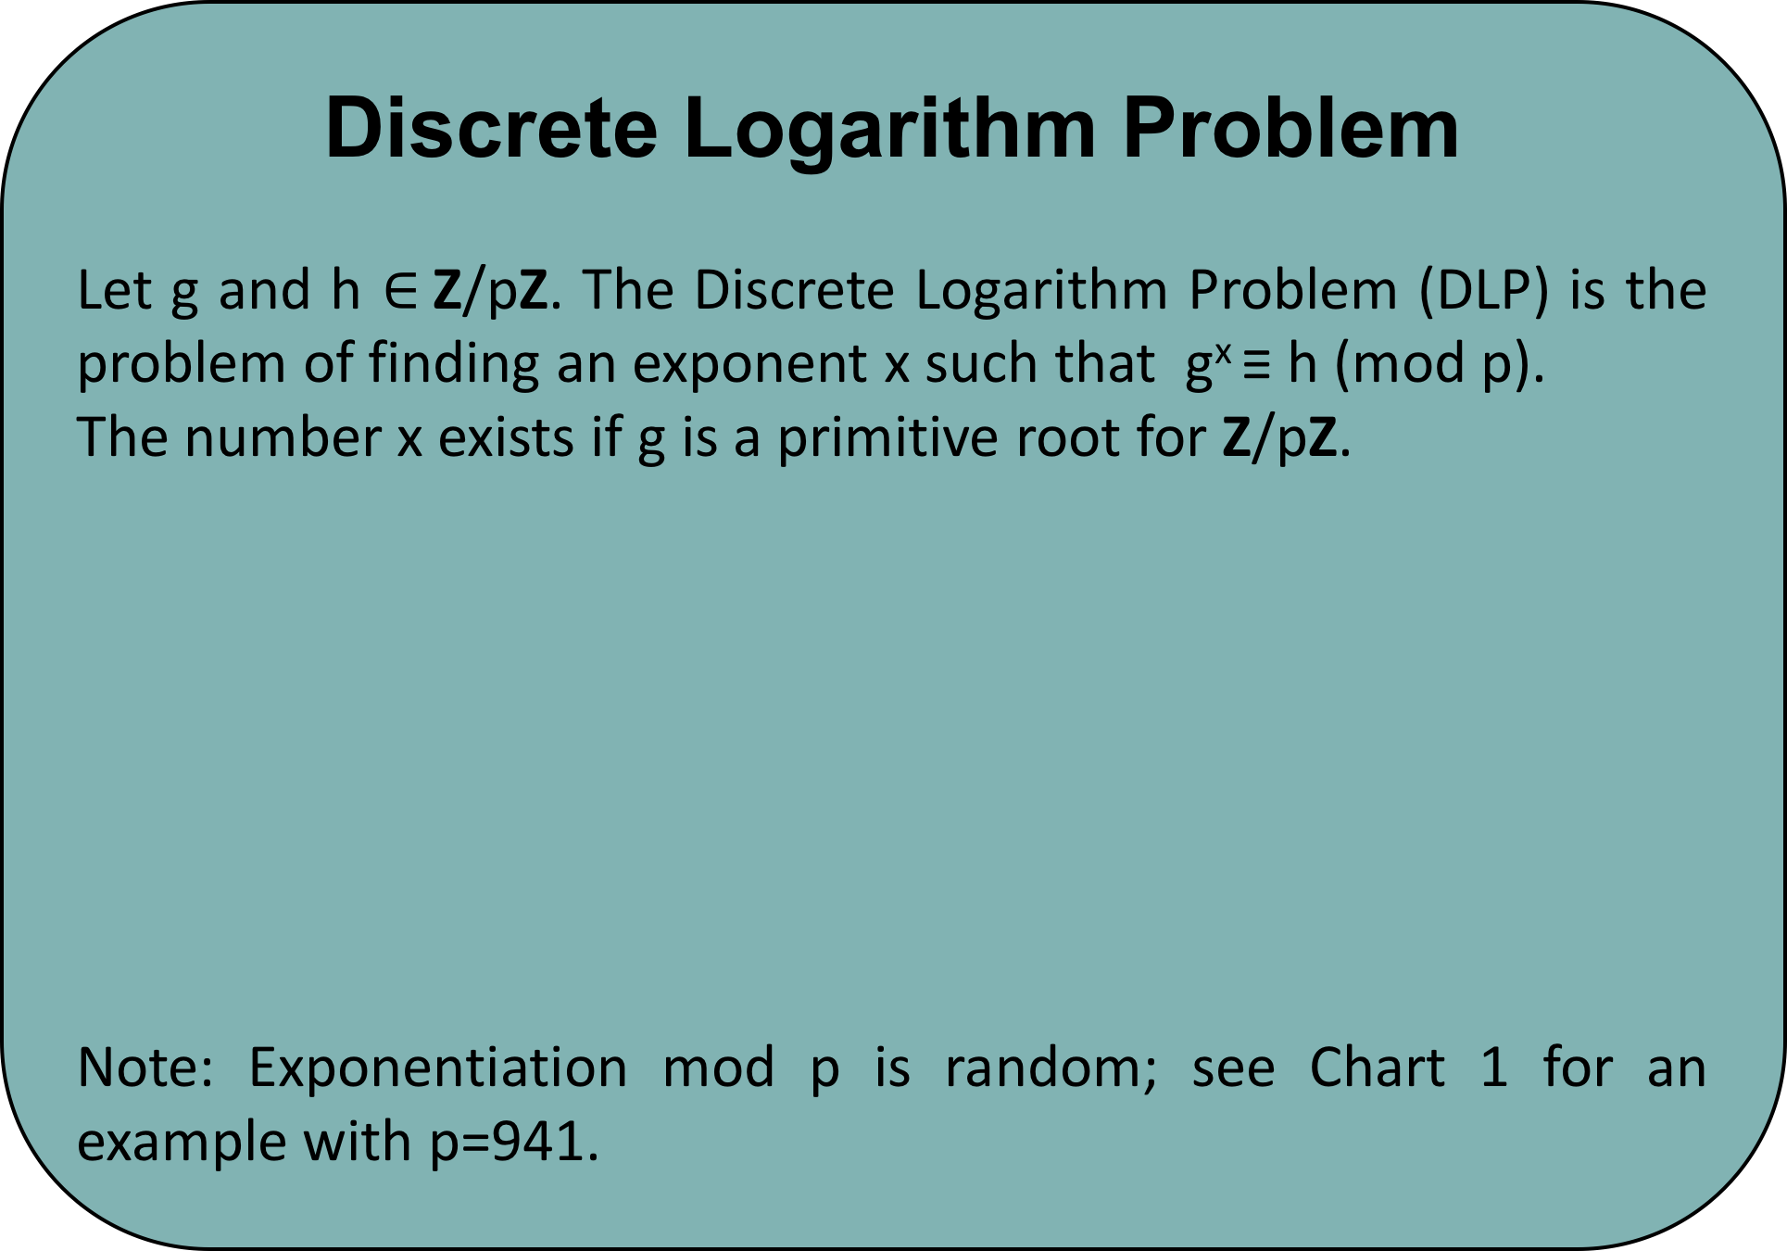
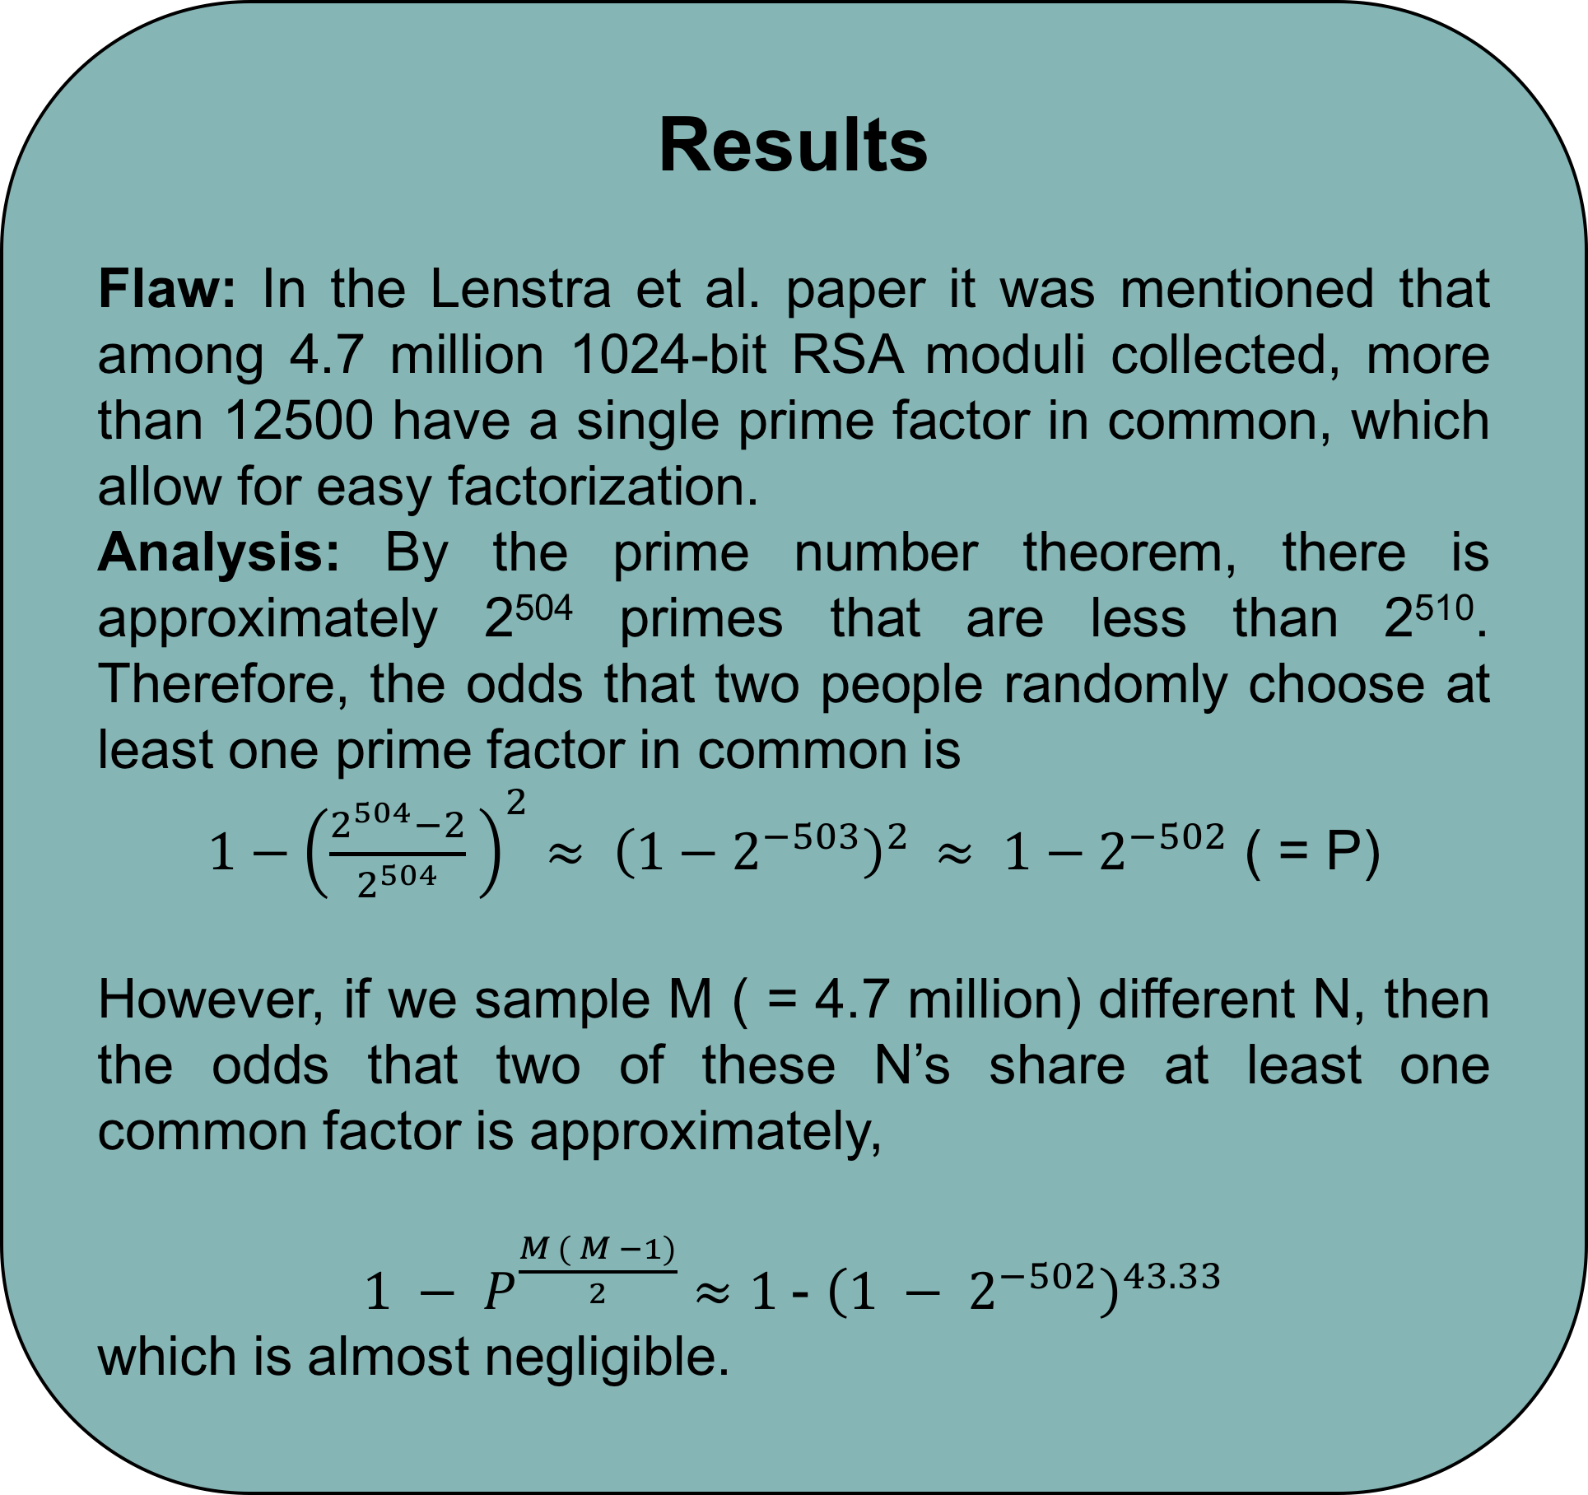
How Secure is RSA: A Mathematical Approach
By: Rana Khalil, Undergraduate
Supervisor: Dr. Monica Nevins, Professor and Chair
University of Ottawa, Faculty of Science
102639592829741105772054196573991675900716567808038066803341933521790711307779
Introduction
Cryptography is the art and science of writing in secret code. With the advent of the Computer Age, cryptography has become essential in today's economy. Public key cryptography is based on mathematical problems that currently admit to no efficient solution. This in turn has allowed individuals to share secret communication over insecure channels, such as the internet, which begs the question: How secure are public key algorithms? Recently, it was revealed that the National Security Agency (NSA) has obtained access to RSA protected information by exploiting some unknown flaws. In this research we analyze a paper by Lenstra et al. called "Ron was wrong, Whit is right" which identifies some of these potential flaws. Our project is to understand the mathematical theory behind two major algorithms: RSA and Deffie Hellman, with the probability of these flaws occurring.
Methods and Materials
Symmetric Cryptography
Asymmetric Cryptography
106603488380168454820927220360012878679207958575989291522270608237193062808643
Symmetric encryption algorithms work on one basic principle- the same key that is used to encrypt the plaintext is used to decrypt the ciphertext.
Chart 1. Distributions of discrete logarithms for g = 641 modulo p = 941
Symmetric | RSA, DL | Comments
64 Bit | 70 Bit | Short term security
80 Bit | 1024 Bit | Medium security
256 Bit | 3072 Bit | High security
Figure 2. Symmetric Key Cryptography
Table 4. Key lengths and Security Levels
Results
Flaw: In the Lenstra et al. paper it was mentioned that among 4.7 million 1024-bit RSA moduli collected, more than 12500 have a single prime factor in common, which allow for easy factorization.
Analysis: By the prime number theorem, there is approximately 2⁵⁰⁴ primes that are less than 2⁵¹⁰. Therefore, the odds that two people randomly choose at least one prime factor in common is
$1−{\left(\frac{2^{504}−2}{2^{504}} \right)}^{2}≈ {\left(1−2^{−503}\right)}^{2 }≈ 1−2^{−502}$ ( = P)
However, if we sample M ( = 4.7 million) different N, then the odds that two of these N’s share at least one common factor is approximately,
$1 − P^{\frac{M ( M −1)}{2}}$ $≈$ $1$- ${\left(1 − 2^{−502}\right)}^{43.33}$
which is almost negligible.
Prime Numbers
There are infinitely many random prime numbers. The prime number theorem states that for a randomly chosen prime number N, the probability that it is prime is 1/ ln (N), i.e. prime numbers are “easy” to find.
-
-
-
-
-
-
-
1 | 2 | 3 | 4 | 5 | 6 | 7 | 8 | 9 | 10
11 | 12 | 13 | 14 | 15 | 16 | 17 | 18 | 19 | 20
21 | 22 | 23 | 24 | 25 | 26 | 27 | 28 | 29 | 30
31 | 32 | 33 | 34 | 35 | 36 | 37 | 38 | 39 | 40
41 | 42 | 43 | 44 | 45 | 46 | 47 | 48 | 49 | 50
51 | 52 | 53 | 54 | 55 | 56 | 57 | 58 | 59 | 60
61 | 62 | 63 | 64 | 65 | 66 | 67 | 68 | 69 | 70
71 | 72 | 73 | 74 | 75 | 76 | 77 | 78 | 79 | 80
81 | 82 | 83 | 84 | 85 | 86 | 87 | 88 | 89 | 90
91 | 92 | 93 | 94 | 95 | 96 | 97 | 98 | 99 | 100
Table 2. Diffie-Hellman key exchange
Asymmetric encryption and decryption uses separate keys. Decryption is done using the private (secret) key, while encryption is done using the public key.
Table 1. Sieve of Eratosthenes from 1 to 100
Discrete Logarithm Problem
Let g and h $∈$Z/pZ. The Discrete Logarithm Problem (DLP) is the problem of finding an exponent x such that g^{x} ≡ h (mod p).
The number x exists if g is a primitive root for Z/pZ.
Note: Exponentiation mod p is random; see Chart 1 for an example with p=941.
Figure 3. Asymmetric Key Cryptography
Alice | Bob
Key Creation
Choose secret primes p and q. Choose encryption exponent e with gcd( e, (p – 1)(q – 1)) = 1 Publish N (= pq) and e.
Encryption
 | Choose plaintext m. Use Bob's public key (N, e) to compute c ≡ m^{e} (mod N) Send ciphertext c to Bob.
Decryption
Compute d satisfying ed ≡ 1 (mod (p – 1)(q -1)). Compute m' ≡ c^{d} (mod N). Then m' equals the plaintext m.
Conclusion
In conclusion, the mathematics behind RSA is still very solid. The major flaw detected by Lenstra et al. seems to be an implementation error not a mathematical error. For further research refer to [2], [3] & [4].
First and foremost, I would like to thank God for giving me the opportunity to participate in this research. I would also like to thank UROP for providing me with the funding and resources to complete my research. Lastly, special thanks to Dr. Monica Nevins for taking time out of her very busy schedule to teach me about the fascinating world of cryptography!
Figure 1. DLP example
Table 3. RSA key creation, encryption, and decryption
10941738641570527421809707322040357612003732945449205990913842131476349984288934784717997257891267332497625752899781833797076537244027146743531593354333897
Contact
References
Rana Khalil
University of Ottawa, Undergraduate Research Opportunity Program (UROP)
rkhal101@uottawa.ca
References:
Hoffstein, J. , Pipher, J. , Silverman, J. H. , (2008). An Introduction to Mathematical Cryptography. New York, NY: Springer Science+Business Media.
Mironov, I. (2012, May 15) . Factoring RSA Moduli. Part I. . Retrieved from windowsontheory.org/2012/05/15/979/
Mironov, I. (2012, May 17) . Factoring RSA Moduli. Part II. . Retrieved from windowsontheory.org/2012/05/17/factoring-rsa-moduli-part-ii/
Lenstra, A. K., Hughes J. P., Augier, M., Bos, J. W., Kleinjung T. & Wacher, C. (2012). Ron was wrong, Whit is right, 064. Retrieved from eprint.iacr.org/2012/064.pdf
Survivability and Information Assurance (n.d.). Retrieved March 16, 2014, from http://people.ubuntu.com/~duanedesign/SurvivabilityandInformationAssuranceCurriculum/02everything/02everything.html#AEN379

