Slide 1

How secure is RSA:
Mathematical Approach
By: Rana Khalil
Supervised by: Dr. Monica Nevins
Notes:
Good afternoon! My name is Rana Khalil. Today I will be talking about how secure is RSA, in a mathematical approach.

Slide 2
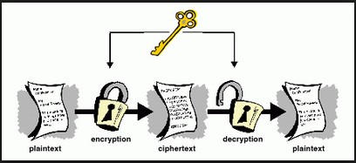
Symmetric Key Cryptography
Notes:
Up till the 1970s cryptography has been based on symmetric keys, that is the sender encrypts their message using a specific key and the receiver decrypts using an identical key.

Slide 3
Alice Bob
Identical keys
Notes:
So for Alice and Bob to communicate securely they must first share identical keys. However, establishing a shared key is often impossible if Alice and Bob can't physically meet.

Slide 4
Alice Bob
Identical keys
Notes:
So for Alice and Bob to communicate securely they must first share identical keys. However, establishing a shared key is often impossible if Alice and Bob can't physically meet.

Slide 5

Jack
Alice Bob
Notes:
Plus if Alice needs to communicate with multiple people, then she's going to have to exchange distinct keys with each person.

Slide 6

Mary
Jack
Alice Bob
Max
David
Notes:
So if Alice was a bank, she's going to have to manage thousands of keys and send thousands of messages just to establish them. Could there be a simpler way?

Slide 7


Asymmetric Key Cryptography
Alice Bob
Notes:
In 1970, James Ellis, a British engineer and mathematician was working on an idea for non-secret encryption. It's based on a clever yet simple idea. Lock and unlock are inverse operations. Alice can buy a lock keep the key and send an open lock to Bob,

Slide 8


Alice Bob
Notes:
Bob then locks his message and sends it back to Alice; no keys are exchanged.

Slide 9

Alice Bob
Notes:
This means Alice can publish the lock widely, and let anyone in the world use it to send her a message, and now she can only keep track of a single key.

Slide 10

Alice Bob
Notes:
Ellis never arrived at a mathematical solution, though he added an intuitive sense of how it should work. The idea is based on splitting a key into two parts: an encryption key and a decryption key. The decryption key performs the inverse or undo operation, which was applied by the encryption key.

Slide 11
RSA
Eve
Alice Bob
Notes:
Alice and Bob want to communicate securely, while eve wants to eavesdrop to obtain access to that information.

Slide 12

Eve
Alice Bob
m =NO
m = 17
Notes:
Say Bob has a message he converted into a number using a padding scheme, let's call this m.

Slide 13
Eve
Alice Bob
p1 = 3
p2 = 11
N = 3* 11 = 33
m =NO
m = 17
Notes:
Then Alice generates her public and private keys as follows:
First she generates 2 random prime numbers of similar size and multiplies them to get n = 33.

Slide 14
Eve
Alice Bob
p1 = 3
p2 = 11
N = 3* 11 = 33
Φ(n) = ( p1 – 1) ( p2 -1)
= 2 * 10 = 20
m =NO
m = 17
Notes:
Then she calculates Phi of n easily, since she knows the factorization of n, which turns out to 20.

Slide 15
Eve
Alice Bob
p1 = 3
p2 = 11
N = 3* 11 = 33
Φ(n) = ( p1 – 1) ( p2 -2)
= 2 * 10 = 20
e = 3
m =NO
m = 17
Notes:
Next she picks some small public exponent e, with a condition that it must be an odd number, that does not share a factor with Phi(n). ). In this case she picks e equals 3.

Slide 16

Eve
Alice Bob
p1 = 3
p2 = 11
N = 3* 11 = 33
Φ(n) = ( p1 – 1) ( p2 -2)
= 2 * 10 = 20
e = 3
m =NO
m = 17
$$ed ≡1 mod \text{Φ}\text{(}\text{n}\text{)}$$
$3d=$1 mod 20
d = 7
Notes:
She then calculates her decryption key by taking the inverse of d mod phi(n) which in our case is 20. Therefore, she calculates d = 7.
Just to recap, Alice did a couple of things here: she picked two primes, multiplied them to get N, found phi of n, picked an exponent e, which she used to calculate d.
Alice uses her trapdoor to hide the two primes, phi of n and the decryption key.

Slide 17

Eve
Alice Bob
N = 33
e = 3
N = 33
e = 3
m =NO
m = 17
Notes:
She publicizes N and e, so both Bob and Eve has access to them.
She sends this to Bob to lock his message with.

Slide 18


Eve
Alice Bob
N = 33
e = 3
N = 33
e = 3
m =NO
m = 17
$$m^{e} mod n≡c$$
$${17}^{3}mod 33≡29$$
Notes:
Bob locks his message by calculating m to the power of e mod n, call this c, his encrypted message, which he sends back to Alice.

Slide 19

Eve
Alice Bob
n = 33
e = 3
c = 29
m = 17
c =29
$$m ≡ c^{d} mod N$$
$$m ≡ {29}^{7} mod 33$$
m = 17
EQUAL!
Notes:
Finally, Alice decrypts his message using her private key d accessed through her trapdoor, c to the power of d mod n equals Bob's original message m. Notice that Eve, or anyone else with c, n and e can only find exponent d, if they can calculate Phi(n) , which requires they know the prime factorization of n.
If n is large enough, Alice can be sure that this will take hundreds of years even with the most powerful network of computers
This trick was immediately classified after its publication. However it was independently re-discovered at 1977 by Ron Rivest, Adi Shamir and Leonard Adlemen. Which is why its now known as RSA ENCRYPTION.

Slide 20
How Hard is factoring?
Let N be 1024 digits long
In order to find a factor you need to search
√N ~ 512 digits

Slide 21

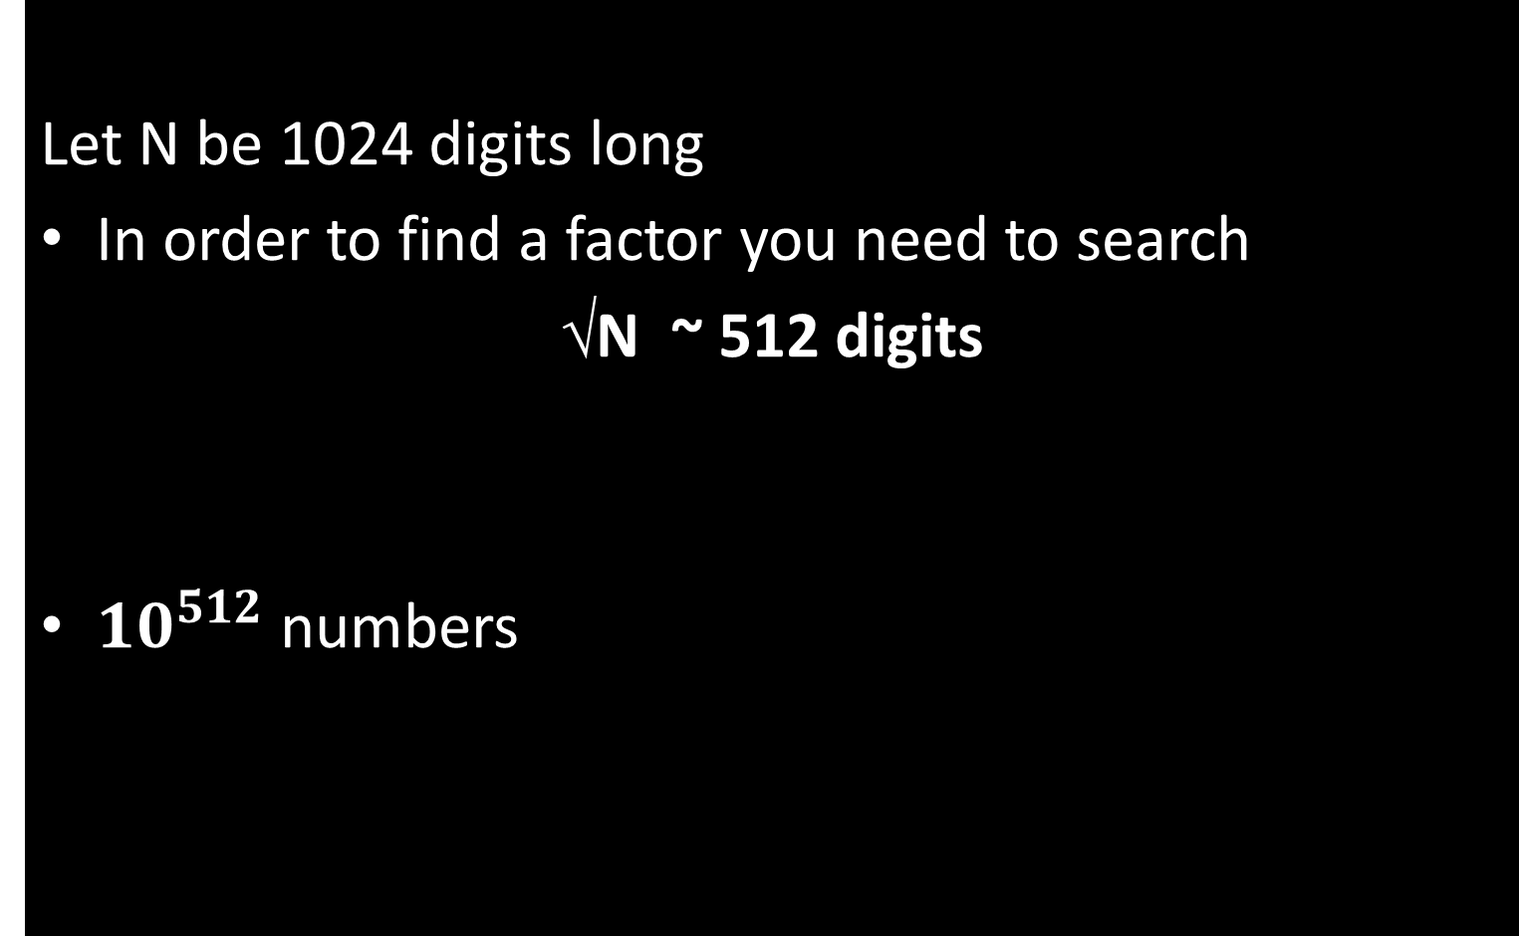
How Hard is factoring?
Let N be 1024 digits long
In order to find a factor you need to search
√N ~ 512 digits
${10}^{512}$ numbers

Slide 22
How Secure is RSA?
National Security Agency (NSA) – Access to classified information
Lenstra et al.
Prime factor in common
Among 4.7 million 1024-bit RSA moduli collected, more than 12500 have a single prime factor in common!

Slide 23

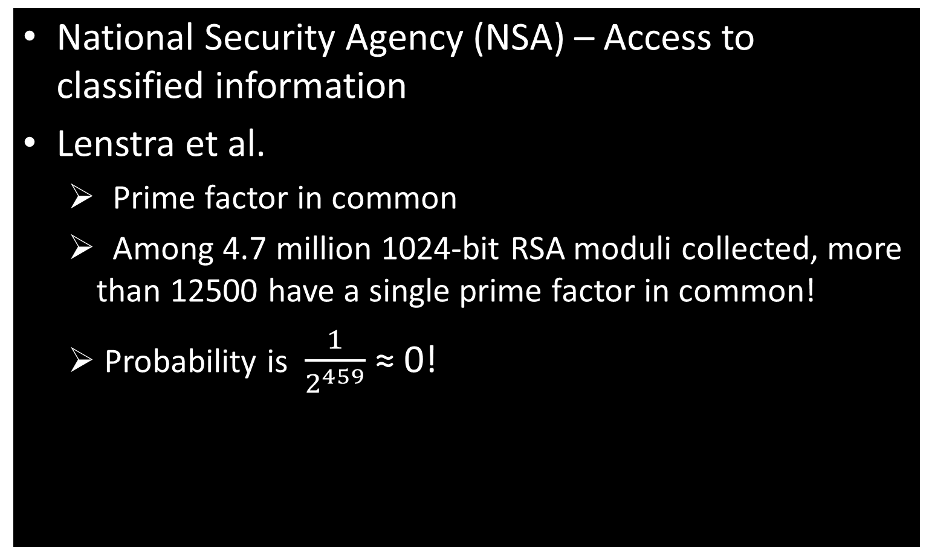
How Secure is RSA?
National Security Agency (NSA) – Access to classified information
Lenstra et al.
Prime factor in common
Among 4.7 million 1024-bit RSA moduli collected, more than 12500 have a single prime factor in common!
Probability is $\frac{1}{2^{459}}$ ≈ 0!

